Slide 1
Automatic Build Version Numbering
fun With Version numbers!
© 2024 Len Popp
Notes:
© 2024 Len Popp. This work is licensed under a Creative Commons Attribution 4.0 International License.
https://creativecommons.org/licenses/by/4.0/

Slide 2

Len Popp
Retired Software Guy, Software & Hardware Hobbyist
https://lenp.net/
Notes:
I’m a retired software developer.
I worked at ImageWare Systems for a long time; before that at Microsoft in Redmond for a few years.

Slide 3
Agenda
About Version Numbers
What I Want
How I Do It
Questions?
Notes:
About Version Numbers
What I Want – Requirements for version numbering in projects I work on
How I Do It – My streamlined process for setting and auto-generating version numbers
Questions?

Slide 4
About Version Numbers

Slide 5
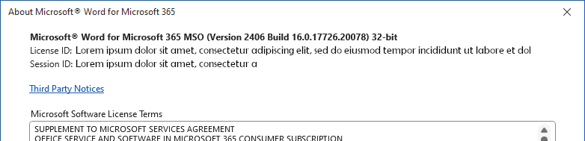

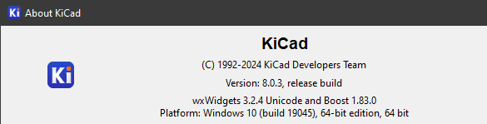

Examples
$ git -v
git version 2.39.2.windows.1
Notes:
Examples:
Windows – note long number, obv. auto-generated
Firefox – simpler
KiCad
Git for Windows –there’s a word in the middle of the number?!

Slide 6
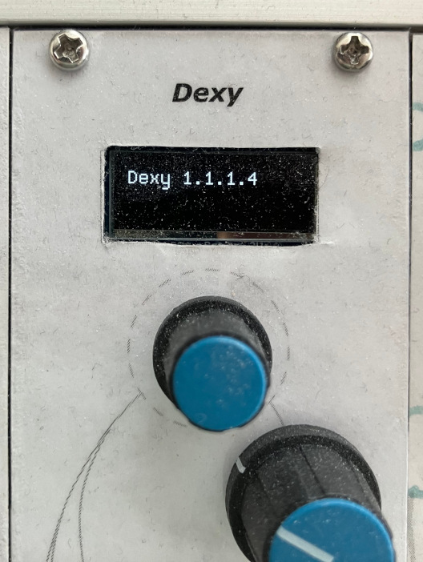
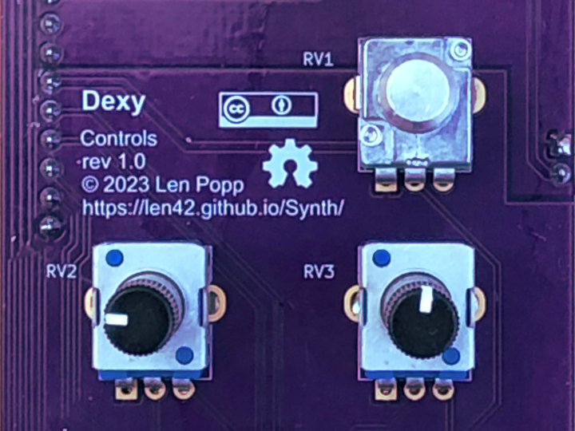
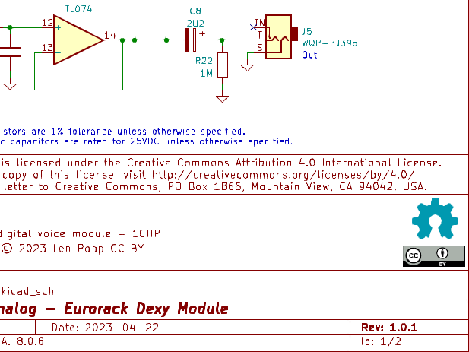
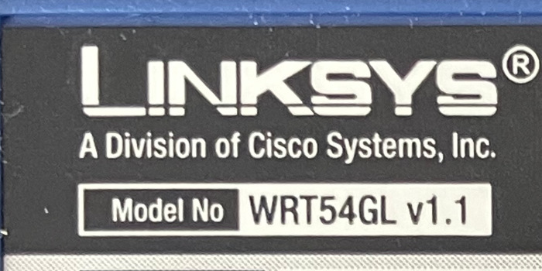
Examples (Not Software)
Notes:
Examples that are not software:
An electronic device
A circuit schematic
A printed circuit board
Firmware
This is software, but embedded in hardware
Version numbers should have some relation (not necessarily match)

Slide 7
Why Version Numbers?
Know which version of software you’re running
Dependencies
Bug reporting/debugging
Connect an executable to a particular version of the source code
Notes:
People want to know which version of software they’re running, for various reasons
Dependencies – Getting the correct version of a library to run with a particular version of software (manually or automatically)
Bug reporting/debugging – Need to find the precise version of the source code corresponding to a given executable

Slide 8
Where version numbers Are Used
In the code, for display (“About…”, git -v)
EXE file properties
Text files (README)
Installer (Windows Control Panel)
Documentation (WinHelp, Doxygen)
Version control system (git tags, GitHub releases)
These should all match!
Notes:
In the code
EXE file properties (in Windows for example)
Text files (README)
Installer – Windows Control Panel list of installed programs shows a version number for each
Documentation (WinHelp, Doxygen)
Version control system – This connects a software release to the source code that made it
These should all match – I have found that this actually is a problem

Slide 9
The Easy Way
// Update this whenever a new release is built
constexpr unsigned verMajor = 1;
constexpr unsigned verMinor = 0;
constexpr unsigned verRevision = 5;
constexpr char verString[] = "1.0.5";
version.h
Notes:
The easy way: Define version number constants in a header file, version.h

Slide 10
The End

Slide 11
Why is this presentation not over?
Can’t do everything with version.h
Multiple languages (e.g. C++ and C#), text files, installer, help files, git tags, etc.
Version info must be duplicated in multiple places
Every distinguishable build should have a distinct version number, automatically
That includes unreleased builds during development and testing, and automated builds
That’s a pain!
There must be an easy way
Notes:
Can’t do everything with version.h because not everything can use a C++ header file.
Examples: multiple languages (e.g. C++ and C#), text files, installer, help files, git tags, etc.
Therefore, the version number must be defined redundantly in multiple places
That asks for errors
Every distinguishable build should have an automatic build number
That includes unreleased builds during development and testing, and automated builds
That’s a pain!
There must be an easy way to get consistent version numbers everywhere

Slide 12
My Specific Motivation
Problems encountered building releases of commercial software
Version numbers were a pain to maintain properly – error-prone
Lesson learned: Every build that is seen by two people needs a version number
Needed a correct, streamlined build process
Similar issues in my open-source hobby projects
Notes:
I ran into problems working on commercial software products
Version numbers were a pain to maintain properly – error-prone
Every build that is seen by two people needs a version number
Example: Test build sent to a tester to verify a bug fix
I’ve been bitten by this – e.g. “Wasn’t this bug supposed to be fixed in this build?”
Needed a correct, streamlined build process
These days, I want a good version-numbering system for my open-source hobby projects

Slide 13
What I Want
My requirements for version numbers
Notes:
Your mileage may vary.

Slide 14
Requirements
The version number is specified in one single place, simply & easily
It can be used wherever it’s needed
Consistent everywhere
Automatically append a build number
For intermediate “releases” that don’t have an explicit version number
Auto numbering must be in increasing order
Efficient to build
Notes:
Efficient to build means:
No appreciable delay added to the code-compile-test loop
Minimal rebuild: Don’t re-compile everything that depends on version.h every time!

Slide 15
My version number schema
Format: [major].[minor].[revision].[build]-[stuff]
Example: 1.2.3.4567-stuff
“stuff” will be described later
Windows-compatible (4 numeric components)
“Inspired by” semantic versioning but not quite the same
major, minor, revision are set explicitly; build is generated automatically
Caveat: This is just how I do it
Notes:
[build] is generated automatically to ensure that different versions of the software have different version numbers, even when I don’t explicitly update the version numbers.

Slide 16
How I Do It
My streamlined process for setting version numbers

Slide 17
My development environment
C++, C#
Microsoft Visual Studio
Git
Various other tools for software & hardware development
For other projects I use VS Code with make or CMake (with a few changes)
It could easily work with other build systems

Slide 18
Version number is set by a git tag
This is the “one place” where I set the version number
To increment the version number for a new release, set a git tag
Examples: 1, 1.2, 1.2.3
Minor and revision numbers are optional; build number is omitted
This connects an executable precisely to its source code
Again, this is just how I do it.
Version number could be defined in a file, for example.
$ git tag
0
0.1
0.2
1.0
1.1
1.2
1.3
1.4
1.5
1.5.1

Slide 19
MakeVersionInfo project
Add this Visual Studio project to the solution
Main C++ project depends on MakeVersionInfo
MakeVersionInfo runs every time you do a build:
Gets the version number from git
Updates the version number references in any specified files
But only if the version number has changed
Files are only recompiled if the version info has changed since the last build
Notes:
This is where it works differently with CMake

Slide 20
Which Files?
:: Project settings for MakeVersionInfo
set SOLUTIONDIR=%~dp0
set TARGETS="%SolutionDir%version.h" "%SolutionDir%README.txt"
Need a list of the files that will contain the up-to-date version number
init-version-info.bat in the Visual Studio solution directory
Notes:
This is a boilerplate file that gets information (the list of files) from the C++ project you’re working on, to MakeVersionInfo
Maybe not the cleanest way to do this, but it’s simple and it works

Slide 21
Template Files
namespace Version
{{
constexpr unsigned major = {verMajor};
constexpr unsigned minor = {verMinor};
constexpr unsigned revision = {verRevision};
constexpr unsigned build = {verBuild};
constexpr char commit[] = "{verCommit}";
constexpr bool isDevBuild = {verIsDevBuild};
constexpr char name[] = "{verString}";
constexpr char date[] = "{verDatestamp}";
constexpr char time[] = "{verTimestamp}";
}}
Each file listed in init-version-info.bat is created from a template file
Example: version.h is defined by version.htemplate
The template contains substitution items where the version numbers are to appear
There’s other info too, e.g. build date
“{” characters are represented by “{{”
Unfortunate compromise
Notes:
The “{{ }}” syntax is annoying for C/C++ files, but it makes the template-processing code much simpler (Python).

Slide 22
How It Works
MakeVersionInfo is a Visual Studio “Makefile” project (nmake)
Calls init-version-info.bat to get the list of files to be processed
Calls git describe to get version info from a recent tag
Calls a Python script to update version-info file, only if the version number changed
nmake rebuilds output files as required (using Makefile and another Python script)
If any files were written, build targets depending on them will be re-built

Slide 23
Automatic Build Number
From git describe
$ git describe --tags --always --dirty
3.1-5-g8f5bc0e-dirty
Build number is the number of commits past the most recent tag
Resulting version string:
3.1.0.5-g8f5bc0e-dev
The extra stuff disambiguates the git branch and marks in-development code
tag
build
commit
modified
Notes:
git describe’s “number of commits since the tag” gives the auto-incrementing build number.
Build number and commit ID do not appear if the tag points at the current commit.

Slide 24
How-To Summary
Add MakeVersionInfo to the Visual Studio solution
Other projects that use version info depend on MakeVersionInfo
Copy & modify init-version-info.bat to specify version-specific files
Make template files for all those files
git tag 0.1
Build the solution

Slide 25
Efficiency
The MakeVersionInfo build step runs on every build
When version number is unchanged, takes very little time
Python is faster than PowerShell
Minimal rebuild
No unnecessary recompilation when version number is unchanged
Notes:
MakeVersionInfo overhead includes calling git describe, loading Python, and running update-version-info.py
Time to “do nothing” on my (v. old) PC: 1.5 secs when run “cold”, fraction of a second when run “hot”
I originally implemented this using PowerShell – much slower (a few seconds on first run)
Switched to Python for non-Windows projects (cross-development) – faster!

Slide 26
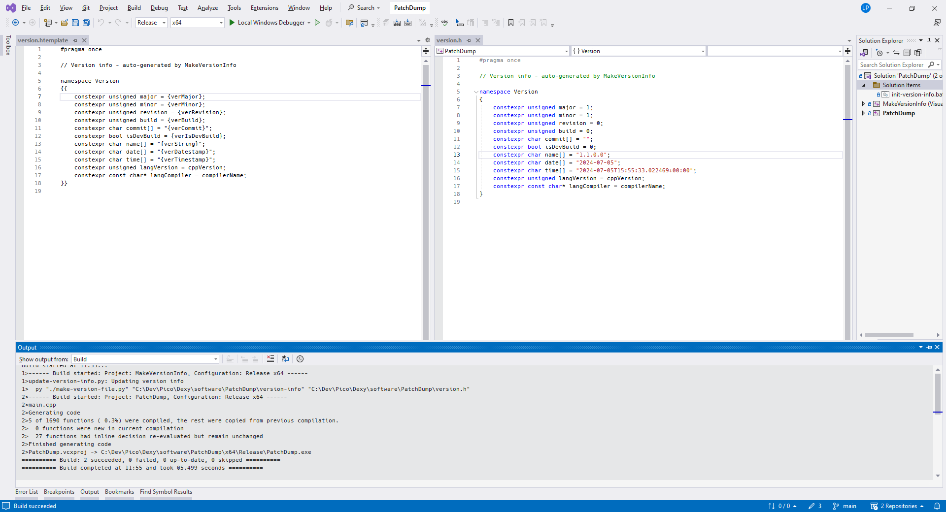

Example
Notes:
A C++ program in Visual Studio, with only one templated file (version.h)
MakeVersionInfo build took a fraction of a second when I created this screenshot

Slide 27
What’s Wrong With This?
Doesn’t work with files that are not “built”
And that can’t easily be post-processed
Typically don’t support include files
Examples:
Word documents
Hardware designs
KiCad – Electronics schematic & PCB CAD
Some version numbers must still be updated manually 😥

Slide 28
Source Code
Visual Studio implementation: https://github.com/Len42/MakeVersionInfoP
CMake example: https://github.com/Len42/Dexy/tree/main/firmware
Makefile example: https://github.com/Len42/dat-ting/tree/main/lib/MakeVersionInfo
Or just lenp.net
Notes:
Open source

Slide 29
\0
Questions?

