Slide 1
A Simple Task Scheduler for Microcontrollers
In C++
© 2024 Len Popp
Notes:
© 2024 Len Popp. This work is licensed under a Creative Commons Attribution 4.0 International License.
https://creativecommons.org/licenses/by/4.0/
Time: approx. 20-25 mins

Slide 2

Len Popp
Retired Software Guy, Software & Hardware Hobbyist
https://lenp.net/

Slide 3
Agenda
What It Is
How to Use It
How It Works
Questions?

Slide 4
Warning / promise
Contains “modern” C++
[&](){}();

Slide 5
What It Is

Slide 6
Background
Embedded microcontroller
Firmware written in C++
Firmware must perform multiple tasks
No operating system (RTOS)
Small-to-medium microcontroller
Programming with an SDK over the bare metal
Want a simple task scheduler to help with simple projects

Slide 7
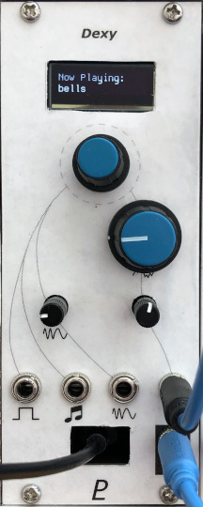
Example: Dexy
Digital FM synth module
Based on a Raspberry Pi Pico(-ish)
Firmware runs a task scheduler for low-priority tasks, including:
UI (display and rotary encoder)
USB serial I/O
Other tasks for testing, debugging, etc.
Task scheduler is not used for audio synthesis
Interrupt-driven for timing precision
https://lenp.net/synth/dexy/

Slide 8
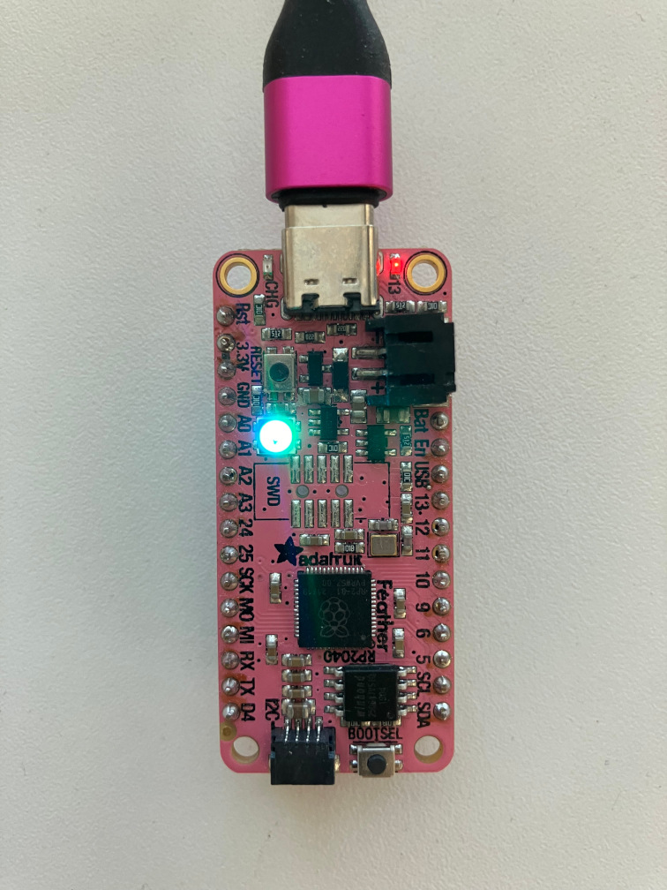
Demo
Adafruit Feather RP2040
Raspberry Pi Pico-compatible board
Two tasks:
Blinking LED
Colour-cycling RGB LED
https://github.com/Len42/TaskDemo-RP2040

Slide 9
Simple Task Scheduling
Several independent tasks to run “simultaneously”
Round-robin execution
Each task specifies how often it wants to run
When called, each task performs an increment of work
Very little overhead
Microcontroller’s performance and memory are limited

Slide 10
What It Doesn’t Do
Not suitable for tasks with hard real-time requirements
No task pre-emption
No long-executing functions allowed
Tasks must be broken up into bite-size increments
For example, must use non-blocking calls for internet requests.
Tasks not guaranteed to run precisely on time

Slide 11
Hardware Requirements
Not much!
Clock/timer for elapsed time
Millisecond or microsecond resolution
Interrupts not required

Slide 12
Software Requirements
C++ 17 (or 20 or 23, depending on implementation)
Can be implemented in “traditional” C++ with a bit more boilerplate code
Elapsed time function
From device SDK

Slide 13
How To Use It
Writing firmware with tasks

Slide 14
Main()
// Task List
using TaskList = Tasks::TaskList<
//DebugTask,
LedBlinkTask,
LedColourTask
>;
int main()
{
// Initialize all the Tasks and run them forever
TaskList::initAll();
while (true) {
TaskList::runAll();
}
}
Tasks::TaskList defines the list of Task classes to be executed
Commented-out tasks are not compiled
initAll calls each Task’s init function
runAll calls each Task’s execute function
Called in order listed
Loop forever

Slide 15
Example Task
// LedBlinkTask: Task to blink an LED on & off
class LedBlinkTask : public Tasks::Task
{
public:
// Task execution interval in microseconds
unsigned intervalMicros() const override { return 500'000; }
// Task initialization, called once at program start
void init() override {
gpio_init(PICO_DEFAULT_LED_PIN);
gpio_set_dir(PICO_DEFAULT_LED_PIN, GPIO_OUT);
gpio_put(PICO_DEFAULT_LED_PIN, false);
}
// Main task function
void execute() override {
fLed = !fLed;
gpio_put(PICO_DEFAULT_LED_PIN, fLed);
}
private:
bool fLed = false;
};
Task to blink an LED
Class encapsulates everything, so this task is independent of other code
Class is a subclass of Tasks::Task
Implements 3 virtual functions
Not necessary to declare an instance of LedBlinkTask
Done automatically by Tasks::TaskList

Slide 16
How It Works
It’s not rocket science
It’s C++ magic

Slide 17
Task Base Class
class Task
{
public:
virtual unsigned intervalMicros() const = 0;
virtual void init() = 0;
virtual void execute() = 0;
void tick(absolute_time_t now)
{
if (timeIsReached(now, timer)) {
timer = make_timeout_time_us(intervalMicros());
execute();
}
}
private:
absolute_time_t timer = from_us_since_boot_constexpr(0);
};
Abstract base class
Pure virtual functions implemented by task subclasses
tick is called frequently by the task scheduler
If it’s time to execute this task, call execute
timer keeps track of the next time to run the task

Slide 18
Task Scheduler
template<typename... TASKS>
class TaskList
{
public:
static void initAll()
{
((taskInstance<TASKS>.init()), ...);
}
static void runAll()
{
absolute_time_t now = get_absolute_time();
((taskInstance<TASKS>.tick(now)), ...);
} private:
template<typename TASK_T>
static TASK_T taskInstance;
};
This is the TaskList type seen in main.cpp
Template arguments are the Task subclasses
Implements initAll and runAll
Iteration by fold expression over parameter pack
taskInstance is a variable template that creates a single instance of each Task subclass

Slide 19
Outro

Slide 20
What I Like
Tasks are modular, independent
Good code organization
Easy to add and remove tasks (debugging etc.)
Each task has its own repetition interval
Low overhead
No heap memory allocation
A few bytes per task compared to inline code

Slide 21
What I don’t Like
Not suitable for tasks with hard real-time constraints
A long-running task blocks other tasks from running

Slide 22
download
https://github.com/Len42/TaskDemo-RP2040
Notes:
Or go to lenp.net

Slide 23
The end…
Questions?
Compile-Time Polymorphism
Notes:
Thank you.

Slide 24
Appendix A – Compile-Time Polymorphism

