Slide 1
A Simple Task Scheduler for Microcontrollers
In C++
© 2024 Len Popp
Notes:
© 2024 Len Popp. This work is licensed under a Creative Commons Attribution 4.0 International License.
https://creativecommons.org/licenses/by/4.0/
Time: approx. 20-25 mins

Slide 2

Len Popp
Retired Software Guy, Software & Hardware Hobbyist
https://lenp.net/
Notes:
I worked at ImageWare Systems for a long time
This talk is based on my hobby projects – I don’t have professional experience in embedded systems programming
Web site: https://lenp.net/

Slide 3
Agenda
What It Is
How to Use It
How It Works
Questions?
Notes:
Feel free to ask questions

Slide 4
Warning / promise
Contains “modern” C++
[&](){}();
Notes:
Warning / promise: Not sure which it is
Will be showing some modern C++
Looks strange to someone like me

Slide 5
What It Is

Slide 6
Background
Embedded microcontroller
Firmware written in C++
Firmware must perform multiple tasks
No operating system (RTOS)
Small-to-medium microcontroller
Programming with an SDK over the bare metal
Want a simple task scheduler to help with simple projects
Notes:
Embedded microcontroller in a device
...
Want a simple task scheduler
In lieu of a proper OS, this is the kernel of a kernel

Slide 7
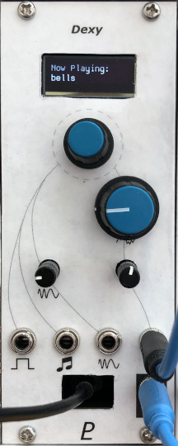
Example: Dexy
Digital FM synth module
Based on a Raspberry Pi Pico(-ish)
Firmware runs a task scheduler for low-priority tasks, including:
UI (display and rotary encoder)
USB serial I/O
Other tasks for testing, debugging, etc.
Task scheduler is not used for audio synthesis
Interrupt-driven for timing precision
https://lenp.net/synth/dexy/
Notes:
Module from a modular synthesizer, which I made, that does digital audio synthesis

Slide 8
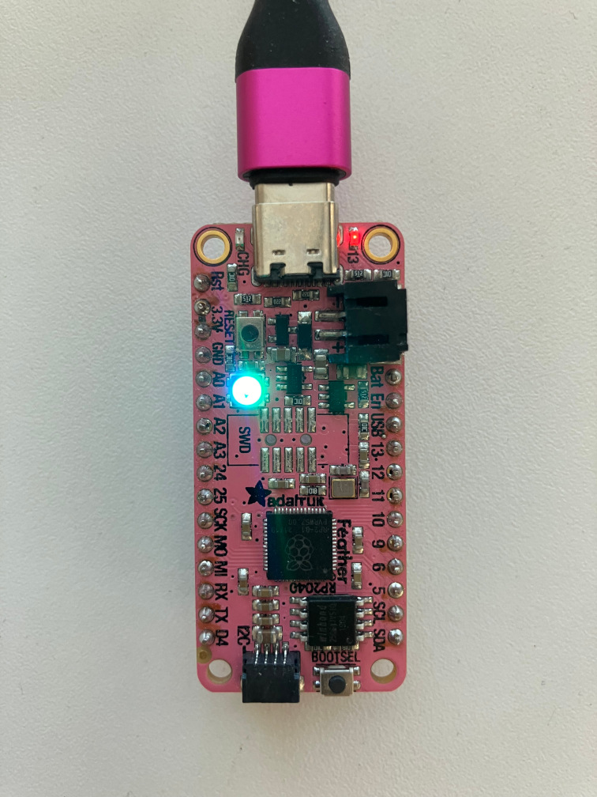
Demo
Adafruit Feather RP2040
Raspberry Pi Pico-compatible board
Two tasks:
Blinking LED
Colour-cycling RGB LED
https://github.com/Len42/TaskDemo-RP2040

Slide 9
Simple Task Scheduling
Several independent tasks to run “simultaneously”
Round-robin execution
Each task specifies how often it wants to run
When called, each task performs an increment of work
Very little overhead
Microcontroller’s performance and memory are limited

Slide 10
What It Doesn’t Do
Not suitable for tasks with hard real-time requirements
No task pre-emption
No long-executing functions allowed
Tasks must be broken up into bite-size increments
For example, must use non-blocking calls for internet requests.
Tasks not guaranteed to run precisely on time

Slide 11
Hardware Requirements
Not much!
Clock/timer for elapsed time
Millisecond or microsecond resolution
Interrupts not required
Notes:
Clock/timer for elapsed time: Any microcontroller has this

Slide 12
Software Requirements
C++ 20
Can be implemented in “traditional” C++ with a bit more boilerplate code
Elapsed time function
From device SDK

Slide 13
How To Use It
Writing firmware with tasks

Slide 14
Main()
// Task List
constexpr Tasks::TaskList<
//DebugTask,
LedBlinkTask,
LedColourTask
> taskList;
int main()
{
// Initialize all the Tasks and run them forever
taskList.initAll();
while (true) {
taskList.runAll();
}
}
Tasks::TaskList defines the list of Task classes to be executed
Commented-out tasks are not compiled
initAll calls each Task’s init function
runAll calls each Task’s execute function
Called in order listed
Loop forever
Notes:
This is the main() code running on the demo board.
taskList is initialized at compile time
Hence the funny brackets <>
Lots of constexpr & consteval used to force things to be done at compile time

Slide 15
Example Task
// LedBlinkTask: Task to blink an LED on & off
class LedBlinkTask : public Tasks::Task
{
public:
// Task execution interval in microseconds
unsigned intervalMicros() const override { return 500'000; }
// Task initialization, called once at program start
void init() override {
gpio_init(PICO_DEFAULT_LED_PIN);
gpio_set_dir(PICO_DEFAULT_LED_PIN, GPIO_OUT);
gpio_put(PICO_DEFAULT_LED_PIN, false);
}
// Main task function
void execute() override {
fLed = !fLed;
gpio_put(PICO_DEFAULT_LED_PIN, fLed);
}
private:
bool fLed = false;
};
Task to blink an LED
Class encapsulates everything, so this task is independent of other code
Class is a subclass of Tasks::Task
Implements 3 virtual functions
Not necessary to declare an instance of LedBlinkTask
Done automatically by Tasks::TaskList
Notes:
This is one of the tasks running on the demo board
Implements 3 virtual functions:
intervalMicros() specifies how often the task should run
init() is called once at startup
execute() is called as required – must be a short snippet of work
Not necessary to declare an instance of the Task
This was one of the drivers for me to create the crazy template code to be shown later
I don’t like having to define/declare things in 2 places – annoying and error prone

Slide 16
How It Works
It’s not rocket science
It’s C++ magic

Slide 17
Task Base Class
class Task
{
public:
virtual unsigned intervalMicros() const = 0;
virtual void init() = 0;
virtual void execute() = 0;
void tick(absolute_time_t now)
{
if (timeIsReached(now, timer)) {
timer = make_timeout_time_us(intervalMicros());
execute();
}
}
private:
absolute_time_t timer = from_us_since_boot_constexpr(0);
};
template<typename TASK_T>
static TASK_T taskInstance;
Abstract base class
Pure virtual functions implemented by task subclasses
tick is called frequently by the task scheduler
If it’s time to execute this task, call execute
timer keeps track of the next time to run the task
taskInstance is a variable template that creates a single instance of each Task subclass
Notes:
tick() is implemented with Pi Pico SDK functions & types
Can work on any other microcontroller, coded appropriately
Note: Could use compile-time polymorphism instead (CRTP)
No virtual functions, more efficient in theory
But it makes Task subclasses a bit more complicated
And it’s not more efficient because the compiler inlines the virtual calls (in my projects)
Maybe discuss more later

Slide 18
Task Scheduler
template<typename... TASKS>
class TaskList
{
public:
consteval TaskList()
{
int i = 0;
((tasks[i++] = &taskInstance<TASKS>), ...);
}
void initAll() const /* ... */
void runAll() const /* ... */
private:
Task* tasks[sizeof...(TASKS)];
};
// in main.cpp (as seen before):
constexpr Tasks::TaskList<
//DebugTask,
LedBlinkTask,
LedColourTask
> taskList;
This is the type of taskList seen earlier
Template arguments are the Task subclasses
Contains an array of Task*
Constructor initializes the list of tasks
consteval – executes at compile time
C++ magic turns a list of class names into a list of Task instances
Iteration by fold expression over parameter pack
Notes:
Declaration from main.cpp included at the bottom
Variadic template – parameter pack
“sizeof…(TASKS)” gives the number of template arguments
(C++20 warning): Constructor is declared consteval – necessary for compile-time initialization
taskInstance<> is the variable template defined earlier
Refers to one instance of the given class

Slide 19
Task Scheduler (cont.)
template<typename... TASKS>
class TaskList
{
public:
consteval TaskList() /* ... */
void initAll() const
{
for (auto&& task : tasks) {
task->init();
}
};
void runAll() const
{
absolute_time_t now = get_absolute_time();
for (auto&& task : tasks) {
task->tick(now);
}
};
private:
Task* tasks[sizeof...(TASKS)];
};
Implements the initAll and runAll functions
Notes:
Device-specific code

Slide 20
Outro

Slide 21
What I Like
Tasks are modular, independent
Good code organization
Easy to add and remove tasks (debugging etc.)
Each task has its own repetition interval
Low overhead
No heap memory allocation
A few bytes per task compared to inline code

Slide 22
What I don’t Like
Not suitable for tasks with hard real-time constraints
A long-running task blocks other tasks from running

Slide 23
download
https://github.com/Len42/TaskDemo-RP2040
Notes:
Or go to lenp.net

Slide 24
FIN
Questions?
Notes:
Thank you.

