Slide 1
PostBar管理系统
白春淼，邵金宇：帖子模块
刘遨嘉：用户模块
李晓莹：登陆界面
任晓帆：流程图
李宝兰：数据库
姚先知：PPT，代码整合

Slide 2
登录
注册
查找
帖子管理
用户管理

Slide 3
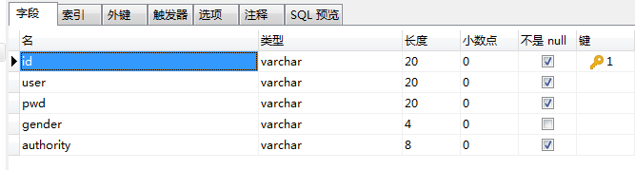
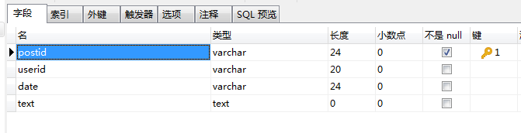
用户表
帖子表

Slide 4
INSERT INTO `post` VALUES ('A10000100000', '001', '2019.08.09', '这是一条帖子');
INSERT INTO `post` VALUES ('A10000100001', '001', '2019.08.09', '这是一条帖子');
INSERT INTO `post` VALUES ('A10000100002', '001', '2019.08.09', '这是一条帖子');

Slide 5
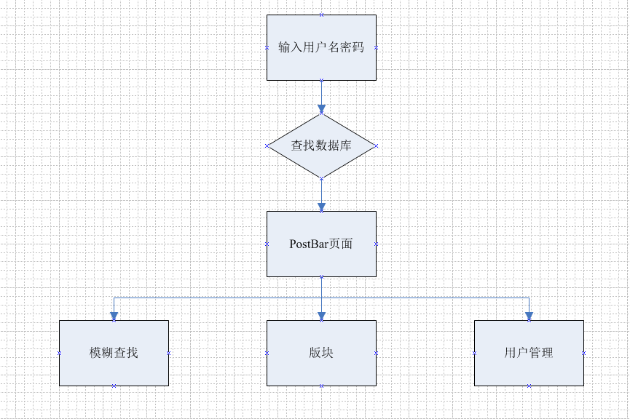
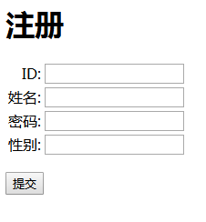
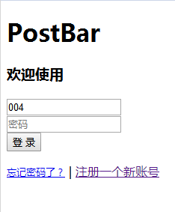
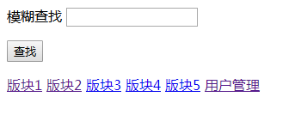

Slide 6
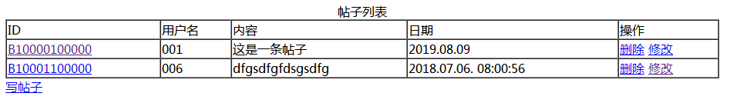
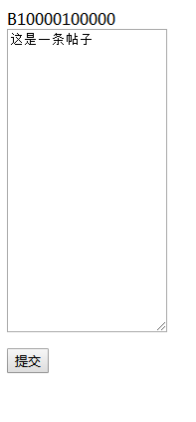
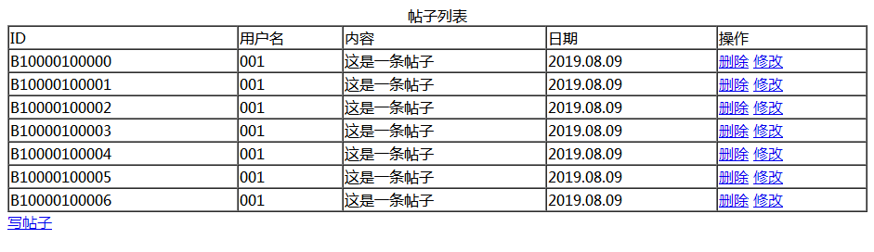

Slide 7
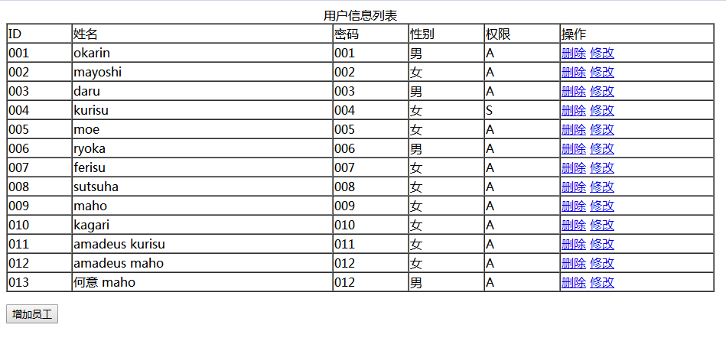

Slide 8
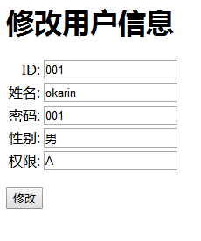
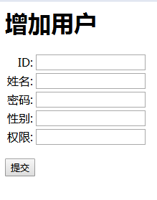

Slide 9
提取同一题目下的帖子
INSERT INTO `post` VALUES ('A10000100000', '001', '2019.08.09', '这是一条帖子');
String sqlString="select * from post where postid like ?";
PreparedStatement preparedStatement=connection.prepareStatement(sqlString);
preparedStatement.setString(1, "%"+titleString.substring(0,6)+"%");

Slide 10
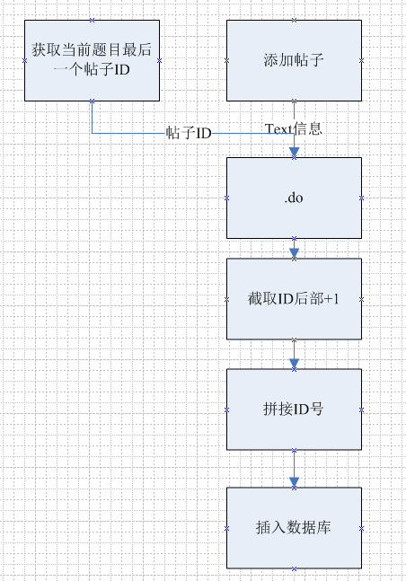
添加帖子-1
//添加帖子
else if (action.equals("postaddtrans")) {
String titleString= request.getParameter("titleString");
//创建dao对象
request.setAttribute("titleString", titleString);
request.getRequestDispatcher("postadd.jsp"). forward(request, response);
}

Slide 11
添加帖子-2
String idString=request.getParameter("idString");
int id=Integer.parseInt(idString.substring(6)); //新帖子id尾数+1
id++;
idString=idString.substring(0,6).concat(String.valueOf(id));
System.out.print(idString);
String textString=request.getParameter("text");
PostDao dao=new PostDaoImpl();
Post post=new Post(idString, my.getIdString(), dateString, textString);
dao.addPost(post);
request.setAttribute("idString", idString);
request.getRequestDispatcher("post.do").forward(request, response);

Slide 12
添加题目-1
String blockString=idString.substring(0,1);
//新帖子id尾数+1
int id=Integer.parseInt(idString.substring(1));
id++;
idString=blockString.concat(String.valueOf(id)).concat("100000");
String textString=request.getParameter("text");
PostDao dao=new PostDaoImpl();
Post post=new Post(idString, my.getIdString(), dateString, textString);
dao.addPost(post);

Slide 13
添加题目-2
if(blockString.equals("A")){
response.sendRedirect("block1.do");
}else if(blockString.equals("B")){
response.sendRedirect("block2.do");
}else if(blockString.equals("C")){
response.sendRedirect("block3.do");
}else if(blockString.equals("D")){
response.sendRedirect("block4.do");
}else if(blockString.equals("E")){
response.sendRedirect("block5.do");
}

Slide 14
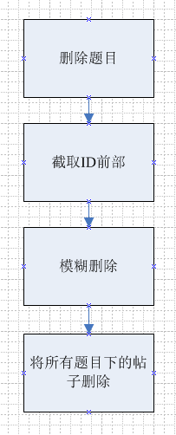
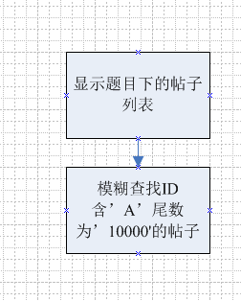
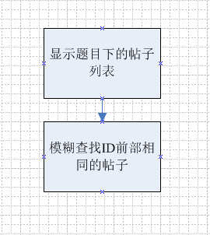

Slide 15
谢谢

