Slide 1
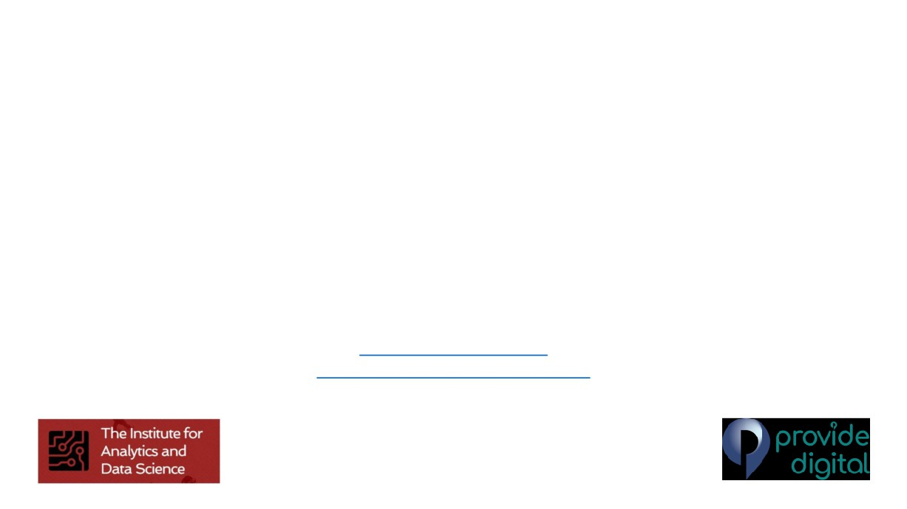
Tree based Machine Learning Models
for Data Science
Session-2
Dr Dheeraj Rathee
Chief Technology and Analytics Officer Provide Digital
dheeraj.rathee@nhs.net
dheeraj.rathee@providedigital.com

Slide 2
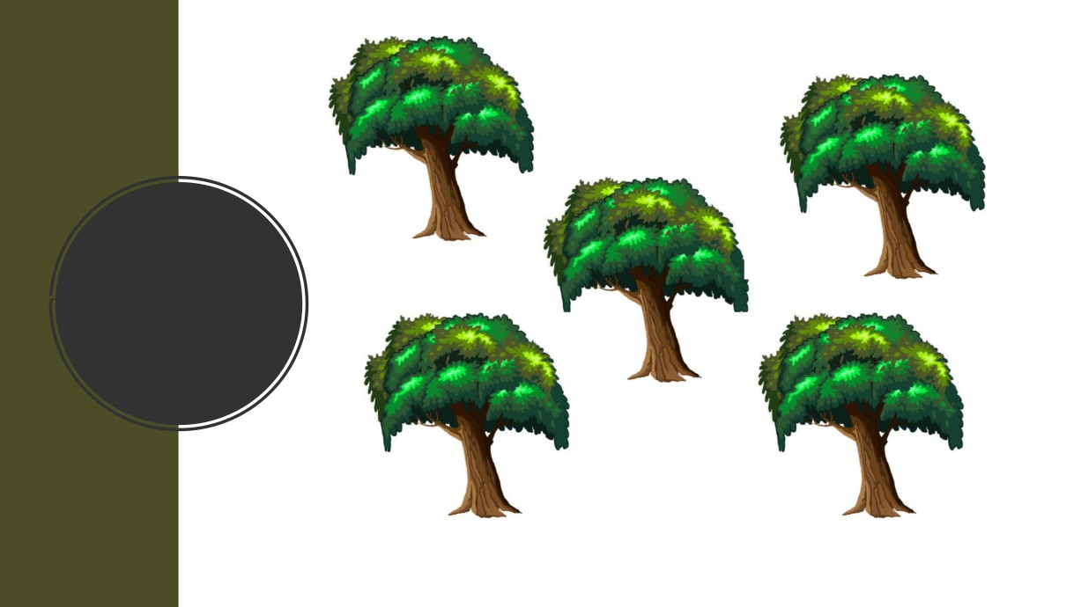
Random
Forest

Slide 3
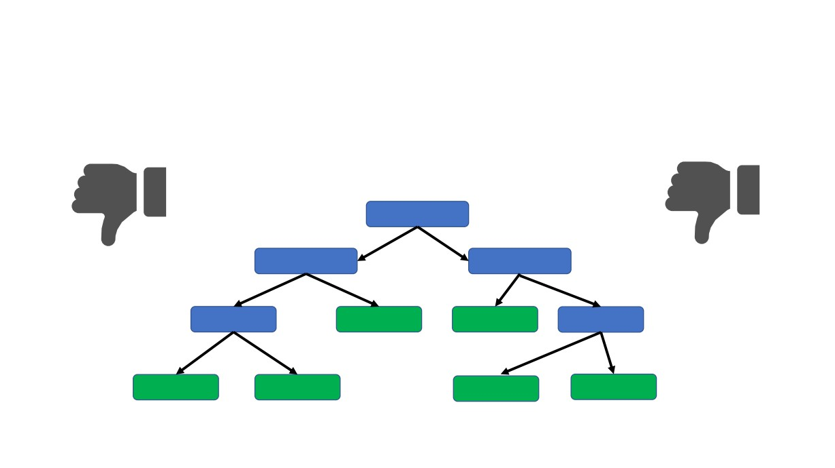
Decision trees are awesome but͙
Although they are good at the data that used to create them they are not so good while working with new data samples
OVER-FITTING

Slide 4
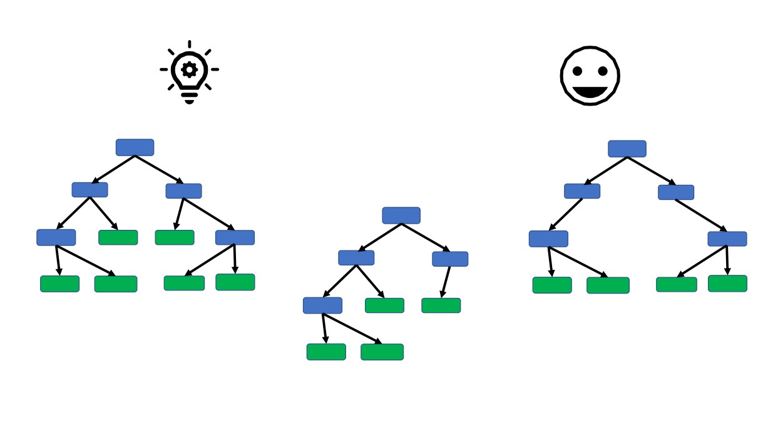
Let’s combine the simplicity of decision trees and Randomness to provide flexibility
and resolve the problem of over-fitting.
Thus grow several trees out of the given data and create a
FOREST
Decision Tree 1
Decision Tree 3
Decision Tree 2

Slide 5

Let’s create a Random Forest!!!

Slide 6

Step 1: Create a ‘bootstrapped’ dataset.
(Slides below slightly corrupted
in transfer PDF to PPT, check pdf)

Slide 7
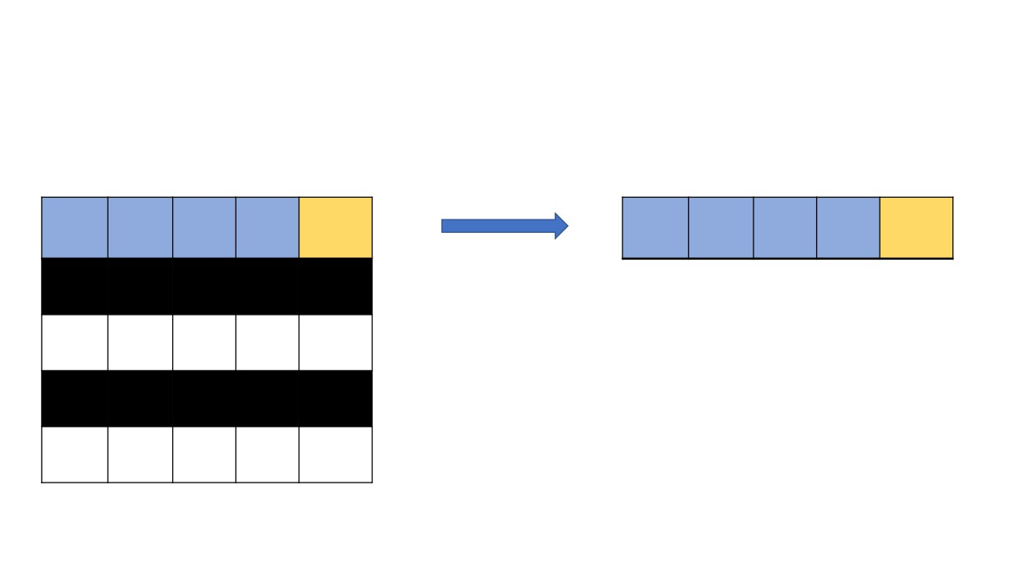
Original Dataset
Bootstrapped Dataset
Often
Blurred Losing
Often
Blurred Losing
Feeling
Vision Weight
Weight Diabetes Feeling
Vision Weight
Weight Diabetes
Tired
Tired
No
No
No
170
No
Yes
Yes
Yes
190
Yes
Yes
Yes
No
200
No
Yes
No
Yes
160
Yes

Slide 8
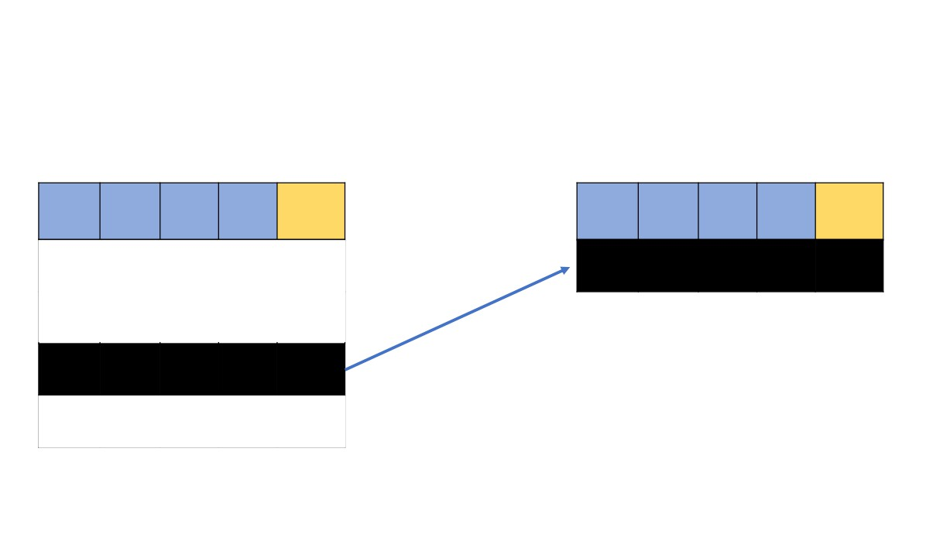
Original Dataset
Bootstrapped Dataset
Often
Blurred Losing
Often
Blurred Losing
Feeling
Vision Weight
Weight Diabetes Feeling
Vision Weight
Weight Diabetes
Tired
Tired
Yes
Yes
No
200
No
Yes
Yes
No
200
No

Slide 9
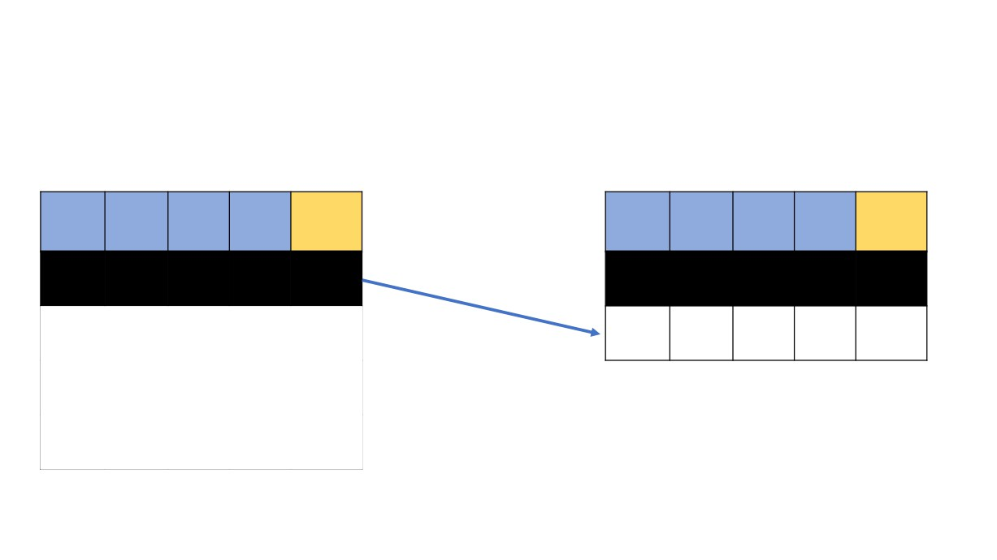
Original Dataset
Bootstrapped Dataset
Often
Blurred Losing
Often
Blurred Losing
Feeling
Vision Weight
Weight Diabetes Feeling
Vision Weight
Weight Diabetes
Tired
Tired
No
No
No
170
No
Yes
Yes
No
200
No
No
No
No
170
No

Slide 10
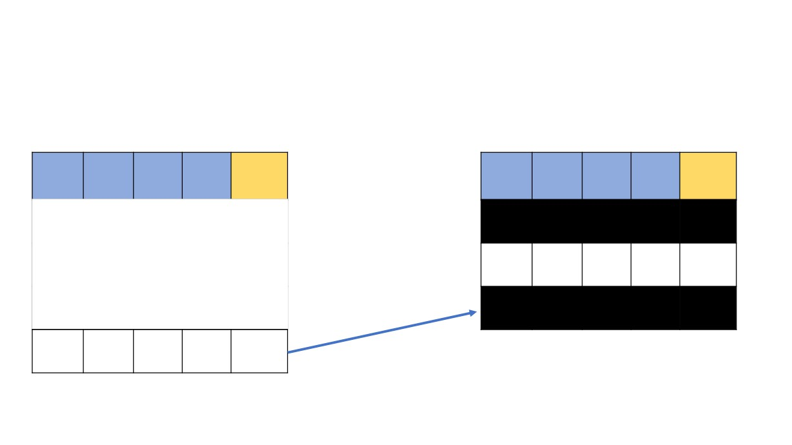
Original Dataset
Bootstrapped Dataset
Often
Blurred Losing
Often
Blurred Losing
Feeling
Vision Weight
Weight Diabetes Feeling
Vision Weight
Weight Diabetes
Tired
Tired
Yes
Yes
No
200
No
No
No
No
170
No
Yes
No
Yes
160
Yes
Yes
No
Yes
160
Yes

Slide 11

Original Dataset
Bootstrapped Dataset
Often
Blurred Losing
Often
Blurred Losing
Feeling
Vision Weight
Weight Diabetes Feeling
Vision Weight
Weight Diabetes
Tired
Tired
Yes
Yes
No
200
No
No
No
No
170
No
Yes
No
Yes
160
Yes
Yes
No
Yes
160
Yes
Yes
No
Yes
160
Yes

Slide 12
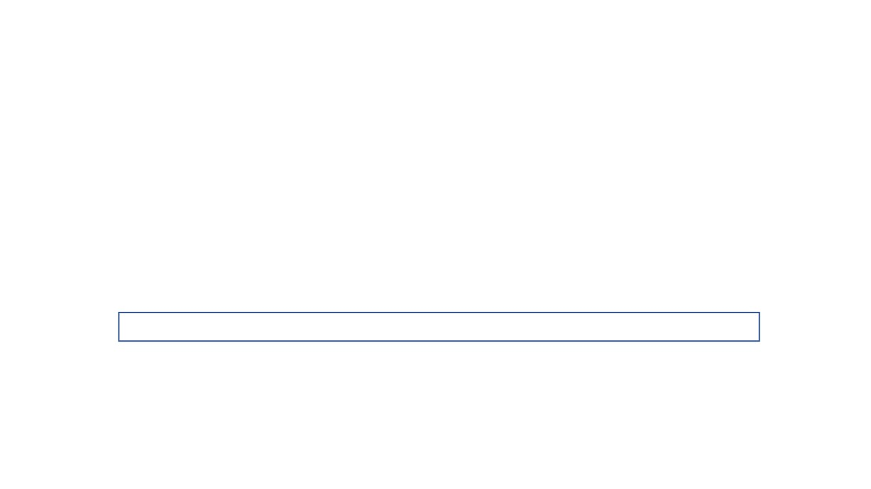
Step 2: Create a decision tree using the bootstrapped data.
Note: Use randomly selected subset of variables rather than all variables at each step.

Slide 13
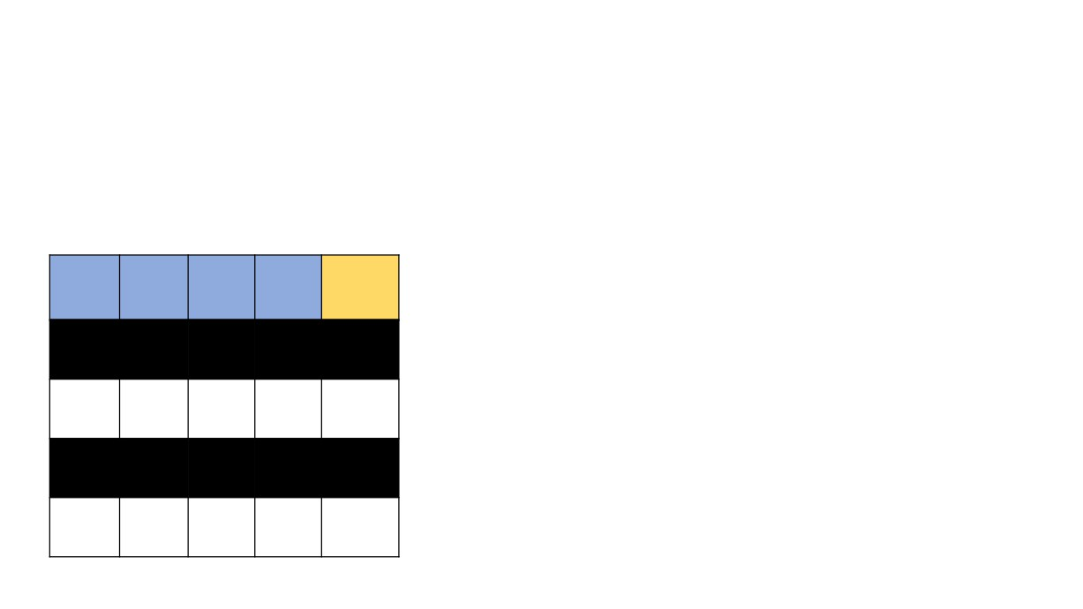
Bootstrapped Dataset
Often
Blurred Losing
Feeling
Vision Weight
Weight Diabetes
Tired
Yes
Yes
No
200
No
No
No
No
170
No
Yes
No
Yes
160
Yes
Yes
No
Yes
160
Yes

Slide 14
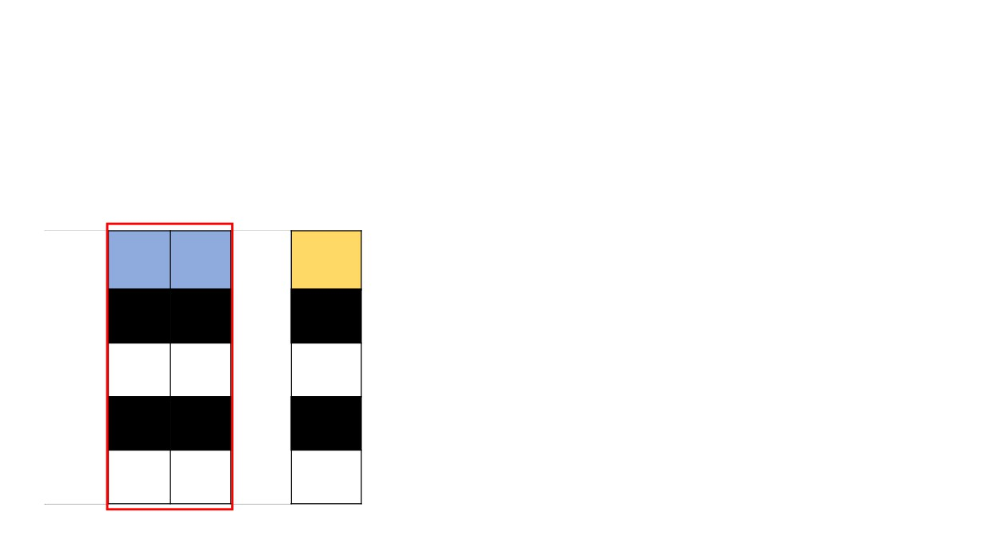
Bootstrapped Dataset
Blurred Losing
Diabetes
Vision Weight
Yes No
No
No No
No
No Yes
Yes
No Yes
Yes

Slide 15
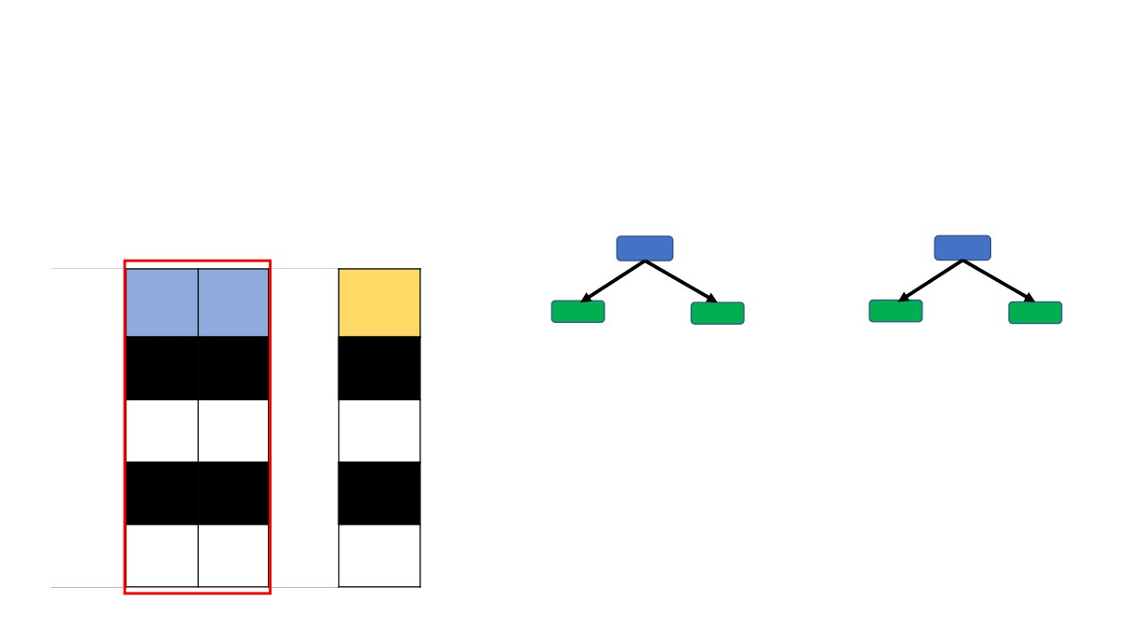
Bootstrapped Dataset
B.V. L.W.
Blurred Losing
Vision Weight
Diabetes
Yes No
No
Run the same process as we did it while creating a decision tree
No No
No
No Yes
Yes
No Yes
Yes

Slide 16
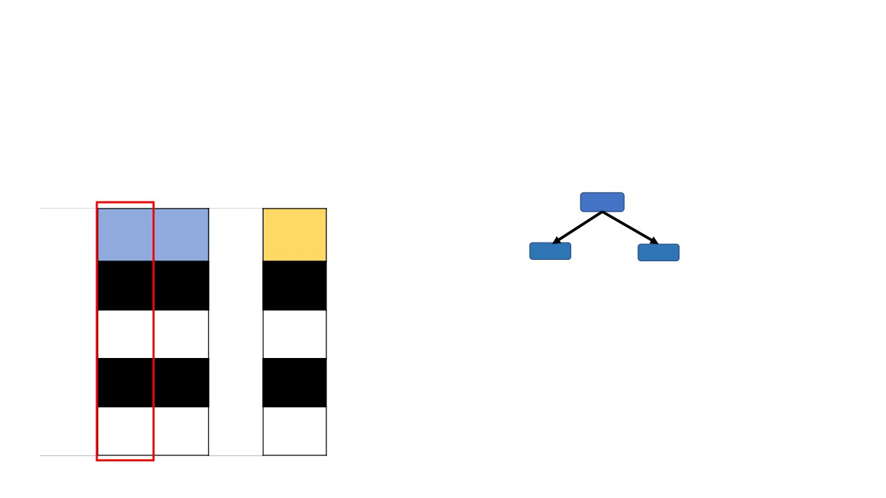
Bootstrapped Dataset
B.V.
Blurred Losing
Diabetes
Vision Weight
Yes No
No
Let’s assume that Blurred Vision provided less impurity, we take this feature to create our root node.
No No
No
No Yes
Yes
No Yes
Yes

Slide 17
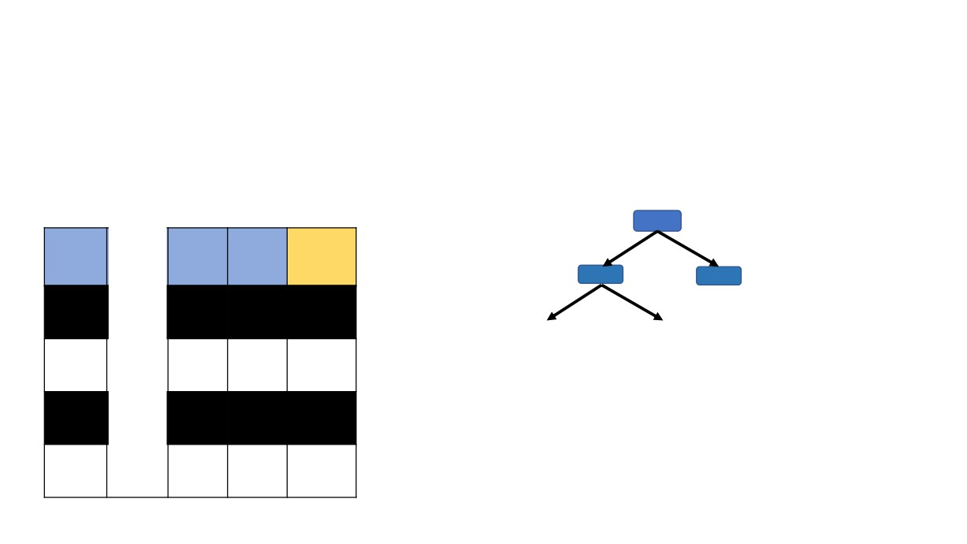
Bootstrapped Dataset
B.V.
Often
Losing
Feeling
Weight
Weight Diabetes
Tired
Yes
No
200 No
No
No
170 No
Yes
Yes
160 Yes
Yes
Yes
160 Yes

Slide 18
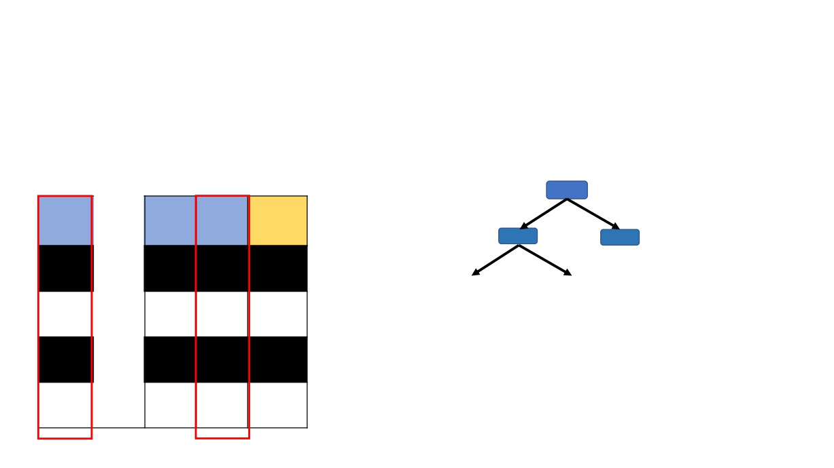
Bootstrapped Dataset
B.V.
Often
Losing
Feeling
Weight
Weight Diabetes
Tired
Yes
No
200 No
No
No
170 No
Yes
Yes
160 Yes
Yes
Yes
160 Yes

Slide 19
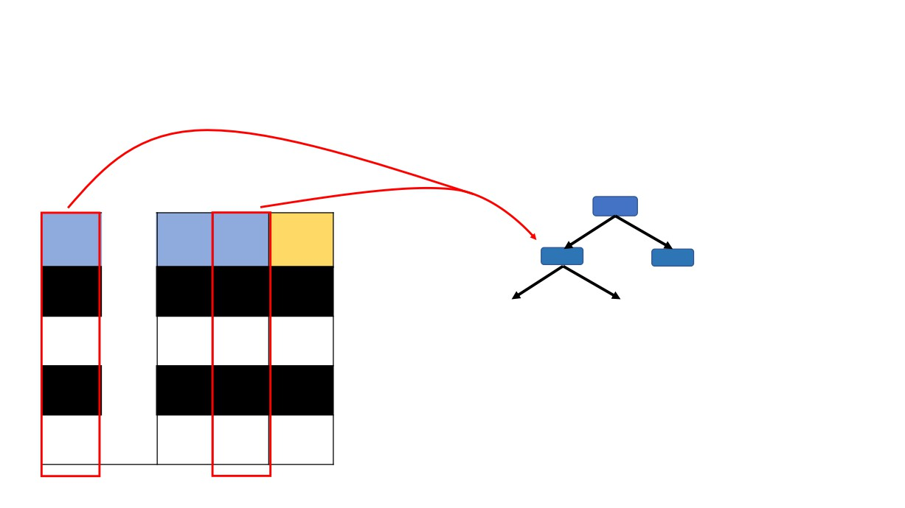
Bootstrapped Dataset
B.V.
Often
Losing
Feeling
Weight
Weight Diabetes
Tired
Yes
No
200 No
No
No
170 No
Yes
Yes
160 Yes
Yes
Yes
160 Yes

Slide 20
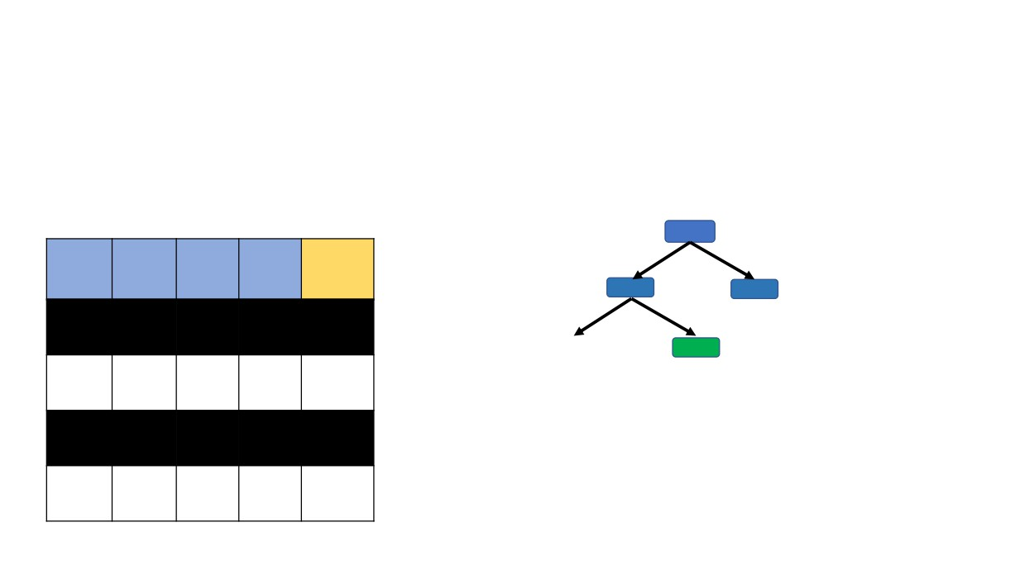
Bootstrapped Dataset
B.V.
Often
Blurred Losing
Feeling
Vision Weight
Weight Diabetes
Tired
Yes
Yes
No
200
No
No
No
No
170
No
Yes
No
Yes
160
Yes
Yes
No
Yes
160
Yes

Slide 21
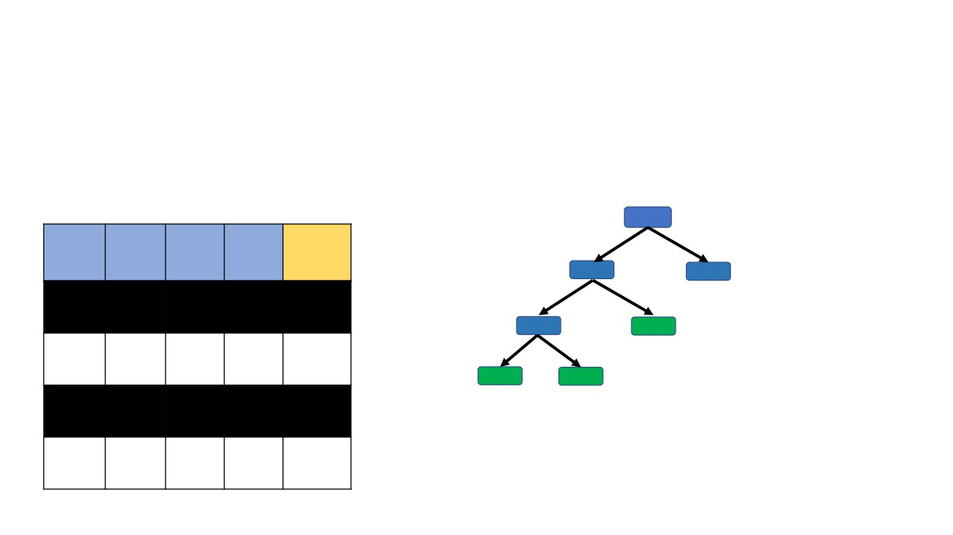
Bootstrapped Dataset
B.V.
Often
Blurred Losing
Feeling
Vision Weight
Weight Diabetes
Tired
Yes
Yes
No
200
No
No
No
No
170
No
Yes
No
Yes
160
Yes
Yes
No
Yes
160
Yes

Slide 22
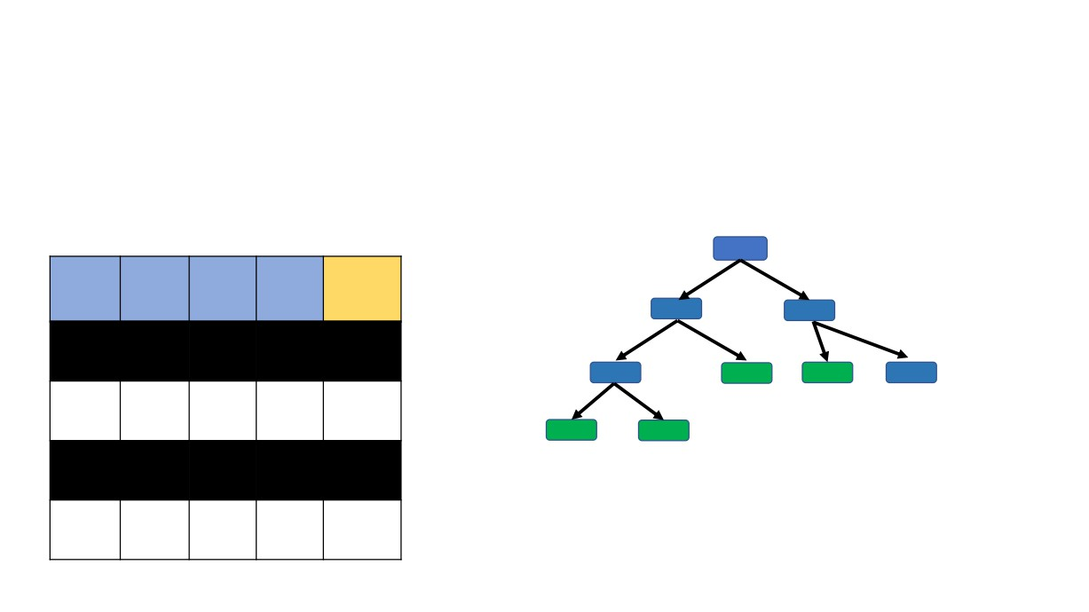
Bootstrapped Dataset
B.V.
Often
Blurred Losing
Feeling
Vision Weight
Weight Diabetes
Tired
Yes
Yes
No
200
No
No
No
No
170
No
Yes
No
Yes
160
Yes
Yes
No
Yes
160
Yes

Slide 23
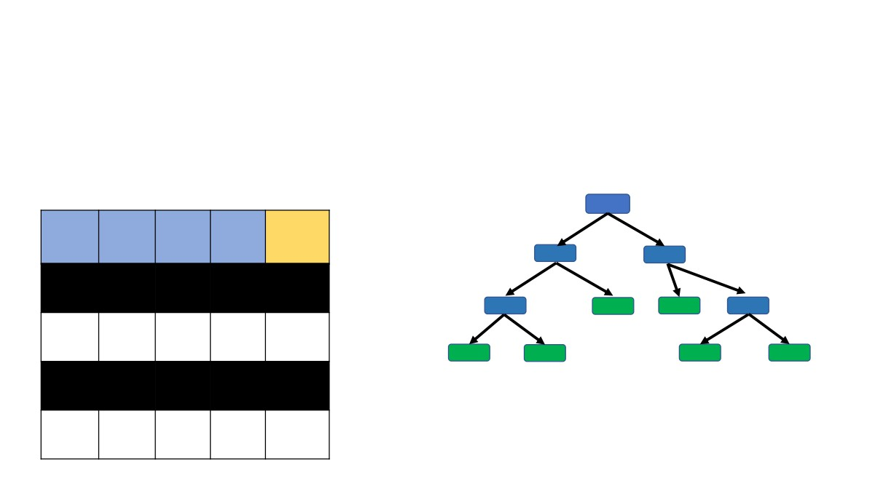
Bootstrapped Dataset
B.V.
Often
Blurred Losing
Feeling
Vision Weight
Weight Diabetes
Tired
Yes
Yes
No
200
No
No
No
No
170
No
Yes
No
Yes
160
Yes
Yes
No
Yes
160
Yes

Slide 24
We built a decision tree
Bootstrapped Dataset
B.V.
Often
Blurred Losing
Feeling
Vision Weight
Weight Diabetes
Tired
Yes
Yes
No
200
No
No
No
No
170
No
Yes
No
Yes
160
Yes
Yes
No
Yes
160
Yes

Slide 25
We built a decision tree
A. Using a bootstrapped dataset
Bootstrapped Dataset
B.V.
Often
Blurred Losing
Feeling
Vision Weight
Weight Diabetes
Tired
Yes
Yes
No
200
No
No
No
No
170
No
Yes
No
Yes
160
Yes
Yes
No
Yes
160
Yes

Slide 26
We built a decision tree
A. Using a bootstrapped dataset
B. Considering random subset of features at each step
Bootstrapped Dataset
B.V.
Often
Blurred Losing
Feeling
Vision Weight
Weight Diabetes
Tired
Yes
Yes
No
200
No
No
No
No
170
No
Yes
No
Yes
160
Yes
Yes
No
Yes
160
Yes

Slide 27
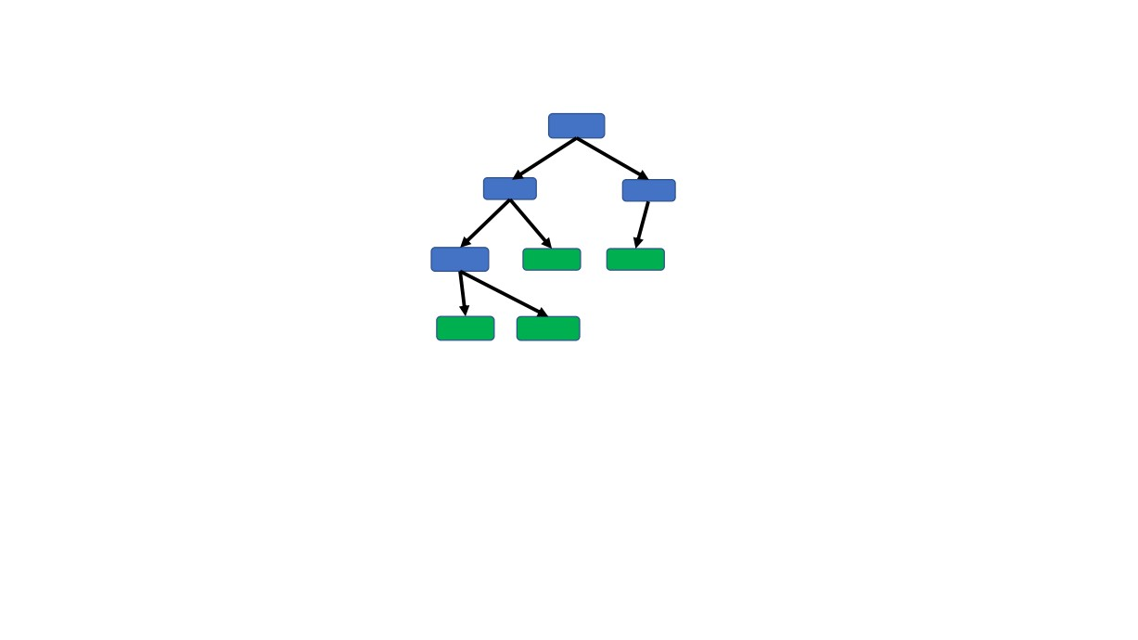
Now repeat all steps again to create several (usually 100s) of trees to build a Random Forest

Slide 28
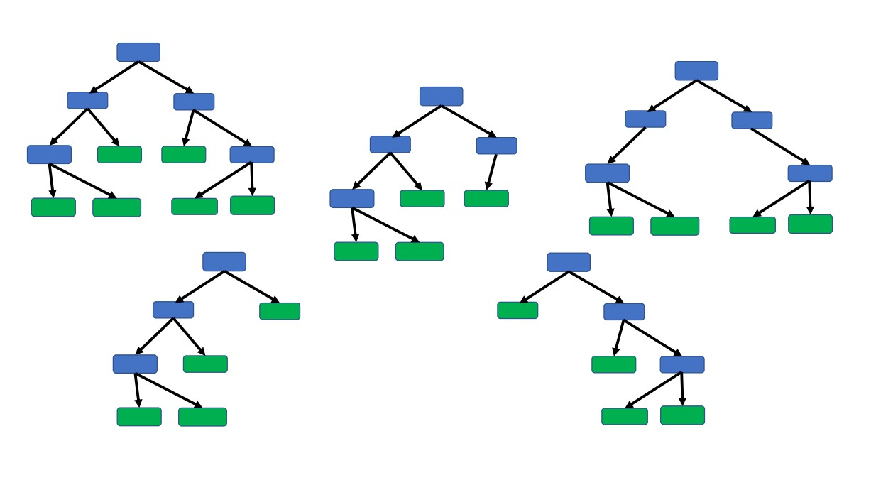
Now repeat all steps again to create several (usually 100s) of trees to build a Random Forest

Slide 29

Now we have created a Random Forest
Let’s see how well we have created them..

Slide 30
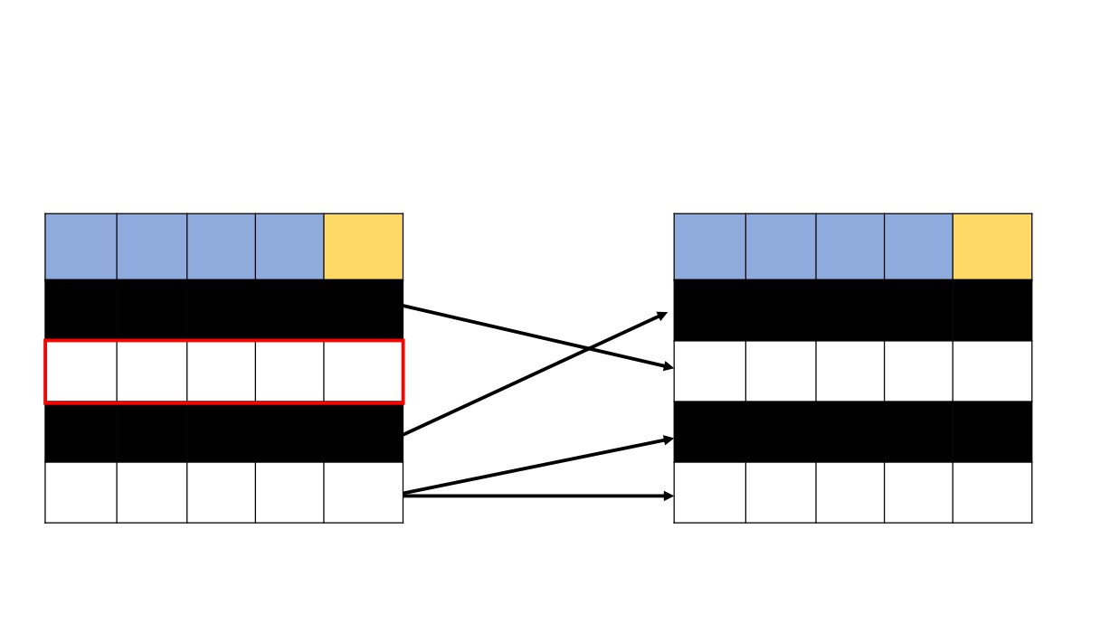
Remember how we created a bootstrapped data from the original data??
Original Dataset
Bootstrapped Dataset
Often
Blurred Losing
Often
Blurred Losing
Feeling
Vision Weight
Weight Diabetes Feeling
Vision Weight
Weight Diabetes
Tired
Tired
No
No
No
170
No
Yes
Yes
No
200
No
Yes
Yes
Yes
190
Yes
No
No
No
170
No
Yes
Yes
No
200
No
Yes
No
Yes
160
Yes
Yes
No
Yes
160
Yes
Yes
No
Yes
160
Yes

Slide 31
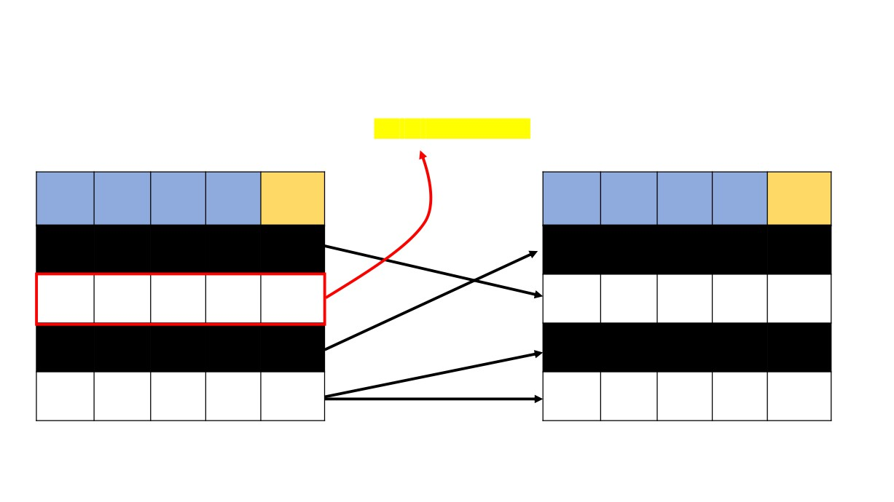
Remember how we created a bootstrapped data from the original data??
Out-Of-Bag (OOB) data
Original Dataset
Bootstrapped Dataset
Often
Blurred Losing
Often
Blurred Losing
Feeling
Vision Weight
Weight Diabetes Feeling
Vision Weight
Weight Diabetes
Tired
Tired
No
No
No
170
No
Yes
Yes
No
200
No
Yes
Yes
Yes
190
Yes
No
No
No
170
No
Yes
Yes
No
200
No
Yes
No
Yes
160
Yes
Yes
No
Yes
160
Yes
Yes
No
Yes
160
Yes

Slide 32
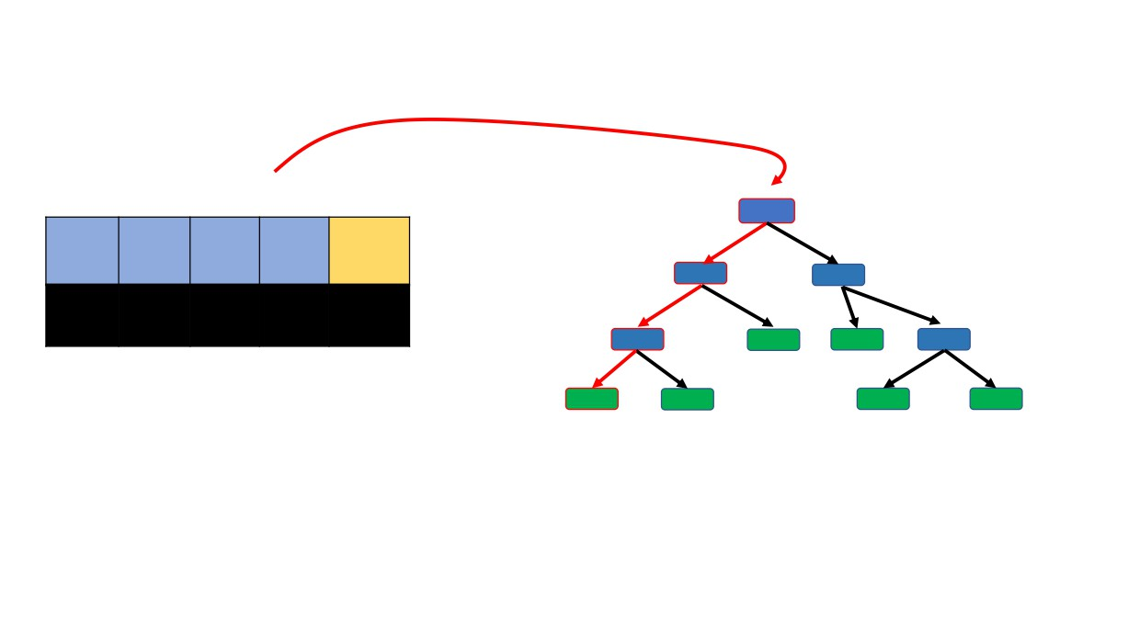
Out-Of-Bag Dataset
B.V.
Often
Blurred Losing
Feeling
Vision Weight
Weight Diabetes
Tired
Yes
Yes
Yes
190
Yes
Run this data through the first decision tree and see if the tree predicts rightly or not͙

Slide 33
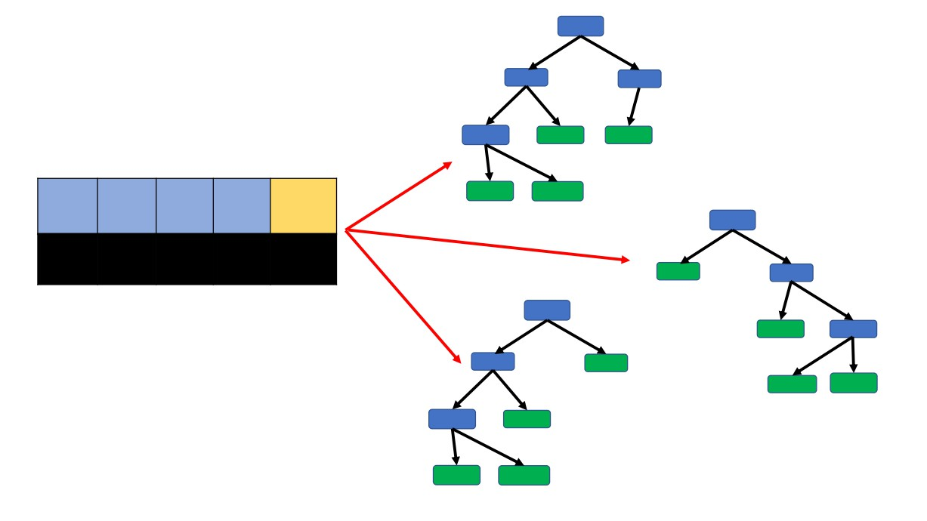
Then we run this data through all the decision Trees and see if they predicts rightly or not͙
Out-Of-Bag Dataset
Often
Blurred Losing
Feeling
Vision Weight
Weight Diabetes
Tired
Yes
Yes
Yes
190
Yes

Slide 34
Then we run this data through all the decision Trees and see if they predicts rightly or not͙
Out-Of-Bag Dataset
Often
Blurred Losing
Feeling
Vision Weight
Weight Diabetes
Tired
Yes
Yes
Yes
190
Yes
USE MAJORITY VOTING

Slide 35
Finally, we find predicted outcomes for rest of the OOB samples.
The proportion of the Out-Of-Bag samples predicted incorrectly is =
Out-Of-Bag Error

Slide 36

We have created a Random Forest, Tested it with out-of-bag (OOB) data,
Let’s see how to use them

Slide 37
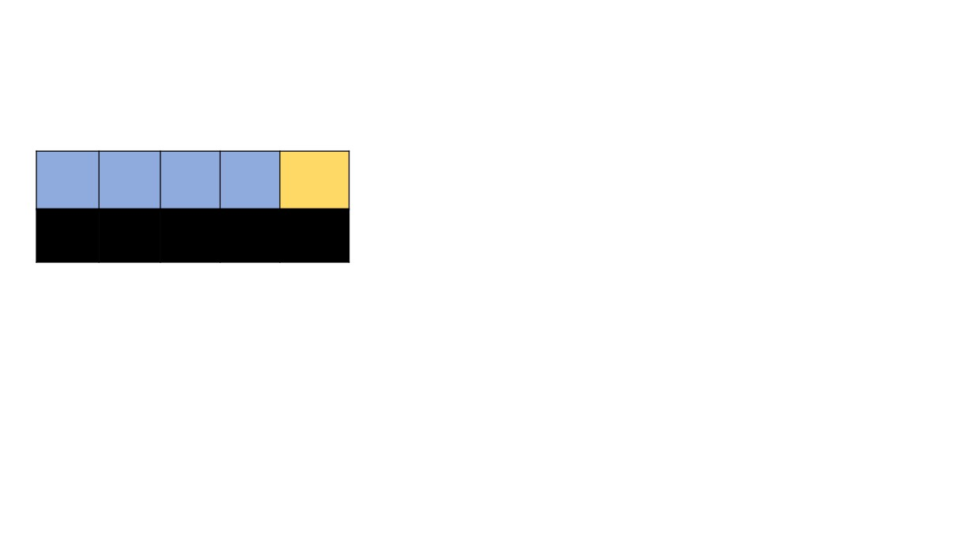
New Data Sample
Often
Blurred Losing
Feeling
Vision Weight
Weight Diabetes
Tired
No
Yes
No
178

Slide 38
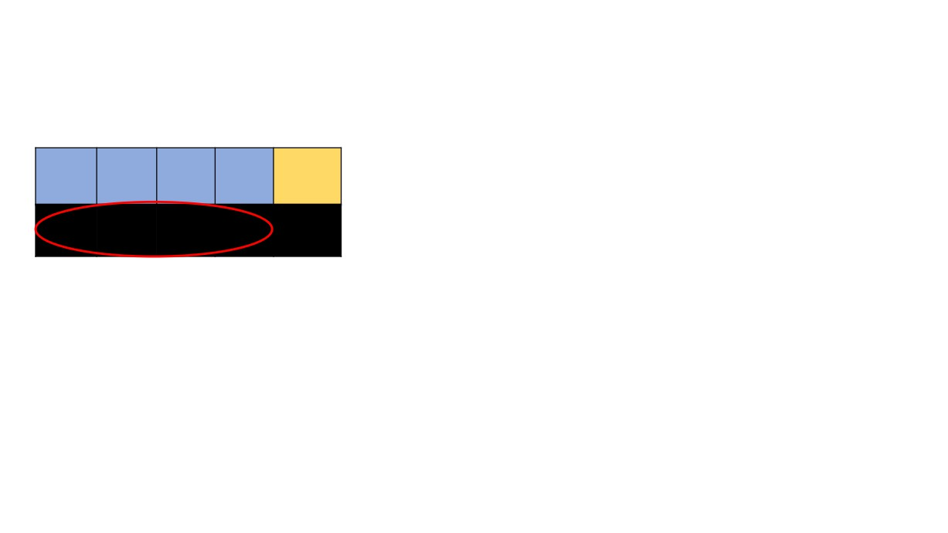
New Data Sample
Often
Blurred Losing
Feeling
Vision Weight
Weight Diabetes
Tired
No
Yes
No
178

Slide 39
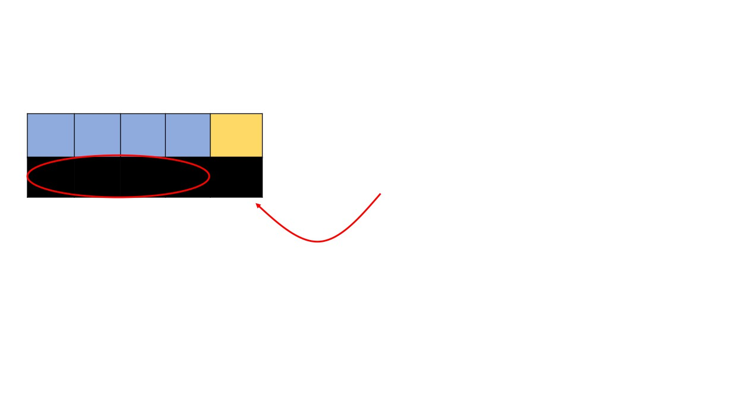
New Data Sample
Often
Blurred Losing
Feeling
Vision Weight
Weight Diabetes
Tired
No Yes No 178
?
Task

Slide 40
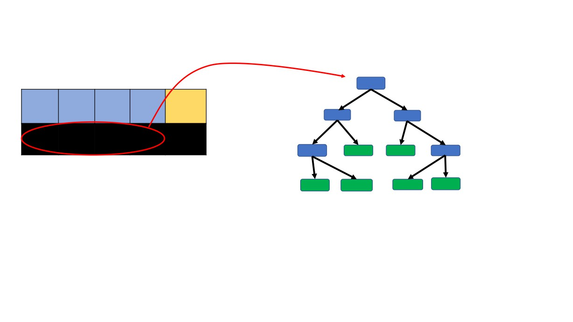
New Data Sample
Often
Blurred Losing
Feeling
Vision Weight
Weight Diabetes
Tired
No Yes No 178
?
We take the first tree and run the data sample through it to find the outcome

Slide 41

New Data Sample
Often
Blurred Losing
Feeling
Vision Weight
Weight Diabetes
Tired
No Yes No 178
?
We take the first tree and run the data sample through it to find the outcome

Slide 42
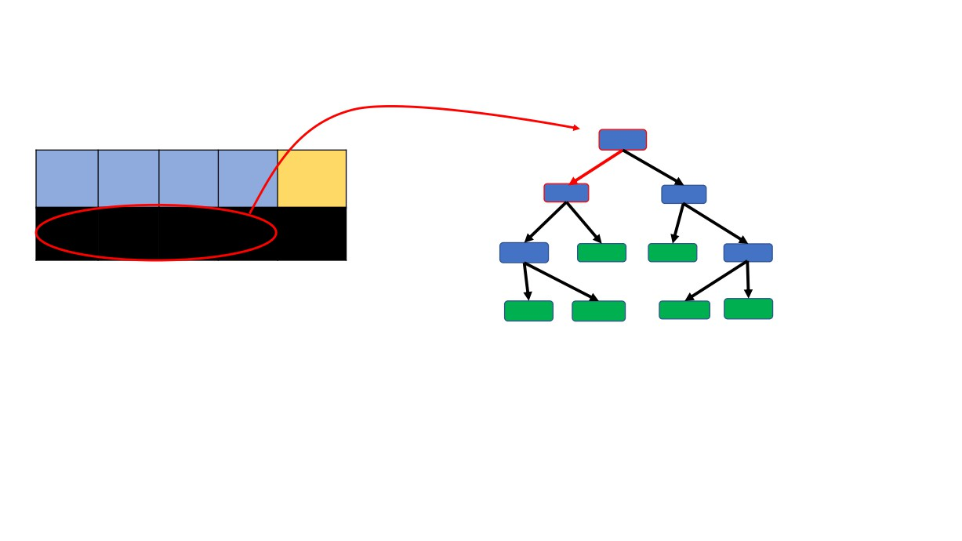
New Data Sample
Often
Blurred Losing
Feeling
Vision Weight
Weight Diabetes
Tired
No Yes No 178
?
We take the first tree and run the data sample through it to find the outcome

Slide 43
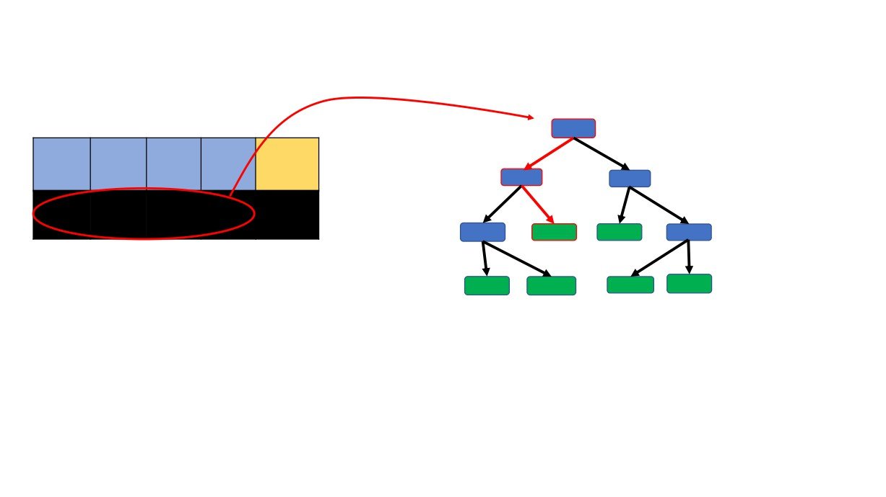
New Data Sample
Often
Blurred Losing
Feeling
Vision Weight
Weight Diabetes
Tired
No Yes No 178
?
We take the first tree and run the data sample through it to find the outcome

Slide 44
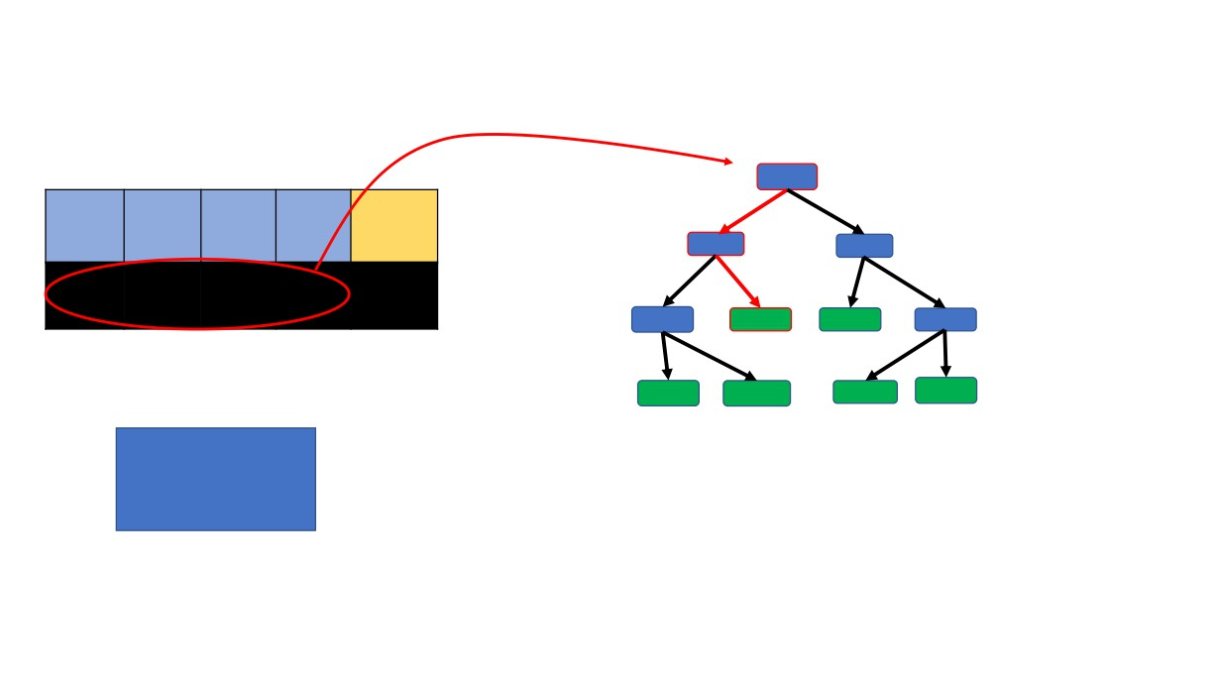
New Data Sample
Often
Blurred Losing
Feeling
Vision Weight
Weight Diabetes
Tired
No Yes No 178
?
Diabetes
Yes No
We take the first tree and run the data sample through it to find the outcome
1

Slide 45
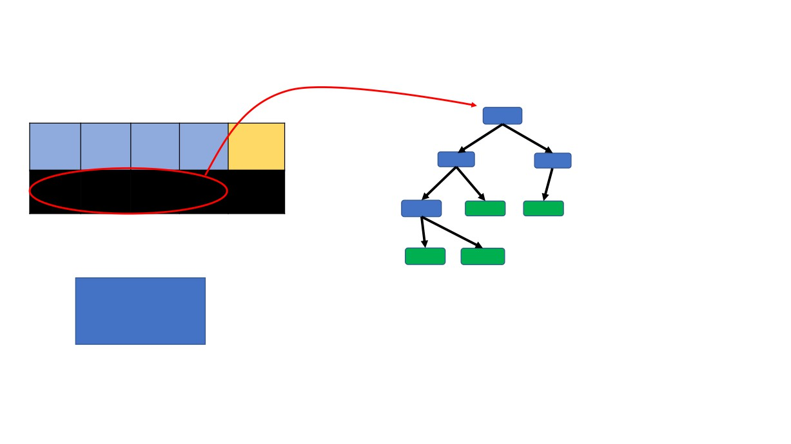
New Data Sample
Often
Blurred Losing
Feeling
Vision Weight
Weight Diabetes
Tired
No Yes No 178
?
Diabetes
Yes No
Likewise we run this data sample to all the trees and record the outcomes.
1

Slide 46

New Data Sample
Often
Blurred Losing
Feeling
Vision Weight
Weight Diabetes
Tired
No Yes No 178
?
Diabetes
Yes No
Likewise, we run this data sample to all the trees and record the outcomes.
1

Slide 47
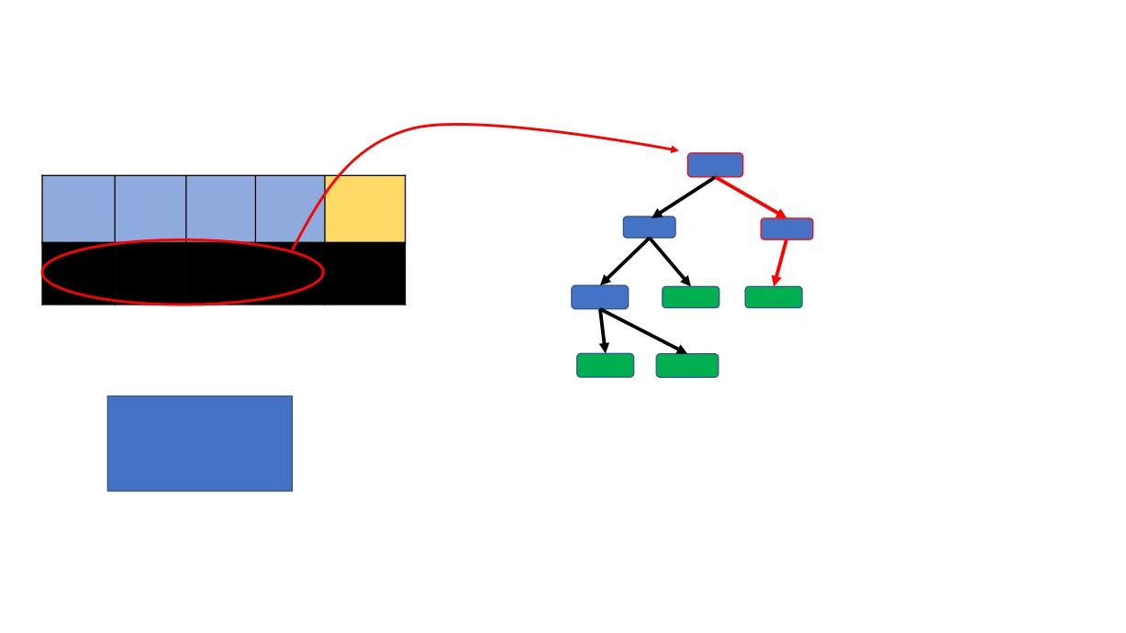
New Data Sample
Often
Blurred Losing
Feeling
Vision Weight
Weight Diabetes
Tired
No Yes No 178
?
Diabetes
Yes No
Likewise we run this data sample to all the trees and record the outcomes.
1

Slide 48

New Data Sample
Often
Blurred Losing
Feeling
Vision Weight
Weight Diabetes
Tired
No Yes No 178
?
Diabetes
Yes No
Likewise we run this data sample to all the trees and record the outcomes.
1 1

Slide 49
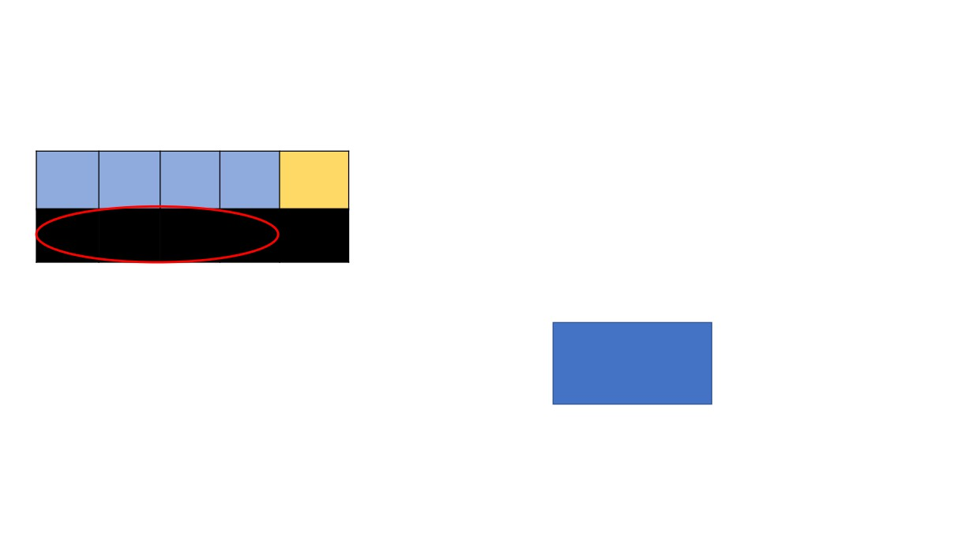
New Data Sample
Often
Blurred Losing
Feeling
Vision Weight
Weight Diabetes
Tired
And Finally get the outcomes from all the trees.
No Yes No 178
?
Diabetes
Yes
No
4
1

Slide 50
New Data Sample
Often
Blurred Losing
Feeling
Vision Weight
Weight
Diabetes
Use majority voting criterion to select the final decision
Tired
No
Yes No
178
?
Diabetes
Yes
No
4
1

Slide 51
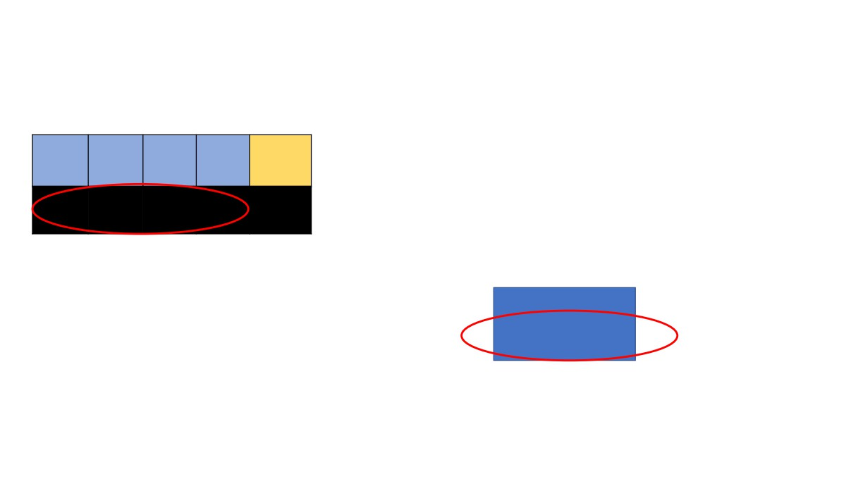
New Data Sample
Often
Blurred Losing
Feeling
Vision Weight
Weight
Diabetes
Use majority voting criterion to select the final decision
Tired
No
Yes No
178
?
Diabetes
Yes
No
4
1

Slide 52
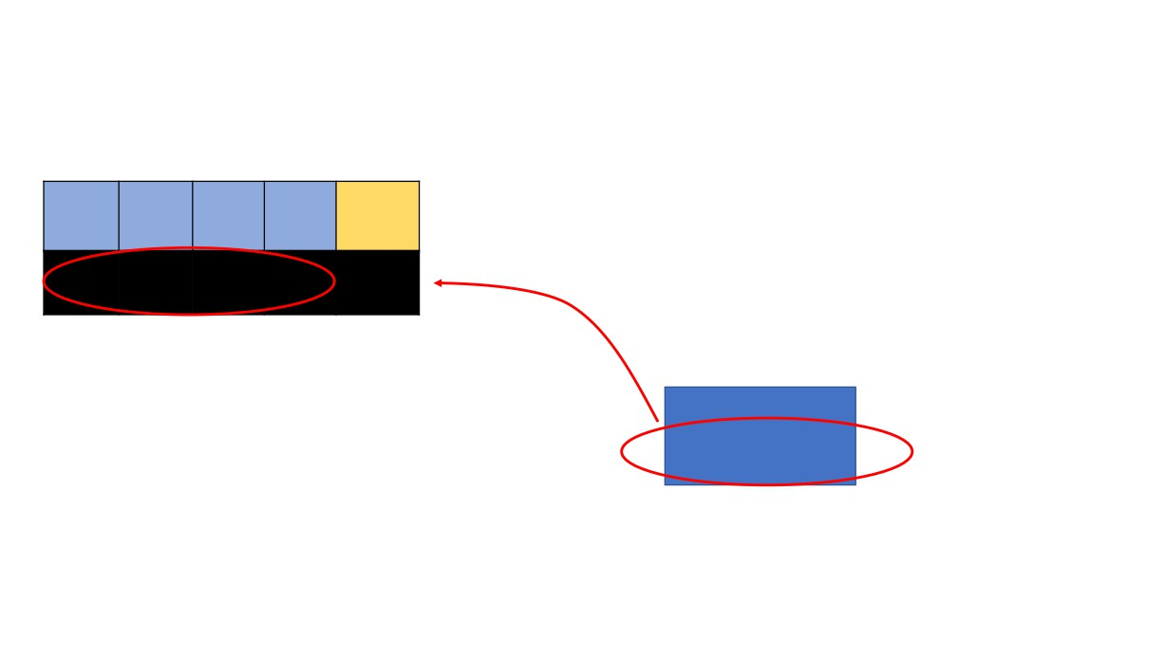
New Data Sample
Often
Blurred Losing
Feeling
Vision Weight
Weight
Diabetes
Use majority voting criterion to select the final decision
Tired
No
Yes No
178
Yes
Diabetes
Yes
No
4
1

Slide 53
Bootstrapping the data +
New Data Sample
Often
Blurred Losing
Feeling
Weight
Diabetes aggregating the decisions
Tired
Vision Weight
=
No
Yes No
178
Yes
Diabetes
Yes
No
4
1

Slide 54
Bootstrapping the data +
New Data Sample
Often
Blurred Losing
Feeling
Weight
Diabetes aggregating the decisions
Tired
Vision Weight
=
No
Yes No
178
Yes ‘Bagging’
Diabetes
Yes
No
4
1

Slide 55

Time to code a
Random Forest

Slide 56
Advantages of Random Forest
BOTH CLASSIFICATION AND REGRESSION CAN BE PERFORMED
HANDLES THE MISSING VALUES AND MAINTAINS THE ACCURACY FOR MISSING DATA NUMERICAL & CATEGORICAL DATA
WON’T OVERFIT THE MODEL WITH LARGE DATASETS
EFFECTIVE HANDLING OF HIGH DIMENTIONAL DATA

Slide 57
Disadvantages of Random Forest
DIFICULT TO INTERPRET BECAUSE OF COMPLEX STRUCTURE
CAN OVERFIT IN CASE NOISY CLASSIFICATION/REGRESSION DATA
FOR CATEGORICAL DATA WITH DIFFERENT NUMBER OF LEVELS, RFs BECAME BIASED
LARGE NUMBER OF TREES LIMIT THE REAL-TIME PREDICTION CAPABILITY
SINCE FINAL PREDICTION IS BASED ON THE MEAN PREDICTIONS FROM SUBSET
TREES, IT WON’T GIVE PRECISE VALUES FOR THE REGRESSION MODEL

Slide 58
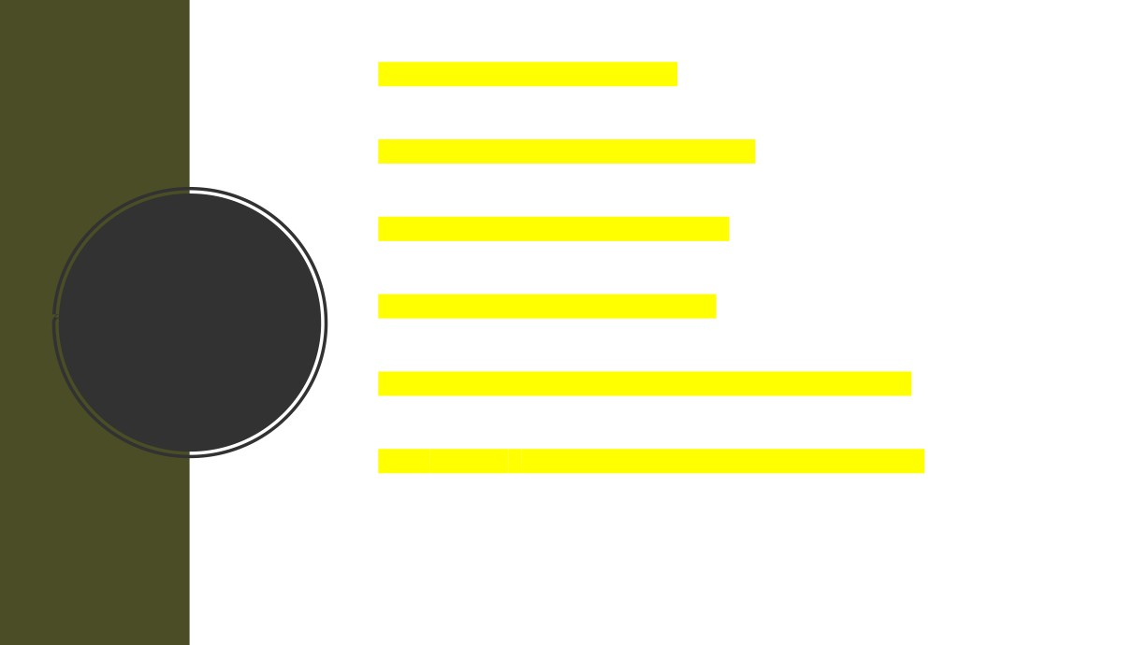
• Basics of Random Forest
• How to create a Random Forest
• How to test a Random Forest
Random
• How to use a Random Forest
Forest
• Advantages/Disadvantages of Random Forest
• Use scikit-learn to implement RF algorithm

Slide 59

Contact
https://www.linkedin.com/in/dheerajrathee/ dheeraj.rathee@nhs.net

