Slide 1
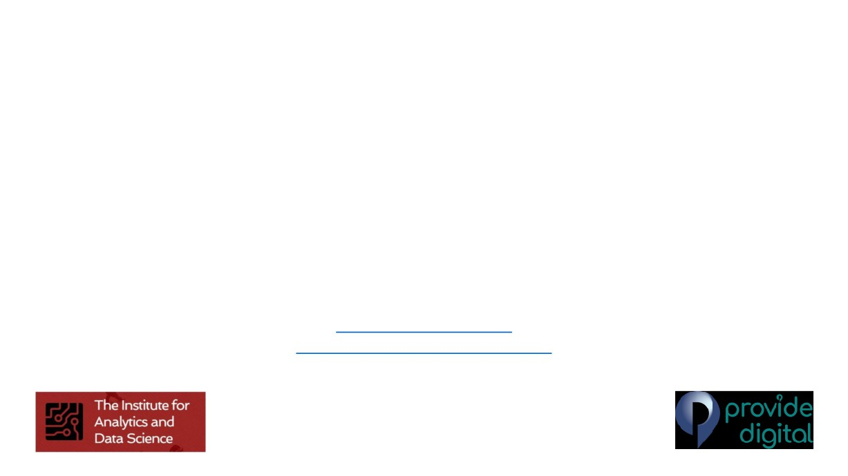
Tree based Machine Learning Models
for Data Science
Session-2
Dr Dheeraj Rathee
Chief Technology and Analytics Officer Provide Digital
dheeraj.rathee@nhs.net
dheeraj.rathee@providedigital.com

Slide 2
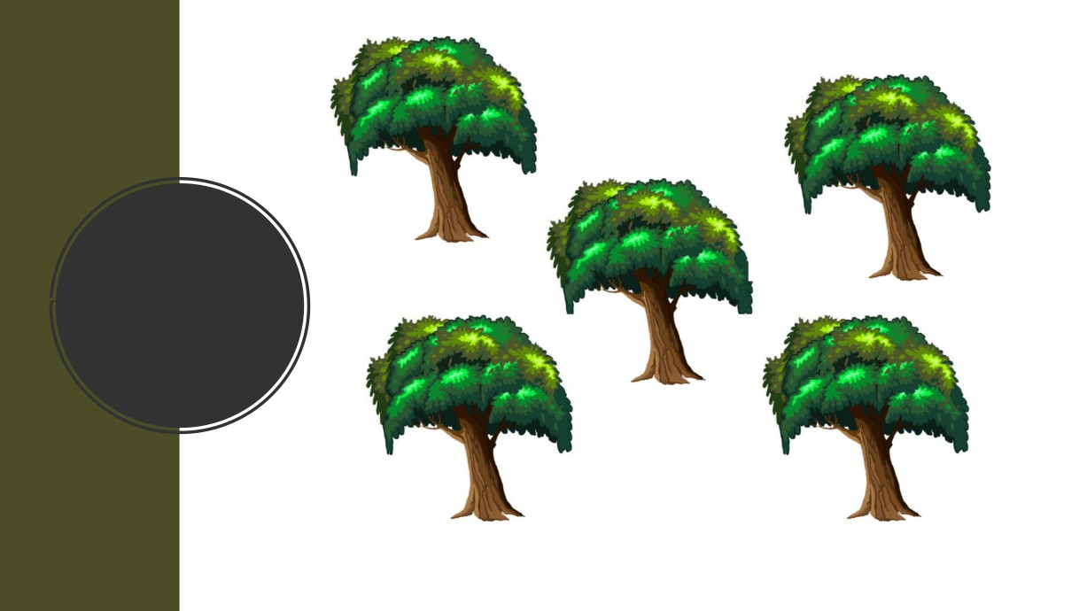
Random
Forest

Slide 3
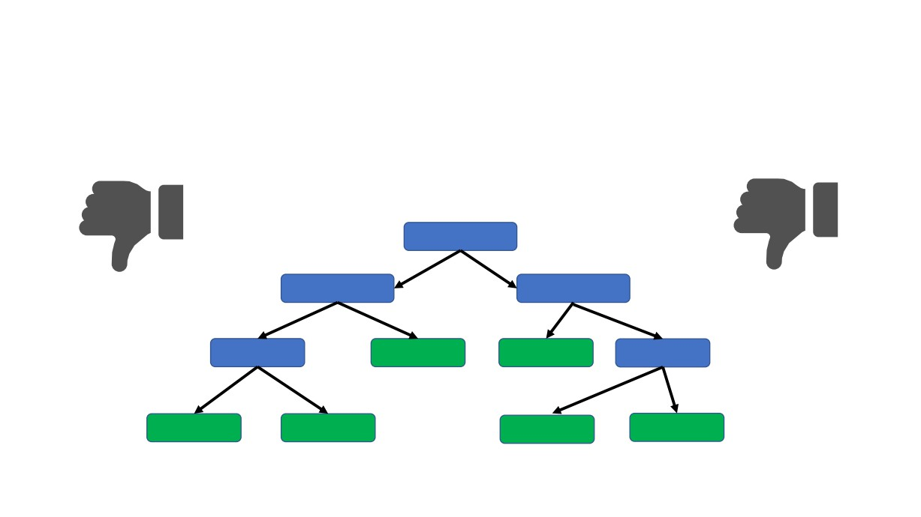
Decision trees are awesome but͙
Although they are good at the data that used to create them they are not so good while working with new data samples
OVER-FITTING

Slide 4
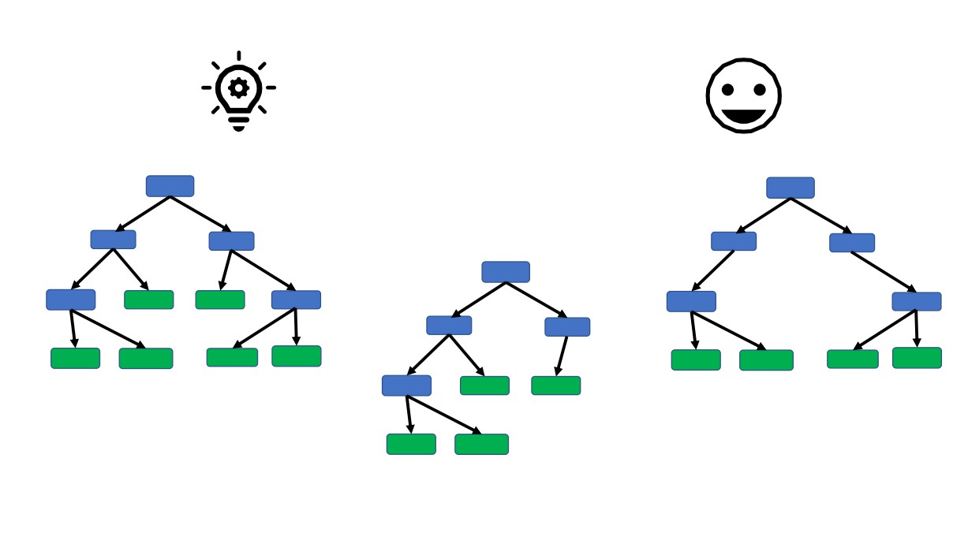
Let’s combine the simplicity of decision trees and Randomness to provide flexibility
and resolve the problem of over-fitting.
Thus grow several trees out of the given data and create a
FOREST
Decision Tree 1
Decision Tree 3
Decision Tree 2

Slide 5

Let’s create a Random Forest!!!

Slide 6
Step 1: Create a ‘bootstrapped’ dataset.

Slide 7
Original Dataset
Bootstrapped Dataset
Often Feeling Tired | Blurred Vision | Losing Weight | Weight | Diabetes
No | No | No | 170 | No
Yes | Yes | Yes | 190 | Yes
Yes | Yes | No | 200 | No
Yes | No | Yes | 160 | Yes
Often Feeling Tired | Blurred Vision | Losing Weight | Weight | Diabetes

Slide 8
Original Dataset
Bootstrapped Dataset
Often Feeling Tired | Blurred Vision | Losing Weight | Weight | Diabetes
No | No | No | 170 | No
Yes | Yes | Yes | 190 | Yes
Yes | Yes | No | 200 | No
Yes | No | Yes | 160 | Yes
Often Feeling Tired | Blurred Vision | Losing Weight | Weight | Diabetes
Yes | Yes | No | 200 | No

Slide 9
Original Dataset
Bootstrapped Dataset
Often Feeling Tired | Blurred Vision | Losing Weight | Weight | Diabetes
No | No | No | 170 | No
Yes | Yes | Yes | 190 | Yes
Yes | Yes | No | 200 | No
Yes | No | Yes | 160 | Yes
Often Feeling Tired | Blurred Vision | Losing Weight | Weight | Diabetes
Yes | Yes | No | 200 | No
No | No | No | 170 | No

Slide 10
Original Dataset
Bootstrapped Dataset
Often Feeling Tired | Blurred Vision | Losing Weight | Weight | Diabetes
No | No | No | 170 | No
Yes | Yes | Yes | 190 | Yes
Yes | Yes | No | 200 | No
Yes | No | Yes | 160 | Yes
Often Feeling Tired | Blurred Vision | Losing Weight | Weight | Diabetes
Yes | Yes | No | 200 | No
No | No | No | 170 | No
Yes | No | Yes | 160 | Yes

Slide 11
Original Dataset
Bootstrapped Dataset
Often Feeling Tired | Blurred Vision | Losing Weight | Weight | Diabetes
No | No | No | 170 | No
Yes | Yes | Yes | 190 | Yes
Yes | Yes | No | 200 | No
Yes | No | Yes | 160 | Yes
Often Feeling Tired | Blurred Vision | Losing Weight | Weight | Diabetes
Yes | Yes | No | 200 | No
No | No | No | 170 | No
Yes | No | Yes | 160 | Yes
Yes | No | Yes | 160 | Yes

Slide 12
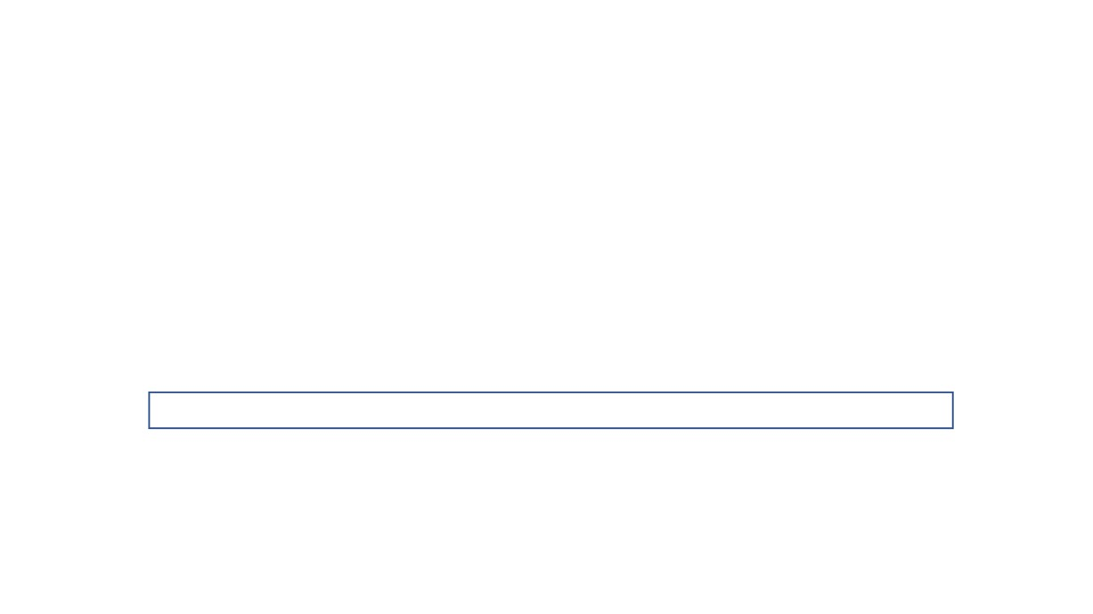
Step 2: Create a decision tree using the bootstrapped data.
Note: Use randomly selected subset of variables rather than all variables at each step.

Slide 13
Bootstrapped Dataset
Often Feeling Tired | Blurred Vision | Losing Weight | Weight | Diabetes
Yes | Yes | No | 200 | No
No | No | No | 170 | No
Yes | No | Yes | 160 | Yes
Yes | No | Yes | 160 | Yes

Slide 14
Bootstrapped Dataset
B.V.
L.W.
 | Blurred Vision | Losing Weight |  | Diabetes
 | Yes | No |  | No
 | No | No |  | No
 | No | Yes |  | Yes
 | No | Yes |  | Yes
Often
Feeling Tired
Yes
No Yes
Yes
Weight
200
170
160
160
Run the same process as we did it while creating a decision tree

Slide 15
Bootstrapped Dataset
B.V.
 | Blurred Vision | Losing Weight |  | Diabetes
 | Yes | No |  | No
 | No | No |  | No
 | No | Yes |  | Yes
 | No | Yes |  | Yes
Often
Feeling Tired
Yes
No Yes
Yes
Weight
200
170
160
160
Let’s assume that Blurred Vision provided less impurity, we take this feature to create our root node.

Slide 16
Bootstrapped Dataset
B.V.
Often Feeling Tired |  | Losing Weight | Weight | Diabetes
Yes |  | No | 200 | No
No |  | No | 170 | No
Yes |  | Yes | 160 | Yes
Yes |  | Yes | 160 | Yes
Blurred
Vision
Yes No No
No

Slide 17
Bootstrapped Dataset
B.V.
Often Feeling Tired |  | Losing Weight | Weight | Diabetes
Yes |  | No | 200 | No
No |  | No | 170 | No
Yes |  | Yes | 160 | Yes
Yes |  | Yes | 160 | Yes
Blurred
Vision
Yes No No
No

Slide 18
Bootstrapped Dataset
B.V.
Often Feeling Tired | Blurred Vision | Losing Weight | Weight | Diabetes
Yes | Yes | No | 200 | No
No | No | No | 170 | No
Yes | No | Yes | 160 | Yes
Yes | No | Yes | 160 | Yes

Slide 19
Bootstrapped Dataset
B.V.
Often Feeling Tired | Blurred Vision | Losing Weight | Weight | Diabetes
Yes | Yes | No | 200 | No
No | No | No | 170 | No
Yes | No | Yes | 160 | Yes
Yes | No | Yes | 160 | Yes

Slide 20
Bootstrapped Dataset
B.V.
Often Feeling Tired | Blurred Vision | Losing Weight | Weight | Diabetes
Yes | Yes | No | 200 | No
No | No | No | 170 | No
Yes | No | Yes | 160 | Yes
Yes | No | Yes | 160 | Yes

Slide 21
We built a decision tree
A. Using a bootstrapped dataset
B. Considering random subset of features at each step
Bootstrapped Dataset
B.V.
Often Feeling Tired | Blurred Vision | Losing Weight | Weight | Diabetes
Yes | Yes | No | 200 | No
No | No | No | 170 | No
Yes | No | Yes | 160 | Yes
Yes | No | Yes | 160 | Yes

Slide 22
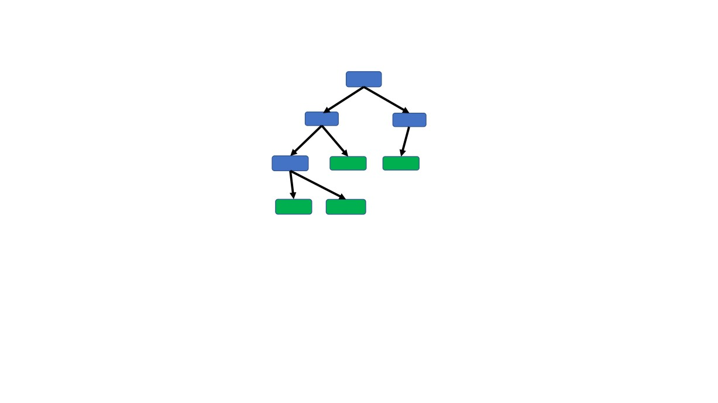
Now repeat all steps again to create several (usually 100s) of trees to build a Random Forest

Slide 23
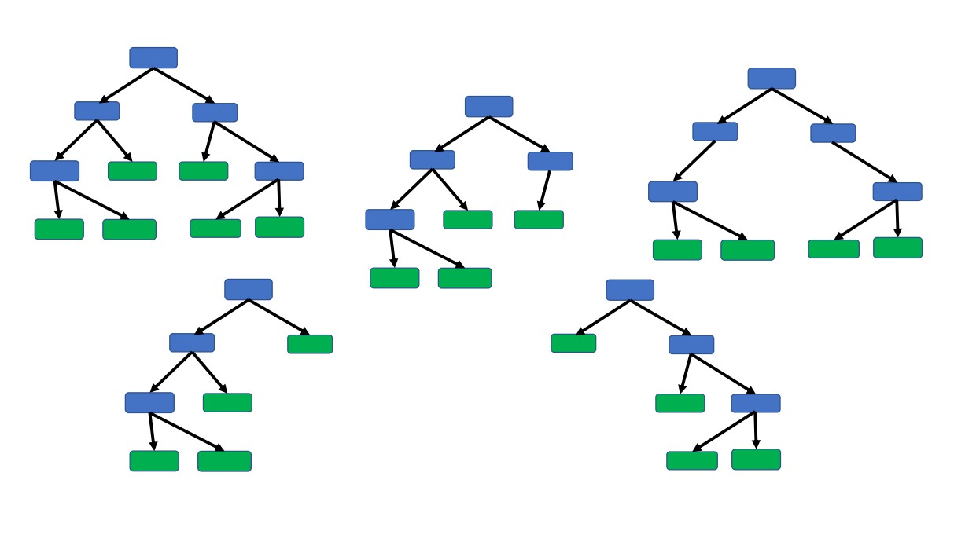
Now repeat all steps again to create several (usually 100s) of trees to build a Random Forest

Slide 24

Now we have created a Random Forest
Let’s see how well we have created them..

Slide 25
Remember how we created a bootstrapped data from the original data??
Out-Of-Bag (OOB) data
Original Dataset
Bootstrapped Dataset
Often Feeling Tired | Blurred Vision | Losing Weight | Weight | Diabetes
No | No | No | 170 | No
Yes | Yes | Yes | 190 | Yes
Yes | Yes | No | 200 | No
Yes | No | Yes | 160 | Yes
Often Feeling Tired | Blurred Vision | Losing Weight | Weight | Diabetes
Yes | Yes | No | 200 | No
No | No | No | 170 | No
Yes | No | Yes | 160 | Yes
Yes | No | Yes | 160 | Yes

Slide 26
Out-Of-Bag Dataset
B.V.
Often Feeling Tired | Blurred Vision | Losing Weight | Weight | Diabetes
Yes | Yes | Yes | 190 | Yes
Run this data through the first decision tree
and see if the tree predicts rightly or not…

Slide 27
Then we run this data through all the decision
Trees and see if they predicts rightly or not…
Out-Of-Bag Dataset
Often Feeling Tired | Blurred Vision | Losing Weight | Weight | Diabetes
Yes | Yes | Yes | 190 | Yes
USE MAJORITY VOTING

Slide 28

Finally, we find predicted outcomes for rest of the OOB samples.
The proportion of the Out-Of-Bag samples predicted incorrectly is =
Out-Of-Bag Error

Slide 29

We have created a Random Forest, Tested it with out-of-bag (OOB) data,
Let’s see how to use them

Slide 30
New Data Sample
Often Feeling Tired
Blurred Vision
Losing Weight
Diabetes
Weight
Task for which we want to use decision tree: to answer whether this person is diabetic
No
Yes
No
178
?

Slide 31
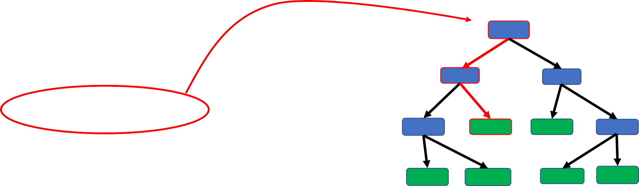
New Data Sample
Often Feeling Tired | Blurred Vision | Losing Weight | Weight | Diabetes
No | Yes | No | 178 | ?
Diabetes Yes No
1
We take the first tree and run the data sample through it to find the outcome

Slide 32
New Data Sample
Often Feeling Tired
Blurred Vision
Losing Weight
Diabetes
Weight
No
Yes
No
?
178
Diabetes Yes No
1
Likewise we run this data sample to all the trees and record the outcomes.

Slide 33
New Data Sample
Often Feeling Tired
Blurred Vision
Losing Weight
Diabetes
Weight
No
Yes
No
?
178
Likewise we run this data sample to all the trees and record the outcomes.
= why lecturer said ‘oob data may be part of some trees but not of all’
My/the class issue is this does not seem in line with what we find online.
OOB would only be ‘ run it on the trees not used for it’ ??
Diabetes Yes No
1 1

Slide 34
And Finally get the outcomes from all the trees.
New Data Sample
Often Feeling Tired | Blurred Vision | Losing Weight | Weight | Diabetes
No | Yes | No | 178 | ?
Diabetes Yes No
4 1

Slide 35
Use majority voting criterion to select the final decision
New Data Sample
Often Feeling Tired | Blurred Vision | Losing Weight | Weight | Diabetes
No | Yes | No | 178 | Yes
Diabetes Yes No
4 1

Slide 36
Bootstrapping the data
New Data Sample
+
aggregating the decisions
=
‘Bagging’
Often Feeling Tired | Blurred Vision | Losing Weight | Weight | Diabetes
No | Yes | No | 178 | Yes
Diabetes Yes No
4 1

Slide 37

Time to code a
Random Forest

Slide 38
Advantages of Random Forest
BOTH CLASSIFICATION AND REGRESSION CAN BE PERFORMED
HANDLES THE MISSING VALUES AND MAINTAINS THE ACCURACY FOR MISSING DATA NUMERICAL & CATEGORICAL DATA
WON’T OVERFIT THE MODEL WITH LARGE DATASETS
EFFECTIVE HANDLING OF HIGH DIMENTIONAL DATA

Slide 39
Disadvantages of Random Forest
DIFICULT TO INTERPRET BECAUSE OF COMPLEX STRUCTURE
CAN OVERFIT IN CASE NOISY CLASSIFICATION/REGRESSION DATA
FOR CATEGORICAL DATA WITH DIFFERENT NUMBER OF LEVELS, RFs BECAME BIASED
LARGE NUMBER OF TREES LIMIT THE REAL-TIME PREDICTION CAPABILITY
SINCE FINAL PREDICTION IS BASED ON THE MEAN PREDICTIONS FROM SUBSET
TREES, IT WON’T GIVE PRECISE VALUES FOR THE REGRESSION MODEL

Slide 40
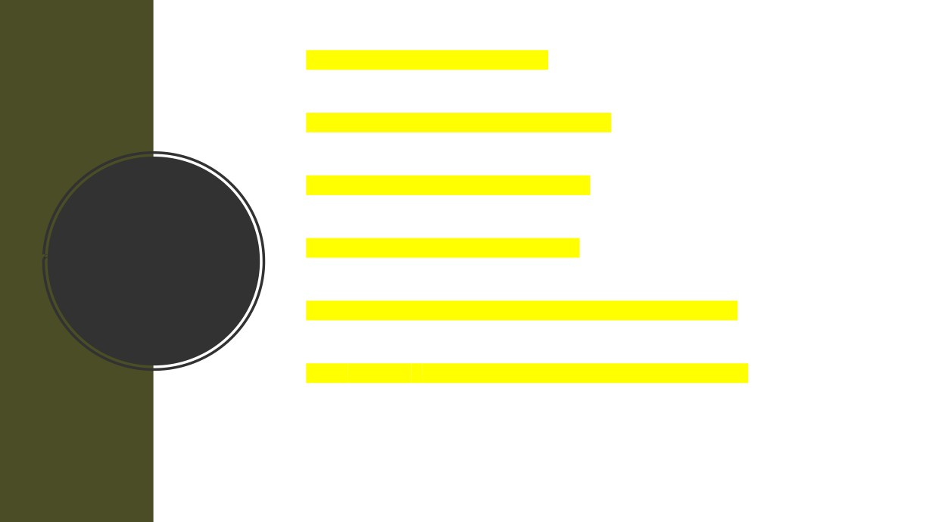
• Basics of Random Forest
• How to create a Random Forest
• How to test a Random Forest
Random
• How to use a Random Forest
Forest
• Advantages/Disadvantages of Random Forest
• Use scikit-learn to implement RF algorithm

Slide 41

Contact
https://www.linkedin.com/in/dheerajrathee/ dheeraj.rathee@nhs.net

