Slide 1
Gene drive mathematical models
Léna Kläy, PhD 3rd year

Slide 2
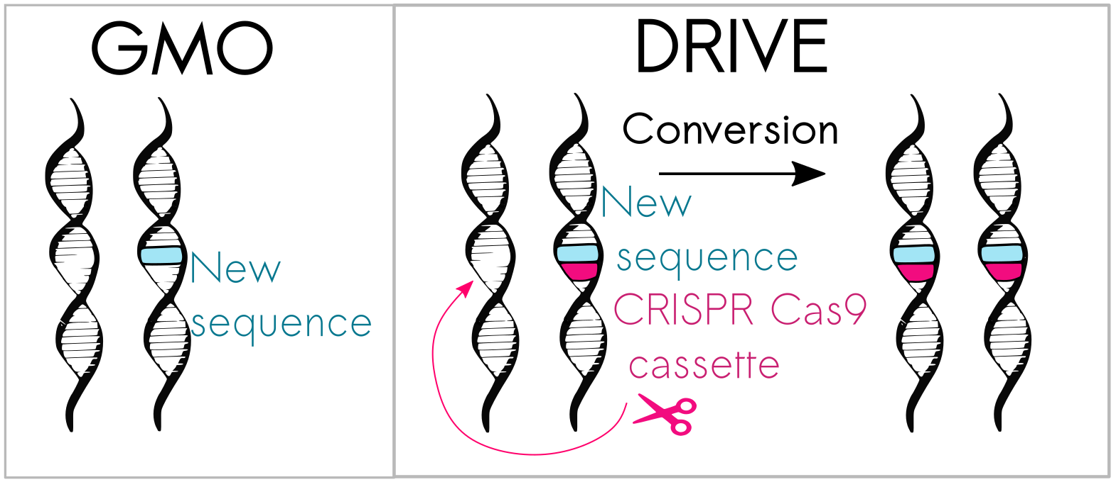
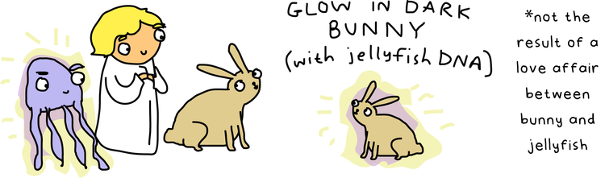
Gene drive mathematical models
Léna Kläy, PhD 3rd year

Slide 3
Gene drive mathematical models
Léna Kläy, PhD 3rd year

Slide 4
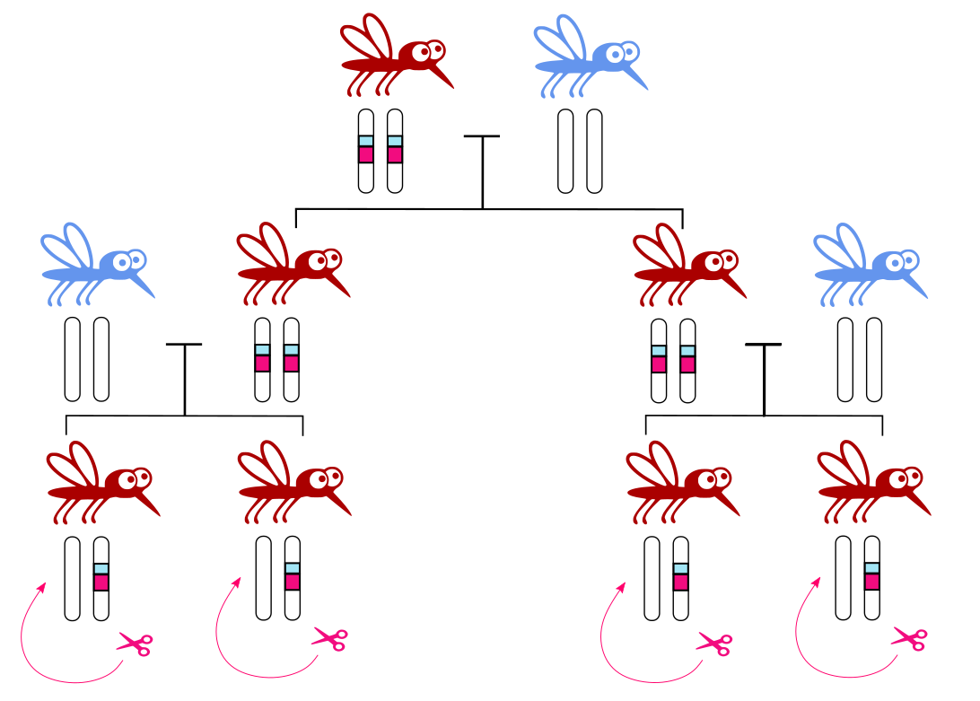
Gene drive mathematical models
Léna Kläy, PhD 3rd year

Slide 5
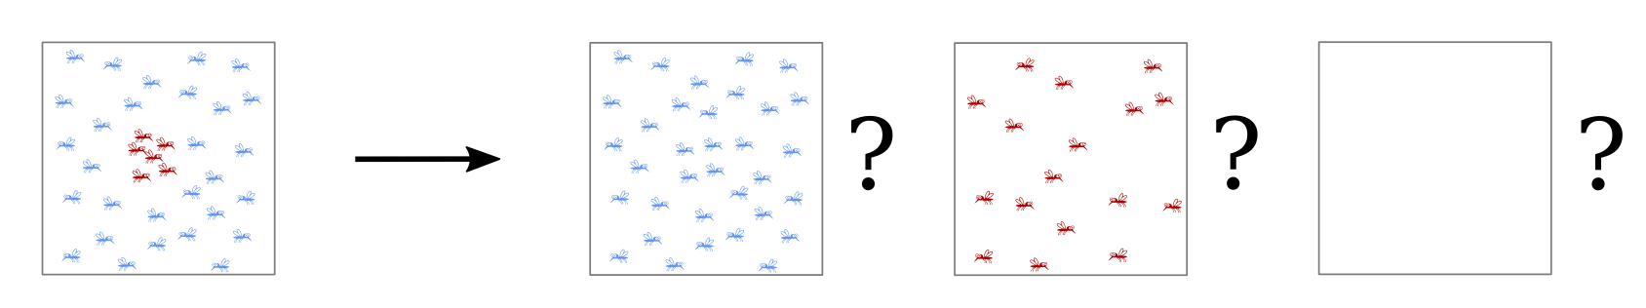
Gene drive mathematical models
Léna Kläy, PhD 3rd year

Slide 6
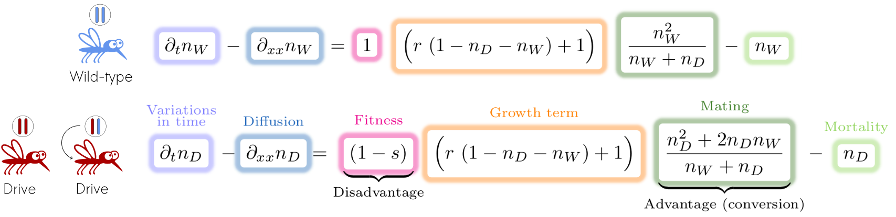

Gene drive mathematical models
Léna Kläy, PhD 3rd year
Aaaarrrgg !!!

