Slide 1
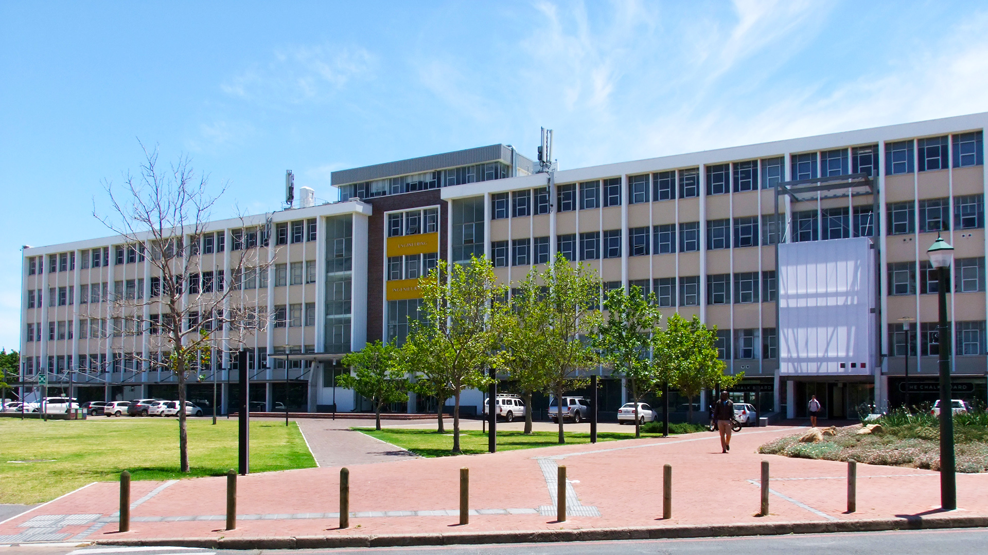
PRESENTATION TITLE
Photo by Stefan Els
Notes:
Cover & End Slide Option
Replace the background image: Right-click on the slide, then choose Format Background and select Picture or texture fill. Select a new picture of your choice.
Remember to add an image attribution for e.g., Photo by Stefan Els.

Slide 2
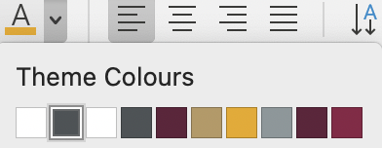
FONT SPECIFICATIONS
HEADINGS |  | Should appear in UPPERCASE | Left aligned Font: Trebuchet MS Bold 32-point Colour: Maroon | RGB: R = 97, G = 34, B = 59 | HEX: 61223b
Sub-headings |  | Should appear in sentence case | Left aligned Font: Trebuchet MS Regular 28-point Colour: Gold | RGB: R = 183, G = 153, B = 97 | HEX: b79962
Body text |  | Should appear in sentence case | Left aligned Font: Calibri Light 24-point (or smaller) Colour: Steel Grey | RGB: R = 77, G = 83, B = 86 | HEX: 4d5356
Emphasis |  | Should appear in sentence case Font: Calibri Bold (may be bigger than the rest of the body text) Choose an emphasis colour from the pre-populated Theme Colours
1
2

Slide 3

COLOUR RATIO
Colour ratio distribution on slides |  | Maroon 70% Gold 10% Faculty colour 30%
Engineering
RGB: R = 235, G = 169, B = 0
HEX: EBA900

