Slide 1
ICN Programming Course
An introduction to Python
Andrea Castegnaro
uceeaca@ucl.ac.uk

Slide 2
Who is this course for?
Absolute beginners from psychology/neuroscience - no prior coding experience assumed
What will you gain?
Comfort running Python, understanding core concepts of Object-Oriented Programming (OOP) - data types, flow control, functions, classes, files. An introduction to Git. Jupyter notebooks, pandas, basic statistics, building our own cognitive experiments using PsychoPy package.
How each lesson runs
1. short concept overview → 2. coding examples → 3. practical examples

Slide 3
Roadmap
Term 1, Lessons 1–5
Setup, variables & built-in types, lists and numpy arrays
Git intro, mathematical functions, random numbers
Control flow, dictionaries, user input
Basics of object oriented programming, functions and classes
Handling files, exceptions
Term 2, Lessons 6–10
Using pandas, exploratory analysis
Basic statistics
Plotting (using matplotlib/seaborn)
Using PyschoPy for builing experiments (1/2)
Using PsychoPy for building experiments (2/2)

Slide 4
What is Python?
Python is an interpreted language (as opposed to compiled like C/C++)
Invented in 1991 with the following philosophy in mind:
  Emphasizes code readability
  Uses significant whitespace.
  Allows expression of concepts in fewer lines of code
  Dynamic typing
It has a versatile use – ranging from web development, data analysis, ai, devops, etc
Reasons for popularity:
Large community – vast collection of modules, created by the community
Open source – freely available, redistributable and modifiable

Slide 5
Installation (Windows)
Download Python:
  Visit the official Python website: https://www.python.org/
  Click on "Download Python 3.x.x" (for compatibility with the rest of the course use 3.10.X).
Run the Installer:
  Locate the downloaded file (usually in the 'Downloads' folder).
  Double-click the installer.
Installation Setup:
  Ensure to check the box "Add Python to PATH" at the bottom of the installer window.
  This will ensure that Python will be added to your environmental variables, so you can call it anywhere
After installation, open Command Prompt (Win Key + “cmd”)
  Type “python --version” and press Enter.
  If installed correctly, you should see the Python version displayed.#
Troubleshooting:
  If you encounter issues, revisit the installer and ensure "Add Python to PATH" was selected.

Slide 6
Installation (Linux)
Open Terminal:
  Access it through Linux desktop interface, depending on distribution you could try “ctrl+alt+t”
Update the package list as the “super user”:
  Run “sudo apt-get update”
Install Python:
  Run “sudo apt-get install python3”
  This will install the that Python will be added to your environmental variables, so you can call it anywhere
After installation, in the same terminal window
  Type “python --version” and press Enter.
  If installed correctly, you should see the Python version displayed.
Additional tools:
  You may want to install also pip (Python installation package) using “sudo apt-get install python3-pip”

Slide 7
Installation (MacOS)
Download Python:
  Visit the official Python website: https://www.python.org/
  Click on "Download Python 3.x.x" (for compatibility with the rest of the course use 3.10.X).
Run the Installer:
  Locate the downloaded file in “Finder”
  Double-click the installer.
Installation Setup:
  Might need to enter your credentials to complete the installation
After installation, open Terminal (Applications->Utilities)
  Type “python --version” and press Enter.
  If installed correctly, you should see the Python version displayed.#
Troubleshooting:
  If you encounter issues, revisit the installer and ensure "Add Python to PATH" was selected.

Slide 8





Setting up your development environment
Integrated Development Environments (IDEs) suitable for programming in Python
Pycharm
  offers a rich set of features tailored specifically for Python
  Key features: code completion, on-the-fly error checking, automated refactoring
Visual Studio Code (VS Code):
  Free and open-source editor by Microsoft
  Key features: customizable, multitude of programming languages, integrated Git control, debugging supported, vast market-place
  Supports Github co-pilot which is free for students
Cursor (VS Code wrapper):
  the first AI powered IDE (wrapped around VS code)
Jupyter notebook or Google Colab
  Made for data science, allow you to create and share documents containing live code, visualizations and narrative tex

Slide 9
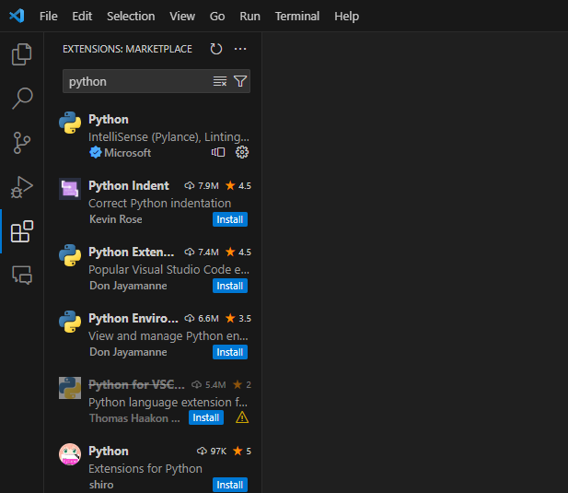
Visual Studio IDE
For installation go top https://code.visualstudio.com/
Open VSCode and click on extensions to check (feel free to check extensions that can be useful for you)
Make sure to install the following extensions: Python, Jupiter, CoPilot and CoPilot Chat. (Search for those using the text bar)

Slide 10
Installing packages
To install packages/modules you need to use pip (python installation package) which comes usually with the python installation
In any terminal:
pip --version
pip install package_name
pip show package_name
pip uninstall package_name
Tip: Requirements File
You can create a requirements.txt file containing a list of all packages.
To generate: pip freeze > requirements.txt
To install from the file: pip install -r requirements.txt
Packages that are commonly used are numpy, scipy, matplotlib

Slide 11
Installing packages – better!
Given the amount of packages/modules that exists for Python, one common problem is dependencies.
To constrain dependency problems you can install packages in a virtual environment instead. You can do so using the Python package called Pipenv.
In any terminal install the package (skip if already installed):
pip install pipenv
Create the virtual environment in your project directory using
pipenv shell
Install packages within the virtual environment
pipenv install package_name
The procedure will create a file called “Pipfile.lock” that will contain all of the packages installed in the virtual environment
To remove:
pipenv --rm
To recreate a virtual environment from an existing project
pipenv install

Slide 12
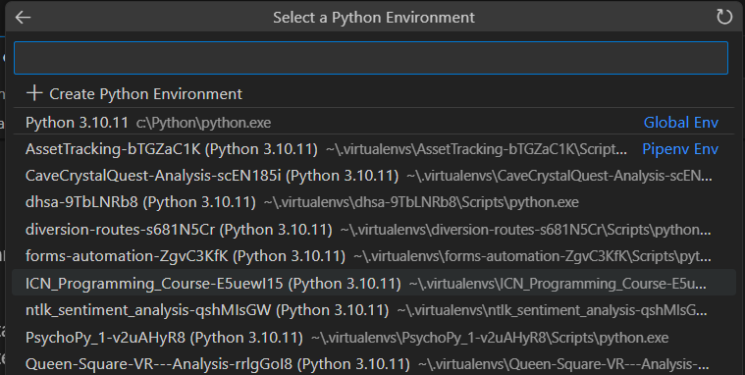
Installing packages – better!
If you are using a virtual environment make sure to enable the correct interpreter in your IDE or eventually your Jupyter Notebooks.
In Visual Studio Code it s in the bottom right of the VS code ide or on the top left if you have a Jupyter Notebook opened.

Slide 13
Exploring Jupyter Notebook
Open-source web application that allows you to create and share documents containing live code, equations, visualizations and text ( https://jupyter.org/ )
Ideal for data cleaning, transformation, numerical simulations, data visualization and data analysis
Key features:
Interactive coding: the code is executed in real time and you can executed it in blocks
Data visualization: inline visualization supporting packages like matplotlib, seaborn
Support LaTeX: to write mathematical equations ( https://www.latex-project.org/ )
Support Markdown: to help with documentation and commenting your code ( https://www.markdownguide.org/ )

Slide 14
Key Considerations in Python Coding
Indentation:
  Crucial for code blocks: there are no braces in Python
  Consistency: do not mix tabs and spaces to avoid errors
Dynamic Typing:
  Variable Types: Python is dynamically typed, meaning variables can be reassigned to different data types.
  Type Checking: Be mindful of variable types during operations to avoid type-related errors.
Naming Conventions:
  Descriptive Names: Use clear and descriptive variable and function names.
  Case Sensitivity: Python is case-sensitive, so ‘Variable’ and ‘variable’ are different
  Stick to snake_case for functions and variables and PascalCase for class names
Importing Packages/Modules:
  Use as Needed: Import only necessary modules to keep the code efficient.
  Avoid Wildcard Imports: Using ‘from module import *’ can lead to unexpected behaviors and conflicts.

Slide 15

Resources
Resources have been linked in the moodle main page
For debugging:
ChatGPT (https://chat.openai.com/)
GitHub Copilot (Visual Studio / Visual Studio Code) – free for students
Stack overflow: https://stackoverflow.com/ (Tip: use square-brackets for specific tags)

Slide 16
Moving on from the slides…
  On the moodle page you will find a link the Jupyter notebook.
  You can also access the most up-to-date version on GitHub (make sure to check the correct week):
  https://github.com/Lenakeiz/ICN_Programming_Course

