Slide 1
Psychophysics Toolbox (PTB) A Gentle Introduction (Part Two)
How to design psychological experiments using MATLAB
Andrea Castegnaro
uceeaca@ucl.ac.uk
Course material: https://moodle.ucl.ac.uk/course/view.php?id=35720

Slide 2

PTB Resources
Main webpage: http://psychtoolbox.org/
Main documentation: http://psychtoolbox.org/docs/PsychBasic
Tutorials: https://peterscarfe.com/ptbtutorials.html
Community forum: https://psychtoolbox.discourse.group/
Stack overflow: https://stackoverflow.com/
(Tip: use square-brackets for specific tags)
ChatGPT(https://chat.openai.com/chat)

Slide 3

Timing – example 1
We are often dealing with timings in experiments
After showing a stimuli we can use event.waitKeys to wait for user presses within an allowed time.
This function is highly performant in Python as PsychoPy innerly uses clock libraries that can read directly from the clock CPU
keys = event.waitKeys(
maxWait=trial_duration,
timeStamped=True
)
if keys:
resp_t = keys[0][1]
key_name = keys[0][0] react_time = resp_t - start_t
timeStamped will ensure that each time a keyboard has been pressed also the time stamp associated with that press will be registered.
The return will be a list of tuple each tuple containing a string (keyname) and a float (timestamp).
The timestamp is in seconds (float) relative to the start of the experiment, using the same clock as core.getTime()

Slide 4
Timing – example 2
Sometimes, you don t want to stop the execution of your program (e.g. check for participants responses while updating information on the screen, check both keyboard and other peripherical, record multiple keypress for a single stimuli).
You can manually calculate timings and check peripherals within a loop.
while (curr_t - start_t < trial_duration):
keys = event.getKeys(timeStamped=True)
if keys and not read_response:
resp_key = keys[0][0]
react_time = keys[0][1] - start_t
read_response = True
curr_t = core.getTime()

Slide 5
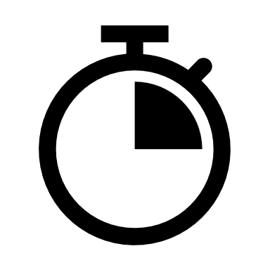
Timing – example 3
Similar to querying from the user, timings is critical also when presenting passive stimuli to the user.
To get precise the time at which the flip occurred as the return function from flip().
If you want to calculate the exact duration for a stimulus you can combine this information with timings from the core library class
rect.draw()
stimulus_onset = win.flip()
core.wait(required_seconds)
stimulus_offset = core.getTime()
actual_duration = stimulus_offset - stimulus_onset

Slide 6

Cursor – example 4/5
For working with the pointer, you need the mouse class from hardware library
mouse_obj = mouse.Mouse(visible=True, win=win)
A mouse instance can be made visible/invisible using
mouse_obj.setVisible(False)
You can set the position of the mouse
mouse_x = - 150
mouse_y = - 150
mouse_obj.setPos((mouse_x, mouse_y))
Or query the current status by doing of the mouse including buttons
mouse_pos = mouse_obj.getPos()
isLeftPressed = mouse_obj.leftButtonPressed

Slide 7

Audio – example 6
For playing audios, PsychoPy has a sound class that works using different backends. There are also various libraries external to PsychoPy that manages audio with low latency
pipenv install sounddevice
Once you have your sound library of choice you can either play a tone, or play simple audio from a file
t = np.linspace(0,
duration,
int(sample_rate * duration))
tone = amplitude * np.sin(2 * np.pi * frequency * t)
sd.play(tone, sample_rate)
sd.wait()
import soundfile as sf
data, sample_rate = sf.read(file_path)
sd.play(data, sample_rate)
sd.wait()

Slide 8
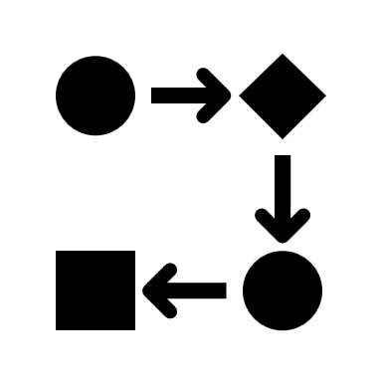
Structuring your code
Initialize expt. variables
Initialize PTB + ext. devices
Open PTB
Run experiment
load premade stimulus files
create new stimuli
trial loop:
- present stimuli
- get responses
save final data & close files
Close PTB

Slide 9
Preparing experimental variables
Initialize expt. variables
Make brief comments (# for line comments or ‘’’ for block comments). Design your code by writing bullet points first
Initialize empty variables and structures that you are going to use later on in the script so that you avoid hard coded values e.g.:
exp_info['trial_duration'] = 2
exp_info['fix_cross_dim_pix'] = 50
exp_info['fix_line_width_pix'] = 10
exp_info['fix_cross_duration'] = 1
etc.
Optionally: create empty variables or zero variables to store the data you would like to collect later as a results of your experiment
Initialize PTB + ext. devices
Open PTB
Run experiment
load premade stimulus files
create new stimuli
trial loop:
- present stimuli
- get responses
save final data & close files
Close PTB

Slide 10
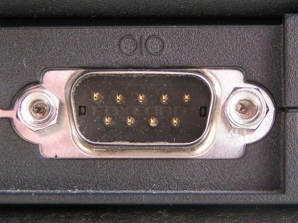
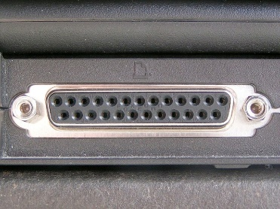
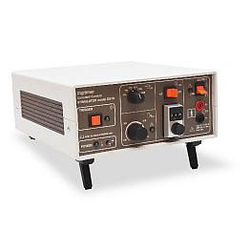
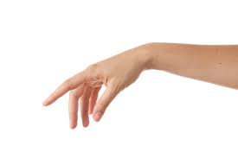

External devices
Initialize expt. variables
Sometimes your experiment will need to deal with additional triggers:
Receiving triggers from an eye tracker, MRI scanner etc.
Sending triggers to EEG system, electric shock box etc.
Vendors usually have their own libraries for handling communication to specific devices
Otherwise, you can try to open a serial communication with the device.
ser = serial.Serial(
port=port,
baudrate=baudrate,
timeout=0.1)
message = "Hello\n"
ser.write(message.encode('utf-8'))
if ser.in_waiting:
response = ser.readline().decode('utf-8').strip()
Initialize PTB + ext. devices
Open PTB
Run experiment
load premade stimulus files
create new stimuli
trial loop:
- present stimuli
- get responses
save final data & close files
Close PTB

Slide 11
PTB window
Initialize expt. variables
Initialize PTB + ext. devices
A recap on how to handle the PTB window:
win = visual.Window(
fullscr=True,
monitor="testMonitor",
units="pix",
color=[0, 0, 0], # Black background
colorSpace='rgb255'
)
win.close()
Open PTB
Run experiment
load premade stimulus files
create new stimuli
trial loop:
- present stimuli
- get responses
save final data & close files
Close PTB

Slide 12
Preparing stimuli
Initialize expt. variables
Initialize PTB + ext. devices
Sometimes you may wish to load stimuli before starting the trial loop - for example, if you have a large number of images and loading them on a trial by trial basis might affect your experimental timings
That means loading stimuli (images, audio) into variables might save CPU time (e.g. textures for the images)
In some case your experiment will require the creation of new stimuli. You should also do this before the trial loop begins and save them to your workspace, to be accessed later on during the trial loop (e.g. tones, made-up images
Open PTB
Run experiment
load premade stimulus files
create new stimuli
trial loop:
- present stimuli
- get responses
save final data & close files
Close PTB

Slide 13

Trial loop – example 7
Initialize expt. variables
Creating a trial structure means identifying what a single trial will entail
Each single part of the trial can eventually be a separate function or script (e.g. a function ‘doFixationCross()’). This helps your code to be transparent and supports debugging.
Next, we need to identify what will change between trials (e.g. the image being presented ).
If we have defined our stimuli at the beginning of the script then we can loop through the images. However, it may be important to randomise the order of stimuli:
Initialize PTB + ext. devices
Open PTB
Run experiment
load premade stimulus files
create new stimuli
trial loop:
- present stimuli
- get responses
save final data & close files
Close PTB

Slide 14
Saving variables
Initialize expt. variables
We also need to log information about each trial (e.g. stimulus type, position) and the participants responses (e.g. reaction time and accuracy), for example:
trial_data['key_press'] = key_name
trial_data['rt'] = press_time - start_time
trial_data['correct'] = int(key_name == trial_data['key’])
…
results.append(trial_data)
Data has to be saved into your project folder to be accessed for later analysis. It is good practice to save the data on every trial, in case of any issue during later trials:
df = pd.DataFrame(results)
df.to_csv(f'./Results/participant_{participant_id}.csv', index=False)
Initialize PTB + ext. devices
Open PTB
Run experiment
load premade stimulus files
create new stimuli
trial loop:
- present stimuli
- get responses
save final data & close files
Close PTB

Slide 15

Input dialog – example 8
Sometimes we wish to collect information from the participants or would like to set some experimental variables outside of the task code. You can quickly do this by using the PsychoPy gui library with the use of Dlg() class
from psychopy import gui
dlg = gui.Dlg(title="Participant Info")
dlg.addField("Enter participant ID:", "1")
ok_data = dlg.show()
All the information will be returned into the variable returned by the show function. Each info will be indexed according to the order in which you will add the fields to the dialog. Keep in mind that the return array will be always a string array, so casting to desired variable type might be necessary.

Slide 16
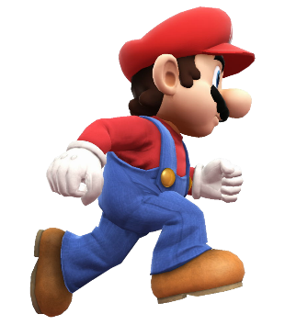
That’s it…
Any questions or clarifications?
On the course webpage (https://moodle.ucl.ac.uk/course/view.php?id=35720) there is a practical exercise, for you to build a full “game” over the course of these two lectures using PTB
A description of the second part of the exercise can be found in the PracticalExercise8 document
There is also a proposed solution on the course webpage
Please don’t hesitate to contact me if you want to ask any questions

