Slide 1
Python's PsychoPy A Gentle Introduction (Part One)
How to design psychological experiments using Using Python and PsychoPy.
Andrea Castegnaro
uceeaca@ucl.ac.uk

Slide 2
Motivation
Experiment design
Necessary for having an accurate and flexible control over stimulus presentation (e.g. visuals and auditory)
Robust timing for stimulus presentation and response collection
examples: visual detection task, auditory pitch discrimination
Low-level programming often involves C++ for peripherals (e.g., keyboard, sound) or OpenGL for graphics (shapes, images, video)
PsychoPy (Python based) is a mid-level layer providing an application programming interface (API) to perform low-level operations in friendly way
https://www.psychopy.org/
Alternatives: E-prime (paid), Gorilla (paid,online), PsychToolbox (Matlab)

Slide 3

Resources
Main webpage: https://www.psychopy.org
Main documentation: https://www.psychopy.org/documentation.html
Community forum: https://discourse.psychopy.org/
List of resources: https://psychopy.org/teaching/index.html
For debugging:
ChatGPT (https://chat.openai.com/)
GitHub Copilot (Visual Studio / Visual Studio Code) – free for students
Stack overflow: https://stackoverflow.com/ (Tip: use square-brackets for specific tags)

Slide 4

Installation
Follow guide at: https://www.psychopy.org/download.html
Install Python
Use a virtual environment manager (such as pipenv)
PS C:\Projects\ProjectFolder\> pip install python
PS C:\Projects\ProjectFolder\> pipenv install python
Ensure external dependencies are installed (e.g. OpenGL for managing the graphics on your system).

Slide 5

Useful tips (1)
PsychoPy windows do not automatically close when errors are encountered in your scripts. That means you may need to force close the PsychoPy window.
Windows: ctrl+alt+del → terminate window / alt+tab to go back to Visual Studio Code; ctrl+c in a terminal window to terminate the execution of the program
To check description of any API look at the documentation
https://www.psychopy.org/api/
Run in a jupyter notebook the help function:
from psychopy import visual
help(visual.Window)
visual.Window? #concise help

Slide 6
Useful tips (2)
The try / catch statement can ensure a smooth closure of the application in case of errors
try:
# Your PsychoPy experiment code here
win = visual.Window(size=(800, 600))
# Display something or run experiment
except Exception as e:
print(f"Error occurred: {e}")
finally:
win.close() # Ensure the window is closed

Slide 7

The ‘Window’ class
Contains all of the functions that will help you to manage your experimental window and will manage the execution of the elements we have prepared to draw on the screen.
Every time we “draw” in PsychoPy we interact with the back-buffer (imagine it as a virtual copy of your window).
Each time we want to display what we are drawing in the back-buffer to the PsychoPy window we have to perform a specific operation called flip.
This function will move the objects on the back-buffer to the front-buffer and at the same time to clear the back-buffer, enabling us to prepare the next screen.
Back-buffer
Front-buffer (screen)
win.flip()

Slide 8
The ‘Window’ class
Flipping aligns with the monitor's refresh rate (Hz), which defines how often the display updates per second.
PsychoPy syncs the operation to occur between refresh cycles, ensuring smooth transitions.
Legacy sync tests are included but less critical with modern monitors.
Failure in flipping can cause partial image display, disrupting experiments.
Back-buffer
Refresh Time 1
Front buffer (screen)
Refresh Time 2 > RefreshTime1
Front buffer (screen)
win.flip()

Slide 9
The visual library
When drawing any object (shapes/images/text) we go always from the background to the foreground
Step One
–
drawing a background
Step Two
–
drawing the circle
Step three
–
drawing the triangle
Back-buffer
Back-buffer
Back-buffer

Slide 10
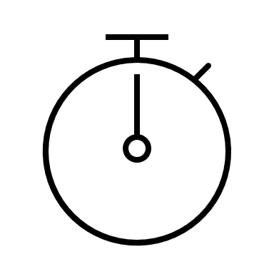
Basic timing
To display an object for a set time, halt script execution using functions from the core library
core.wait(seconds_to_display)
Alternatively, to ‘read’ the time at any specific point during script execution — useful for calculating durations —
# Get start time
start_time = core.getTime()
# Wait for 2 seconds
wait_time = 2.0 # seconds
core.wait(wait_time)
# Get end time and calculate actual duration
end_time = core.getTime()
real_time_seconds = end_time - start_time

Slide 11

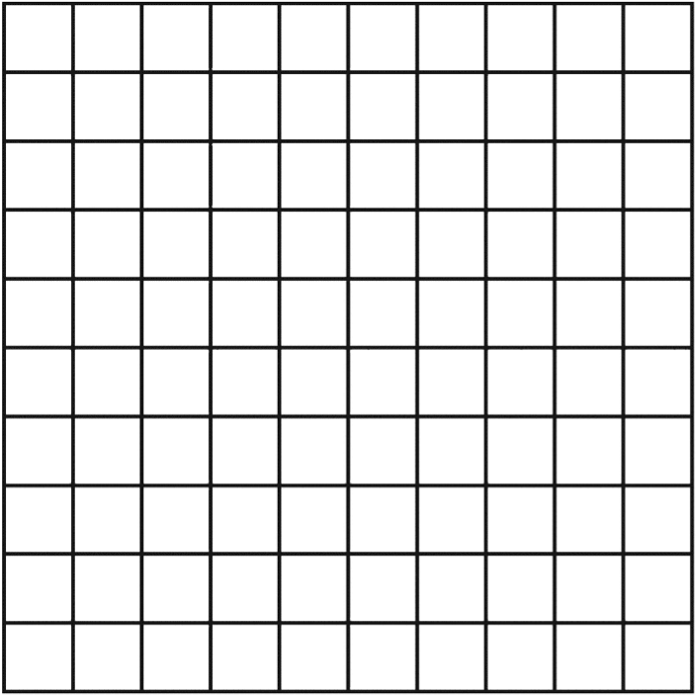
Opening a window - examples 1/2
win = visual.Window(
size=(8, 8),
pos=(2, 2),
color=(0, 0, 0),
colorSpace='rgb255',
units="pix",
checkTiming = False,
screen=0
)
Background color as an RGB value. RGB is a triplet of number indicating the magnitude of each channel of the overall color. Colors are defined using different ranges depending on the color space.
Screen identify the monitor attached to your setup indexed from 0
Units specify what dimension we providing for initializing the window, can be ‘norm’, ‘cm’, ‘pix’
After you have instantiated the Window class you can change the property using its handle (win)
(0,0)
window

Slide 12

Drawing shapes – examples 3/4
line = visual.Line( win=win,
start=(-3, 3),
end=(-3, -3),
lineWidth=30,
lineColor=[1, 0, 1],
colorSpace='rgb’,
units=‘pix’
)
When drawing shapes you need to specify the windows where you are going to draw
Within PsycoPy windows the origin of the coordinate system is the center
The start and the end positions are relative to the PsycoPy window dimension only
(0,0)

Slide 13
Drawing shapes – examples 5/6
rect = visual.Rect(
win=win,
width=6,
height=4,
pos=(-3, -3),
fillColor=[1, 1, 0],
units='pix'
)
Within PsycoPy windows the origin of the coordinate system is the center
The start and the end positions are relative to the PsycoPy window dimension only

Slide 14


Drawing images – examples 7/8
image = visual.ImageStim(
win=win,
image=‘path/to/imagefile.extension’,
units='pix’,
pos=(0, 0),
size=None,
)
Using size you can resize dimension

Slide 15
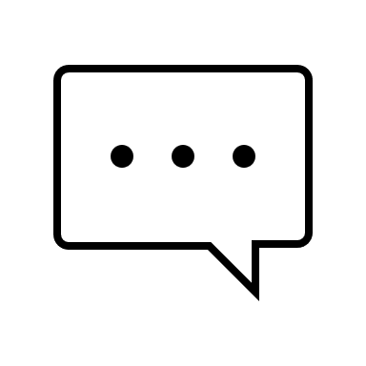
Drawing text – example 9
text = visual.TextStim(
win=win,
text='write text here’,
font='Courier New’,
pos=(0, 0),
color=[-1, -1, -1],
height=30,
wrapWidth=200,
anchorHoriz='center’,
anchorVert='center’,
units='pix'
)
Tex class enables you to do formatting on the text you want to draw (font, font size, italic, bold)
Anchor properties can be used to adjust the position of the text within the bounding box (which is the rectangle that inscribe the circumscribes the text).
wrapWidth can be used to control after how many units the text goes on a new line

Slide 16

Reading keyboard – example 10/11
keys = event.waitKeys(
keyList=[‘w',‘a’,‘s’,‘d’],
clearEvents = True
)
waitKeys()
Waits for at least one keypress before returning
Blocking function
clearEvents – if not set to true it will keep previous keyboard hits in memory before subsequent waitKeys call.
getKeys()
Returns immediately
Non-blocking function
Returns a list of keys pressed since last call
You can use a keyList to restrict the input to a desired list
keys = event.getKeys(
keyList=[‘w',‘a’,‘s’,‘d’]
)

Slide 17
That’s it for now…
Any questions or clarifications?
On the course webpage there is a practical exercise, for you to build a full experience over the course of these two lectures using PsychoPy
A description of the exercise can be found in the PracticalExercise_PsycoPyOne document
…
Please don’t hesitate to contact me for any questions

