Slide 1
Psychophysics Toolbox (PTB) A Gentle Introduction (Part Two)
How to design psychological experiments using MATLAB
Andrea Castegnaro
uceeaca@ucl.ac.uk
25 January 2022
Course material: https://moodle.ucl.ac.uk/course/view.php?id=22765

Slide 2

PTB Resources
Main webpage: http://psychtoolbox.org/
Main documentation: http://psychtoolbox.org/docs/PsychBasic
Tutorials: https://peterscarfe.com/ptbtutorials.html
Community forum: https://psychtoolbox.discourse.group/
Stack overflow: https://stackoverflow.com/
(Tip: use square-brackets for specific tags)

Slide 3

Reading keyboard
Sometimes you want to query the number of USB-devices there are in your setup. PTB handles USB devices on initialization, meaning that to query the devices status you can do
[keyboardIndices, productNames, allInfos] = GetKeyboardIndices
Returning an array of numbers indicating the indices of the external keyboards detected.
Default keyboard has index 0. Using indices can instruct PTB to query that specific device.
KbWait(1);
KbCheck(1);
If you want to check all the devices PTB recognizes you can run
devices=PsychHID('Devices')

Slide 4
Reading keyboard – example 1/2
Sometimes we are required to collect keyboard input with precise timings
[respT, keyCode, ~] = KbWait(keyboardIndex, keyOperation, untilTime);
The real clock time in seconds
real time in seconds when you want to stop checking for an input
reskeyCode is a 256 elements number array. Each position indicates the number with a 0 or 1 the index of the key for which a status change is being detected
keyboard index we are going to query
A number indicating what key events to wait for:
0 is press, 1 is release, 2 is all key released then press, 3 is all key released, press and release
KbWait polls the keyboard status every 5ms. This operation might not be enough for some particular cases in which timing is essential. An alternative solution could be using kbCheck in a for..loop statement to continuously.
while(currTime - startTime < trialDuration)
[keyIsDown, currSecs, keyCode, ~] = KbCheck;
end

Slide 5

Timing – example 3
There are extra options to be taken when execution timing is really important when designing your experiment. You can set the PTB to get more resources from your operating system preventing other applications or background processes interfering with your execution processes
topPriorityLevel = MaxPriority(PTBwindow);
Priority(topPriorityLevel);
The most accurate way for displaying stimuli with a specific duration can be achieved by calculating when the nearest flip to your desired duration should happen
screenRefreshRate = Screen('GetFlipInterval’, PTBwindow);
Return the refresh rate of the monitor where the PTB window has been opened
totalWaitFrames = round(requiredSeconds / screenRefreshRate);
When calling Screen Flip we can then specify when we want the flip to happen
currentTime = Screen('Flip', window, currentTime + (totalWaitFrames - 0.5) * screenRefreshRate)

Slide 6

Cursor – example 4
Depending on your kind of experiment you may want to hide/show the mouse when necessary
HideCursor
ShowCursor
You can also explicity set the position of the mouse by using
SetMouse(mouseX, mouseY, PTBwindow);
Where mouseX and mouseY are the pixel coordinates in the PTB window reference where we want to set our mouse position
In some cases you would like to restrain the mouse within the PTB window or a portion of it
Screen('ConstrainCursor’, PTBwindow, 1, restrainRect);
the pointer to the PTB window where we want to draw our line
restrainRect is a rectangle indicating the portion of the PTB window where to resrtain the mouse. Default is empty [] indicating the full size of the window
1 indicates restrain, 0 unrestrained

Slide 7
Cursor – example 5
Sometimes you would like to query the status of the mouse
[x, y, buttons, focus] = GetMouse(PTBwindow);
x and y pixels PTB window coordinate of the mouse location at the time when function returns
the pointer to the PTB window where we want to check if the system has focus or not
Logical array indicating the status of all of the mouse buttons indicating whether a button is being pressed (1) or not (0)
Logical indicating whether the PTB window is being focused (1) or not (0)

Slide 8

Audio – example 6
Using audio in your experiments require communicating with your systems audio drivers. PTB handles the audio with a specific function
PsychPortAudio
Initialization where audio drivers are loaded into PTB is performed automatically using
InitializePsychSound;
Before loading audio files in PTB we need to load them in the Matlab workspace
[sWave, freq] = psychwavread('./Assets/pos_feedback.wav');
Returns the wave information of the audio as a matrix where each column represent an audio channel and a number indicating the sampling frequency for that audio. If the audio is mono, as most of the experimental setup have two speakers we can simulate a stereo sound by duplicating the sound wave
nrChannels = size(sWave,1);
if(nrChannels < 2)
sWave = [sWave;sWave];
nrChannels = 2;
end

Slide 9
Audio – example 6
Once PTB has loaded the audio driver we can open an audio device to prepare for communicating with it. This function may be called only once during your script.
audioHandle = PsychPortAudio('Open’,audioDevice,playType,latency,frequency,nrChannels);
Number of audio channels to use. Default is 2 (stereo mode)
Returns a pointer to the audio device we just opened we are going to use for playing any audio
Select the audio device you want to interact with
1 for playback, 2 for capturing audio
Select how to deal with latency. 0 means don’t care about timing precision, 1 lowest latency, 2 take full control of the audio device (preventing other app to use it)
Requested rate in samples per seconds (Hz) for the playback, capture
Once the audio device has been opened we can finally load the audio into an holder PTB recognizes. The holder is an audio buffer
PsychPortAudio('FillBuffer',audioHandle,audioWave);
With the audio on the buffer we can finally
PsychPortAudio('Start',audioHandle);
PsychPortAudio(‘Stop',audioHandle);
To close the audio handler
PsychPortAudio('Close',audioHandle);

Slide 10
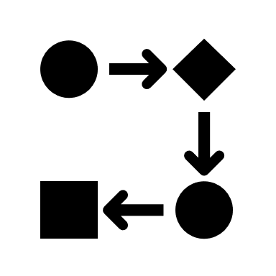
Structuring your code
Initialize expt. variables
PTB initialization + ext. devices
PTB opening
Run experiment
load premade stimulus files
create new stimuli
trial loop:
- present stimuli
- get responses
save final data & close files
PTB closing

Slide 11
Preparing experimental variables
Initialize expt. variables
Make a brief comment (% for comments). Sometimes also a bullet points for your design flow can be useful
Set the path to folders you are going to use in your experiment
Creating empty variables and structures that you are going to call later on in the script so that you avoid hard coded values e.g.
expInfo.numtrials = 50
expInfo.times.stimDuration = 5;
expInfo.times.fixationDuration = 3;
expInfo.times.blankDuration = 2;
expInfo .stim.images = {‘image1.png’, ‘image2.png’};
etc.
Optionally: create empty variables or zero variables to store the data you would like to collect later
PTB initialization + ext. devices
PTB opening
Run experiment
load premade stimulus files
create new stimuli
trial loop:
- present stimuli
- get responses
save final data & close files
PTB closing

Slide 12
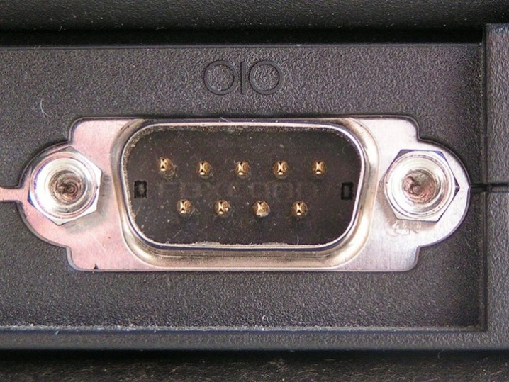
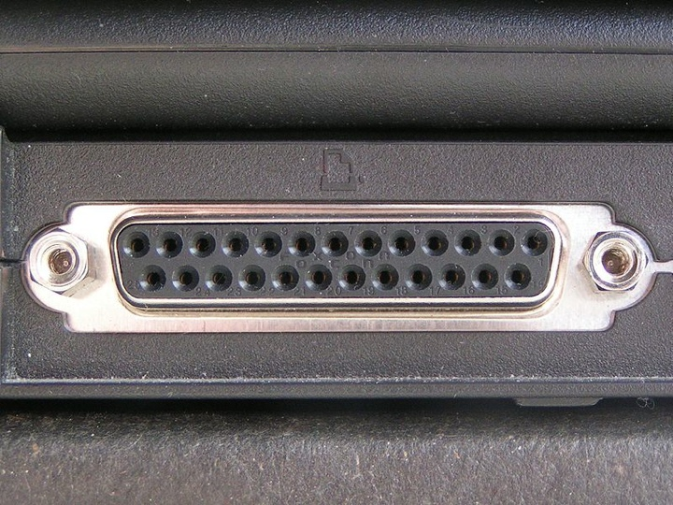
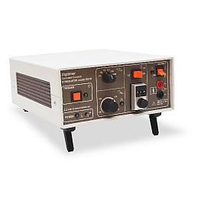
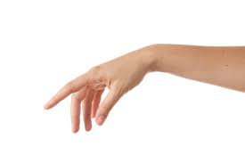

External devices
Initialize expt. variables
help PsychDefaultSetup
Sometimes your experiment will require to deal with addition triggers.
Receive triggers from eyetracker, MRI scanner, etc
Sending triggers to EEG, Electric Shock Box
You can do this by opening a communication with the external devices via serial or parallel port
The PTB function IOPort can be used to handle the communication
[handle, errmsg] = IOPort('OpenSerialPort’, portName);
[writtenBytes, tStampWrite] = IOPort('Write', handle, byteArray);
[dataRead, tStampRead, errmsgRead] = IOPort('Read', handle);
IOPort('CloseAll');
PTB initialization + ext. devices
PTB opening
Run experiment
load premade stimulus files
create new stimuli
trial loop:
- present stimuli
- get responses
save final data & close files
PTB closing

Slide 13
PTB window
Initialize expt. variables
A recap on how to handle the PTB window
[window, windowRect] = PsychImaging('OpenWindow', screenNumber, [R G B]);
sca; % equivalent to Screen('CloseAll')
PTB initialization + ext. devices
PTB opening
Run experiment
load premade stimulus files
create new stimuli
trial loop:
- present stimuli
- get responses
save final data & close files
PTB closing

Slide 14
Preparing stimuli – example 7
Initialize expt. variables
Sometimes you may want to load the stimuli before starting the trial loop. This is for example if you have a large number of images and you would not like loading them affecting your experimental timings
That means loading the stimuli (images, audios) on the workspace, in some cases preparing the relative holders for PTB to use those stimuli (e.g. textures for the images)
In some case your experiment will require to create new stimuli. You should do this at this stage and save them to your workspace for being accessed later on during the trial loop.
PTB initialization + ext. devices
PTB opening
Run experiment
load premade stimulus files
create new stimuli
trial loop:
- present stimuli
- get responses
save final data & close files
PTB closing

Slide 15

Trial loop – example 8
Initialize expt. variables
Creating a trial structure means identifying what a single trial will be.
Each of the single part of the trial can eventually be a separate function or script (e.g. a function ‘doFixationCross()’). This helps code readability and helps in debugging simple problems when writing the code.
After that we want to identify what is going to change between trials (e.g. changing the image).
If we have defined our stimuli at the beginning of the script then we can loop through the images. It s important at this point however to randomise the way we access our stimuli.
trialStructure = repmat(1:size(expInfo.images,2),1,expInfo.nPresentations);
trialStructure = Shuffle(trialStructure);
for nTrial = 1:size(trialStructure,2)
% present single trial
end
PTB initialization + ext. devices
PTB opening
Run experiment
load premade stimulus files
create new stimuli
trial loop:
- present stimuli
- get responses
save final data & close files
PTB closing

Slide 16
Saving variables
Initialize expt. variables
We need to log information about each trial (e.g. stimulus type, position) and we need log the participants responses (e.g. reaction time and accuracy).
A structure example could be
results.image(nTrial) = expInfo.image{trialStructure(nTrial)}; results.response(nTrial) = KbName(keycode);
results.rt(nTrial) = responseTime;
Data has to be saved permanently on your project folder so to accessed later on for analysis. It is a good practice to save the data every single trial, so in case of setup faults we have the data saved partially
save(filename)%Save entire workspace to a .mat file
save(filename, variables)%Save specific variables
save(filename,'-struct','structName')%Save a specific struct but as independent variables
save(filename,variables,’-append’)%Add variables to existing file
PTB initialization + ext. devices
PTB opening
Run experiment
load premade stimulus files
create new stimuli
trial loop:
- present stimuli
- get responses
save final data & close files
PTB closing

Slide 17

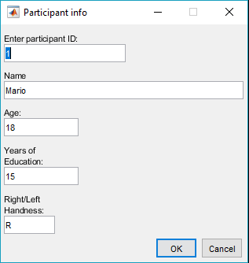
Input dialog – example 9
Sometimes we are required to collect information about the participants or we would like to set some experimental variables without going to change the script code. We can do that using a Matlab function to create an input dialog.
pInfo = inputdlg(prompts,dlgtitle,dims,definput);
A cell array indicating the default inputs for each prompt
Cell array containing the information collected from the dialog box upon closing
Opens dialog box, with fields specified by a cell array of prompt strings
A title for our input dialog
Nx2 array indicating the width and height dimensions of each prompt. N is the number of different prompts we are collecting

Slide 18

That’s it…
Any questions or clarifications?
On the course webpage (https://moodle.ucl.ac.uk/course/view.php?id=22765) there is a practical exercise, for you to build a full “game” over the course of these two lectures using PTB
A description of the second part of the exercise can be found in the PracticalExercise7 document
There is also a proposed solution on the course webpage
Please don’t hesitate to contact me if you want to ask any questions

