Slide 1
Psychophysics Toolbox (PTB) A Gentle Introduction (Part Two)
How to design psychological experiments using MATLAB
Andrea Castegnaro
uceeaca@ucl.ac.uk
1 February 2022
Course material: https://moodle.ucl.ac.uk/course/view.php?id=22765

Slide 2

PTB Resources
Main webpage: http://psychtoolbox.org/
Main documentation: http://psychtoolbox.org/docs/PsychBasic
Tutorials: https://peterscarfe.com/ptbtutorials.html
Community forum: https://psychtoolbox.discourse.group/
Stack overflow: https://stackoverflow.com/
(Tip: use square-brackets for specific tags)

Slide 3

Reading keyboard
Sometimes you will want to query the number of USB-devices that are connected to your machine
PTB handles USB devices on initialization, meaning that to query the status of those devices you enter:
[keyboardIndices, productNames, allInfos] = GetKeyboardIndices
This returns an array of numbers indicating the indices of all detected external keyboards
The default keyboard has index 0. Using indices can instruct PTB to query that specific device:
KbWait(1);
KbCheck(1);
If you want to check all the devices that PTB recognizes you can enter:
devices=PsychHID('Devices')

Slide 4
Reading the keyboard – example 1/2
Sometimes we are required to collect keyboard input with precise timings
[respT, keyCode, ~] = KbWait(keyboardIndex, keyOperation, untilTime);
The real clock time in seconds
The real clock time in seconds when you want to stop checking for an input
reskeyCode is a 256 element numerical array. Each position indicates, with a 0 or 1, the index of the key for which a status change has been detected
keyboard index we are going to query
A number indicating what key event to wait for:
0 is press; 1 is release; 2 is all keys released then pressed; 3 is all keys released, pressed and released again
KbWait polls the keyboard status every 5ms – but this operation might not be enough for some particular cases in which more accurate timing is essential. An alternative solution would be to use kbCheck continuously in a for or while loop:
while(currTime - startTime < trialDuration)
[keyIsDown, currSecs, keyCode, ~] = KbCheck;
end

Slide 5

Timing – example 3
There are extra steps to be taken when execution timing is really important for your experimental design. First, you can instruct PTB to ask for more resources from your operating system which prevents other applications or background processes interfering with your task processes:
topPriorityLevel = MaxPriority(PTBwindow);
Priority(topPriorityLevel);
The most accurate way to display stimuli for a specific duration is to calculate when the nearest ‘flip’ to your desired duration will occur. To do this, we first need to query the time between screen refreshes:
flipInterval = Screen('GetFlipInterval’, PTBwindow);
Then we can compute the total number of screen refreshes, or ‘frames’, that we wish to display for:
totalWaitFrames = round(requiredSeconds / flipInterval);
Then, when calling the Screen ‘Flip’ sub-function, we can specify when we want the flip to happen:
currentTime = Screen('Flip', window, currentTime + (totalWaitFrames - 0.5) * screenRefreshRate)

Slide 6

Cursor – example 4
Depending on your experimental desin you may want to hide/show the mouse cursor when necessary:
HideCursor
ShowCursor
You can also explicitly set the position of the mouse by entering:
SetMouse(mouseX, mouseY, PTBwindow);
…where mouseX and mouseY are the pixel coordinates in the PTB window where we want to set the cursor position
In some cases you may also wish to restrain the mouse within the PTB window or some portion of it:
Screen('ConstrainCursor’, PTBwindow, 1, restrainRect);
the pointer to the PTB window where we want to restrict our cursor
restrainRect is a rectangle indicating the portion of the PTB window in which to restrain the cursor. Default is empty [], indicating the full size of the window
1 indicates restrained,
0 unrestrained

Slide 7
Cursor – example 5
Sometimes you would like to query the status of the mouse, which can be achieved by entering:
[x, y, buttons, focus] = GetMouse(PTBwindow);
x and y pixel coordinates of the mouse location in the PTB window at the time when the function is called
the pointer to the PTB window we wish to check
Logical array indicating the status of all of the mouse buttons indicating whether a button is being pressed (1) or not (0)
Logical array indicating whether the PTB window is in focus (i.e. contains the mouse cursor, 1) or not (0)

Slide 8

Audio – example 6
Using audio in your experiments require communicating with your system audio drivers
PTB handles this with a specific function:
PsychPortAudio
Initialization of audio drivers can then be performed using:
InitializePsychSound
Before preparing audio files for use in PTB we need to load them into the Matlab workspace:
[sWave, freq] = psychwavread('./Assets/pos_feedback.wav');
This function returns the audio signal as a matrix, where each row represents a single audio channel; and the sampling frequency of that audio signal. If the audio is mono, but the experimental setup uses two speakers, then we can generate stereo sound by duplicating the sound wave:
nrChannels = size(sWave,1);
If (nrChannels < 2)
sWave = [sWave;sWave];
nrChannels = 2;
end

Slide 9
Audio – example 6
Once PTB has loaded the audio driver we can open an audio device to communicate with.
This function may be called only once during your script:
audioHandle = PsychPortAudio('Open’,audioDevice,playType,latency,frequency,nrChannels);
Returns a pointer to the audio device we just opened – this will be used by any subsequent audio functions
Select the audio device you want to interact with
1 for playback,
2 for capture
Select how to deal with latency. 0 means don’t care about timing precision, 1 means lowest latency, 2 take full control of the audio device (preventing other apps using it)
Requested rate in samples per second (i.e. Hz) for playback or capture
Number of audio channels to use. The default is 2 (i.e. stereo)
Once the audio device has been opened, we can load the audio data into the audio ‘buffer’:
PsychPortAudio('FillBuffer',audioHandle,audioWave);
With the audio on the buffer we can finally start or stop the audio output:
PsychPortAudio('Start',audioHandle);
PsychPortAudio(‘Stop',audioHandle);
Finally, to close the audio driver once it is no longer needed
PsychPortAudio('Close',audioHandle);

Slide 10
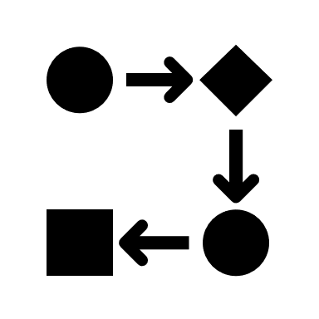
Structuring your code
Initialize expt. variables
Initialize PTB + ext. devices
Open PTB
Run experiment
load premade stimulus files
create new stimuli
trial loop:
- present stimuli
- get responses
save final data & close files
Close PTB

Slide 11
Preparing experimental variables
Initialize expt. variables
Make brief comments (% for comments). Sometimes using bullet points for your design flow can also be useful
Set the path to folders you are going to use in your experiment
Create empty variables and structures that you are going to call later on in the script so that you avoid hard coded values e.g.:
expInfo.numtrials = 50
expInfo.times.stimDuration = 5;
expInfo.times.fixationDuration = 3;
expInfo.times.blankDuration = 2;
expInfo.stim.images = {‘image1.png’, ‘image2.png’};
etc.
Optionally: create empty variables or zero variables to store the data you would like to collect later
Initialize PTB + ext. devices
Open PTB
Run experiment
load premade stimulus files
create new stimuli
trial loop:
- present stimuli
- get responses
save final data & close files
Close PTB

Slide 12
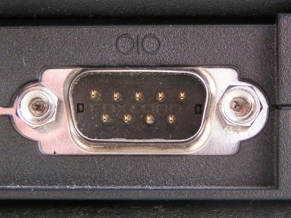
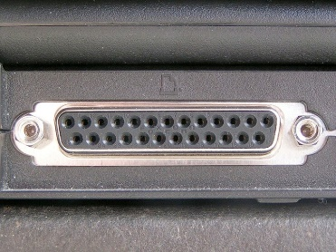
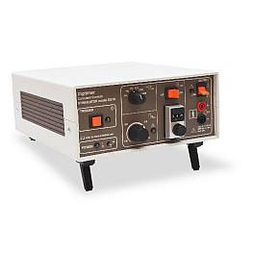
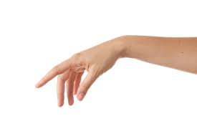

External devices
Initialize expt. variables
help PsychDefaultSetup
Sometimes your experiment will need to deal with additional triggers:
Receiving triggers from an eye tracker, MRI scanner etc.
Sending triggers to EEG system, electric shock box etc.
You can do this by opening communication with the external devices via a serial or parallel port
The PTB function IOPort is used to handle this communication
[handle, errmsg] = IOPort('OpenSerialPort’, portName);
[writtenBytes, tStampWrite]
= IOPort('Write', handle, byteArray);
[dataRead, tStampRead, errmsgRead]
= IOPort('Read', handle);
IOPort('CloseAll');
Initialize PTB + ext. devices
Open PTB
Run experiment
load premade stimulus files
create new stimuli
trial loop:
- present stimuli
- get responses
save final data & close files
Close PTB

Slide 13
PTB window
Initialize expt. variables
Initialize PTB + ext. devices
Open PTB
A recap on how to handle the PTB window:
[window, windowRect] = PsychImaging('OpenWindow', screenNumber, [R G B]);
sca; % equivalent to Screen('CloseAll')
Run experiment
load premade stimulus files
create new stimuli
trial loop:
- present stimuli
- get responses
save final data & close files
Close PTB

Slide 14
Preparing stimuli – example 7
Initialize expt. variables
Initialize PTB + ext. devices
Sometimes you may wish to load stimuli before starting the trial loop - for example, if you have a large number of images and loading them on a trial by trial basis might affect your experimental timings
That means loading stimuli (images, audio) into the workspace, in some cases preparing the relevant buffers for PTB to use those stimuli (e.g. textures for the images)
In some case your experiment will require the creation of new stimuli. You should also do this before the trial loop begins and save them to your workspace, to be accessed later on during the trial loop
Open PTB
Run experiment
load premade stimulus files
create new stimuli
trial loop:
- present stimuli
- get responses
save final data & close files
Close PTB

Slide 15

Trial loop – example 8
Initialize expt. variables
Creating a trial structure means identifying what a single trial will entail
Each single part of the trial can eventually be a separate function or script (e.g. a function ‘doFixationCross()’). This helps your code be transparent and supports debugging
Next, we need to identify what will change between trials (e.g. the image being presented )
If we have defined our stimuli at the beginning of the script then we can loop through the images. However, it may be important to randomise the order of stimuli:
trialStructure = repmat(1:size(numImages,2),1,numPres);
trialStructure = Shuffle(trialStructure);
for nTrial = 1:size(trialStructure,2)
% present single trial
end
Initialize PTB + ext. devices
Open PTB
Run experiment
load premade stimulus files
create new stimuli
trial loop:
- present stimuli
- get responses
save final data & close files
Close PTB

Slide 16
Saving variables
Initialize expt. variables
We also need to log information about each trial (e.g. stimulus type, position) and the participants responses (e.g. reaction time and accuracy), for example:
results.image(t) = expInfo.image{trialStructure(nTrial)}; results.response(t) = KbName(keycode);
results.rt(t) = responseTime;
Data has to be saved into your project folder to be accessed for later analysis. It is good practice to save the data on every trial, in case of any issue during later trials:
save(filename) %Save entire workspace to a .mat file
save(filename, variables) %Save specific variables
save(filename,'-struct','structName') %Save a specific struct but as independent variables
save(filename,variables,’-append’) %Add variables to existing file
Initialize PTB + ext. devices
Open PTB
Run experiment
load premade stimulus files
create new stimuli
trial loop:
- present stimuli
- get responses
save final data & close files
Close PTB

Slide 17

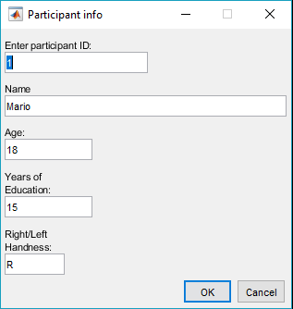
Input dialog – example 9
Sometimes we wish to collect information from the participants or would like to set some experimental variables outside of the task code. We can do that in Matlab using an input dialog box:
pInfo = inputdlg(prompts,dlgtitle,dims,definput);
A cell array indicating the default inputs for each prompt
Cell array containing the information collected from the dialog box
Opens dialog box, with fields specified by a cell array of prompt strings
A title for our input dialog box
Nx2 array indicating the width and height dimensions of each prompt. N is the number of different prompts we are collecting

Slide 18
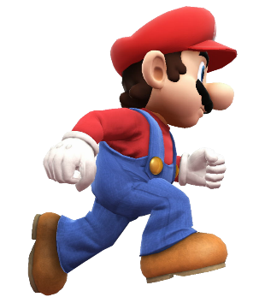
That’s it…
Any questions or clarifications?
On the course webpage (https://moodle.ucl.ac.uk/course/view.php?id=22765) there is a practical exercise, for you to build a full “game” over the course of these two lectures using PTB
A description of the second part of the exercise can be found in the PracticalExercise7 document
There is also a proposed solution on the course webpage
Please don’t hesitate to contact me if you want to ask any questions

