Slide 1



Business Analytics Course Project
Marketing and
E-Commerce
Purchase Prediction
Lena Swaileh - 60302049

Slide 2
Content
01. | Project Overview
02. | Business Context
03. | Dataset Description
06. | Feature Engineering and Target
07. | Model Development and Results
08. | Explainability and Bias Analysis
04. | Data Preparation
05. | EDA Findings
09. | Deployment Preparation
10. | Dashboard and Conclusion

Slide 3


Project Overview
This project focuses on understanding customer behavior in a marketing and e-commerce environment and predicting whether an event will lead to a purchase.
Analyze customer and behavioral data
Build and compare predictive models
Support business understanding through a dashboard

Slide 4

Business Context
view
Companies invest in marketing campaigns and customer engagement activities to increase conversions, but many customer interactions do not lead to a purchase. This project addresses that problem by using data analysis and machine learning to understand customer behavior and predict purchase events.
click
add to cart
purchase

Slide 5
Dataset Description
customers.csv
products.csv
campaigns.csv
transactions.csv
events.csv
customer_id
product_id
campaign_id
Customers: 100000
Products: 2000
Campaigns: 50
Transactions: 103127
Events: 2000000
Dataset Files
Key links
SIZE

Slide 6


Data Preparation
The data preparation process included converting date columns,
checking duplicates, handling missing values, correcting selected data types, and merging the files into one dataset.
One challenge was that some missing values
appeared after the merge because not every
event record matched a product or campaign
entry.
Main challenge: missing values after merging

Slide 7
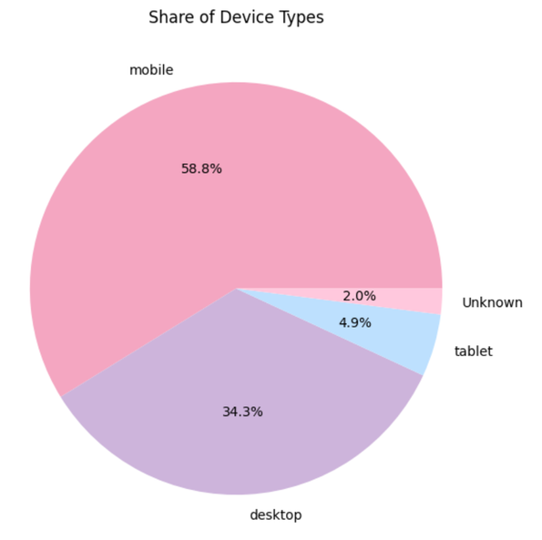
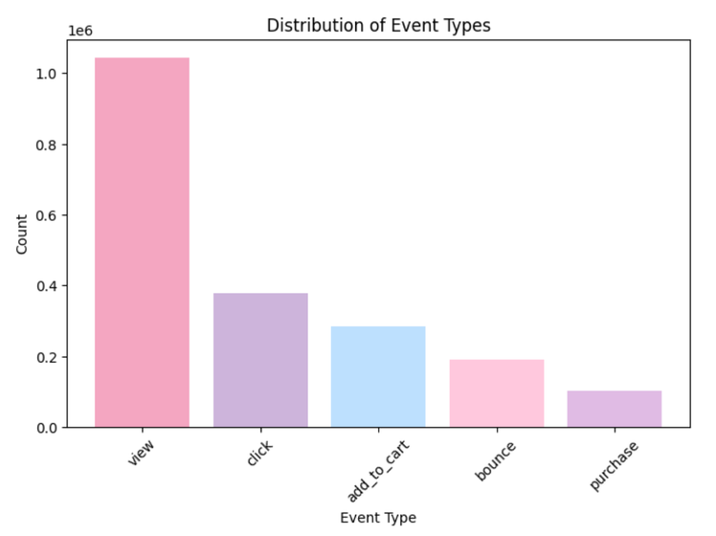
Exploratory Data Analysis
The exploratory analysis showed that views were the most common event type, mobile was the most used device, organic traffic was the largest traffic source, and many customers belonged to the Bronze loyalty tier.

Slide 8

Feature Engineering and Target
Feature Engineering
Target Variable
event_hour
event_day
signup_year
age_group
campaign_status
product_status
Target Variable: purchase_flag
1 = purchase
0 = non-purchase
Binary classification problem

Slide 9
Model Development and Results
Models Tested
Why selected
Random Forest
Logistic Regression
AutoML
More practical balance between recall and false positives
More useful for identifying purchase events
Stronger minority-class performance than AutoML
Final model
Model
Accuracy
Precision (Purchase)
Recall (Purchase)
Tuned Logistic Regression
Threshold = 0.60
Random Forest
0.55
0.08
0.77
Logistic Regression
0.72
0.09
0.52
AutoML
0.92
0.08
0.04

Slide 10
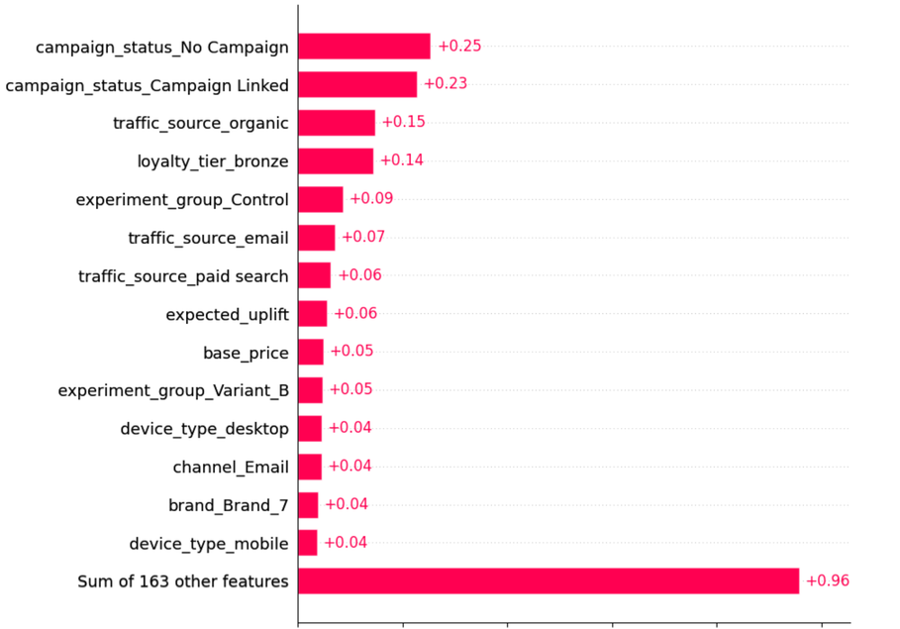
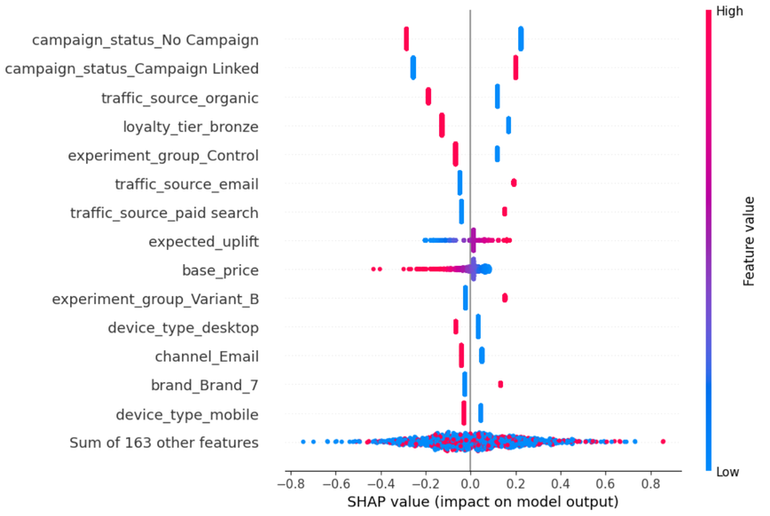
Explainability and Bias Analysis
SHAP analysis showed that campaign status, traffic source, loyalty tier, experiment group, expected uplift, and base price were among the most important features influencing the model’s predictions. Bias analysis showed fairly similar performance across gender and age groups, with some variation across countries.

Slide 11
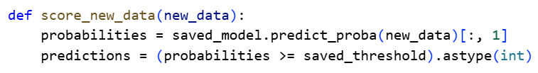
Deployment Preparation
Purchase probability
Predicted purchase label
Saved final model using joblib
Saved selected threshold
Created scoring function for new data
Scoring output
scoring code Example

Slide 12
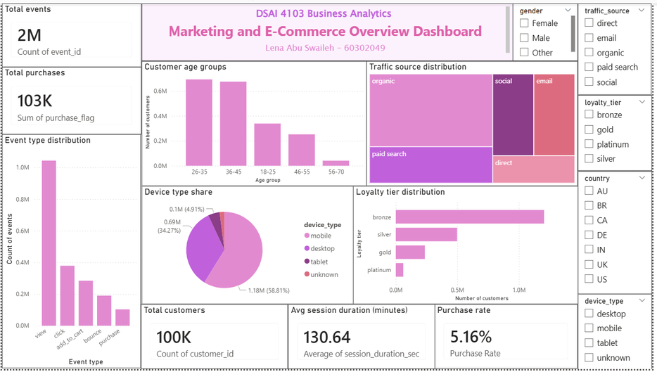
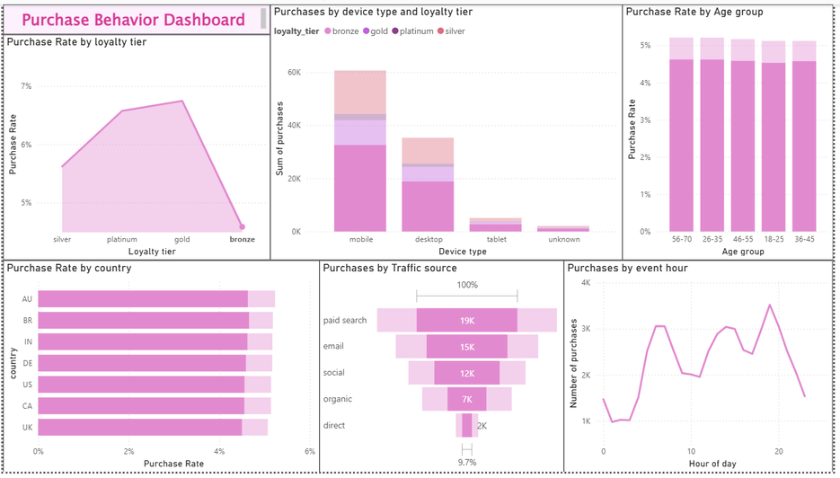
Dashboard and Conclusion
The Power BI dashboard was designed to summarize customer behavior and purchase patterns using interactive visuals and filters. Overall, the project combined descriptive analysis, predictive modeling, explainability, and dashboard reporting to support purchase prediction and business decision-making.

Slide 13
Links
01. | Github Link: https://github.com/Lenaosama/DSAI4103_CourseProject.git
02. | Dashboard Link: https://app.powerbi.com/links/9TBtp98DxX?ctid=b30f4b44-46c6-4070-9997-f87b38d4771c&pbi_source=linkShare
03. | Dataset Link: https://www.kaggle.com/datasets/geethasagarbonthu/marketing-and-e-commerce-analytics-dataset?resource=download
04. | Google Colab Link: https://colab.research.google.com/drive/1WCqBlj1N8-QFnCIi5lfDXEb-2wPe48lE?usp=sharing
05. | Slides Link: https://colab.research.google.com/drive/1WCqBlj1N8-QFnCIi5lfDXEb-2wPe48lE?usp=sharing

Slide 14
thank
you
Any Questions?

