Slide 1
Types of Operators
An operator is a symbol specifying an action that is performed on one or more expressions. The following table lists the operator categories that SQL Server 2008 uses.
Arithmetic Operators
Logical Operators
Assignment Operator
String Concatenation Operator
Comparison Operators

Slide 2
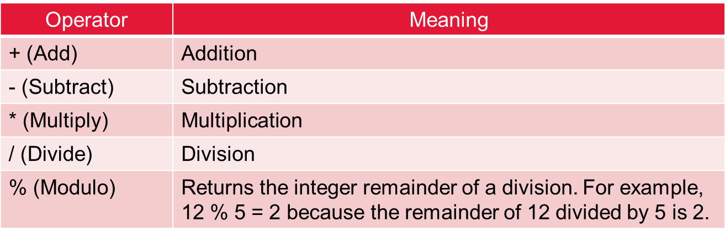
Arithmetic Operators

Slide 3
Arithmetic Operators
Select EmpID, Name, Salary*12 “Annual Salary”, Dept from Employees
Select EmpID, Name, Salary-1000 “Revised Salary”, Dept from Employees
Select EmpID, Name, Salary+2000 “Revised Salary”, Dept from Employees
Select EmpID, Name, (Salary*12)/3 “Quarter Salary”, Dept from Employees

Slide 4
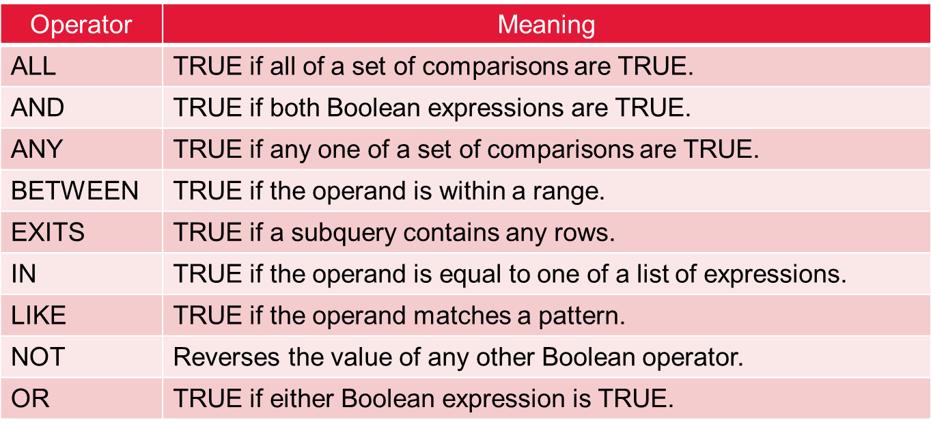
Logical operators
Logical operators test for the truth of some condition and return a Boolean data type with a value of TRUE, FALSE, or UNKNOWN.

Slide 5
Assignment
The equal sign (=) is the only Transact-SQL assignment operator.
String Concatenation Operator
The plus sign (+) is the string concatenation operator that enables string concatenation.

Slide 6
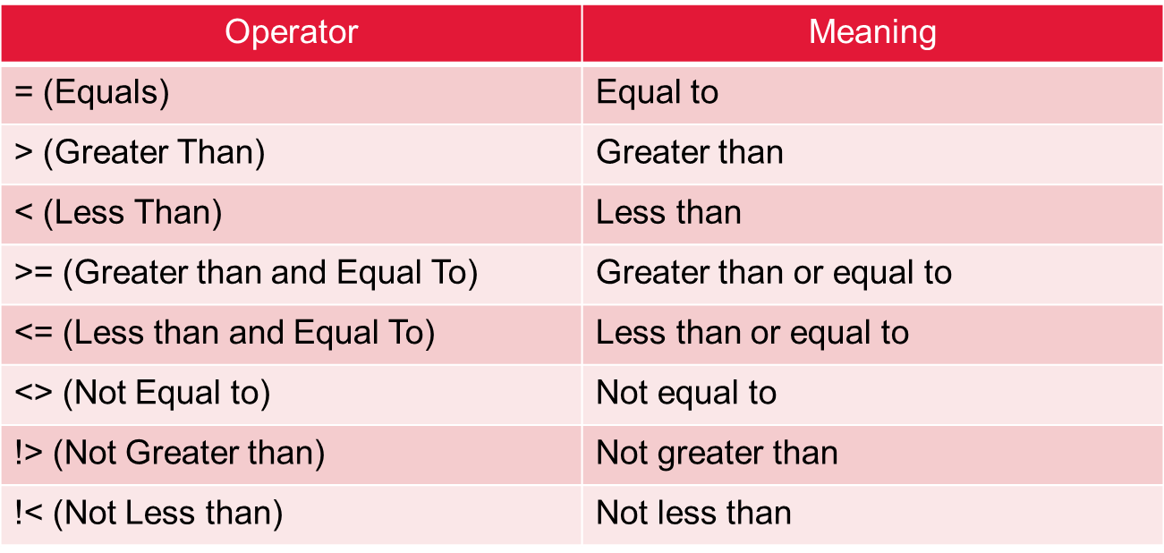
Comparison operators
Comparison operators test whether two expressions are the same. Comparison operators can be used on all expressions except expressions of the text, ntext, or image data types.

