Slide 1
Dataset
A Dataset is an in-memory data store that can hold numerous tables.
It is heart of your disconnected model.
Datasets only hold data and do not interact with a datasource.
The Dataset class has been designed as an offline container of data. It has no notion of database connections
it will contains collection of tables called data tables
Inside dataset we can access data from data table with name or index
Dataset supports bi directional navigation and manipulations
dataset supports constrains and relation b/w tables
dataset is purely disconnected implementation, where database records can be maintained to perform navigation & manipulations without db connectivity.
DataSet
SqlDataAdapter
SqlConection

Slide 2
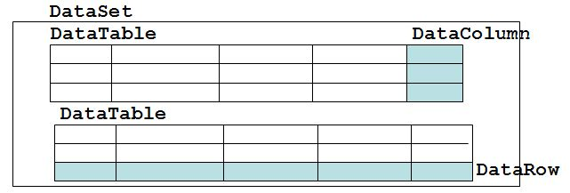
Dataset
The DataSet contains a collection of one or more DataTable objects made up of rows and columns of data, as well as primary key, foreign key, constraint, and relation information about the data in the DataTable objects.
In System.Data namespace.

Slide 3
Dataset
Initialize dataset object. Dataset ds=new Dataset()
ds.tables[0].rows. Count - returns no of rows in a table
ds.tables.count- returns no of tables in dataset
//get a value from dataset
ds.tables[0].rows[row index][col index/col name]
Sort Records in dataset:
ds.Tables[0].DefaultView.Sort = “ColumnName”;

Slide 4
Dataset
Methods:
Clear():
It clears all rows and all tables.
Haschanges():
Gets a bool value indicating whether the DataSet has changes or not, changes like including new, deleted, or modified rows.
Merge(Dataset ds):
Merges a specified DataSet and its schema into the current DataSet.
ReadXml(string xml_path):
To read a data from xml file
WriteXml(string xml_path):
To write table data to xml file.
WriteXmlSchema(string path):
To write xml schema for a selected table in dataset.

Slide 5
Dataset
Search a Record:
ds.Tables[0].Rows. Find(value);
DataRow dr;
dr = ds.Tables[0].Rows. Find("E0001");
Note: when we search a Record in dataset the data table in dataset should have primary key
Set primary key:
DataColumn [] dc = new DataColumn[1];
dc[0] = ds.Tables[0].Columns["empid"];
ds.Tables[0].PrimaryKey = dc;
Deleting a Record
ds.tables("emp").rows(1).delete()
da.update(ds,"emp")

Slide 6
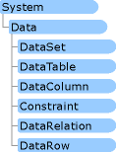
Classes under system. Data
Dataset
Datatable
Datarow
Datacolumn
DataRelation
Constraint
Dataview

Slide 7
Types of Datasets
Untyped Dataset | Typed Dataset
the dataset which follows the unstructured is called as Unstructured dataset. | typed dataset have specific table structure. It inherited from dataset class by providing strongly typed properties and methods. Structure+strongly typed properties and methods.
It is generic dataset can hold any table data. | Typed dataset can have schema of specific table so u can hold only specific table data. Extension of type dataset is .xsd
It is not type safe | It is type safe dataset.
Untyped dataset performance is slow | Typed dataset is faster compare to normal dataset because type casting is not required.

