Slide 1
What is the Internet?
Network: a group of connected computers/devices
internet: a network of networks
Internet: the world wide web

Slide 2
Internet address
Used to identify a computer connected to the Internet.
Every address must be unique, since the computer represented by that address is unique to the Internet.
The Internet Corporation for Assigned Names and Numbers (ICANN) is an internationally organized, non-profit corporation that has responsibility for Internet Protocol (IP) address space allocation, protocol identifier assignment.

Slide 3
Internet address
Internet addresses can be represented in terms of textual domain names, such as www.yahoo.com and mapped to corresponding IP addresses. The IP for www.yahoo .com is 205.132.48.237.

Slide 4
Protocol
A protocol is a set of rules for communicating across the Internet. Both parties know and follow the rules for sending and receiving information, making meaningful communication possible.
Ex;
Hypertext Transfer Protocol (HTTP)
File Transfer Protocol (FTP)
HTTPS

Slide 5
HTTP
This protocol, the backbone of the World Wide Web, enables users to send and receive information from Internet servers in the form of documents, or pages, written using the Hypertext Markup Language (HTML). The user who receives the document, often called the client, can then use a browser or other form of software that recognizes the HTML language to view the contents of the document.

Slide 6
WWW (World Wide Web)
An information system that brings together data from many of the other Internet services under one set of protocols.
W3 Consortium was created for continuing to develop the standards. The consortium put together a set of protocols for the World Wide Web.

Slide 7
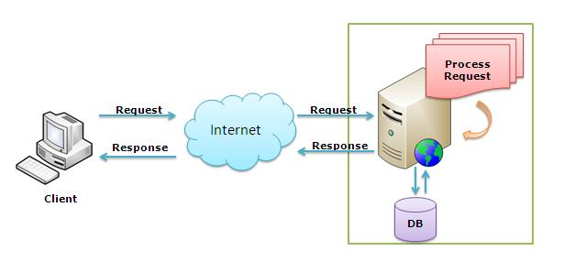
Basic Process

Slide 8
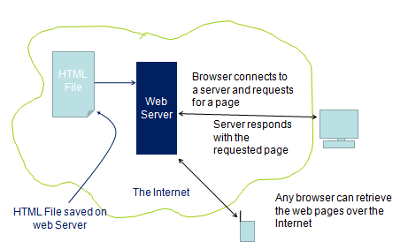
Basic Process

Slide 9
Behind the Scene!!!
The browser breaks the URL into three parts:
The protocol ("http")
The server name ("www.rediff.com")
The file name (“index.html")
The browser communicates with a name server to translate the server name "www.rediff.com" into an IP Address, which it uses to connect to the server machine.
The browser then establishes a connection with the server at that IP address on port 80.

Slide 10
Behind the Scene!!!
Following the HTTP protocol, the browser sends a request to the server, asking for the file http://www.rediff.com/index.html
The server then sends the HTML text for the Web page to the browser.
The browser reads the HTML tags, formats the page and displays it onto your screen.

Slide 11
HTML
HTML stands for Hyper Text Markup Language.
HTML is a presentation Language to present data on webpage.
HTML is not case sensitive language.
HTML standards are provided by W3C[World Wide Web Consortium]
HTML is a error free language.
HTML is useful to develop static web pages.
HTML comes with predefined tags and entities.
Extension of HTML is .html or .htm

Slide 12
HTML Sturcture
<html>
<head>
<title>
Title of the webpage
</title>
</head>
<body>
--------
</body>
</html>
<head>
Declare JavaScript
Declare styles
Declare external styles files
Declare js files
Declare meta info
</head>
<Body>
To declare all predefined Tags
</Body>

Slide 13
HTML
Html comes with predefined tags and entities
The general format for a HTML tag is:
<tag_name>string of text</tag_name>
Heading Tags
h1,h2,h3,h4,h5,h6
<h1>Welcome to HTML</h1>
<p></p> for paragraphs
Adding Images
<img src="peter.jpg" width="200" height="150" alt="My friend Peter">
The alt attribute is used to give the short description

Slide 14
Overview
Adding links
<a href="peter.html">Peter's page</a>
<a href=“home.html"><img src="logo.gif" alt="home page"></a>
Adding lists
a) unordered list.
<ul>
<li> the first list item</li>
<li> the second list item</li>
</ul>

Slide 15
Overview
b) ordered list.
<ol type=1> (type=1 or a or i)
<li> the first list item</li>
<li> the second list item</li>
</ol>
Note:<br> is use to line brakes

Slide 16
Tables
Tables are used for information as well as for layout.
<table border="1"> <tr><th>Year</th><th>Sales</th></tr> <tr><td>2000</td><td>$18M</td></tr> <tr><td>2001</td><td>$25M</td></tr> <tr><td>2002</td><td>$36M</td></tr>
</table>
<table border="1" cellpadding="10">
<table border="1" cellpadding="10" cellspacing="10">
<table border="1" cellpadding="10" width="80%">

Slide 17
Overview
Entities:
&nbsp; | Blank space
&copy; | ©
&reg; | ®
&#8482; | ™

Slide 18
Forms
Form tag is used to create controls on the page
<form>
<input type=“text” name=“txtuser”>
<input type=“password” name=“txtpass”>
<input type=“submit” value=“Login”>
</form>
Form tag attributes
method- specifies the way how the data is to be sent to the server (request from client to server)
most important values for method attribute are;
get, post
Other values are- delete, options, trace, put, head
action – specifies the file to be invoked on submitting the form to the server

Slide 19
Forms
Input Controls.
TextBox:
<input type=“text” name=“txtuser”>
Password:
<input type=“password” name=“txtpass”>
Button
<input type=“button” value=“clickme”>
<input type=“submit” value=“Login”>
<input type=“reset” value=“reset”>
Checkbox
<input type=“checkbox” value=“clickme”>
Radio
<input type=“Radio” value=“clickme”>

Slide 20
Forms
Combo Box(only one selection at a time)
<select name=“country”>
<option value="India"> India </option>
<option value="China"> China </option>
</select>
List Box(one/many selection allowetd)
<select name=“country” multiple=multiple>
<option value="India"> India </option>
<option value="China"> China </option>
</select>

Slide 21
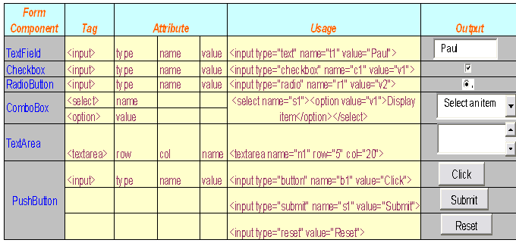

Slide 22
Html
Some other formatting tags
<b> </b> - makes the text bold
<i> </i> - makes the text italics
<p> </p> - creates a paragraph
<center> </center> -aligns the text center
<HR> - draws a horizontal line
<font> </font> - specifies type and size of font
face=“Times New Roma” size=29

