Slide 1
DataBinding
Data binding allows data from the data source to be associated with the controls.
Data source then becomes data provider and controls become data consumer.
Any object that implements IList interface is a Data provider.
DataSet, DataTable, DataColumns, arrays, collections that implement IList are all Data Providers.
There are several web server control available that can be linked with Data Source and be used to display data.
Some of them are GridView, FormView, DetailsView etc.

Slide 2
Data Server Controls
GridView: Similar to DataGridView of windows form. Used to display multiple data items in form of rows and columns where columns are fields and rows represents values in the field. Enables select, edit and sort data items
DetailsView: Displays one record at a time. Enables add, edit and delete data items.
FormView: Like DetailsView but has a template defined to display data.
DataList, ListView and Repeater are controls are very similar to GridView with minor differences →listed in the next slide.

Slide 3
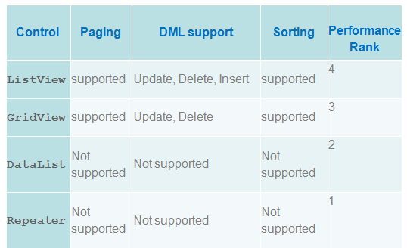
Differences

Slide 4
GridView
The GridView displays data as a table and provides the capability to sort columns, page through data, and edit or delete a single record.
The DataSource property binds GridView with data.
DataSource must be either an IListSource, IEnumerable, or IDataSource

