Slide 1
WCF Overview
WCF stands for Windows Communication Foundation.
Windows Communication Foundation (WCF) is an SDK and runtime system for developing, configuring and deploying network-distributed services over Network.
A Service is a collection of operations that are exposed so that the Client can call them and execute them. Here the Service is a WCF service or a Web service.
Windows Communication Foundation (WCF) is unified programming model provided in .NET Framework 3.0.
WCF is a combined features of Web Service, Remoting, MSMQ and COM+.

Slide 2
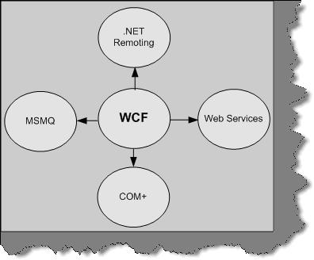

Slide 3
WCF Endpoints
All communications with the WCF service will happen via the endpoints.
In WCF endpoint is a collection of Address, Contract and Binding.
All the WCF communications are take place through end point.
Contract defines which methods of the Service class that will be accessible via the endpoint; each endpoint may expose a different set of methods.
Binding specifies how a client will communicate with the service.
Address specifies where the service is hosted.
Endpoints will be mentioned in the web.config file or App.config file.

Slide 4
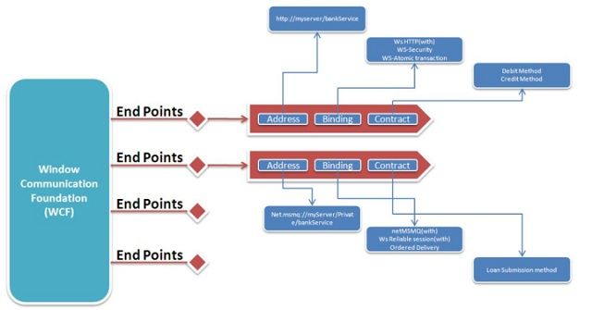
WCF Endpoints

Slide 5
Address
A-Address(Where?): Specifies the location of the service which will be like http://Myserver/MyService.
Clients will use this location to communicate with our service.
The sample address for above transport schema may look like
http://localhost:81
http://localhost:81/MyService net.tcp://localhost:82/MyService
net.pipe://localhost/MyPipeService net.msmq://localhost/private/MyMsMqService net.msmq://localhost/MyMsMqService

Slide 6
Bindings
B-Binding(How?): Bindings specify how a service endpoint communicates with the Client Endpoints.
A Binding consists of several Binding elements describing some aspect of communication.
For Example:
How do the messages are Transport? Are they moving over HTTP or do they use TCP protocol for communication?
What are the Protocol requirements? Security, reliability, Transactions etc.
Message Encoding ( text, binary, etc )

Slide 7
Bindings
WCF Supports following Bindings
Basic Binding
Offered by the BasicHttpBinding class, this is designed to expose a WCF service as a legacy ASMX web service, so that old clients can work with new services. When used by the client, this binding enables new WCF clients to work with old ASMX services.
Web Service (WS) Binding
Offered by the WSHttpBinding class, this uses HTTP or HTTPS for transport, and is designed to offer a variety of features such as reliability, transactions, and security over the Internet.
TCP Binding
Offered by the NetTcpBinding class, this uses TCP for cross-machine communication on the intranet. It supports a variety of features, including reliability, transactions, and security, and is optimized for WCF-to-WCF communication. As a result, it requires both the client and the service to use WCF.

Slide 8
Bindings
IPC Binding
Offered by the NetNamedPipeBinding class, this uses named pipes as a transport for same-machine communication. It is the most secure binding since it cannot accept calls from outside the machine and it supports a variety of features similar to the TCP binding.
Federated WS Binding
Offered by the WSFederationHttpBinding class, this is a specialization of the WS binding, offering support for federated security.
Peer Network Binding
Offered by the NetPeerTcpBinding class, this uses peer networking as a transport. The peer network-enabled client and services all subscribe to the same grid and broadcast messages to it.

Slide 9
Bindings
Duplex WS Binding
Offered by the WSDualHttpBinding class, this is similar to the WS binding except it also supports bidirectional communication from the service to the client.
MSMQ Binding
Offered by the NetMsmqBinding class, this uses MSMQ for transport and is designed to offer support for disconnected queued calls.
MSMQ Integration Binding
Offered by the MsmqIntegrationBinding class, this converts WCF messages to and from MSMQ messages, and is designed to interoperate with legacy MSMQ clients.

Slide 10
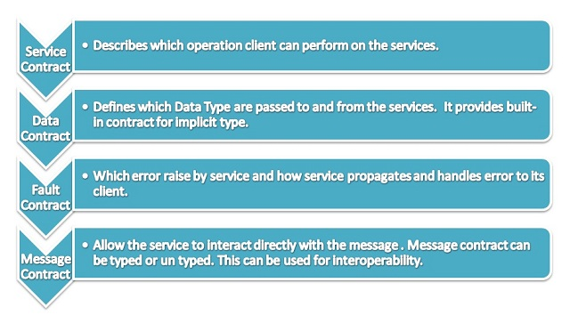
Contracts
C-Contract(What?): Specifies the interface between client and the server. It's a simple interface with some attribute.
A contract is a standard way of describing what the service does.
contracts are platform independent.
In WCF, all services expose contracts.

Slide 11
Service Contract
Service contract describes the operations that service provide to the client.
Service Contracts defines what operations are available and how clients use them.
A WCF Service can have more than one service contract but it should have at least one Service contract.
Service contracts are two types
Service Contract
Operation Contract
Service Contract can be define using [ServiceContract] attribute Operation Contract can be define using [OperationContract] attribute
The ServiceContract attribute marks an interface as a Service Contract.
service contract attribute implements to classes and interfaces
[ServiceContract] attribute is similar to the [WebServcie] attribute in the WebService
The OperationContract attribute exposes methods of the interface.
[OpeartionContract] is similar to the [WebMethod] attribute in WebService.

Slide 12
Service Contract
[ServiceContract]
public interface ICalculator
{
[OperationContract]
int Add(int num1, int num2);
//int Sub(int num1, int num2);
}
Once we define Service contract in the interface, we can create implement class for this interface.
public class Calculator:ICalculator
{
public int Add(int a, int b)
{
return (a + b);
}
}

Slide 13
DataContract
A data contract is a formal agreement between a service and a client.
Data Contract abstractly describes the what data to be exchanged between client to service or service to client.
Data Contracts describes the data that the Client and the Service exchange.
WCF uses a serialization engine called the Data Contract Serializer by default to serialize and deserialize data.[Implicit DataContract]
Simple types such as int, string etc has an implicit data contracts.
We can also explicitly create a data contract by using DataContractAttribute and DataMemberAttribute attributes. This attribute can be applied to classes, structures, and enumerations.
The DataMemberAttribute attribute must then be applied to each member of the data contract type to indicate that it is a data member, that is, it should be serialized.
Note: We need to include System.Runtime.Serialization reference to the application. This assembly holds the DataContract and DataMember attribute.

Slide 14
DataContract
Data Contracts can be defined as follows:
It describes the external format of data passed to and from service operations
It defines the structure and types of data exchanged in service messages
It maps a CLR type to an XML Schema
It defines how data types are serialized and deserialized. Through serialization, you convert an object into a sequence of bytes that can be transmitted over a network. Through deserialization, you reassemble an object from a sequence of bytes that you receive from a calling application.
It is a versioning system that allows you to manage changes to structured data .

Slide 15
[ServiceContract]
public interface IEmployeeService
{
[OperationContract]
Employee GetEmployeeDetails(int EmpId);
}
[DataContract]
public class Employee
{
private string m_Name;
private int m_Age;
[DataMember]
public string Name
{
get { return m_Name; }
set { m_Name = value; }
}
[DataMember]
public int Age
{
get { return m_Age; }
set { m_Age = value; }
}
}

Slide 16
Versioning in Data Contract
DataContract versioning is required when a modification has been made to the existing DataContract exposed to the client from the service or vice versa.
If either service or client changes the schema of DataContract exposed, then a new version of DataContract is needed and both parties involved in communication should be able to accommodate the changes done in the DataContract.
The scenario that can cause for a new version of DataContract is as below,
Missing a member from existing DataContract.
Adding a new member to existing DataContract.

Slide 17
Fault Contract
In all managed applications, processing errors are represented by Exception objects.
In WCF By default when we throw any exception from service, it will not reach the client side.
service methods communicate processing error information using SOAP fault messages.
WCF provides the option to handle and convey the error message to client from service using SOAP Fault contract.
SOAP faults are message types that are included in the metadata for a service operation.
SOAP faults are expressed to clients in XML form, they are highly interoperable.
Fault Contract provides documented view for error accorded in the service to client. This help as to easy identity the what error has accord.
In wcf any exception thrown by the service reaches the client as a FaultException.

Slide 18
Implement Fault Contract in service: public interface IService
{
[OperationContract]
[FaultContract(typeof(MyFaultException))]
int Div(int a, int b);
}
[DataContract]
public class MyFaultException
{
private string _reason;
[DataMember]
public string Reason
{
get { return _reason; }
set { _reason = value; }
}

Slide 19
Implement Fault Contract in service: public int Div(int a, int b)
{
try
{
int res;
res = a / b;
return res;
}
catch (Exception ex)
{
MyFaultException theFault = new MyFaultException();
theFault.Reason = "Some Error " + ex.Message.ToString();
throw new FaultException<MyFaultException>(theFault,new FaultReason(theFault.Reason));
}
}

Slide 20
Fault Contract
Implement Fault Contract in Client: try
{
int res = ob.Div(i, j);
}
catch(FaultException<ServiceReference1.MyFaultException>ee)
{
Console.WriteLine(ee.Reason);
}
Console.ReadLine();

Slide 21
Endpoints
<system.serviceModel>
<services>
<service name="MathService"
behaviorConfiguration="MathServiceBehavior">
<endpoint
address="http://localhost:8090/MyService/MathService.svc
contract="IMathService"
binding="wsHttpBinding"/>
</service>
</services>
</system.serviceModel>

Slide 22
Endpoints
Multiple endpoints on the same service
<service name = "MyService">
<endpoint
address = "http://localhost:8000/MyService/"
binding = "wsHttpBinding"
contract = "IMyContract"
/>
<endpoint
address = "net.tcp://localhost:8001/MyService/"
binding = "netTcpBinding"
contract = "IMyContract"
/>
<endpoint
address = "net.tcp://localhost:8002/MyService/"
binding = "netTcpBinding"
contract = "IMyOtherContract"
/>
</service>

Slide 23
Endpoints
Service-side programmatic endpoint configuration
ServiceHost host = new ServiceHost(typeof(MyService));
Binding wsBinding = new WSHttpBinding();
Binding tcpBinding = new NetTcpBinding();
host.AddServiceEndpoint(typeof(IMyContract), wsBinding,
"http://localhost:8000/MyService");
host.AddServiceEndpoint(typeof(IMyContract), tcpBinding,
"net.tcp://localhost:8001/MyService");
host.AddServiceEndpoint(typeof(IMyOtherContract), tcpBinding,
"net.tcp://localhost:8002/MyService");
host.Open();

Slide 24
Hosting WCF Services
There are three major ways of hosting a WCF services:
Self Host
IIS hosting
Windows service
WAS
Self-hosting the service in its own application domain. The service comes into existence when you create the object of Service Host class and the service closes when you call the Close of the Service Host class.
Host in application domain or process provided by IIS Server.
Host in application domain and process provided by WAS (Windows Activation Service) Server.

