Slide 1
Assemblies
Assembly is a unit of code consist one or more Namespaces.
It is automatically generated by the compiler upon successful compilation of every .NET application.
It can be either a Dynamic Link Library or an executable file.
It is generated only once for an application and upon each subsequent compilation the assembly gets updated.

Slide 2
Assemblies
A Collection of classes is called as Namespace.
A Assembly consist of one or more Namespaces.
Assemblies are reusable (Write once and use it many times)
Assemblies Contains language independent code. In the form of IL code i.e. (MSIL (Microsoft intermediate Language))
Assemblies supports language Interoperability. I.e. The dll developed in c#.net
can be used in vb.net.

Slide 3
Deploying Assemblies
Assembly Types
private assembly
shared assembly

Slide 4
Private Assemblies
This just involves copying the dll in the applications base directory or bin directory.
The private assemblies can be used only inside the application where it is copied.
The CLR discovers the path to the private assembly at run time.

Slide 5
Adding private assembly to the project
Note that in the bin\Release directory ConversionLib.dll gets created.
Create a new windows console application project.
Right click on project in solution explorer →Add Reference
Go to Browse tab in the “Add Reference” dialog.
Browse to ConversionLib.dll and add the file.

Slide 6
Global/Shared Assemblies
dll will share to several applications.
To share dll across several application in the same machine it must be in the Global Assembly Cache (GAC) .The assembly search first happens in GAC.

Slide 7
Shared Assemble
Shared Assemble creation requires 4 steps
Creating Library[assembly]
Generate Public key
Signing Assembly(Attaching Public key to an assemble.)
placing assemble in to GAC.

Slide 8
Security restriction for GAC
There are 2 security restrictions in placing assembly in the GAC
Only Administrators or Power Users privileges can add assemblies or remove them from the GAC unless you have either.
An assembly in the GAC should have a strong name. This ensures that the GAC has assemblies that have been signed by someone in possession of the proper private key.
CLR does not verify for strong name since it assumes that only a strong name assembly will be in GAC. Hence it does not affect the performance.

Slide 9

Activity: Signing an assembly
1.First a key file has to be generated using the command
sn –k <file name>
sn –k sgKey.snk
2.Sign the assembly using the file generated This can be done by
Right click the project in solution explorer and selecting properties
In the Signing part browse and get the file sgKey.snk.

Slide 10
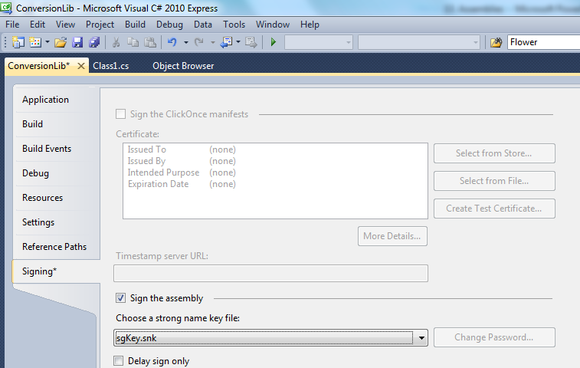

Slide 11
Activity: Installing the application in GAC
Using the command-line utility named GACUTIL.EXE that ships with the Microsoft® .NET Framework SDK, the assembly can be installed into GAC.
gacutil -i ConversionLib.dll
This will copy the dll file into the location C:\Windows\assembly.
C:\Windows\assembly is the place where all the global assemblies are located.
These assemblies an then be referenced by any project by first adding the reference of it in the project.
Right click on project in solution explorer →Add Reference→NET tab in the “.NET” tab and find the assembly.

Slide 12


