Slide 1
Lex Retail Stores - Cybersecurity Architecture for SMEs
A NIST-CSF & ISO/IEC 27001-Aligned Approach
Group 6
Team Members: Lenethia, Robert, Prosper, Precious
Date: August 2025

Slide 2

Project Overview & Objectives
Overview:
Design a scalable cybersecurity architecture for Lex Retail Stores, a 20-employee online retail startup with no prior security maturity.
Objectives:
Build from zero using NIST CSF
Simulate realistic SME risks
Map controls to ISO/IEC 27001
Assign team roles with real-world tools and simulations

Slide 3
Team Member Responsibilities
Lenethia (Team Lead):
Risk Assessment, Control Mapping, Final Recommendations
Robert (Asset & Controls Analyst):
Asset Inventory, Protective Controls Review
Prosper (Vulnerability & Monitoring Specialist):
• Threat/Vulnerability Scanning, Detection and Monitoring
Precious ( Awareness & Communication Lead)
•Awareness Training Program, IR & Recovery Strategy

Slide 4
Strategies & Frameworks Used
NIST Cybersecurity Framework - Identify, Protect, Detect, Respond, Recover
ISO/IEC 27001:2022 - Mapped key controls
Approach:
Simulate real risks in an SME context
Use free or open-source tools
Assign tasks by function

Slide 5
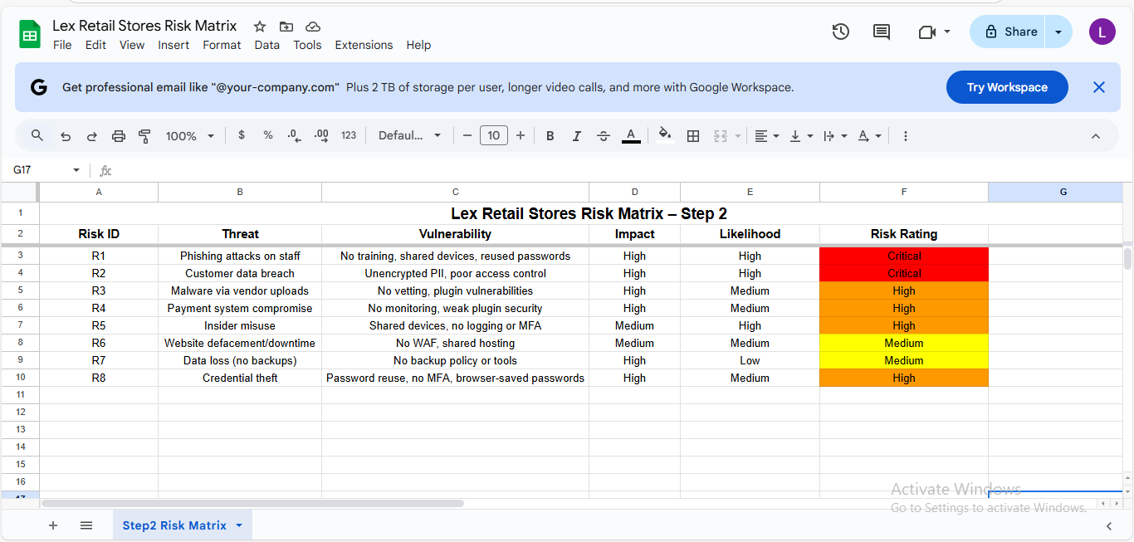
Risk Assessment
Approach: Identify assets,threats,score risk
Top Risks:
Phishing & data theft
Insider misuse
SQL injection
Mapped controls:
A.5.4, A.5.9, A8.8

Slide 6
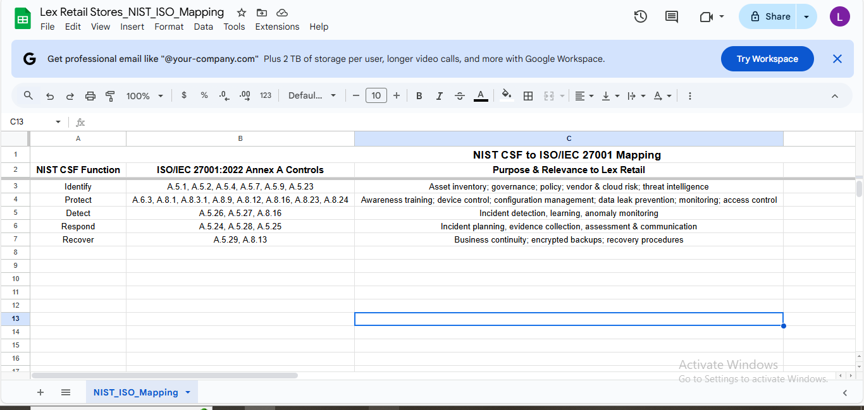
Controls & ISO Mapping
Approach: Mapped NIST functions - ISO 27001

Slide 7
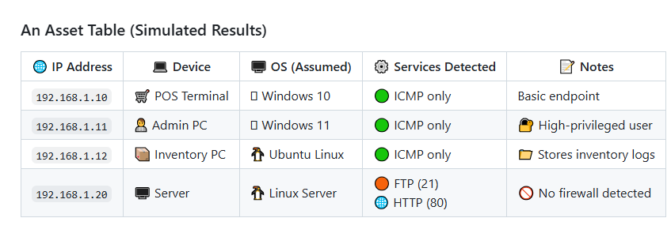
Asset Discovery & Protection
Tools: Nmap, Packet Tracer, WordPress
Findings:
No endpoint protection
Shared admin privileges
Exposed plugins
ISO Controls:
A.5.9, A.5.17, A..18, A.8.24

Slide 8
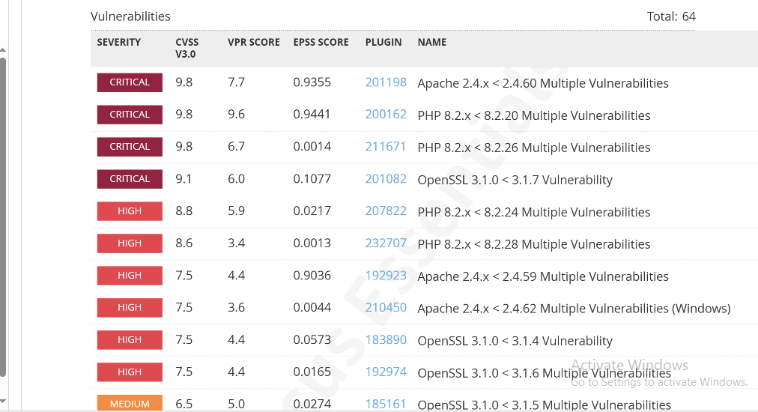
Threat Scanning & Detection
Tools: Nessus (simulated), WordPress scanner, Nmap
Findings:
Vulnerable ports
WordPress CVEs
Lack of alerting/SIEM
ISO Controls:
A.5.26, A.5.31, A.8.8

Slide 9
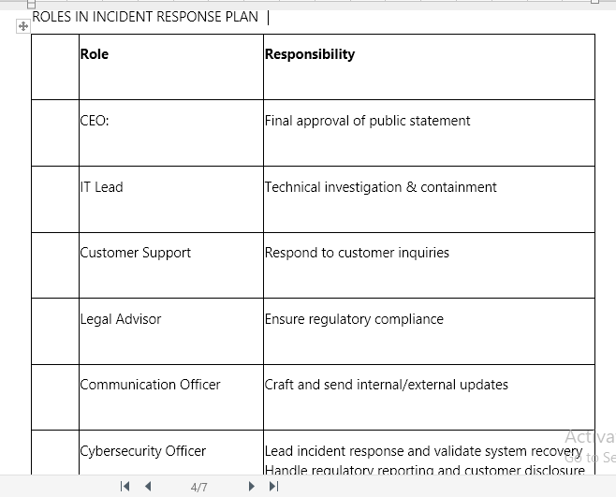
Awareness & Incident Strategy
Components:
12-month phishing training plan
Incident roles & comms template
Quarterly tabletop drills
ISO Controls:
A.5.1, A.5.29, A.6.3

Slide 10
Key Results & Lessons Learned
Outcomes:
✅ Baseline architecture designed
✅ All functions of NIST CSF covered
✅ SME-specific risks simulated
Lessons Learned:
Culture & training = critical for SMEs
Free tools can achieve strong visibility
Policy + technology = resilience

