Slide 1
Digital Geometry Processing and Simulation
Jinlan Xu
Spring, 2020

Slide 2
Differential Geometry
Differential Geometry of a Curve
Differential Geometry of a Surface
I and II Fundamental Forms
Change of Coordinates (Tensor Calculus)
Curvature
Weingarten Operator
Bending Energy

Slide 3
Differential Geometry of a Curve
C(u)

Slide 4
Differential Geometry of a Curve
Point p on the curve at u₀
p
C(u)
p=C(u₀)

Slide 5
Differential Geometry of a Curve
Tangent T to the curve at u₀
p
C_{u}
C(u)

Slide 6
Differential Geometry of a Curve
Normal N and Binormal B to the curve at u₀
B
p
C_{u}
C_{uu}
C(u)
N

Slide 7
Differential Geometry of a Curve
Curvature κ at u₀ and the radius ρ osculating circle
B
Geometric meaning?
p
C_{u}
C_{uu}
C(u)
N

Slide 8
Differential Geometry of a Curve
Curvature at u₀ is the component of -N_{T} along T
C(u₀)
C(u₁)
T
N(u₀)
C(u)
N(u₁)
N_{T}

Slide 9
Computing the Curvature of a Curve

Slide 10
Computing the Curvature of a Curve

Slide 11
Computing the Curvature of a Curve

Slide 12
Computing the Curvature of a Curve

Slide 13
Computing the Curvature of a Curve

Slide 14
Computing the Curvature of a Curve

Slide 15
Curve Curvature
Curvature is independent of parameterization
C(t), C(t+5), C(2t) have same curvature (at corresponding locations)

Slide 16
Differential Geometry of a Surface
S(u,v)

Slide 17
Differential Geometry of a Surface
Point p on the surface at (u₀,v₀)
p
S(u,v)

Slide 18
Differential Geometry of a Surface
Tangent S_{u} in the u direction
p
S_{u}
S(u,v)

Slide 19
Differential Geometry of a Surface
Tangent S_{v} in the v direction
S_{v}
p
S_{u}
S(u,v)

Slide 20
Plane of tangents T
S_{v}
p
T
S_{u}
S(u,v)

Slide 21
First Fundamental Form I_{S}
Metric of the surface S

Slide 22
Normal N
N
S_{v}
p
T
S_{u}
S(u,v)

Slide 23
Normal section
N
S_{v}
p
T
S_{u}
S(u,v)

Slide 24
Curvature
N
S_{v}
p
T
S_{u}
S(u,v)

Slide 25
Curvature
N_{T}
N
S_{v}
p
T
S_{u}
S(u,v)

Slide 26
Second Fundamental Form II_{S}

Slide 27
Change of Coordinates
S_{v}
p
S_{u}
Tangent Plane of S

Slide 28
Change of Coordinates
S_{t}
S_{v}
b
θ
p
S_{s}
a
S_{u}
Construct an Orthonormal Basis

Slide 29
Change of Coordinates
S_{t}
S_{v}
b
θ
p
S_{s}
a
S_{u}
First Fundamental Form

Slide 30
Change of Coordinates
S_{t}
S_{v}
s
b
u
T
θ
v
t
p
S_{s}
a
S_{u}
A point T expressed in (u,v) and (s,t)

Slide 31
Curvature
S_{t}
S_{v}
κ_{T} is a function of direction T
b
θ
p
S_{s}
a
S_{u}

Slide 32
Curvature
S_{t}
S_{v}
b
How do we analyze the κ_{T} function?
θ
p
S_{s}
a
S_{u}

Slide 33
Weingarten Operator

Slide 34
Weingarten Operator
If κ₁≠ κ₂
else umbilic (κ1= κ2), chose orthogonal directions

Slide 35
Bending Energy

Slide 36
Bending Energy
Minimizing
= Minimizing

Slide 37
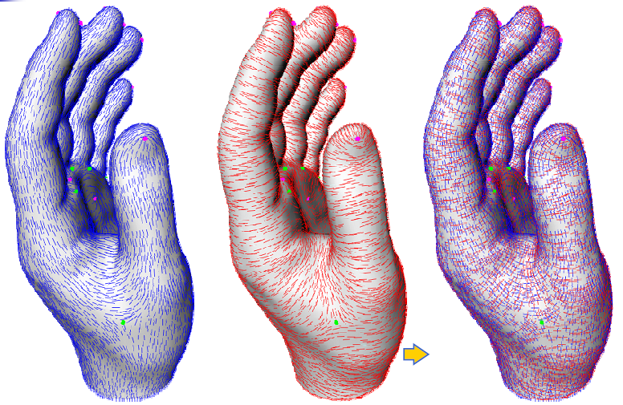
Principal Directions
Min Curvature
Max Curvature

Slide 38
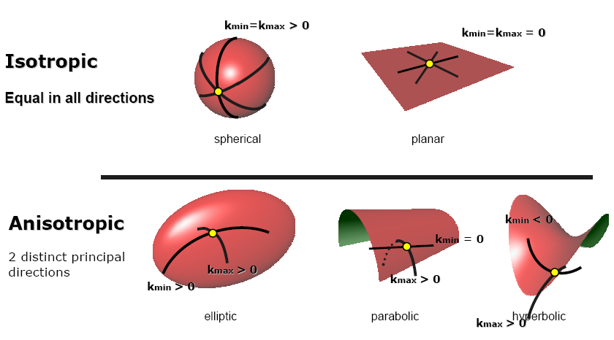
Surface Curvature

Slide 39
Laplace Operator
Laplace operator
Laplace-Beltrami operator

Slide 40

Questions?

