Slide 1

SOFTWARE SECURITY 2 / WEEK 11 · KOSEN
Memory-Safety & Exploitation
Today
Week 11
The C/C++ memory model & the stack
Software Security 2
Software Security · Nutthakorn Chalaemwongwan
Finding bugs with fuzzing
Stack overflow → control hijack
KOSEN-KMITL | Software Security 2 · Week 11
1
Notes:
Current KOSEN class: 150 minutes = quiz/review10 + brief15 + shared practical100 + debrief20 + capture5. Full deck is pre-class/reference; select only the short live explanation. Both versions: common60 plus Conventional40 OR AIR20/10/10. Viva verifies existing work, no extra score or automatic-zero gate. Hook: feed random bytes to a C program until it crashes, then turn that crash into "execute my code." This week is the closest to classic hacking — and to why the world is moving to Rust. ~2 min.

Slide 2
SOFTWARE SECURITY 2 / WEEK 11
Today
The C/C++ memory model & the stack
Finding bugs with fuzzing
Stack overflow → control hijack
Mitigations + the memory-safe language shift
🎮 Game: Fuzzing Race → Pwn the Binary
KOSEN-KMITL | Software Security 2 · Week 11
2
Notes:
Roadmap, 1 min. Arc of the week: find (fuzz) → understand (debug) → exploit (pwn) → defend (mitigations) → cure (Rust). Lab follows the same arc.

Slide 3
SOFTWARE SECURITY 2 / WEEK 11
Why this still matters
C/C++ runs the world's critical infrastructure
Memory bugs = ~70% of severe CVEs historically
Now a national-policy issue (CISA/ONCD roadmaps)
KOSEN-KMITL | Software Security 2 · Week 11
3
Notes:
Motivate hard. ~70% of Microsoft/Chrome severe CVEs are memory-safety bugs — that stat lands. It's now government policy (CISA Secure by Design, White House ONCD memory-safety report). This isn't legacy trivia; it's current. ~4 min.

Slide 4
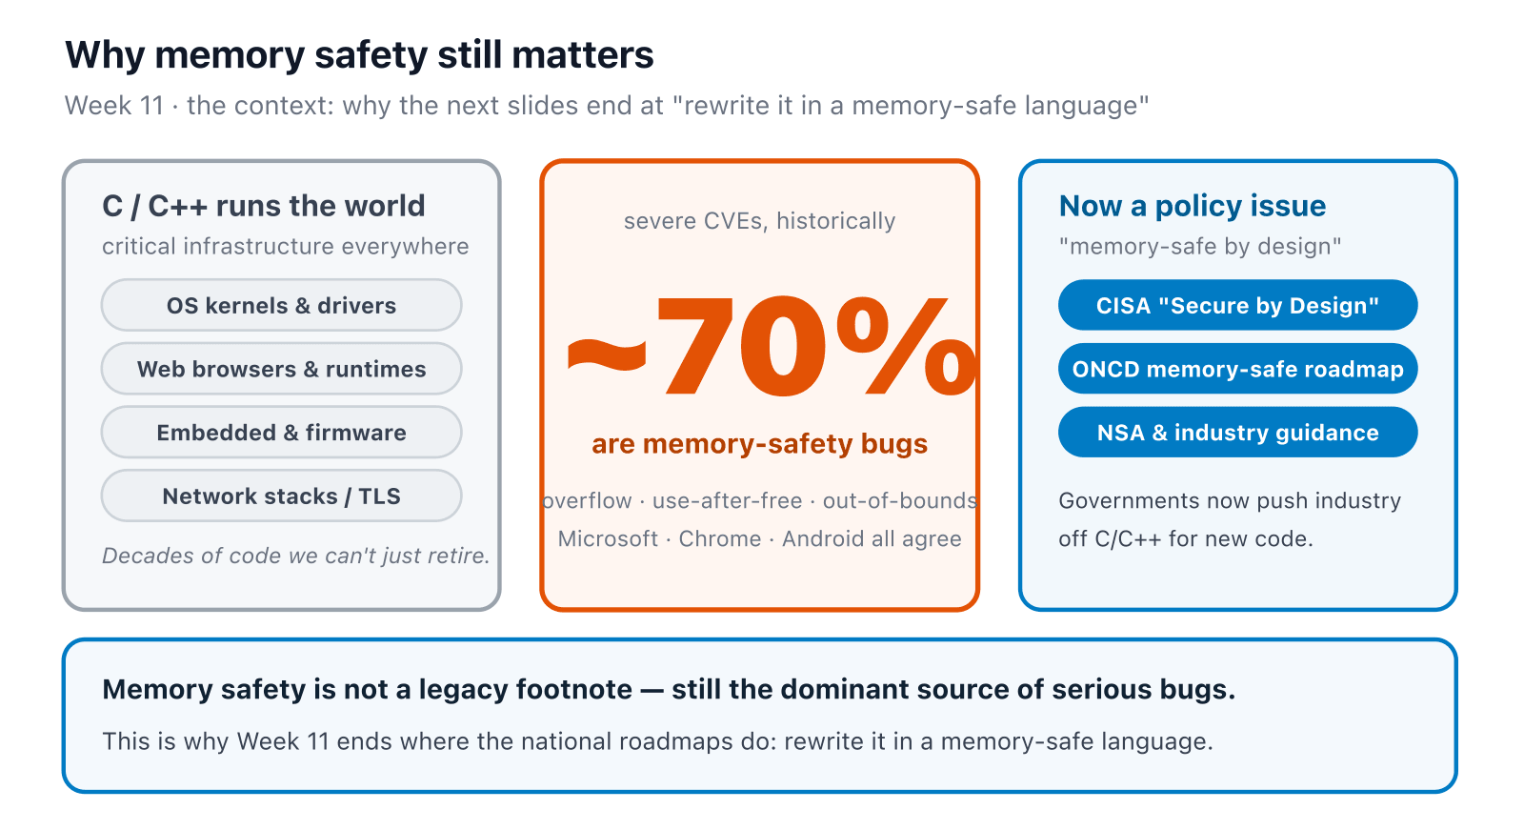
SOFTWARE SECURITY 2 / WEEK 11
Why it still matters — in one picture
KOSEN-KMITL | Software Security 2 · Week 11
4
Notes:
The visual for the motivation — point at the ~70%, say "C/C++ is everywhere AND it's where most severe bugs live," then the policy response. Sets up why the week ends with the Rust rewrite. ~1 min.

Slide 5
SOFTWARE SECURITY 2 / WEEK 11
The stack frame
gets/strcpy/unchecked memcpy → overflow
Overwrite return address → redirect execution
Try it live: /sim/stack-frame (interactive simulation, web only)
KOSEN-KMITL | Software Security 2 · Week 11
5
Notes:
The worked example — the sim IS the board drawing, live. A local buffer sits BELOW the saved return address; writing past the buffer marches upward into the return address. Control the return address = control where the CPU jumps next. This is THE concept of the week. ~8 min.

Slide 6
SOFTWARE SECURITY 2 / WEEK 11
Bug classes
CWE-121 stack overflow · CWE-787 OOB write
CWE-134 format string · CWE-242 dangerous function (gets())
(this week's binary: no UAF, no off-by-one — those are real bug classes but not in this lab's code)
KOSEN-KMITL | Software Security 2 · Week 11
6
Notes:
Map the family — these four are what's actually in vuln.c/fuzz_harness.c, verified against the source. UAF and off-by-one are legitimate classes worth mentioning exist, but don't cite them as "this week's bug classes" — nothing here demonstrates them. CWE-121 (this week's actual bug) ranks #14 in the 2025 CWE Top 25 — a stronger, on-topic stat than the old CWE-787-was-#1 line, which is now #5. ~3 min.

Slide 7
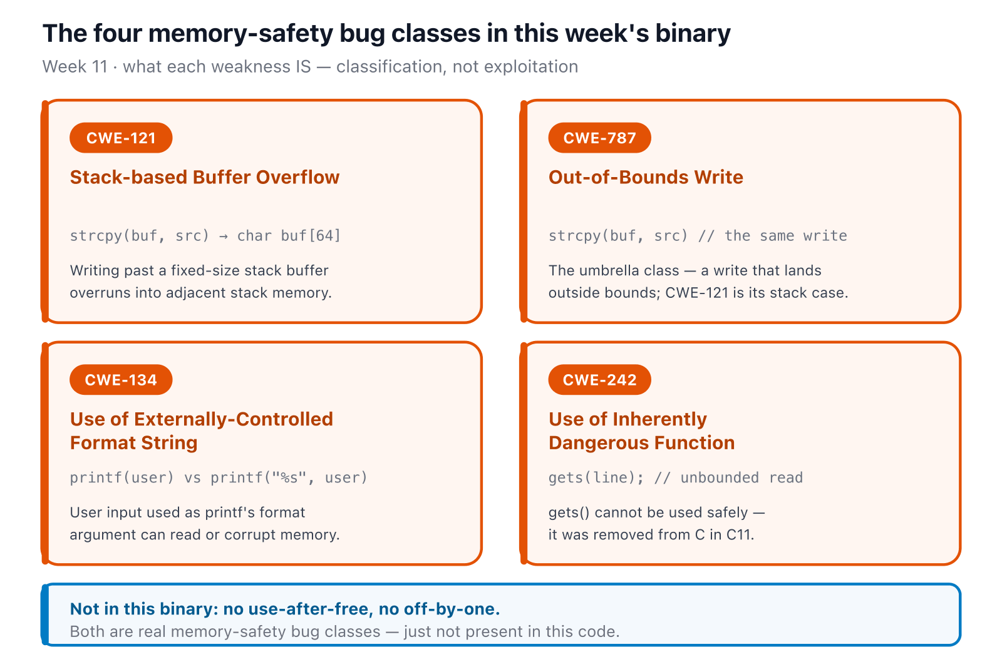
SOFTWARE SECURITY 2 / WEEK 11
The four bug classes, side by side
KOSEN-KMITL | Software Security 2 · Week 11
7
Notes:
The four classes as cards — each is a weakness definition (what it IS), not a how-to. Point out CWE-121 is the stack case of the CWE-787 umbrella, and that gets() (CWE-242) is so unsafe it was removed from the C standard. Keep the UAF/off-by-one footnote honest — those aren't in this binary. ~1 min.

Slide 8
SOFTWARE SECURITY 2 / WEEK 11
Fuzzing — how bugs are found today
clang -g -fsanitize=address,fuzzer fuzz_harness.c -o fuzz && ./fuzz # libFuzzer
Coverage-guided mutation finds crashes fast
Pair with sanitizers (ASan) for root cause
The toolbox has libFuzzer, not AFL++ — one fuzzer is plenty for this lab
KOSEN-KMITL | Software Security 2 · Week 11
8
Notes:
Connect to W2 fuzzing (now hands-on). Coverage-guided = the fuzzer mutates inputs and keeps the ones that reach NEW code, so it "learns" its way to deep bugs. ASan turns a silent corruption into a precise crash report. This is round 1 of the game. ~6 min.

Slide 9
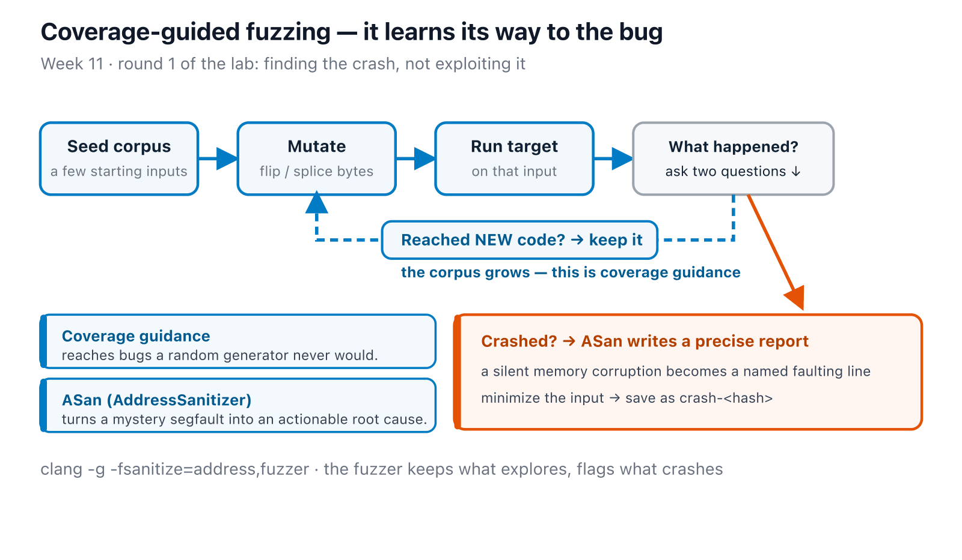
SOFTWARE SECURITY 2 / WEEK 11
Fuzzing — how bugs are found today (cont.)
KOSEN-KMITL | Software Security 2 · Week 11
9
Notes:
Connect to W2 fuzzing (now hands-on). Coverage-guided = the fuzzer mutates inputs and keeps the ones that reach NEW code, so it "learns" its way to deep bugs. ASan turns a silent corruption into a precise crash report. This is round 1 of the game. ~6 min.

Slide 10
SOFTWARE SECURITY 2 / WEEK 11
Exploiting a stack overflow
1
Measure the return-address offset in the issued binary: use a cyclic pattern with a working debugger, or disassembly plus a successful exploit control if ptrace fails under emulation. Do not assume 72 bytes applies to another build.
2
Overwrite RA → jump to win()
3
Format string: %x%x%x leak, %n write
KOSEN-KMITL | Software Security 2 · Week 11
10
Notes:
Walk the exploit method. Cyclic pattern (De Bruijn) tells you exactly how many bytes for THIS specific build — stress that 72 is a fact about the unhardened binary, not a fact about the bug; the sim/exploit-chain diagram shows this shift explicitly. Then overwrite it with the address of win(). Format string: %x leaks stack, %n writes — a primitive most students haven't seen. This is round 2 (pwn). ~6 min.

Slide 11
SOFTWARE SECURITY 2 / WEEK 11
Mitigations raise the bar
FORTIFY_SOURCE — checks the copy itself, at call time (__stpcpy_chk or __strcpy_chk, depending on the compiler)
Stack canaries — detect overwrite at function return, after the copy already happened
ASLR / PIE — randomize addresses
NX/DEP — blocks executing shellcode planted on the stack — irrelevant to this exploit, which returns into existing code (win()), never injects shellcode
On this lab's hardened build, FORTIFY fires first — *** buffer overflow detected ***: terminated. The canary never gets a chance to speak. Verify the order yourself before teaching it as "canary catches it" — that's the wrong answer this lab's own materials were rewritten to correct.
KOSEN-KMITL | Software Security 2 · Week 11
11
Notes:
THE key correction this slide needed: FORTIFY_SOURCE checks at the copy call, before the function even returns — so on the hardened build it always wins the race against the canary, which only checks at return time. This lab's own interactive sim literally calls "the canary detects it" the week's most reliable wrong answer — don't teach it. NX is a real mitigation but not for THIS exploit (ret2win, no injected shellcode) — say so explicitly rather than implying all four defenses equally harden the one attack just demonstrated. Worksheet Q4 grades naming all four (canary/PIE/NX/FORTIFY) + what each defeats — FORTIFY must be on this slide. ~5 min.

Slide 12
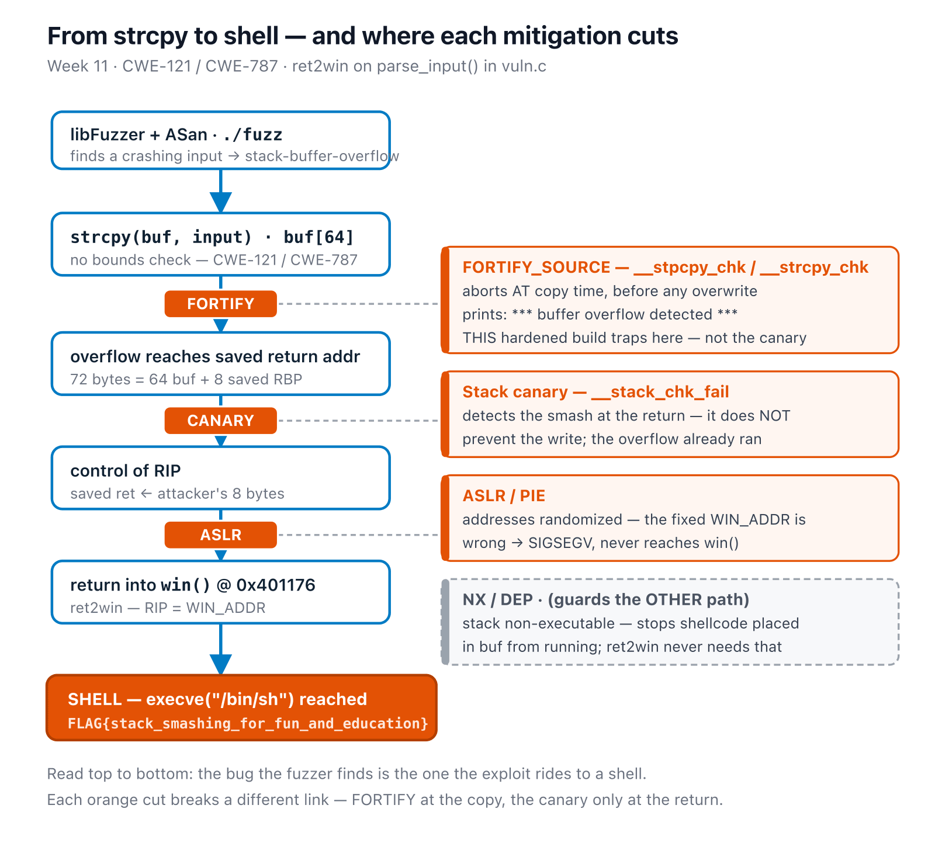
SOFTWARE SECURITY 2 / WEEK 11
From strcpy to shell — where each mitigation cuts the chain
KOSEN-KMITL | Software Security 2 · Week 11
12
Notes:
Walk it top to bottom exactly once — this is the whole week's argument as one picture: which mitigation actually stops THIS exploit, and in what order they'd fire if more than one were present. Land on the same correction as the last slide: FORTIFY wins the race against the canary, every time, on this build. ~4 min.

Slide 13
SOFTWARE SECURITY 2 / WEEK 11
The real fix: memory-safe languages
Safe Rust and managed Go code prevent the unchecked memory writes shown here; unsafe/native boundaries need separate review
CISA "Secure by Design" + ONCD: move off C/C++ for new code
Rust borrow checking and bounds checks, or Go runtime checks, prevent this C-style unchecked buffer write
KOSEN-KMITL | Software Security 2 · Week 11
13
Notes:
The thesis of the week. Explain what safe Rust prevents in this counting task, then name the boundary: unsafe blocks, native interfaces and input/resource errors are not removed by choosing a language. Go has garbage collection and runtime bounds checks, not Rust's borrow checker. ~4 min.

Slide 14
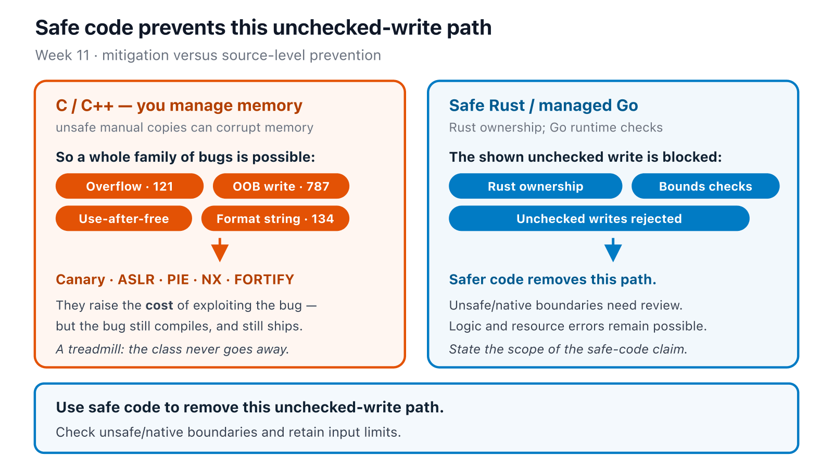
SOFTWARE SECURITY 2 / WEEK 11
The real fix: memory-safe languages (cont.)
KOSEN-KMITL | Software Security 2 · Week 11
14
Notes:
The thesis of the week. Explain what safe Rust prevents in this counting task, then name the boundary: unsafe blocks, native interfaces and input/resource errors are not removed by choosing a language. Go has garbage collection and runtime bounds checks, not Rust's borrow checker. ~4 min.

Slide 15
SOFTWARE SECURITY 2 / WEEK 11
💥 Game — Fuzzing Race → Pwn the Binary
1
Round 1 (Fuzzing Race): first team to crash the target wins
2
Round 2 (Pwn): exploit the overflow / format string
3
Round 3 (Defend): test the supplied hardened build, then implement the bounded safe counting function in student_safe.rs; a full rewrite is extension practice
KOSEN-KMITL | Software Security 2 · Week 11
15
Notes:
Explain the 3 rounds before lab. Round 1 = reproducible crash. Round 2 = measured ret2win in the isolated toolbox. Round 3 = hardened control plus student-authored Rust counting function. If ptrace fails under emulation, accept disassembly with the actual binary and exploit control. The weekly quiz runs before the lab; capture these results in the worksheet. ~3 min.

Slide 16
SOFTWARE SECURITY 2 / WEEK 11
Deliverable
📋 Worksheet 11 — labs/week11-memory-safety-exploitation/worksheet.md · follow the 100-minute core run sheet.
Seeded fuzz/replay and measured ret2win evidence from the issued isolated toolchain
Hardened-build control and its actual observed failure mode
Your student_safe.rs counting change plus python3 check_student.py controls; state memory-safety/input-error limitations
Assigned written version only: Conventional Part 2/4 (20/20) or AIR Audit/EiPE/Prompt (20/10/10), after the shared practical 60.
KOSEN-KMITL | Software Security 2 · Week 11
16
Notes:
No promise that safe Rust can never panic or reject input. Measure the actual architecture/build, and do not execute vulnerable binaries on the host.

Slide 17
SOFTWARE SECURITY 2 / WEEK 11
Key takeaways
Fuzz to find, debug to understand, mitigate to slow attackers
Mitigations raise exploit cost; safe memory handling removes this unchecked-write path
This is where the industry is moving
KOSEN-KMITL | Software Security 2 · Week 11
17
Notes:
Recap. Cold-call: "why aren't stack canaries enough?" (they detect, don't prevent; bypassable via leaks — the cure is memory safety). ~2 min.

Slide 18
SOFTWARE SECURITY 2 / WEEK 11
Questions?
Next week: Software supply-chain security
KOSEN-KMITL | Software Security 2 · Week 11
18
Notes:
Cliffhanger: "Next week — one poisoned dependency owns thousands of victims; we'll replay xz and SolarWinds-style attacks."

Slide 19
SOFTWARE SECURITY 2 / WEEK 11
Current class hand-in
Class: quiz/review 10 + explanation/demo 15 + supervised practice 100 + debrief 20 + evidence capture 5 minutes. Prepare tools, images and access before class. The full reference tasks remain below; their standalone estimates are not an instruction to finish the entire bank during the class. Assessment: all students complete the shared practical 60/100 plus one assigned version's 40/100. Conventional uses the ordinary Part 2 questions (20) and Part 4 reflection (20).
AIR-Sec uses Audit-the-AI (20), Explain-in-Plain-English (10) and Prompt Problem (10). The unassigned written version is reference practice, not an extra requirement. Each teaching worksheet contributes 2.5 course points, making 12 individual worksheets worth 30 in total. Both versions submit their own commands/results and explanation, and complete the student patch and control tests where assigned.
KOSEN-KMITL | Software Security 2 · Week 11
19

Slide 20
SOFTWARE SECURITY 2 / WEEK 11
Current class hand-in (cont.)
Personal flags are used only for an actually issued instance; a local demo flag alone does not demonstrate understanding. Viva/reproduction checks verify the existing work within its rubric: no additional points or automatic-zero gate. 100-minute core run sheet (time, not points): Seeded fuzz/replay 20; measure and try ret2win 25; hardened control 20; student safe-routine edit 25; interpret evidence 10. The practical rubric is 20 + 20 + 20 = 60 points.
Use the instructor-preflighted isolated Linux toolchain for the C exploits; collect the actual architecture, compiler and measured offset. Complete the safe count_chars() function in student_safe.rs and run python3 check_student.py; that benign Rust task can also run on the host. It checks Unicode counting, metacharacters and orderly invalid-input rejection. Do not equate memory safety with a promise that a program can never panic or encounter an input/resource error.
KOSEN-KMITL | Software Security 2 · Week 11
20

