Slide 1

SOFTWARE SECURITY 2 / WEEK 12 · KOSEN
Software Supply-Chain Security
Today
Week 12
Why the supply chain is now top-tier
Software Security 2
Software Security · Nutthakorn Chalaemwongwan
Dependency confusion & typosquatting
SBOMs, SLSA provenance
KOSEN-KMITL | Software Security 2 · Week 12
1
Notes:
Current KOSEN class: 150 minutes = quiz/review10 + brief15 + shared practical100 + debrief20 + capture5. Full deck is pre-class/reference; select only the short live explanation. Both versions: common60 plus Conventional40 OR AIR20/10/10. Viva verifies existing work, no extra score or automatic-zero gate. Hook: ask how many lines of code they wrote in their last project vs how many they shipped. The gap is dependencies — and that's the attack surface this week. One poisoned package = thousands of victims. ~2 min.

Slide 2
SOFTWARE SECURITY 2 / WEEK 12
Today
Why the supply chain is now top-tier
Dependency confusion & typosquatting
SBOMs, SLSA provenance
Signing with Sigstore/Cosign
🎮 Game: Dependency Confusion Heist
KOSEN-KMITL | Software Security 2 · Week 12
2
Notes:
Roadmap, 1 min. Three verbs to remember all week: KNOW your ingredients (SBOM), PROVE your build (SLSA), SIGN your artifacts (Cosign).

Slide 3
SOFTWARE SECURITY 2 / WEEK 12
The new #1 design risk
Your code is ~10% yours, ~90% dependencies
One bad package → thousands of victims (xz, event-stream, SolarWinds)
OWASP A03:2025 Software Supply Chain Failures
KOSEN-KMITL | Software Security 2 · Week 12
3
Notes:
New in OWASP 2025 — promoted to A03, reflecting reality. The 10/90 ratio shocks students. You can write perfect code and still be owned through a dependency you never read. ~4 min.

Slide 4
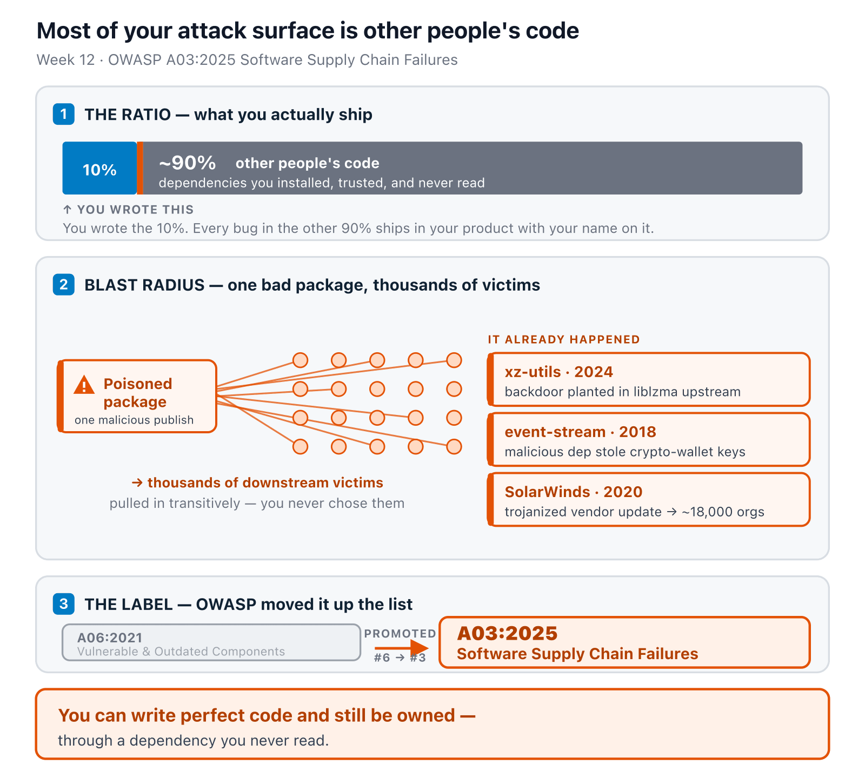
SOFTWARE SECURITY 2 / WEEK 12
Most of your attack surface is other people's code
KOSEN-KMITL | Software Security 2 · Week 12
4
Notes:
The 10/90 ratio made visual — land it hard, then the blast radius (one publish → thousands), then the A03:2025 promotion. The closing line is the week's thesis. ~2 min.

Slide 5
SOFTWARE SECURITY 2 / WEEK 12
Real supply-chain attacks
Case | What happened
SolarWinds (2020) | trojanized vendor update → 18k orgs
Log4Shell (2021) | RCE in a ubiquitous logging dep
event-stream (npm) | malicious dep stole crypto-wallet keys
XZ Utils (2024) | backdoor planted in liblzma upstream
CircleCI (2023) | stolen CI tokens → customer secrets
Attacks are shifting upstream: registry → maintainer → CI/CD.
KOSEN-KMITL | Software Security 2 · Week 12
5
Notes:
Spend time on xz (2024): a patient attacker became a trusted maintainer over years, then planted a backdoor caught only by luck (a 0.5s SSH delay). The lesson: trust in maintainers is itself attackable. ~5 min.

Slide 6
SOFTWARE SECURITY 2 / WEEK 12
Attack vectors
Typosquatting — reqeusts vs requests; the malicious package's setup.py runs at install time, before any of your code runs — you don't have to import it to be owned
Dependency confusion (CWE-1357) — public pkg shadows internal name
Malicious updates — compromised maintainer
Transitive risk — deps of deps you never chose
KOSEN-KMITL | Software Security 2 · Week 12
6
Notes:
Define dependency confusion clearly (it's the game): if your internal pkg "acme-utils" isn't scoped, a public "acme-utils" with a higher version number can get pulled instead. Transitive = you vet your 10 deps, but they pull 800 you never saw. Stress the install-time-execution point — it's why "I never imported it" isn't a defense, and explain that this lab models index selection rather than installing a malicious package. ~5 min.

Slide 7
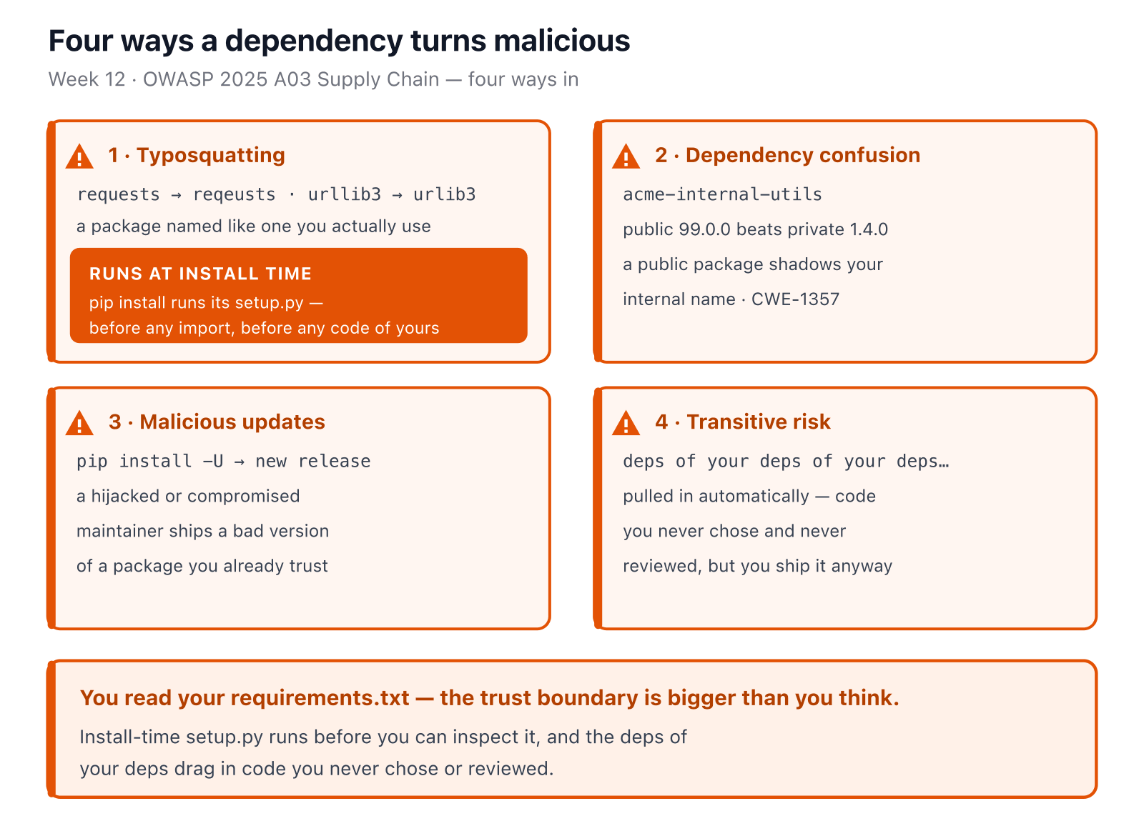
SOFTWARE SECURITY 2 / WEEK 12
Four ways a dependency turns malicious
KOSEN-KMITL | Software Security 2 · Week 12
7
Notes:
The four vectors as cards — the one to hammer is install-time execution (typosquat setup.py), because it kills the "I never imported it" defense but this lab does not install a malicious package or create a PWNED marker. Dependency confusion is the game. ~2 min.

Slide 8
SOFTWARE SECURITY 2 / WEEK 12
Try it — which package actually installs?
Set both versions and the index mode. This bounded single-package comparison demonstrates index selection; it is not pip's complete resolver.
Try it live: /sim/resolver-confusion (interactive simulation, web only)
KOSEN-KMITL | Software Security 2 · Week 12
8
Notes:
Let them find the uncomfortable case themselves: merged mode with the private version numerically HIGHER also happens to be "safe" — but say explicitly that this is not a defense, just luck, since the attacker picks their own version number and will publish something higher. The only real fix in this sim is switching to single-index mode. Ties directly to Task 2 and Task 4's defense #2. ~4 min.

Slide 9
SOFTWARE SECURITY 2 / WEEK 12
SCA — find vulnerable deps
docker run --rm -v "$PWD:/src" aquasec/trivy fs /src # this lab's Python deps
pip-audit # vs PyPI advisories
Produces CVEs + fix versions
CWE-1104 (unmaintained), CWE-829 (untrusted inclusion), CWE-1395 (known-vulnerable 3rd-party dependency)
KOSEN-KMITL | Software Security 2 · Week 12
9
Notes:
Hands-on tooling (ties to W2 SCA). This lab is pure Python — no npm project — so it's trivy fs + pip-audit, not npm audit/dependency-check. Run trivy live on the project — it lists CVEs + the fixed version. The diagram's one job: SCA ≠ SAST. SAST = your code, your bugs; SCA = your versions, other people's known bugs, fix = bump the pin. Don't read the worklist rows aloud — they'll run it live; point at the "→ FIXED IN" column and say "that's the whole remediation, a version number." Q6 of the quiz asks for one real vulnerable dependency they found + remediation. ~4 min.

Slide 10
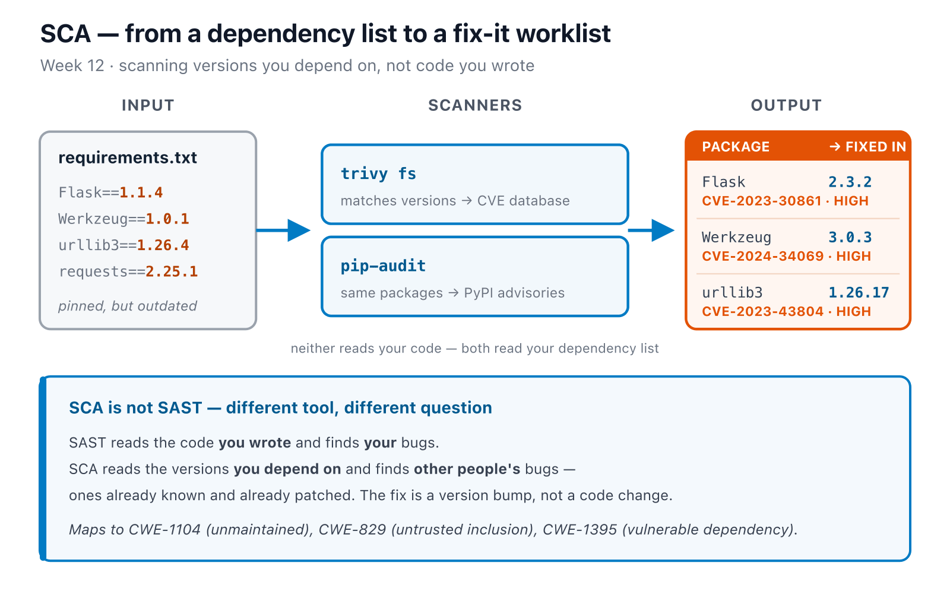
SOFTWARE SECURITY 2 / WEEK 12
SCA — find vulnerable deps (cont.)
KOSEN-KMITL | Software Security 2 · Week 12
10
Notes:
Hands-on tooling (ties to W2 SCA). This lab is pure Python — no npm project — so it's trivy fs + pip-audit, not npm audit/dependency-check. Run trivy live on the project — it lists CVEs + the fixed version. The diagram's one job: SCA ≠ SAST. SAST = your code, your bugs; SCA = your versions, other people's known bugs, fix = bump the pin. Don't read the worklist rows aloud — they'll run it live; point at the "→ FIXED IN" column and say "that's the whole remediation, a version number." Q6 of the quiz asks for one real vulnerable dependency they found + remediation. ~4 min.

Slide 11
SOFTWARE SECURITY 2 / WEEK 12
Integrity: prove what you shipped
SBOM (CycloneDX/SPDX) — ingredient list of the build
SLSA — levels of build provenance & tamper-resistance
A08:2025 Software/Data Integrity Failures
KOSEN-KMITL | Software Security 2 · Week 12
11
Notes:
SBOM = the food-label analogy: you can't manage what you can't list. When the next Log4Shell drops, an SBOM answers "are we affected?" in seconds. SLSA Build Track = levels L0–L3 of build provenance / tamper-resistance (L3 is the top; the old "1–4" numbering was v0.1 and is deprecated). ~5 min.

Slide 12
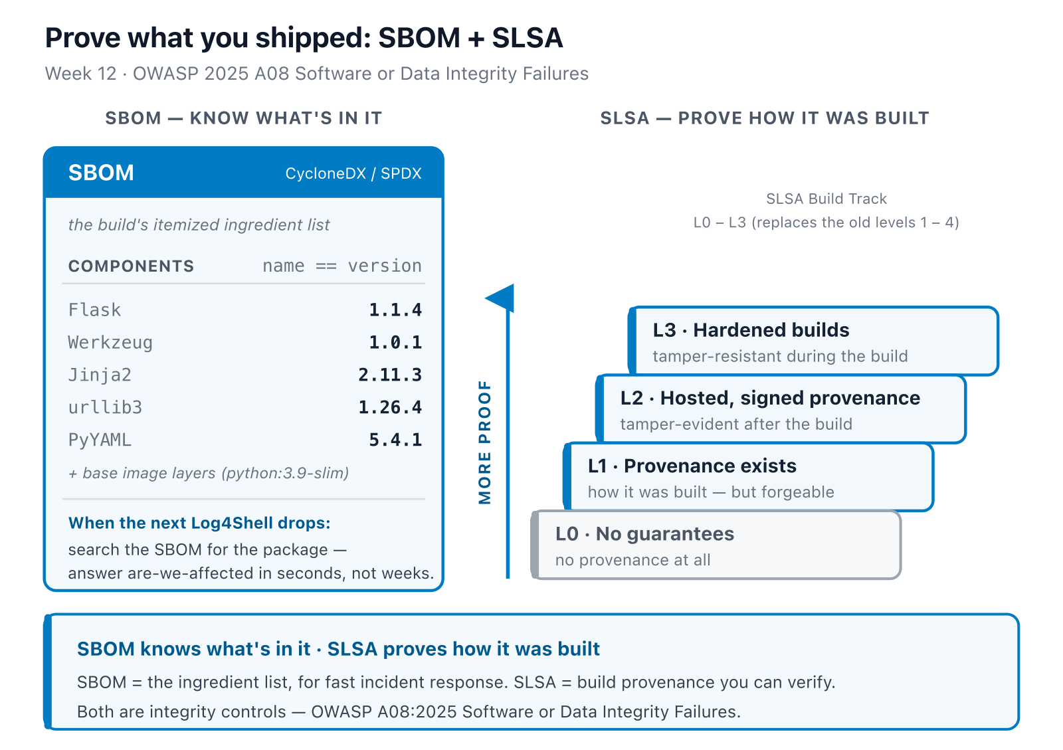
SOFTWARE SECURITY 2 / WEEK 12
Know what's in it, prove how it was built
KOSEN-KMITL | Software Security 2 · Week 12
12
Notes:
SBOM = food label (know the ingredients, fast incident response); SLSA = the provenance ladder L0-L3 (prove how it was built). Two different questions, both integrity. Note the L0-L3 numbering replaces the deprecated 1-4. ~2 min.

Slide 13
SOFTWARE SECURITY 2 / WEEK 12
Signing with Cosign (keyless)
IMG=week12-supplychain:lab
docker run -d --rm --name reg -p 5500:5000 registry:2 # cosign signs a REGISTRY ref,
docker tag "$IMG" localhost:5500/$IMG && docker push localhost:5500/$IMG # not a bare local tag
docker run --rm -v "$PWD:/src" -v /var/run/docker.sock:/var/run/docker.sock \
aquasec/trivy:latest image --format cyclonedx \
--output /src/sbom.cdx.json "$IMG" # SBOM (reads the local image fine)
docker run --rm -it -e COSIGN_EXPERIMENTAL=1 --network host \
gcr.io/projectsigstore/cosign:latest sign --yes localhost:5500/$IMG # sign (OIDC)
docker run --rm -e COSIGN_EXPERIMENTAL=1 --network host \
gcr.io/projectsigstore/cosign:latest verify \
--certificate-identity-regexp ".*" \
--certificate-oidc-issuer-regexp ".*" localhost:5500/$IMG # verify
KOSEN-KMITL | Software Security 2 · Week 12
13
Notes:
Demo the sign→verify loop. sign.sh runs both tools dockerized — match that here, not a bare local binary. Keyless (Sigstore) = identity-based signing via OIDC through Fulcio, logged in Rekor, no key to leak — name both by name, worksheet Q4 grades on the vocabulary. The deploy gate: refuse any image that doesn't verify → a tampered artifact can't ship. This is the lab's defend step. ~4 min.

Slide 14
SOFTWARE SECURITY 2 / WEEK 12
Signing with Cosign (keyless) (cont.)
Unsigned/tampered image → verification fails
cosign sign/verify need a registry reference — mounting the docker socket only lets trivy read the local image; cosign has nowhere to attach a signature until the image is pushed somewhere, so sign.sh starts a throwaway local registry first
Every step needs the docker-socket mount (trivy has to reach the local image, not just a local dir) — the SBOM step is a common copy-paste failure if it's dropped
cosign verify needs the two --certificate-*-regexp flags in keyless mode — without them it errors, it doesn't just "fail closed"
The demo's ".*" identity/issuer patterns accept any signer. Pin the expected identity and issuer in a real admission policy; a mathematically valid signature alone is insufficient.
Keyless signing uses Fulcio (short-lived certificate) + Rekor (transparency log) and avoids storing a long-lived signing key locally. CWE-321 specifically means a hard-coded cryptographic key, not every managed long-lived key.
KOSEN-KMITL | Software Security 2 · Week 12
14
Notes:
Demo the sign→verify loop. sign.sh runs both tools dockerized — match that here, not a bare local binary. Keyless (Sigstore) = identity-based signing via OIDC through Fulcio, logged in Rekor, no key to leak — name both by name, worksheet Q4 grades on the vocabulary. The deploy gate: refuse any image that doesn't verify → a tampered artifact can't ship. This is the lab's defend step. ~4 min.

Slide 15
SOFTWARE SECURITY 2 / WEEK 12
Keyless signing — the flow
1
Authenticate the signer with OIDC; Fulcio binds an ephemeral public key to that identity in a short-lived certificate.
2
Cosign signs the artifact; Rekor records the signing event for transparency.
3
At deploy, verify the artifact signature and the expected identity/issuer. Reject unsigned, changed or wrong-signer artifacts.
4
The local Week 12 RSA fixture teaches this signer-trust decision without requiring a registry or OIDC login. Keyless signing reduces long-lived signing-key handling; it does not prove the build was trustworthy.
KOSEN-KMITL | Software Security 2 · Week 12
15
Notes:
CWE-321 names a hard-coded cryptographic key, not every protected long-lived key. Use this text flow rather than the superseded sigstore-keyless.svg, which conflates those cases. Sigstore identity and Rekor evidence must be checked against an expected policy.

Slide 16
SOFTWARE SECURITY 2 / WEEK 12
Verify the signature — does it deploy?
Signed, unsigned, tampered, or signed by someone else. Run the gate and watch.
Try it live: /sim/cosign-verify (interactive simulation, web only)
KOSEN-KMITL | Software Security 2 · Week 12
16
Notes:
The interactive companion to the keyless-signing diagram: it runs cosign's VERIFY logic in the page, so students drive the deploy gate themselves. Walk the four image states: unsigned → "no signatures found"; tampered → the signature no longer matches the digest; our CI → deploys; signed by another identity → blocked ONLY if the policy pins the expected signer. The move that lands the lesson: flip "pin the expected signer" OFF (the lab command's own '.*') and the attacker's validly-signed image deploys — a valid signature is not a signature you should trust. That's why the two --certificate-*-regexp flags from the previous slide must name YOUR identity, not '.*'. Ties to Task 3's verify-before-deploy gate and worksheet Q4. ~3 min.

Slide 17
SOFTWARE SECURITY 2 / WEEK 12
Tooling — GitHub Advanced Security (GHAS)
Secret scanning + push protection — block secrets at push time (before they reach the remote)
CodeQL code scanning — semantic SAST queries
Dependabot — alerts + auto-PRs for vulnerable deps
Native in the repo → results in the Security tab
KOSEN-KMITL | Software Security 2 · Week 12
17
Notes:
The managed option students will meet in industry. Dependabot is the practical supply-chain workhorse: it opens PRs bumping vulnerable deps automatically. Push protection stops secrets at push time — local commits with a secret are allowed, the block fires on push to the remote (recall W2). ~3 min.

Slide 18
SOFTWARE SECURITY 2 / WEEK 12
Defenses
pip install --require-hashes — a substituted package's hash won't match; install refuses
Single --index-url, not --extra-index-url — one trusted index; the resolver won't "shop around" and pick a higher-versioned public package over your internal one
Verify signatures before deploy (admission policy)
Generate + store SBOMs per release
2FA/MFA on dev/CI/cloud accounts; least privilege
Automate SCA in CI (next week)
KOSEN-KMITL | Software Security 2 · Week 12
18
Notes:
The payoff checklist, now with the exact flags Task 4 grades. --require-hashes and single-index-url are what actually stops dependency confusion — "pin + scope" alone is too vague to reconstruct on the exam. Verify-before-deploy kills tampered artifacts; MFA on maintainer/CI accounts kills the xz/CircleCI vector. "Automate in CI" sets up W15. ~4 min.

Slide 19
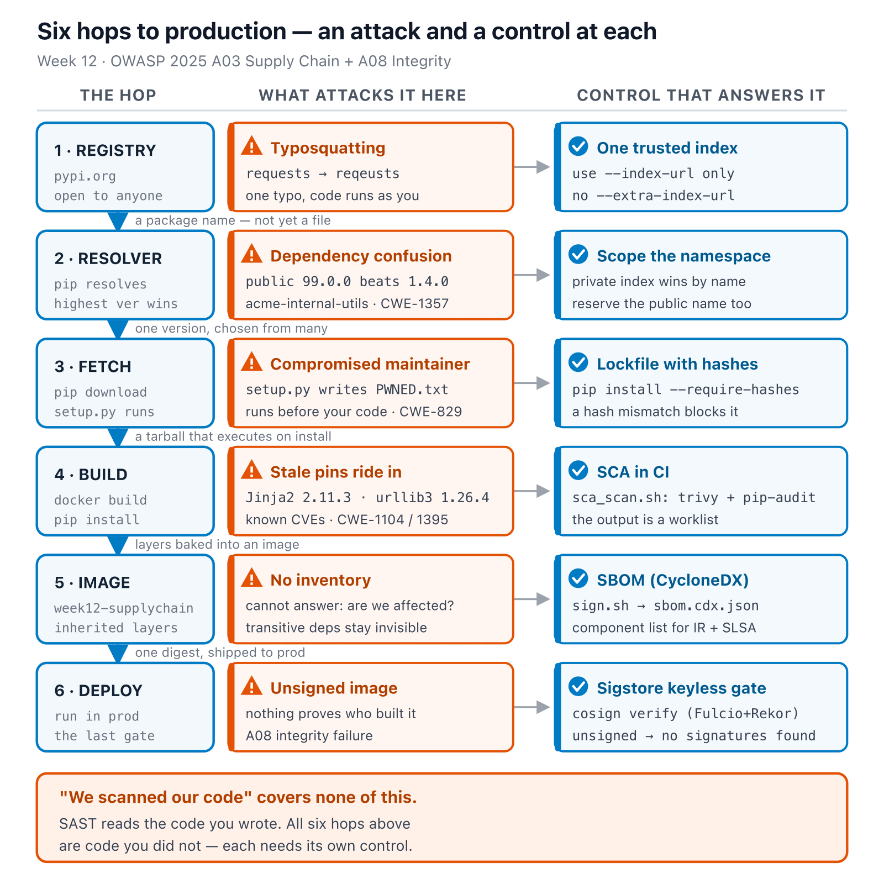
SOFTWARE SECURITY 2 / WEEK 12
The whole journey, one dependency
KOSEN-KMITL | Software Security 2 · Week 12
19
Notes:
The synthesis slide — everything from the last five slides (SAST/SCA, SBOM, Cosign, the defenses checklist) is one column each in this diagram, chained in the order a real dependency actually travels. Walk it left to right ONE time, don't re-teach each hop — the point is showing they were never separate tools, they're six links in the same chain. Land on the closing line before moving to the game. ~5 min.

Slide 20
SOFTWARE SECURITY 2 / WEEK 12
📦 Game — Dependency Confusion Heist
1
Attack: no live registry in this lab — use the resolver simulation to watch a higher-version public pkg beat the private one
2
Required core: declared-component SBOM, bounded resolver/hash controls and a real signature against the trusted key
3
Prepared extension: full image inventory, keyless Cosign and a provenance gate
KOSEN-KMITL | Software Security 2 · Week 12
20
Notes:
Explain before lab — the resolver simulation stands in for a live registry (ethics: never publish a real typosquat). The bounded offline controls carry the shared practical points. Deeper SLSA analysis is reference/extension practice, or part of the assigned Conventional reflection. ~3 min.

Slide 21
SOFTWARE SECURITY 2 / WEEK 12
Deliverable
📋 Worksheet 12 — labs/week12-supply-chain/worksheet.md · follow the 100-minute core run sheet.
Supplied SCA snapshot analysis, or a clearly identified personal scan, plus remediation reasoning
python3 sbom_core.py declared-component inventory and the two resolver_core.py index-mode results
Your trusted-key pin diff and real signature positive/tamper/wrong-signer transcript
Hash/index control and the distinction between component inventory, signature trust and build provenance
Assigned written version only: Conventional Part 2/4 (20/20) or AIR Audit/EiPE/Prompt (20/10/10), after the shared practical 60.
KOSEN-KMITL | Software Security 2 · Week 12
21
Notes:
The required core works without registry/OIDC. Full image SBOM, Cosign keyless signing and deeper SLSA self-assessment are prepared extension practice; signatures plus inventory do not automatically establish a SLSA level.

Slide 22
SOFTWARE SECURITY 2 / WEEK 12
Key takeaways
Most of your attack surface is other people's code
Know your ingredients (SBOM), prove your build (SLSA), sign your artifacts
Verify before you trust
KOSEN-KMITL | Software Security 2 · Week 12
22
Notes:
Recap with the three verbs. Cold-call: "the next Log4Shell drops at 2am — what artifact tells you if you're affected?" (the SBOM). ~2 min.

Slide 23
SOFTWARE SECURITY 2 / WEEK 12
Questions?
Next week: Cloud & container security
KOSEN-KMITL | Software Security 2 · Week 12
23
Notes:
Cliffhanger: "Next week — where your code runs. We'll hunt cloud/container misconfigs, the #1 real-world breach cause."

Slide 24
SOFTWARE SECURITY 2 / WEEK 12
Current class hand-in
Class: quiz/review 10 + explanation/demo 15 + supervised practice 100 + debrief 20 + evidence capture 5 minutes. Prepare tools, images and access before class. The full reference tasks remain below; their standalone estimates are not an instruction to finish the entire bank during the class. Assessment: all students complete the shared practical 60/100 plus one assigned version's 40/100. Conventional uses the ordinary Part 2 questions (20) and Part 4 reflection (20).
AIR-Sec uses Audit-the-AI (20), Explain-in-Plain-English (10) and Prompt Problem (10). The unassigned written version is reference practice, not an extra requirement. Each teaching worksheet contributes 2.5 course points, making 12 individual worksheets worth 30 in total. Both versions submit their own commands/results and explanation, and complete the student patch and control tests where assigned.
KOSEN-KMITL | Software Security 2 · Week 12
24

Slide 25
SOFTWARE SECURITY 2 / WEEK 12
Current class hand-in (cont.)
Personal flags are used only for an actually issued instance; a local demo flag alone does not demonstrate understanding. Viva/reproduction checks verify the existing work within its rubric: no additional points or automatic-zero gate. 100-minute core run sheet (time, not points): Review SCA finding 20; resolver case 15; read/generate SBOM 20; student key-pin plus signature controls 30; hash/index control 15. The practical rubric is 20 + 20 + 20 = 60 points.
Complete trusted_key() in student_task.py, then run python3 check_student.py. The supplied signature-core/ packet contains a real RSA signature, a trusted public-key fingerprint, and an independently signed wrong-key control. Verification uses OpenSSL and no login. This is explicitly key-based artifact verification, not an OIDC/keyless-signing simulation. It demonstrates the key-trust prerequisite.
KOSEN-KMITL | Software Security 2 · Week 12
25

Slide 26
SOFTWARE SECURITY 2 / WEEK 12
Current class hand-in (cont.)
Retain the real Cosign keyless/registry flow below as an instructor-prepared demo or extension; no external login or transparency-log publication is required for full worksheet marks. Prepare the SCA database, image and SBOM before class where downloads would consume the slot.
KOSEN-KMITL | Software Security 2 · Week 12
26

