Slide 1

SOFTWARE SECURITY 2 / WEEK 13 · KOSEN
Cloud & Container Security
Today
Week 13
Shared-responsibility model
Software Security 2
Software Security · Nutthakorn Chalaemwongwan
IAM (who can do what) & least privilege
Secrets management
KOSEN-KMITL | Software Security 2 · Week 13
1
Notes:
Current KOSEN class: 150 minutes = quiz/review10 + brief15 + shared practical100 + debrief20 + capture5. Full deck is pre-class/reference; select only the short live explanation. Both versions: common60 plus Conventional40 OR AIR20/10/10. Viva verifies existing work, no extra score or automatic-zero gate. Hook: most cloud breaches aren't clever zero-days — they're a public S3 bucket or a `*:*` IAM policy. Today we hunt and fix those misconfigs. ~2 min.

Slide 2
SOFTWARE SECURITY 2 / WEEK 13
Today
Shared-responsibility model
IAM (who can do what) & least privilege
Secrets management
Container/image hardening
🎮 Game: Misconfig Hunt
KOSEN-KMITL | Software Security 2 · Week 13
2
Notes:
Roadmap, 1 min. Theme: the cloud is secure; your CONFIGURATION usually isn't. Lab = find + fix misconfigurations, each one a flag.

Slide 3
SOFTWARE SECURITY 2 / WEEK 13
Recap & framing
Supply chain → what you build with
Today → where you run it
OWASP A02:2025 Security Misconfiguration (now #2)
KOSEN-KMITL | Software Security 2 · Week 13
3
Notes:
1-min bridge. Misconfiguration jumped to A02 in 2025 — it's not a footnote, it's the second most critical web risk. Then the story spine: one app, three layers — today we package it and give it cloud permissions (W13), next we add an AI chatbot to it (W14), last we put a pipeline in front of all of it (W15). Same root mistake all day: trusting input and defaults nobody checked. ~2 min.

Slide 4
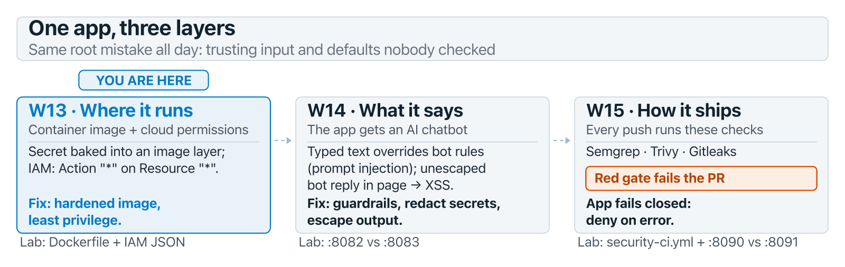
SOFTWARE SECURITY 2 / WEEK 13
Recap & framing (cont.)
KOSEN-KMITL | Software Security 2 · Week 13
4
Notes:
1-min bridge. Misconfiguration jumped to A02 in 2025 — it's not a footnote, it's the second most critical web risk. Then the story spine: one app, three layers — today we package it and give it cloud permissions (W13), next we add an AI chatbot to it (W14), last we put a pipeline in front of all of it (W15). Same root mistake all day: trusting input and defaults nobody checked. ~2 min.

Slide 5
SOFTWARE SECURITY 2 / WEEK 13
Shared responsibility
The provider secures the cloud itself; you secure what you put in it
Misconfig — not provider bugs — causes most breaches
Defaults are rarely safe
KOSEN-KMITL | Software Security 2 · Week 13
5
Notes:
The mental model students most misunderstand: AWS secures the hardware/hypervisor; YOU secure your buckets, IAM, security groups. Almost every headline cloud breach is the customer's config, not the provider. ~4 min.

Slide 6
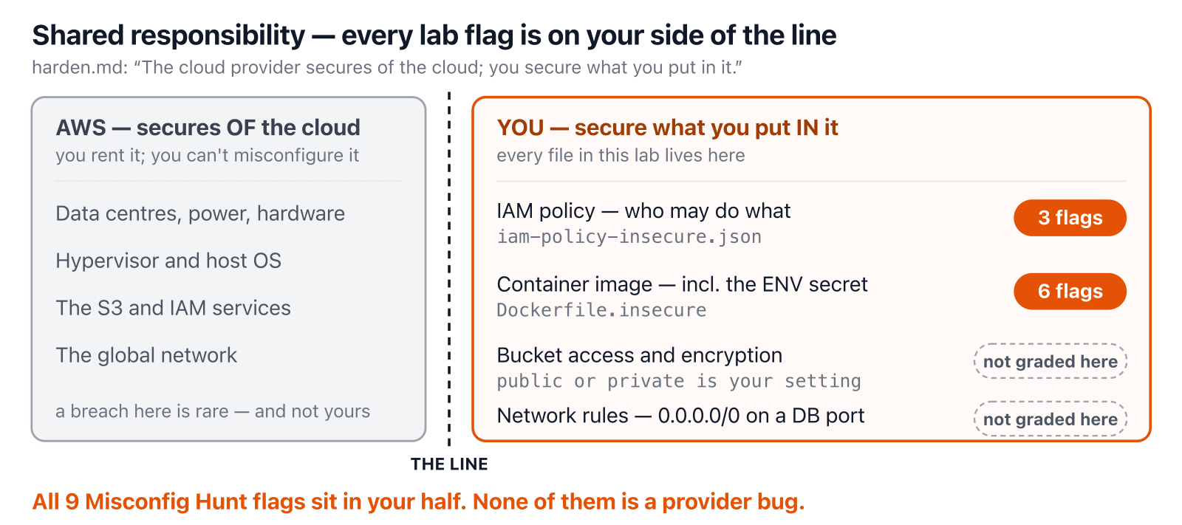
SOFTWARE SECURITY 2 / WEEK 13
Whose job is it?
KOSEN-KMITL | Software Security 2 · Week 13
6
Notes:
Point at the line, then at the two pills: every file the students touch today is on the right. Ask "which of the 9 flags could AWS have fixed for you?" — none. ~2 min.

Slide 7
SOFTWARE SECURITY 2 / WEEK 13
IAM & least privilege
{ "Effect":"Allow", "Action":"*", "Resource":"*" } // 🚩
Read a statement as: Effect (allow or deny) · Action (what) · Resource (on which thing) · Condition (only when …)
Resource:"*" → CWE-732, Action:"*" → CWE-269: graded as two findings on the same policy
Fix: use two statements for one bucket. Allow s3:GetObject on app/*. Allow s3:ListBucket only when the s3:prefix Condition matches app/*
Try it live: /sim/iam-scope (interactive simulation, web only)
KOSEN-KMITL | Software Security 2 · Week 13
7
Notes:
The worked example — this `*:*` policy is the Misconfig Hunt round 1 and the quiz. If a credential with this leaks, the attacker owns everything. This is 100% manual review — Trivy's config scanner does not parse standalone IAM JSON at all, say so explicitly so students don't wait for a scanner to flag it. The sim scores Action and Resource independently, live, so "two findings, not one" is something they watch instead of a claim on a slide. Least privilege = smallest possible blast radius. ~6 min.

Slide 8
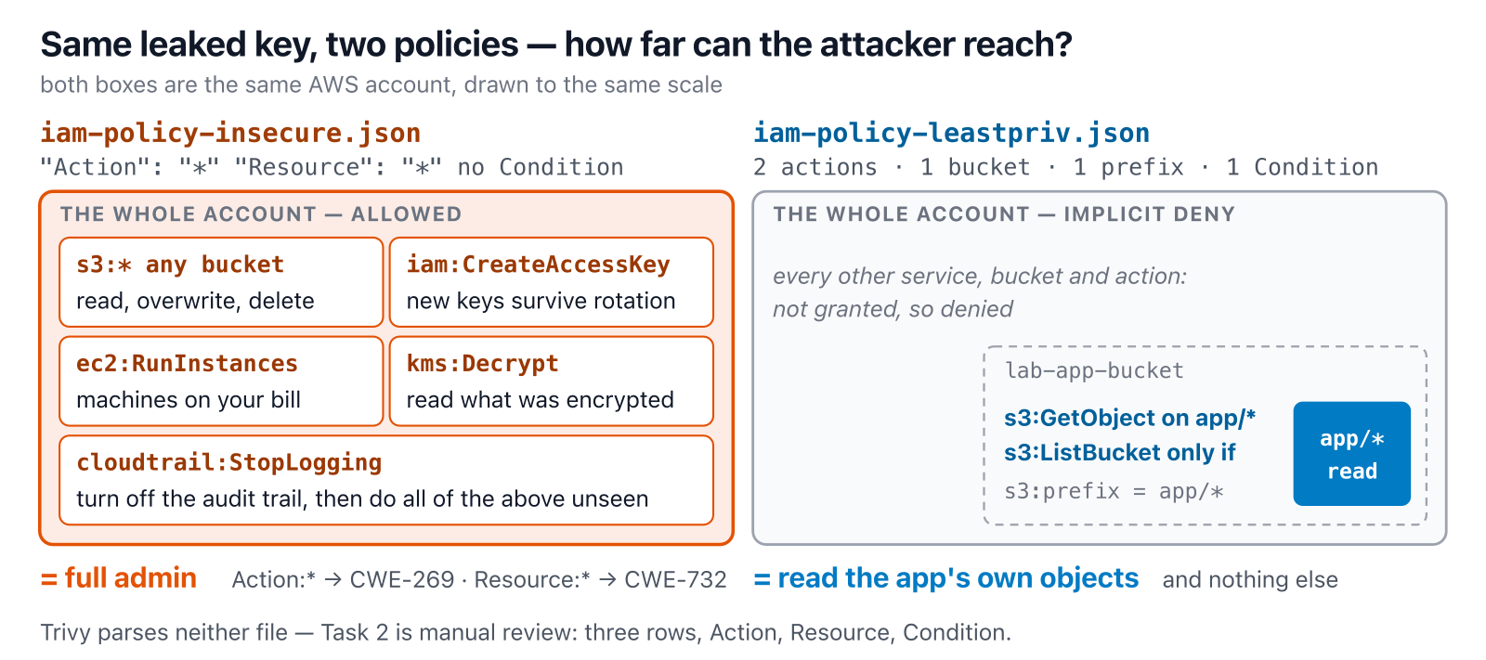
SOFTWARE SECURITY 2 / WEEK 13
If the key leaks — blast radius
KOSEN-KMITL | Software Security 2 · Week 13
8
Notes:
The answer to the cold-call "what does *:* cost you if the key leaks?", drawn. Land on iam:CreateAccessKey: rotating the leaked key doesn't evict an attacker who already minted their own. Right side = iam-policy-leastpriv.json, line for line. ~2 min.

Slide 9
SOFTWARE SECURITY 2 / WEEK 13
Secrets management
Secrets in env vars / Dockerfile / git = leaked
The lab's ENV API_TOKEN maps to CWE-526 (environment exposure), CWE-798 (hard-coded credential) and possible CWE-200 disclosure.
Use a secrets manager / vault; rotate
Scan history (Gitleaks) — recall Week 2
KOSEN-KMITL | Software Security 2 · Week 13
9
Notes:
Connect to W2 (Gitleaks) and W12. A secret baked into an image layer is in every copy of that image forever — `docker history` reveals it. Fix = inject at runtime from a vault + rotate. ~4 min.

Slide 10
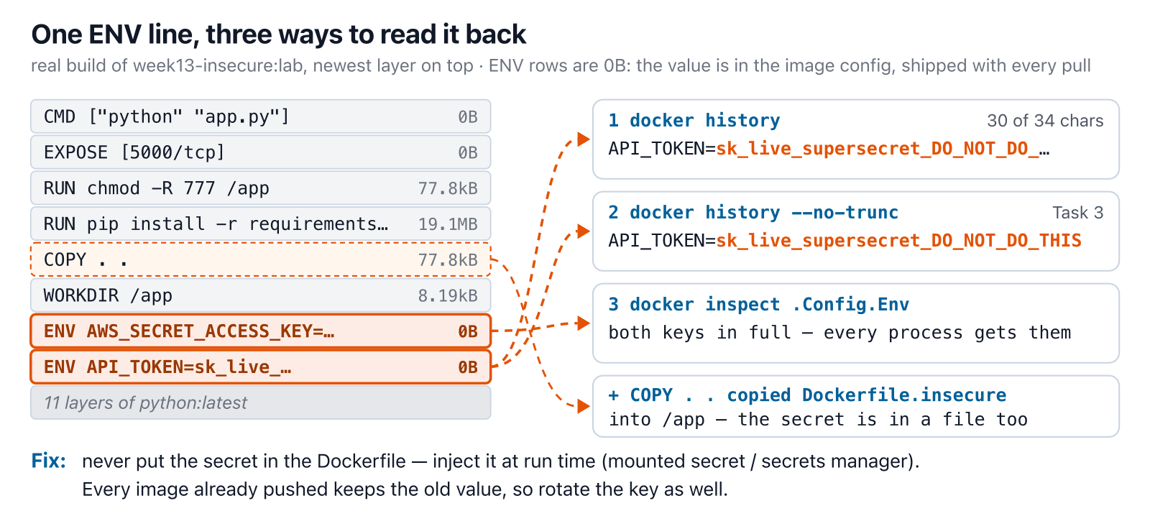
SOFTWARE SECURITY 2 / WEEK 13
Where the ENV secret ends up
KOSEN-KMITL | Software Security 2 · Week 13
10
Notes:
Two misconceptions to kill: "truncated history hides it" (it prints 30 of 34 characters) and "delete it in a later layer" (0B — it's config, not a file). Then the bonus leak: COPY . . shipped the Dockerfile itself. ~3 min.

Slide 11
SOFTWARE SECURITY 2 / WEEK 13
Try it — which layer gives it away?
Real docker history / docker inspect output from both lab images. Start with docker history --no-trunc and compare the ENV rows.
Try it live: /sim/image-layers (interactive simulation, web only)
KOSEN-KMITL | Software Security 2 · Week 13
11
Notes:
Drive it: insecure + "docker history" (still leaks) → "--no-trunc" (Task 3) → "ls -la /app" (Dockerfile.insecure is in the image). Then flip to hardened: no secret row, no build stage, and no ls at all — distroless. Output was captured from real builds, nothing runs live. ~3 min.

Slide 12
SOFTWARE SECURITY 2 / WEEK 13
Storage & network exposure
Public buckets, open ports, default creds
Encrypt at rest + in transit
Private by default; explicit allow
KOSEN-KMITL | Software Security 2 · Week 13
12
Notes:
`0.0.0.0/0` permits any IPv4 source in that security-group rule; routing, other firewalls and service binding still affect actual reachability. Default creds add another risk. Principle: deny by default, open deliberately (echoes W6 access control). ~4 min.

Slide 13
SOFTWARE SECURITY 2 / WEEK 13
Container image hardening
# Required offline core: pre-pull aquasec/trivy:latest before class
docker run --rm --network none --pull never -v "$PWD:/src:ro" aquasec/trivy:latest \
config --skip-check-update --severity MEDIUM,HIGH,CRITICAL /src
# Image CVE scanning is an online/database-prepared extension
Two stages: build in python:3.11-slim, run in distroless (no shell, no package manager) as user 65532, not root
Pin by digest (@sha256:...): a tag can be moved later, a digest cannot
A digest pins bytes, not safety or provenance. :latest is mutable; it is not automatically CWE-1104 unless the selected component is unmaintained.
Trivy finds only 3 of the 6 defects. COPY . ., chmod -R 777 and unpinned pip install: read the file
KOSEN-KMITL | Software Security 2 · Week 13
13
Notes:
Hands-on — run the offline config scan against the lab folder after the image was pulled before class. Check that the report actually lists the Dockerfiles and findings; a missing report is not zero findings. Image CVE scanning needs a prepared database and is extension work. IAM JSON remains manual review. ~5 min.

Slide 14
SOFTWARE SECURITY 2 / WEEK 13
Does Trivy see it?
Start with fix only what Trivy flags: Trivy says 0, but 3 defects are still in the file. Then fix the rest one at a time.
Try it live: /sim/trivy-blindspot (interactive simulation, web only)
KOSEN-KMITL | Software Security 2 · Week 13
14
Notes:
Press "fix only what Trivy flags": Failures 0, three defects still in the file — a clean scan is not a clean image. Then "a tag, not a digest": DS-0001 passes python:3.11-slim, but harden.md row 1 wants @sha256. Rules checked against real Trivy 0.76.1 on all 96 combinations: 4 → 0 matches scan.sh. ~4 min.

Slide 15
SOFTWARE SECURITY 2 / WEEK 13
Kubernetes basics (awareness)
Pod security (a pod = one or more containers run together), network policies, RBAC (role-based access control)
Don't run privileged; limit service-account tokens
KOSEN-KMITL | Software Security 2 · Week 13
15
Notes:
Awareness only (K8s is its own course). Key takeaways: a privileged pod ≈ host root; mounted service-account tokens are a lateral-movement prize. Keep it brief. ~3 min.

Slide 16
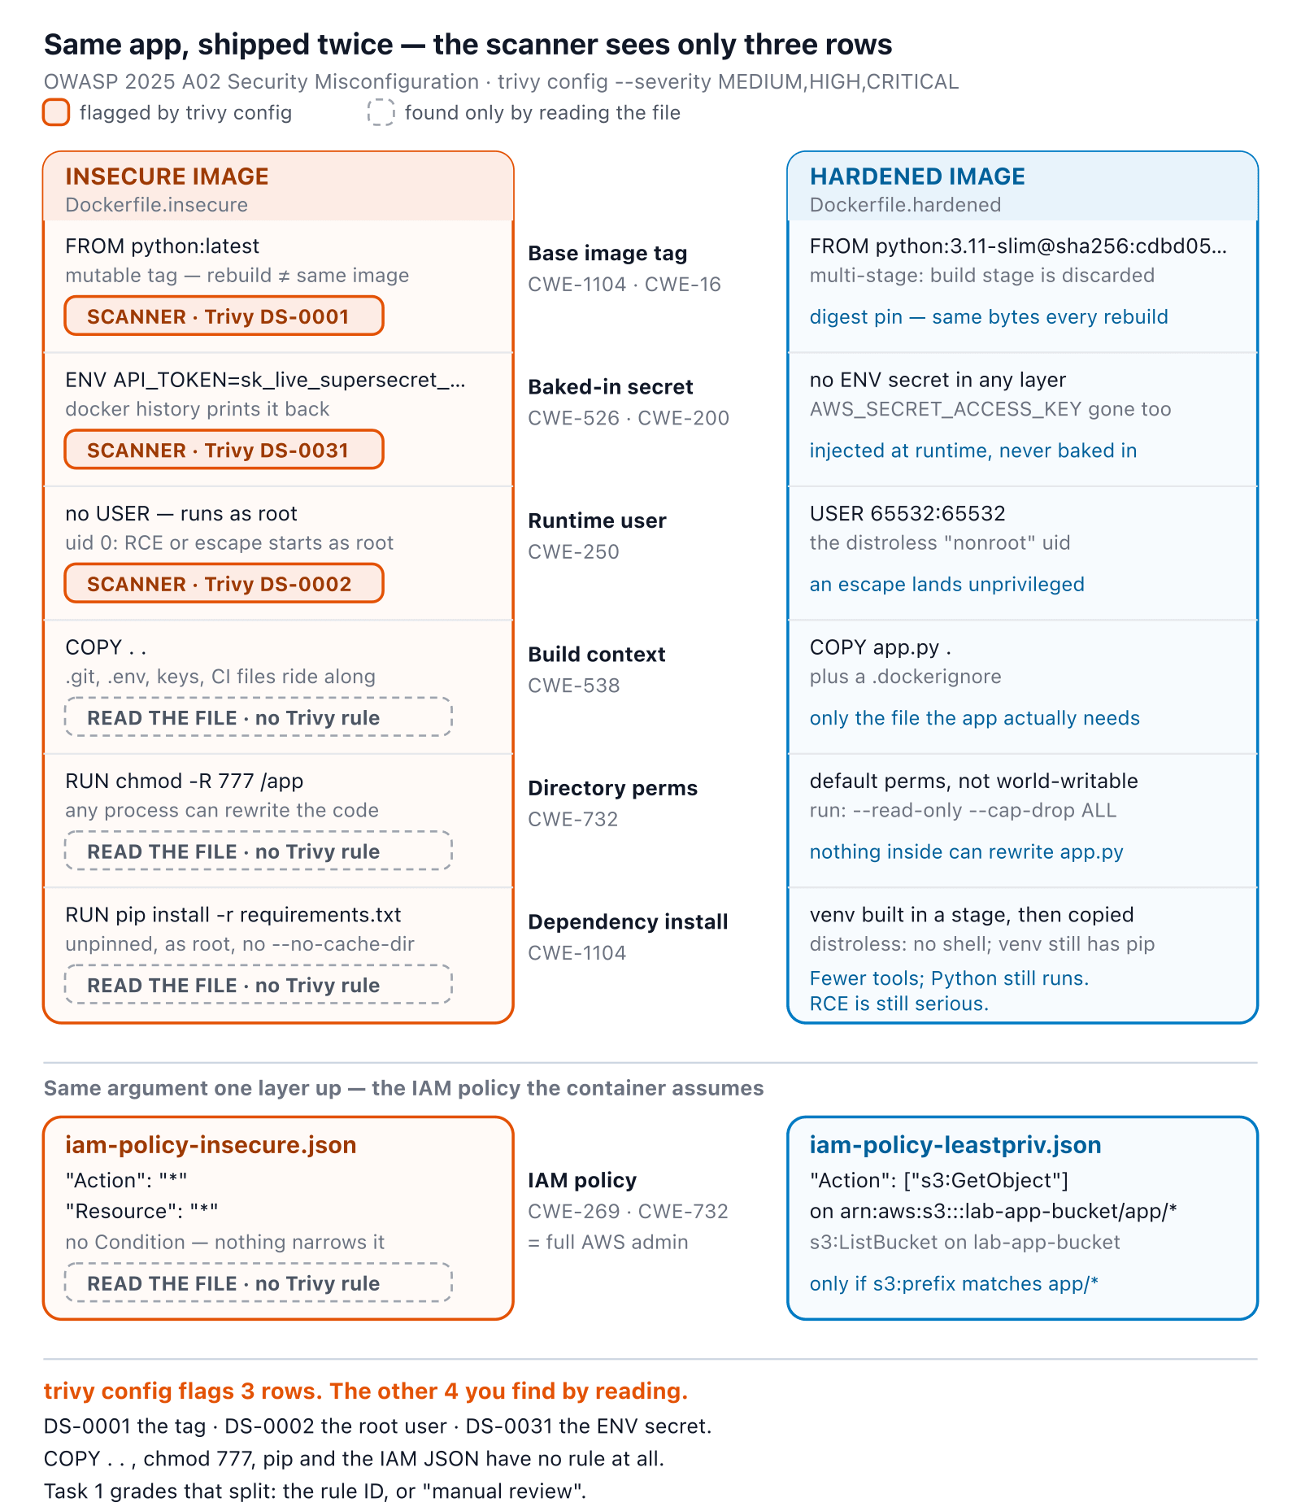
SOFTWARE SECURITY 2 / WEEK 13
Same app, shipped twice
KOSEN-KMITL | Software Security 2 · Week 13
16
Notes:
Walk the container and IAM rows. Cite actual scanner output for detected rules; review COPY, chmod, unpinned install and IAM manually. Scanner coverage is an observation for this prepared lab image and checks, not a universal rule count. ~5 min.

Slide 17
SOFTWARE SECURITY 2 / WEEK 13
🔍 Game — Misconfig Hunt
9 flags — each misconfiguration found + explained = a flag:
1
Container (6): :latest tag, root user, secret-in-ENV, COPY . ., chmod -R 777, unpinned pip install
2
IAM (3): Resource:"*" (CWE-732), Action:"*" (CWE-269), missing Condition scoping
KOSEN-KMITL | Software Security 2 · Week 13
17
Notes:
Explain before lab: 9 flags total, two categories only — no separate bucket/storage flag, no IaC/localstack target exists in this lab. Find AND explain (why it's a finding, which fix applies) = the flag. Q6 of the quiz asks for one misconfig they explained + the principle it violated. ~3 min.

Slide 18
SOFTWARE SECURITY 2 / WEEK 13
Deliverable
📋 Worksheet 13 — labs/week13-cloud-container/worksheet.md · follow the 100-minute core run sheet.
Selected Dockerfile scanner findings plus manual configuration/IAM review
Your student_task.py least-privilege policy diff and python3 check_student.py allow/deny controls
Explain the bounded local evaluator's limits; do not claim deployed AWS permissions were tested
Assigned written version only: Conventional Part 2/4 (20/20) or AIR Audit/EiPE/Prompt (20/10/10), after the shared practical 60.
KOSEN-KMITL | Software Security 2 · Week 13
18

Slide 19
SOFTWARE SECURITY 2 / WEEK 13
Key takeaways
Misconfiguration > zero-days as a breach cause
Least privilege, private-by-default, no secrets in code
Scan infrastructure-as-code (IaC) files and images in CI
KOSEN-KMITL | Software Security 2 · Week 13
19
Notes:
Recap. Cold-call: "what does a `*:*` IAM policy cost you if the key leaks?" (everything — full blast radius). "Scan in CI" sets up W15. ~2 min.

Slide 20
SOFTWARE SECURITY 2 / WEEK 13
Questions?
Next week: AI / LLM application security
KOSEN-KMITL | Software Security 2 · Week 13
20
Notes:
Cliffhanger: "Next week — the newest attack surface: make an AI assistant ignore its rules and leak secrets, with nothing but text."

Slide 21
SOFTWARE SECURITY 2 / WEEK 13
Current class hand-in
Class: quiz/review 10 + explanation/demo 15 + supervised practice 100 + debrief 20 + evidence capture 5 minutes. Prepare tools, images and access before class. The full reference tasks remain below; their standalone estimates are not an instruction to finish the entire bank during the class. Assessment: all students complete the shared practical 60/100 plus one assigned version's 40/100. Conventional uses the ordinary Part 2 questions (20) and Part 4 reflection (20).
AIR-Sec uses Audit-the-AI (20), Explain-in-Plain-English (10) and Prompt Problem (10). The unassigned written version is reference practice, not an extra requirement. Each teaching worksheet contributes 2.5 course points, making 12 individual worksheets worth 30 in total. Both versions submit their own commands/results and explanation, and complete the student patch and control tests where assigned.
KOSEN-KMITL | Software Security 2 · Week 13
21

Slide 22
SOFTWARE SECURITY 2 / WEEK 13
Current class hand-in (cont.)
Personal flags are used only for an actually issued instance; a local demo flag alone does not demonstrate understanding. Viva/reproduction checks verify the existing work within its rubric: no additional points or automatic-zero gate. 100-minute core run sheet (time, not points): Scan the selected Dockerfile 20; manual container/IAM review 20; student least-privilege policy 35; allow/deny controls and explanation 25. The practical rubric is 20 + 20 + 20 = 60 points.
Implement build_policy() in student_task.py and run python3 check_student.py. Submit your policy, a diff and permitted/denied example results. The checker is a deliberately bounded evaluator for this exercise, not AWS IAM policy simulation or proof of deployed permissions. Real AWS authorization, permissions boundaries, SCPs and runtime controls are outside this local static case. Keep the Dockerfile scan versus manual IAM-review distinction from the original tasks.
KOSEN-KMITL | Software Security 2 · Week 13
22

