Slide 1

SOFTWARE SECURITY 2 / WEEK 15 · KOSEN
DevSecOps: Putting It Together
Today
Week 15
Security in the CI/CD pipeline
Software Security 2
Software Security · Nutthakorn Chalaemwongwan
Logging, monitoring & alerting
Failing safely
KOSEN-KMITL | Software Security 2 · Week 15
1
Notes:
Current KOSEN class: 150 minutes = quiz/review10 + brief15 + shared practical100 + debrief20 + capture5. Full deck is pre-class/reference; select only the short live explanation. Both versions: common60 plus Conventional40 OR AIR20/10/10. Viva verifies existing work, no extra score or automatic-zero gate. Final technical teaching week. Hook: configured CI checks can catch selected defects on each run. Today the required core adds a bounded checker and records red-to-green evidence; the full scanner workflow and required merge protection are separate extension/configuration work. ~2 min.

Slide 2
SOFTWARE SECURITY 2 / WEEK 15
Today
Security in the CI/CD pipeline
Logging, monitoring & alerting
Failing safely
Vulnerability mgmt & disclosure
🎮 Game: Break the Build (Red vs Blue)
KOSEN-KMITL | Software Security 2 · Week 15
2
Notes:
Roadmap, 1 min. The required local core compares fail-open and fail-closed behavior, implements a student authorization/logging control, and records the same checker red then green. The full Red/Blue scanner game is extension practice.

Slide 3
SOFTWARE SECURITY 2 / WEEK 15
The whole course in one pipeline
SAST (Wk2) · SCA + image scan (Wk12–13) · IaC (infrastructure-as-code) config scan (Wk13) · secret scanning (Wk2)
Automated gates instead of one-off scans
Secure by Design as the default
KOSEN-KMITL | Software Security 2 · Week 15
3
Notes:
The story spine one last time: W13's image and IAM mistakes and W14's injection and XSS are exactly what this pipeline is built to catch on every push. The synthesis slide — walk back through the term: every tool we used by hand now runs automatically on every PR. Manual scanning doesn't scale and humans forget; pipelines don't. ~4 min.

Slide 4
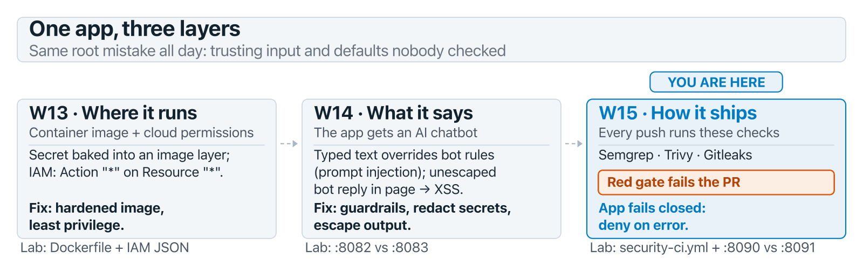
SOFTWARE SECURITY 2 / WEEK 15
The whole course in one pipeline (cont.)
KOSEN-KMITL | Software Security 2 · Week 15
4
Notes:
The story spine one last time: W13's image and IAM mistakes and W14's injection and XSS are exactly what this pipeline is built to catch on every push. The synthesis slide — walk back through the term: every tool we used by hand now runs automatically on every PR. Manual scanning doesn't scale and humans forget; pipelines don't. ~4 min.

Slide 5
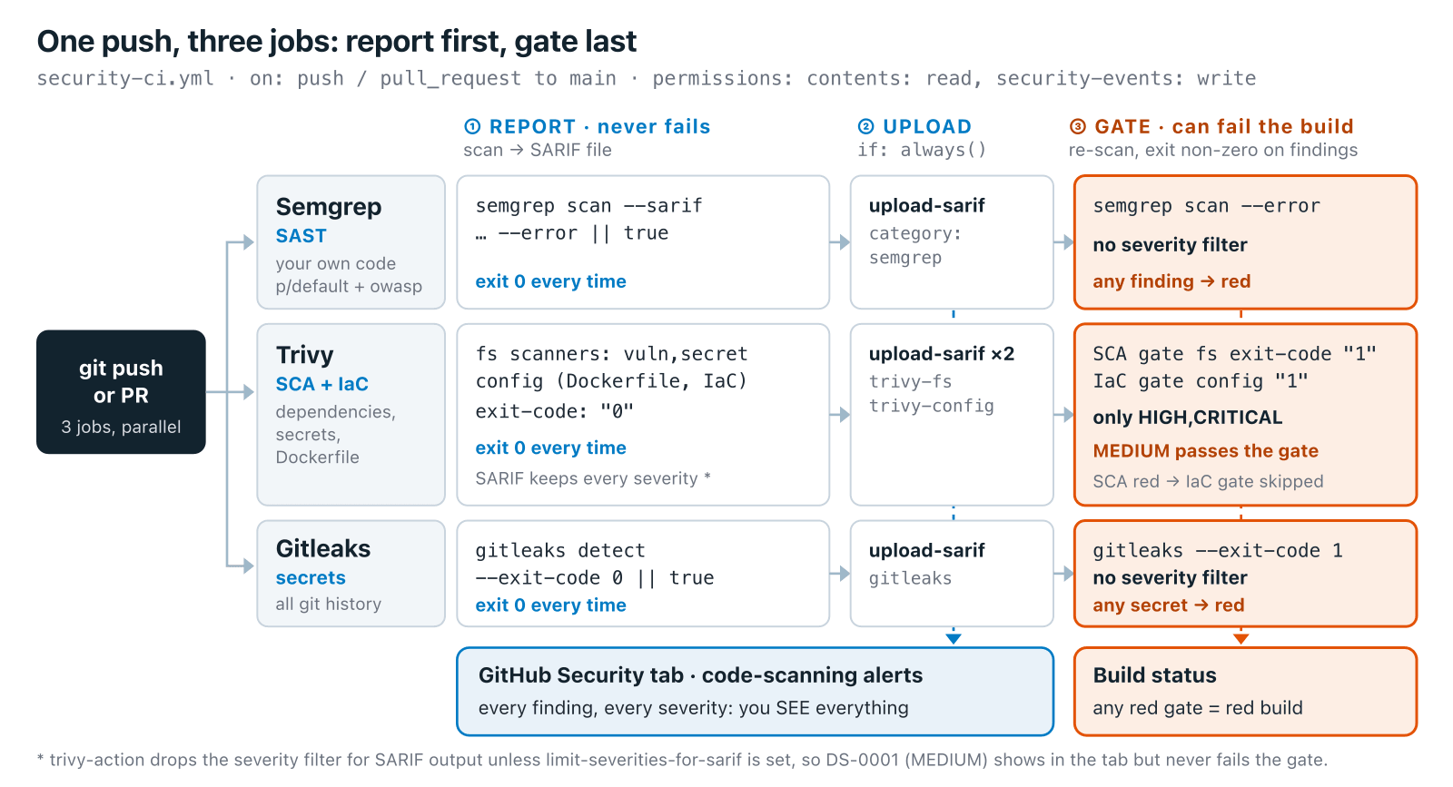
SOFTWARE SECURITY 2 / WEEK 15
One push, three jobs
KOSEN-KMITL | Software Security 2 · Week 15
5
Notes:
Walk it left to right before the YAML: ① report never fails, ② upload always runs, ③ the gate is the step meant to turn the build red — that's Part 2 Q1 in one picture. (An upload can still fail on its own, e.g. a private repo without code scanning — that's why the lab uses a public throwaway repo.) Point at the footnote: the Security tab shows MEDIUM findings like DS-0001 that the gate lets through. ~2 min.

Slide 6
SOFTWARE SECURITY 2 / WEEK 15
A security gate
# .github/workflows/security-ci.yml
- semgrep # SAST
- trivy # SCA (fs) + IaC (config) — image scan is optional, off by default
- gitleaks # secrets + git history
# each tool runs TWICE: once to report (SARIF, always), once to gate (fails the build)
The token gets only what it needs: contents: read, security-events: write
Results (SARIF) go to the GitHub Security tab
A red run blocks a merge only if the jobs are required checks (branch protection)
Try it live: /sim/gate-check (interactive simulation, web only)
KOSEN-KMITL | Software Security 2 · Week 15
6
Notes:
The worked example — this is the lab's actual pipeline. Be precise: Trivy's active jobs are fs (SCA) and config (IaC) — the image-scan step exists in the YAML but is commented out/optional, don't claim it's active. The "runs twice" pattern (report step + separate gate step) is what Part 2 Q1 is built around — say it explicitly. The sim's 2 decoys are the actual worksheet nuance: chmod 777 has no Trivy rule at any severity, while FROM:latest IS detected (DS-0001) but rated MEDIUM and filtered by severity:HIGH,CRITICAL — same green build, different reason. The gate conditions differ by tool: Semgrep selected-rule findings, Trivy HIGH/CRITICAL, Gitleaks detections. A gate that only warns gets ignored. ~6 min.

Slide 7
SOFTWARE SECURITY 2 / WEEK 15
Platform option — GitHub Advanced Security
CodeQL code scanning (SAST) on every PR
Secret scanning + push protection
Dependabot for vulnerable deps
SonarQube as a quality/SAST gate alongside
Same idea as the YAML gate — managed, in the repo.
KOSEN-KMITL | Software Security 2 · Week 15
7
Notes:
The managed equivalent they'll meet in industry. Same concept, less YAML to maintain. Mention SonarQube as the common quality-gate they'll see in internships. ~3 min.

Slide 8
SOFTWARE SECURITY 2 / WEEK 15
Logging, monitoring, alerting
A09:2025 — without logs you can't detect or respond
Log security events (authn, authz failures, anomalies)
Never log the secret/token value itself (CWE-532) — log reason=bad_token, not the token
Alert on suspicious patterns
KOSEN-KMITL | Software Security 2 · Week 15
8
Notes:
Shift from prevention to detection. A09 (logging/monitoring failures) is a Top 10 risk because you can't respond to what you can't see. The CWE-532 point is graded (Part 2 Q4) and easy to skip if you only say "log security events" — a log line that captures the bad token has just created a new secrets-in-logs problem. Recall W6: we read attacker actions FROM logs — but only if they were logged. ~4 min.

Slide 9
SOFTWARE SECURITY 2 / WEEK 15
Detection tooling
NIDS (network intrusion detection) — Snort / Suricata watch network traffic
HIDS (host intrusion detection) — OSSEC watches one machine
SIEM (collects and connects alerts) — Security Onion bundles these tools
Network visibility: TAP (lossless) vs SPAN (cheap, can drop)
KOSEN-KMITL | Software Security 2 · Week 15
9
Notes:
Awareness of the defender's toolkit. NIDS watches the wire, HIDS watches the host, SIEM correlates everything. TAP vs SPAN is a practical gotcha: SPAN ports drop packets under load — you miss attacks. Keep brisk. ~3 min.

Slide 10
SOFTWARE SECURITY 2 / WEEK 15
Alerts — the confusion matrix
 | Incident real | No incident
Alert fired | True positive ✅ | False positive
No alert | False negative 💀 | True negative
False negative = worst case (missed attack)
Some false positives are inevitable — tune, don't silence
KOSEN-KMITL | Software Security 2 · Week 15
10
Notes:
Ties back to W2 triage. The danger asymmetry: a false negative = an attack you never saw. But too many false positives → alert fatigue → analysts mute everything → effective false negatives. The skill is TUNING. ~4 min.

Slide 11
SOFTWARE SECURITY 2 / WEEK 15
When something happens (NIST SP 800-86)
Collection → Examination → Analysis → Reporting
Collect what disappears first (order of volatility): memory → temp files → disk → logs
Failed/success logins: Windows Event 4625 / 4624
KOSEN-KMITL | Software Security 2 · Week 15
11
Notes:
A taste of incident response / forensics. Order of volatility: capture RAM before you pull the plug — it's gone on shutdown. 4625 (failed) / 4624 (success) are the login events they'd grep in a real investigation. ~4 min.

Slide 12
SOFTWARE SECURITY 2 / WEEK 15
Fail safely
A10:2025 — mishandled errors leak info / fail open
Fail closed: deny on error, don't bypass checks
Don't expose stack traces / secrets in errors
KOSEN-KMITL | Software Security 2 · Week 15
12
Notes:
A design principle that recurs: when something breaks, DENY (fail closed), don't accidentally grant access (fail open). Verbose errors leak schema/secrets (recall W4 error-based enumeration). ~3 min.

Slide 13
SOFTWARE SECURITY 2 / WEEK 15
Vulnerability management & disclosure
Triage by severity; track to remediation (SLAs)
Coordinated disclosure & bug bounties
security.txt; a path for researchers to report
KOSEN-KMITL | Software Security 2 · Week 15
13
Notes:
The professional/ethical close: finding a bug is step one; managing it to a fix (with SLAs) is the job. Coordinated disclosure + security.txt = how to receive reports responsibly. Connects to the course ethics theme. ~3 min.

Slide 14
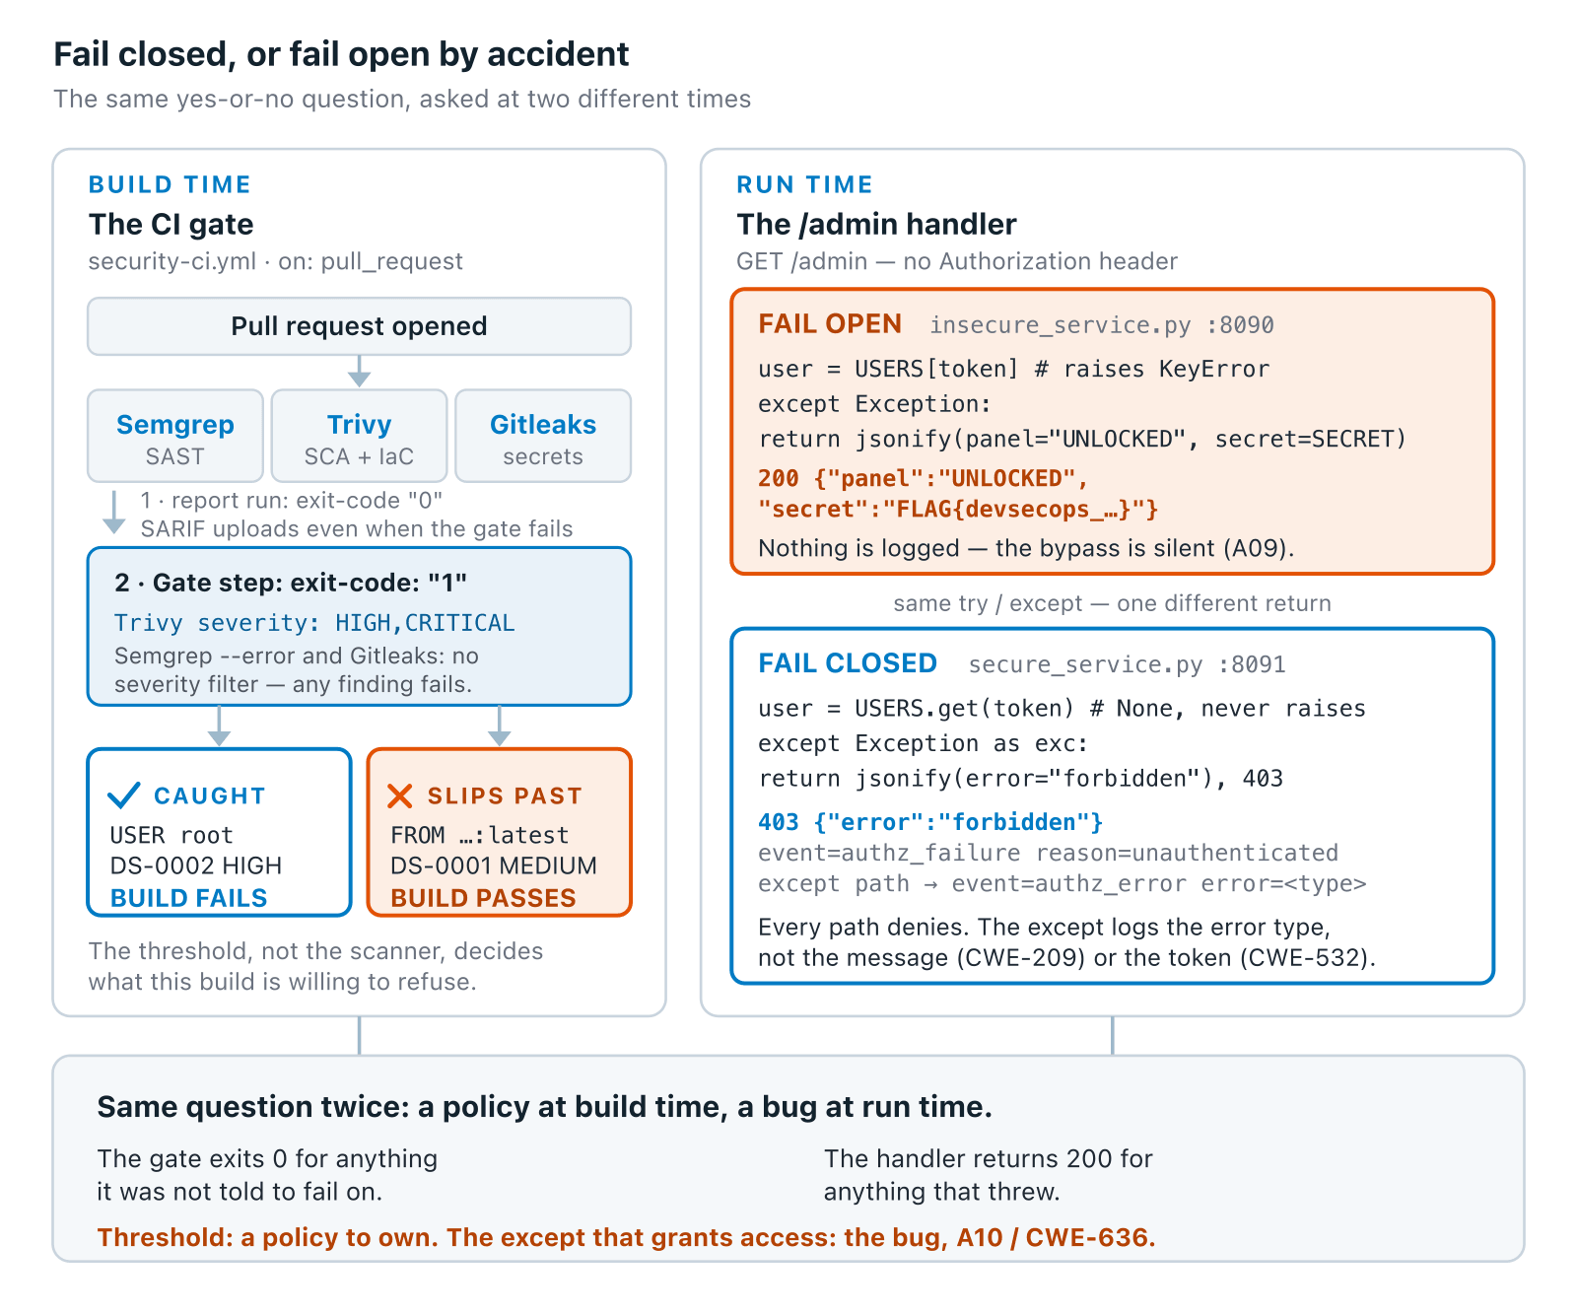
SOFTWARE SECURITY 2 / WEEK 15
One decision, made twice
KOSEN-KMITL | Software Security 2 · Week 15
14
Notes:
The synthesis slide, and arguably the whole course's closing argument: "secure by default" means someone has to have DECIDED the default, twice here — once in YAML severity filters, once in an except block. Keep the two apart: a severity threshold is a policy someone can defend (or not), while an except branch that grants access on error is a bug (A10, CWE-636). Walk both panels, land on the bottom line before the game. ~5 min.

Slide 15
SOFTWARE SECURITY 2 / WEEK 15
Try it — same request, two services
Pick a token. Both real services answer, and you see what each one logs.
Try it live: /sim/fail-open (interactive simulation, web only)
KOSEN-KMITL | Software Security 2 · Week 15
15
Notes:
Interactive companion to the diagram above; every response and log line was captured from the real :8090/:8091 containers. Click "no token" (8090 leaks, 8091 logs a WARNING), then "user, not admin" (both deny: the bug lives only on the error path), then "real admin" (both unlock). ~3 min.

Slide 16
SOFTWARE SECURITY 2 / WEEK 15
🔴🔵 Extension game — Break the Build
Blue: set up the gate (Semgrep selected-rule findings, Trivy HIGH/CRITICAL, Gitleaks detected secrets), log security events and deny on lookup error
Red: one planted defect per PR — an old dependency (Trivy SCA), a Dockerfile running as root (Trivy config), or a hard-coded token (Gitleaks)
Score: Blue +1 per catch · Red +1 per defect that slips through (e.g. chmod 777, FROM :latest stay green) — then propose a rule that would catch it
Flag: leak it from the fail-open /admin in insecure_service.py (local run = public demo flag; personal flag only if an instance is actually issued)
KOSEN-KMITL | Software Security 2 · Week 15
16
Notes:
The full scanner game remains extended project practice. In class, capture one prepared bounded checker red result and a corrected green result; keep the legitimate-admin positive control and safe-log evidence. Game points do not add to the worksheet rubric.

Slide 17
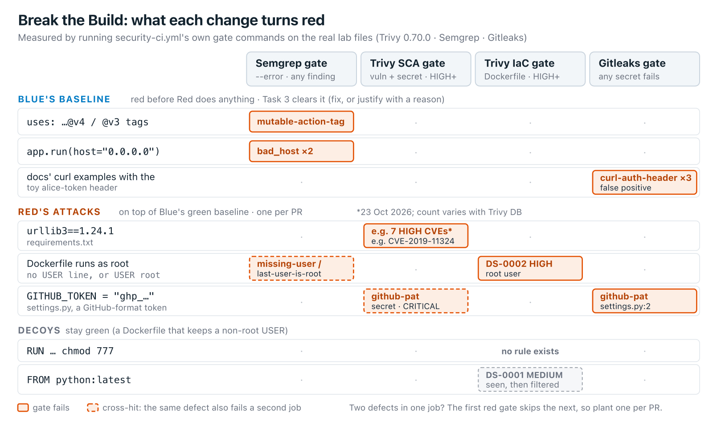
SOFTWARE SECURITY 2 / WEEK 15
Break the Build — what each change turns red
KOSEN-KMITL | Software Security 2 · Week 15
17
Notes:
The rules of the game on one board. Top rows = Task 3 (Blue must clear these first or every Red PR is already red); dashed cells = cross-hits, one defect turning two jobs red. ~2 min.

Slide 18
SOFTWARE SECURITY 2 / WEEK 15
Try it — which job goes red?
Click Blue's clean baseline, then Red: old urllib3, and find the gate that fails.
Try it live: /sim/red-team-pr (interactive simulation, web only)
KOSEN-KMITL | Software Security 2 · Week 15
18
Notes:
Click "untouched lab" first: Semgrep + Gitleaks are red before Red does anything. Then "Blue's clean baseline", then each Red preset. End on "two defects in one PR": the IaC gate shows skipped, which is why the worksheet says one defect per PR. ~3 min.

Slide 19
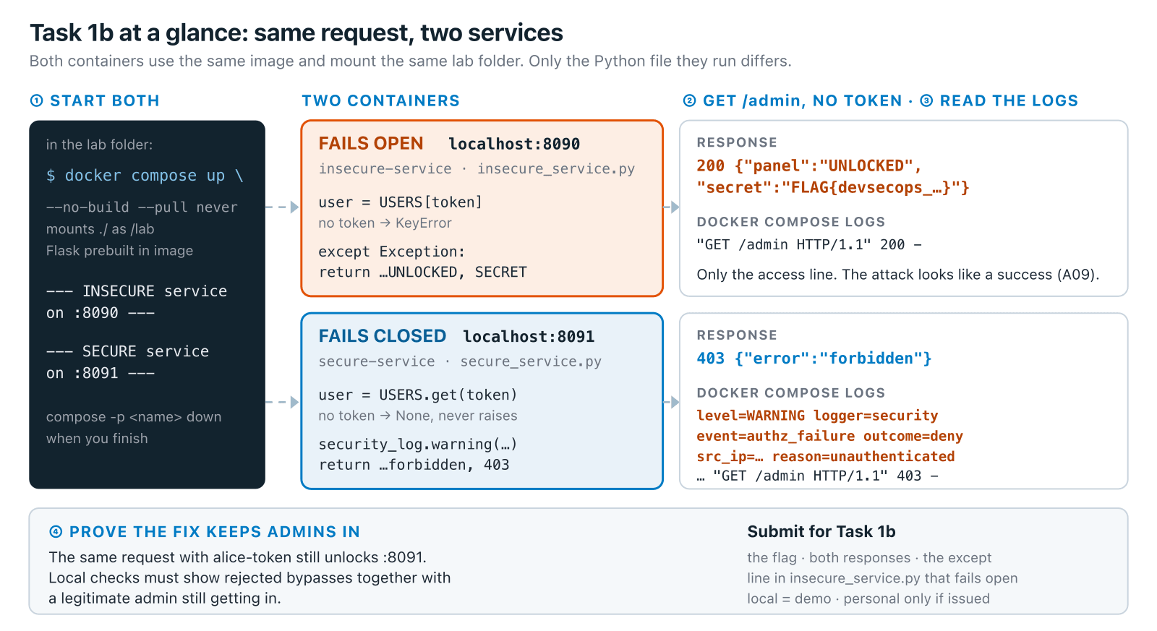
SOFTWARE SECURITY 2 / WEEK 15
Task 1b at a glance
KOSEN-KMITL | Software Security 2 · Week 15
19
Notes:
The lab briefing for the required local core: prebuild before class; start with docker compose up --no-build --pull never; compare both ports; inspect logs; verify alice-token still works. ~2 min.

Slide 20
SOFTWARE SECURITY 2 / WEEK 15
Deliverable
📋 Worksheet 15 — labs/week15-devsecops-pipeline/worksheet.md · follow the 100-minute core run sheet.
Your bounded student_task.py fail-closed and safe-log change
python3 check_student.py results: deny missing/invalid/error cases while preserving legitimate admin access
One prepared student-check-ci.yml red run and corrected green run under the same checks; record the local equivalent if CI is unavailable
Full scanner workflow and all three planted-defect families: extended project practice
Assigned written version only: Conventional Part 2/4 (20/20) or AIR Audit/EiPE/Prompt (20/10/10), after the shared practical 60.
KOSEN-KMITL | Software Security 2 · Week 15
20
Notes:
A hosted verifier/personal instance exists only when explicitly issued. Public demo flags are observations, not personal proof. The prepared bounded checker and full Semgrep/Trivy/Gitleaks workflow have different scopes.

Slide 21
SOFTWARE SECURITY 2 / WEEK 15
Key takeaways
Automate security gates — humans forget, pipelines don't
You can't defend what you don't log
Fail closed; disclose responsibly
KOSEN-KMITL | Software Security 2 · Week 15
21
Notes:
Recap + course wrap of the technical units. Cold-call: "why must the gate FAIL the build, not just warn?" (warnings get ignored). ~2 min.

Slide 22
SOFTWARE SECURITY 2 / WEEK 15
Questions?
Next week: Capstone studio & CTF warm-up
KOSEN-KMITL | Software Security 2 · Week 15
22
Notes:
Wrap: "Teaching is done — next is your capstone: ship something secure, then defend it in the final CTF. Bring your project to the studio."

Slide 23
SOFTWARE SECURITY 2 / WEEK 15
Current class hand-in
Class: quiz/review 10 + explanation/demo 15 + supervised practice 100 + debrief 20 + evidence capture 5 minutes. Prepare tools, images and access before class. The full reference tasks remain below; their standalone estimates are not an instruction to finish the entire bank during the class. Assessment: all students complete the shared practical 60/100 plus one assigned version's 40/100. Conventional uses the ordinary Part 2 questions (20) and Part 4 reflection (20).
AIR-Sec uses Audit-the-AI (20), Explain-in-Plain-English (10) and Prompt Problem (10). The unassigned written version is reference practice, not an extra requirement. Each teaching worksheet contributes 2.5 course points, making 12 individual worksheets worth 30 in total. Both versions submit their own commands/results and explanation, and complete the student patch and control tests where assigned.
KOSEN-KMITL | Software Security 2 · Week 15
23

Slide 24
SOFTWARE SECURITY 2 / WEEK 15
Current class hand-in (cont.)
Personal flags are used only for an actually issued instance; a local demo flag alone does not demonstrate understanding. Viva/reproduction checks verify the existing work within its rubric: no additional points or automatic-zero gate. 100-minute core run sheet (time, not points): Compare fail-open/closed 20; student authorization/logging fix 20; one prepared CI red run 30; corrected green/control run 20; evidence 10. The practical rubric is 20 + 20 + 20 = 60 points.
Complete the bounded fail-closed/logging functions in student_task.py and run python3 check_student.py. Add that same command as a job step in the prepared lab repository: first retain its failing run, then the corrected passing run. A local run is the required fallback when an external CI queue is unavailable, under the same criteria. The existing full scanner workflow and all three defect families remain extended project practice.
KOSEN-KMITL | Software Security 2 · Week 15
24

Slide 25
SOFTWARE SECURITY 2 / WEEK 15
Current class hand-in (cont.)
No new public repository, PR or external service is created by running the local checker. Test a legitimate admin as well as missing, unknown, non-admin and lookup-error cases.
KOSEN-KMITL | Software Security 2 · Week 15
25

