Slide 1

SOFTWARE SECURITY 2 / WEEK 6 · KOSEN
Authentication, Sessions & Access Control
Today
Week 6
Authn vs authz
Software Security 2
Software Security 2 · Nutthakorn Chalaemwongwan · Shinya Oyama
Session management & JWT pitfalls
OAuth2 / OIDC at a glance
KOSEN-KMITL | Software Security 2 · Week 6
1
Notes:
Hook: change /orders/1 to /2 and read a stranger's data — promise that demo. The #1 web risk in 2025 is Broken Access Control, and it's mostly missing one check. ~2 min.

Slide 2
SOFTWARE SECURITY 2 / WEEK 6
Today
KOSEN class: 150 minutes. Quiz/review 10 + brief/demo 15 + practical 100 + debrief 20 + capture 5. Full slide explanations are preparation/reference.
Worksheet: common practical 60 + assigned Conventional written 40 or AIR-Sec Audit 20 / EiPE 10 / Prompt 10. Each totals 100; viva verifies understanding within the rubric. Extensions add no graded points.
Authn vs authz
Session management & JWT pitfalls
OAuth2 / OIDC at a glance
IDOR & broken access control
🎮 Game: IDOR Treasure Hunt + JWT Forgery
KOSEN-KMITL | Software Security 2 · Week 6
2
Notes:
Roadmap, 1 min. This is the last teaching week before review/midterm. Lab = exploit IDOR + forge a JWT, then implement object ownership and proper token verification.

Slide 3
SOFTWARE SECURITY 2 / WEEK 6
Recap — Week 5
XSS steals sessions → today we manage them
Client-side trust is limited — enforce on the server
KOSEN-KMITL | Software Security 2 · Week 6
3
Notes:
1-min bridge. XSS could steal a session token; today: what IS that token, and how do we stop theft + misuse? Theme of the week: enforce on the server, every request.

Slide 4
SOFTWARE SECURITY 2 / WEEK 6
Authn vs Authz
Authentication — who are you? (login, MFA)
Authorization — what are you allowed to do?
Most breaches today are authz failures
Maps to A01 Broken Access Control, A07 Authentication Failures
KOSEN-KMITL | Software Security 2 · Week 6
4
Notes:
The distinction students most often blur — make them repeat it. Authn = identity; authz = permission. A01 is #1 in OWASP 2025 precisely because authz checks get forgotten. Ask for an example of each failing. ~5 min.

Slide 5
SOFTWARE SECURITY 2 / WEEK 6
Sessions
Server issues a session token after login
Classic pattern: stored in a cookie (HttpOnly, Secure, SameSite)
Risks: fixation, predictable IDs, no expiry, no logout invalidation
Today's lab is 100% JWT bearer-token — no cookies at all. Of these four risks, only "no expiry" is what you'll actually exercise (the fix adds a 15-min exp claim); fixation/predictable-ID/logout-invalidation are cookie-session concepts, general knowledge, not tested here
KOSEN-KMITL | Software Security 2 · Week 6
5
Notes:
Connect cookie flags to W5: HttpOnly stops XSS theft, SameSite restricts cross-site cookie attachment; a server-side authorization/CSRF check is still needed, Secure forces HTTPS. Be upfront that this lab doesn't touch cookies — don't let students expect a cookie-based task today. Explain session fixation briefly (attacker sets the id before login) as general knowledge. ~5 min.

Slide 6
SOFTWARE SECURITY 2 / WEEK 6
JWT pitfalls
alg: none accepted → forge any token
Weak/guessable HMAC secret → re-sign
Not checking exp / aud / signature at all
Sensitive data in payload (it's only base64!)
Try it live: /sim/jwt-forge (interactive simulation, web only)
KOSEN-KMITL | Software Security 2 · Week 6
6
Notes:
The sim IS the "decode a JWT live" demo — edit the payload, watch base64url decode instantly (not encrypted), then flip alg to none and watch a server that trusts the header accept it. Emphasize: never put secrets in the payload. This is the JWT Forgery game, live. ~7 min.

Slide 7
SOFTWARE SECURITY 2 / WEEK 6
The fix: verify the signature — one check, every endpoint
# vulnerable: 'none' allowed + weak secret -> any forged token passes
if alg == "none": jwt.decode(token, options={"verify_signature": False})
SECRET = "secret"
# fixed: pin the algorithm, strong secret, require sub + exp + aud
jwt.decode(token, SECRET, algorithms=["HS256"],
audience=AUD, options={"require": ["sub", "exp", "aud"]})
base64url is encoding, not a seal — only the signature check stops forgery
Pin algorithms=["HS256"] (never "none") + a strong random secret from env
Fix it in one place (current_user) → every endpoint is covered at once
KOSEN-KMITL | Software Security 2 · Week 6
7
Notes:
Parallel to Wk4's parameterize slide. The break was never that the payload is readable (base64url always is) — it's that the server trusted a token whose signature it didn't properly check. alg:none says 'no signature' and a vulnerable server obeys; a weak secret ('secret') lets anyone RE-sign. Both defeat the ONE thing that matters: does the signature verify under a key only we hold? Fix: pin HS256 so 'none' is rejected, use a strong random secret from the environment, and require exp+aud so a stray token can't be replayed. Punch line, and the analog of 'parameterize once': this fix lives in current_user(), so the moment you fix it, /api/orders AND /api/admin are both protected — there is no per-endpoint patch to forget. Never put secrets in the payload. ~6 min.

Slide 8
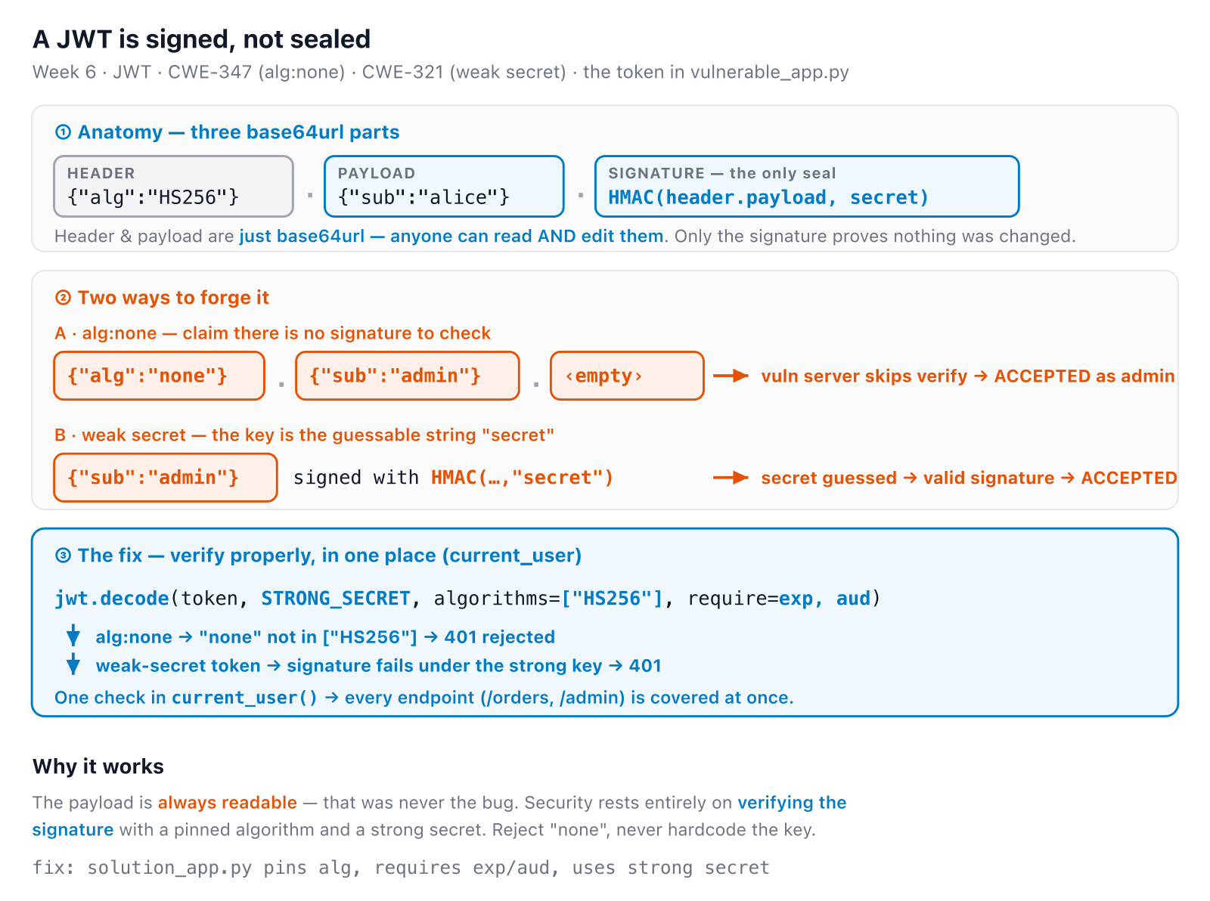
SOFTWARE SECURITY 2 / WEEK 6
JWT forgery in one picture
KOSEN-KMITL | Software Security 2 · Week 6
8
Notes:
Consolidation slide — leave it up during the JWT Forgery lab. It shows the whole story: the payload is always readable (blue), so the bug is never 'they saw the data' — it's a signature that wasn't verified. Point at the orange empty signature (alg:none) and the orange HMAC(secret) (weak key), then the blue fix line: pin HS256, strong secret, require exp+aud. Same story the jwt-forge sim animates live. Land the punch line: signed, not sealed. ~3 min.

Slide 9
SOFTWARE SECURITY 2 / WEEK 6
OAuth2 / OIDC (high level)
Delegated access via tokens — don't share passwords
OIDC adds identity (ID token) on top of OAuth2
Common bugs: open redirect, missing state, token leakage
KOSEN-KMITL | Software Security 2 · Week 6
9
Notes:
Keep high-level (full OAuth is its own course). Key idea: "Login with Google" = delegation, you never give the app your Google password. The `state` parameter prevents CSRF on the callback. ~4 min.

Slide 10
SOFTWARE SECURITY 2 / WEEK 6
IDOR & broken access control
GET /api/orders/1 → your order
GET /api/orders/2 → someone else's 😱
Object reference with no ownership check
Vertical (become admin) vs horizontal (other users)
KOSEN-KMITL | Software Security 2 · Week 6
10
Notes:
The worked example — this is the IDOR Treasure Hunt. The server authenticated you but never checked the object BELONGS to you. Horizontal = peer data; vertical = privilege escalation. ~6 min.

Slide 11
SOFTWARE SECURITY 2 / WEEK 6
The fix: check ownership — a valid token is not permission
# vulnerable: authenticated, but the result is thrown away -> no Gate 2
def get_order(oid):
current_user() # WHO you are...
return jsonify(ORDERS[oid]) # ...but never 'may you see THIS?'
# fixed: deny-by-default ownership check on every object access
if order["owner"] != user: return 403
Authentication answers who; authorization answers may you touch THIS object
alice's real, valid token must still be refused bob's order
Check ownership at every object access — deny by default
KOSEN-KMITL | Software Security 2 · Week 6
11
Notes:
The IDOR fix mechanism. The vulnerable get_order literally CALLS current_user() and throws the answer away — Gate 1 runs, Gate 2 doesn't exist. Drive it home: this is an authorization bug, alice really is alice; being authenticated was treated as permission to read any object. The one-line fix compares the object's owner to the caller and denies by default. Emphasize every object access and centralize the check so one forgotten endpoint does not reopen it. ~5 min.

Slide 12
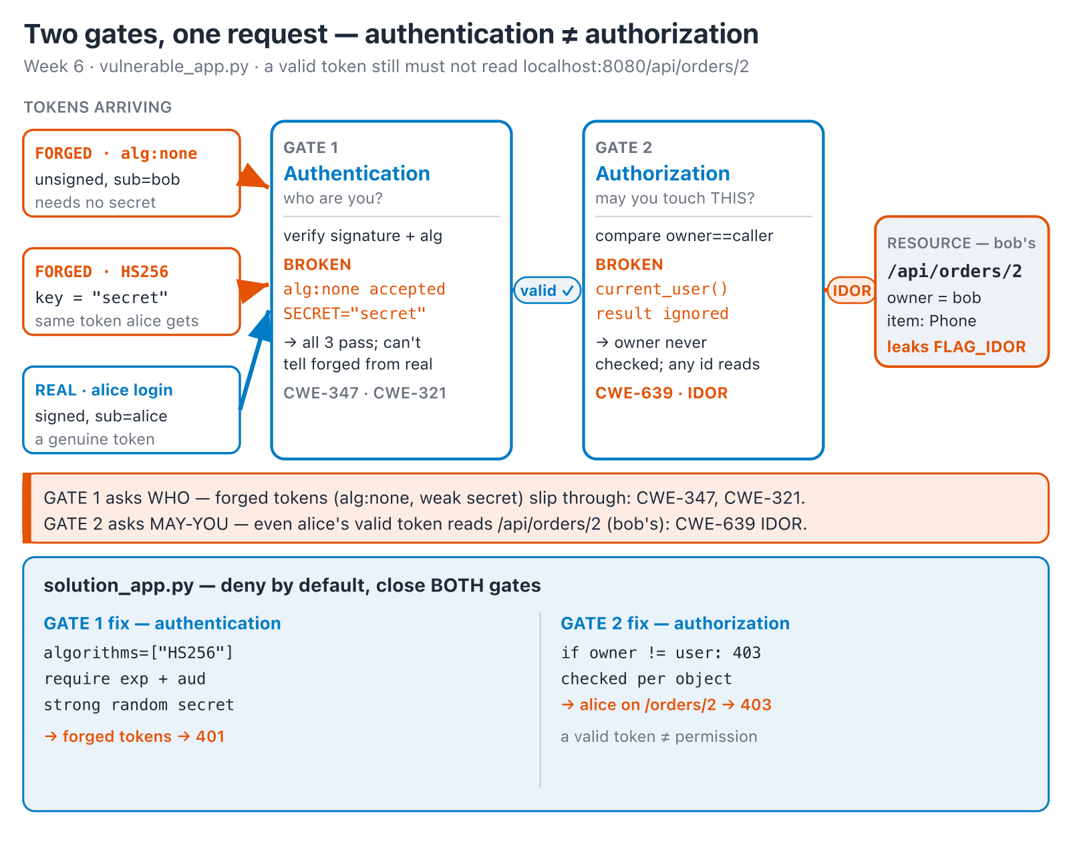
SOFTWARE SECURITY 2 / WEEK 6
One request, two gates
KOSEN-KMITL | Software Security 2 · Week 6
12
Notes:
The thesis of the whole week, made concrete: JWT pitfalls broke Gate 1, IDOR broke Gate 2, and they're independent failures — fixing one doesn't fix the other. This is why "Defenses" lists both "verify JWT" and "check ownership" as separate bullets, not one fix. ~4 min.

Slide 13
SOFTWARE SECURITY 2 / WEEK 6
Access control models
MAC — Mandatory: system-enforced labels (military)
DAC — Discretionary: owner grants access (file perms)
RBAC — Role-Based: permissions via roles
RuBAC — Rule-Based: conditions (time of day, IP)
Best practices: separation of duties · least privilege · implicit deny
KOSEN-KMITL | Software Security 2 · Week 6
13
Notes:
Quick taxonomy — general knowledge. Today's lab does NOT implement RBAC/ABAC: the actual fix is a flat ownership check (`order["owner"] != user`), no roles or permissions structure at all. Don't tell students they'll build RBAC today; they won't. Stress the three best-practice principles — especially implicit deny (default to no access). ~4 min.

Slide 14
SOFTWARE SECURITY 2 / WEEK 6
Exercise — RBAC
Role | Permissions
Developer | Read/write Git, JIRA, run unit tests
QA Engineer | Read Git, write test reports, JIRA, deploy to staging
Project Manager | Read Git, JIRA, view dashboard
Intern | Read Git, run unit tests
1
Who may deploy to staging?
2
An intern must create bug entries — which role's perms to add?
3
List all roles that can modify the codebase.
KOSEN-KMITL | Software Security 2 · Week 6
14
Notes:
Run this interactively — give 2 minutes, then poll answers. (1) QA only. (2) add JIRA-write, narrowly (least privilege, not a full role bump). (3) Developer (write Git); discuss whether QA's staging deploy counts. ~6 min.

Slide 15
SOFTWARE SECURITY 2 / WEEK 6
Reading the attack in the logs
Reconstruct the kill chain from Apache logs:
GET /login.php?username=' or 1=1 limit 1; -- a&... 302 ← SQLi admin
POST /upload.php 200 ← backdoor
GET /uploads/backdoor.php?cmd=ls%20-l 200 ← RCE
%20 = space (URL-decode!) · logs let you trace what happened
KOSEN-KMITL | Software Security 2 · Week 6
15
Notes:
Ties W4 (SQLi auth bypass + upload→RCE) into incident response. Walk the three lines as a story: get in → plant webshell → run commands. Teach URL-decoding (%20=space). Defenders read logs; attackers leave them. ~5 min.

Slide 16
SOFTWARE SECURITY 2 / WEEK 6
CWE mapping
CWE-639 — IDOR / missing ownership check
CWE-347 — improper signature verification (alg:none forgery)
CWE-321 — use of a hardcoded/weak cryptographic key (the guessable HMAC secret)
KOSEN-KMITL | Software Security 2 · Week 6
16
Notes:
Reference for the worksheet — these three are what's actually graded (worksheet header + Q1). CWE-321 is easy to drop since it's not the "obvious" JWT CWE, but it's the weak-secret task's specific id. ~1 min.

Slide 17
SOFTWARE SECURITY 2 / WEEK 6
Defenses
Server-side authorization on every request (deny by default)
Check ownership, not just authentication
Strong session tokens + proper expiry/rotation
Verify JWT signature, alg, exp, aud; keep secrets strong
RBAC / ABAC enforced centrally
Centralize the check — don't scatter if role==... everywhere
KOSEN-KMITL | Software Security 2 · Week 6
17
Notes:
The payoff. #1: authorize EVERY request, deny by default. "Check ownership, not just authentication" is the IDOR fix in one line. Centralize so you can't forget a check on one endpoint. ~6 min.

Slide 18
SOFTWARE SECURITY 2 / WEEK 6
Tool — Burp Suite workflow
Tool | Use
Proxy | intercept & modify requests
Repeater | replay/tweak one request
Intruder | automate brute-force/fuzz
Decoder/Comparer | encode payloads / diff responses
Set scope, intercept, change a value (e.g. price=1), forward
Test auth, sessions, IDOR, privilege escalation
KOSEN-KMITL | Software Security 2 · Week 6
18
Notes:
Practical — they'll use Repeater to tweak object ids and Intruder to enumerate. Demo: intercept, change orders/1→2, forward, see another user's data. Set scope first so you don't attack out-of-bounds. ~5 min.

Slide 19
SOFTWARE SECURITY 2 / WEEK 6
🗺️ Game — IDOR Treasure Hunt + JWT Forgery
1
Tamper object IDs to reach another user's data (horizontal — read bob's order) → the local flag is demo evidence; use only an individually issued hosted flag when assigned
2
Forge a JWT two ways: alg:none, then sign with the exposed weak HMAC secret
3
Defend: complete student_patch.py, then use student_checks.py to prove legitimate access works and cross-user or forged-token access fails. Compare solution_app.py only after your own tests.
KOSEN-KMITL | Software Security 2 · Week 6
19
Notes:
Explain before lab. Treasure hunt = change the order id with alice's real token: horizontal access to bob's order. The local demo flag is shared practice, not proof from an individually assigned hosted instance. Worksheet Task 4 is optional, ungraded admin-forgery practice; Task 5's common-core controls still verify that a real non-admin user gets 403 and forged tokens get 401 on /api/admin. The common core includes student-written JWT verification and object ownership in student_patch.py; the pre-written solution stays a comparison. Do not mislabel object ownership as a complete RBAC system. ~3 min.

Slide 20
SOFTWARE SECURITY 2 / WEEK 6
Lab steps
📋 Worksheet 6 — labs/week06-authn-authz/worksheet.md (Part 3) · before class: docker compose build · kickoff: docker compose up --no-build --pull never → http://localhost:8080
1
Find IDOR endpoints; enumerate other users' objects
2
Forge a JWT (alg:none AND signing with the exposed weak HMAC secret — two separate graded observations)
3
Complete the JWT verification and ownership TODOs in student_patch.py
4
Run student_checks.py in the prepared image before and after the patch; explain the positive and negative results
KOSEN-KMITL | Software Security 2 · Week 6
20
Notes:
Logistics. The graded defense is the student's verification and ownership patch with positive and negative checks. solution_app.py remains the complete reference. The weekly quiz no longer asks for the object id/fix/flag (dropped — quiz runs before the lab) — that's required in the worksheet instead. Also the NoteVault project access-control task.

Slide 21
SOFTWARE SECURITY 2 / WEEK 6
Deliverable
IDOR + JWT findings with impact
Your student_patch.py commit and student_checks.py results
Proof legitimate access works and forged-token / cross-user access fails
Assigned AIR-Sec 40: Audit / EiPE / Prompt; Conventional uses written 40 (see worksheet)
KOSEN-KMITL | Software Security 2 · Week 6
21
Notes:
Before/after + proof must come from the student's patch. The supplied solution is comparison material.

Slide 22
SOFTWARE SECURITY 2 / WEEK 6
Key takeaways
Authenticate once, authorize every request
Never trust client-supplied IDs or tokens blindly
Deny by default
KOSEN-KMITL | Software Security 2 · Week 6
22
Notes:
Recap. Cold-call: "we authenticated the user — why can they still read another user's order?" (no ownership/authz check). ~2 min.

Slide 23
SOFTWARE SECURITY 2 / WEEK 6
Questions?
Next week: Reflection & review (midterm prep)
KOSEN-KMITL | Software Security 2 · Week 6
23
Notes:
Wrap the teaching block: "Next week we consolidate W1-6 — Jeopardy + a mock CTF in the exact midterm format. Bring your cheat-sheet of CWEs." Remind cumulative review quiz in W7. Current authored work: student_patch.py plus student_checks.py, positive and negative controls, and an explanation. Reference-only output does not demonstrate the student patch.

