Slide 1
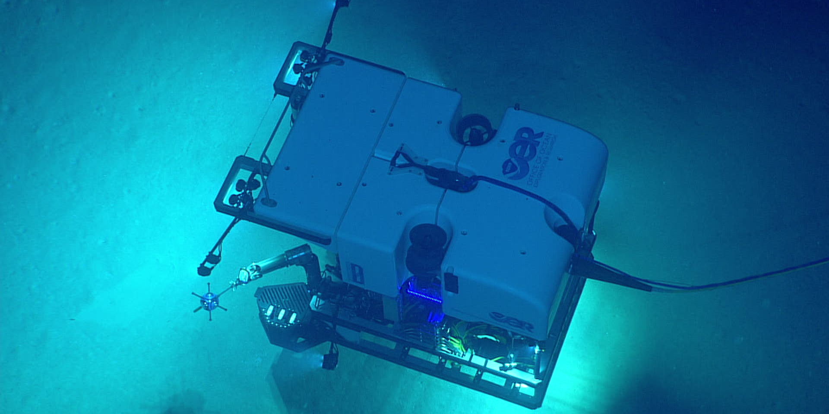
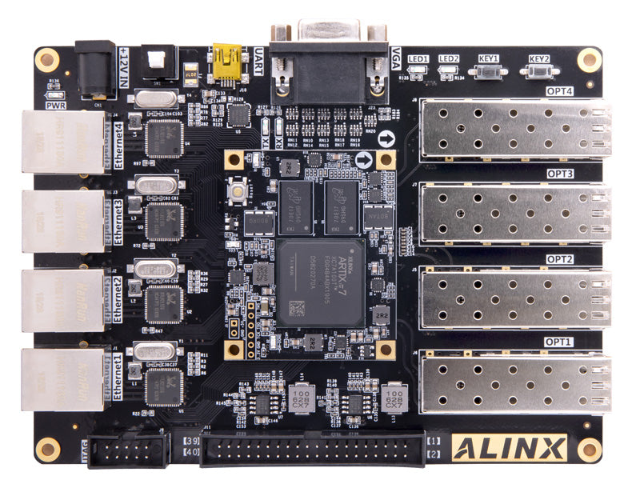
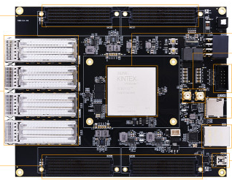
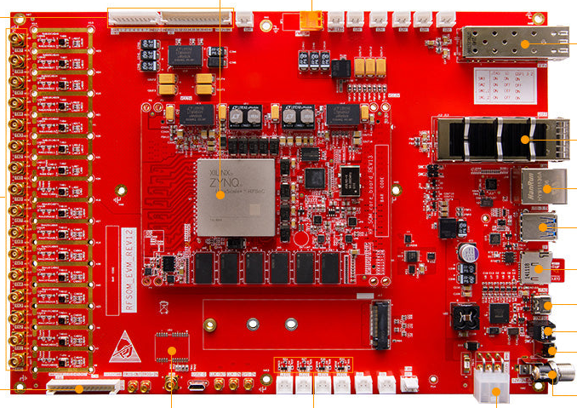
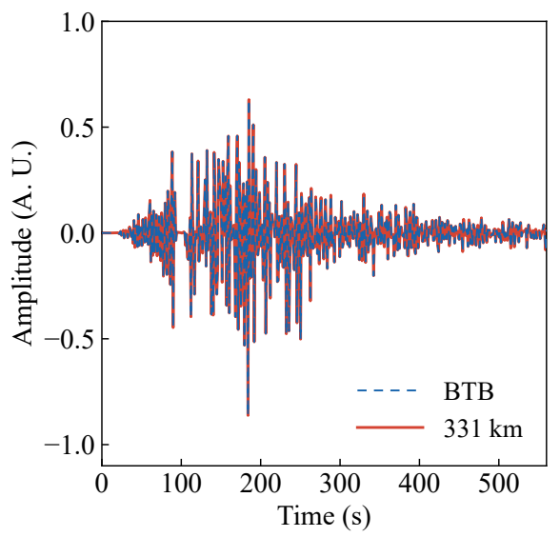
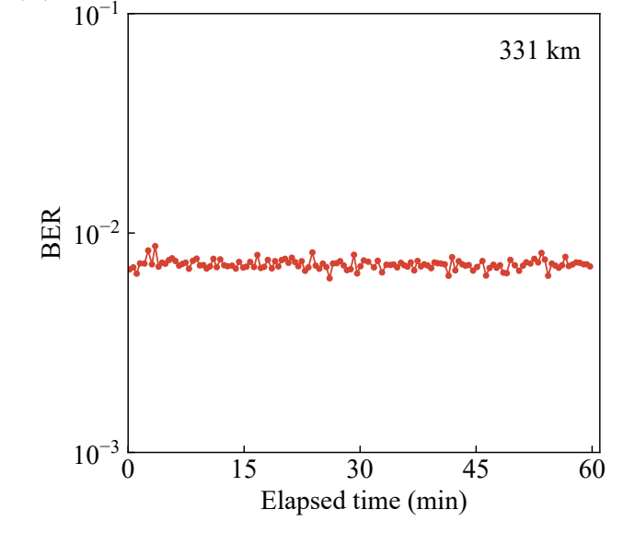
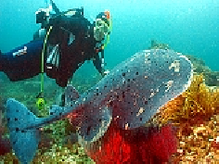
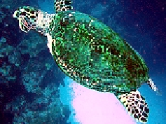
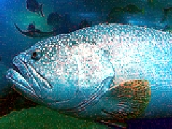
2026 National Undergraduate Embedded Chip and System Design Competition
FPGA Multisource Aggregation
and Coherent Optical Transmission
Underwater images and seismic data over one high-speed link
Zixuan Liu Hui Shen Fan Wu
Subsea Monitoring
331 km
160 Gb/s
4 Gbaud
BER < 0.01
Unrepeatered G.654.E fiber link
10 WDM channels, aggregate gross rate
Dual-polarization QPSK
Best measured BER for each channel
Three FPGAs for Multisource Aggregation and Transmission
Coherent Optical TX / RX
→
→
→
IQ modulation → WDM → 331 km fiber
ICR → Oscilloscope → MATLAB DSP
AX7101 Data Source
KU115 Aggregator
RF47 Waveform TX
CD compensation / equalization / decisions
Read image and seismic data
FIFOs + active-port scheduling
8-ch deskew / long PRBS / payload
CRC checks and object reassembly
Object segments over UDP
Cross-frame segments + CRC32
DP-QPSK mapping + DAC output
Full Recovery of Images and Seismic Data after 331 km
Measured Received Data
3 Underwater Images
160 × 120 RGB, reassembled by object offset
CRC-valid fragments only, with final object verification
11,200 Seismic Samples
1-hour Weighted BER 0.007193
130 valid windows. Pre-FEC BER below the 0.02 SD-FEC reference threshold.
Active-port aggregation with dynamic segmentation, verified by BER and end-to-end data integrity.
FPGA Open Track, Junior Division
Notes:
Project: FPGA Multisource Aggregation and Coherent Optical Transmission for Underwater Images and Seismic Waveforms.
Authors: Zixuan Liu, Hui Shen, Fan Wu.
Data sources: the project report at C:/Users/Administrator/Desktop/SMF/report/design_report.md and its original figures under report/assets/paper_331km/. The three received images, seismic traces and BER curve are existing experimental results. No curve data or image content has been generated or altered.
Measurement definitions: 160 Gb/s is the aggregate gross line rate of 10 WDM wavelengths, not net application throughput. BER < 0.01 refers to the best measured value for each wavelength. The CH3 record covers approximately one hour with 130 valid acquisition windows, 65,452 bit errors and a weighted BER of 0.007193. This is intermittently sampled pre-FEC BER, not continuous monitoring of every transmitted bit. The 0.02 threshold is a reference for 20%-overhead SD-FEC. It is a threshold comparison and does not claim actual post-FEC error-free operation for the DP-QPSK link. Images and seismic waveforms were fully reconstructed by accumulating CRC-valid fragments over repeated transmissions.
Image sources:
ocean_rov.jpg
https://commons.wikimedia.org/wiki/File:Deep_Discoverer_(51816198671).jpg
https://upload.wikimedia.org/wikipedia/commons/c/c5/Deep_Discoverer_%2851816198671%29.jpg
ax7101.jpg
https://coderobin.com/products/alinx-ax7101-xilinx-artix-7-xc7a100t-fpga-development-board
https://coderobin.com/cdn/shop/files/AX7101_Off_01_800x.jpg?v=1712869486
axku115.jpg
https://www.avantadigital.com/alinx-axku115-fpga-development-board-kit-with-amd-kintex-ultrascale
https://www.avantadigital.com/image/cache/catalog/Alinx-AXKU115-FPGA-Development-Board-Kit-with-AMD-Kintex-Ultrascale-600x600.jpg
axrf47.jpg
https://coderobin.com/products/alinx-axrf47-xilinx-zynq-ultrascale-rfsoc-xczu47dr-fpga-development-board
https://coderobin.com/cdn/shop/files/AXRF47_Off_04_1200x1200.jpg?v=1776002604
The sea background depicts Deep Discoverer by NOAA Ocean Exploration & Research, CC BY-SA 2.0 (https://creativecommons.org/licenses/by-sa/2.0/). It illustrates the application context and is not project hardware. It has been scaled and cropped, and this adaptation of the photograph remains under CC BY-SA 2.0. The board images are ALINX product photographs sourced through CodeRobin and Avanta Digital, with rights retained by their respective owners. They identify the selected models and are not photographs of the project test bench.
Original report retained. Repository: https://github.com/LengQingSnow/fpga-optical-subsea-link

