Slide 1




Sensitive Responsive Workplaces
Intelligent workplaces for wellbeing
Lenia Margariti
PhD student - Open Lab, Newcastle University
Notes:
Quantified?
Intelligent?
Smart?
Should I frame it as smart buildings, or workplaces, or workspaces?
Should I discuss about physical or also digital dimensions? ---workplace is the place, workspace is the digital dimension of work (workstation)

Slide 2
A co-design workshop for wellbeing in the hybrid workplace.
Intelligent workplaces for wellbeing
Define
Reflect
Ideate
Places of work.
Workplace Wellbeing.
Intelligent Buildings.
Discuss wellbeing aspects on the home workplace and office space.
Use a card toolkit to co-design scenarios of future hybrid workplaces.
10' online
20' online
2 hours remote
Notes:
Playing between synchronous and asynchronous, collective and individual, co-located and remote co-design aspects.
https://miro.com/welcomeonboard/IU9JoMwJ6iOM5rku69wxdj94XeRc8Ym8ALP4yRRdVEsoxsgMFvcKyOOUt64yr688
Is it design fiction? Or simply card workshop for scenarios?
DIY toolkit to take at home – ask David VerweiJ

Slide 3
Technology is changing the workplace.
Intelligent workplaces for wellbeing
Technology has massively re-shaped the places, spaces and ways we work.
Connected workers.
Remote (home) work.
Distance matters less as work becomes more technology mediated.
Blending the office space with the domestic sphere; flexibility, comfort.
Environmental monitoring.
Hot desking.
Data-rich office buildings monitor CO2, temperature and light.
Adaptive open plan work areas to maximize space-use efficiency and enhance collaboration.
Notes:
Blending the office space with the domestic sphere.

Slide 4
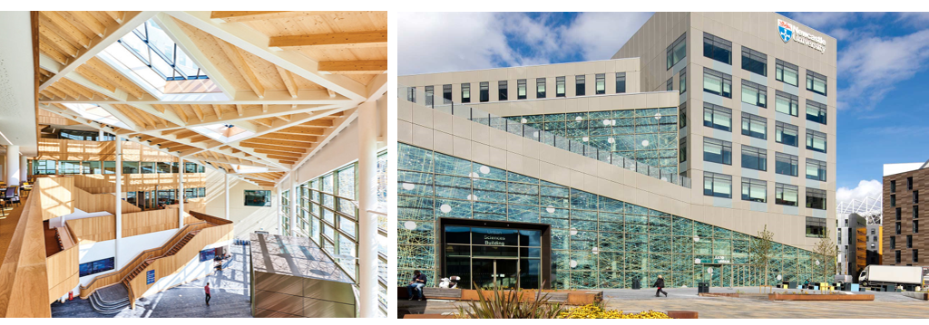
Workplaces as data-rich ecosystems.
Intelligent workplaces for wellbeing
Notes:
https://3d.usb.urbanobservatory.ac.uk/

Slide 5

Notes:
LiveSlide https://3d.usb.urbanobservatory.ac.uk/

Slide 6
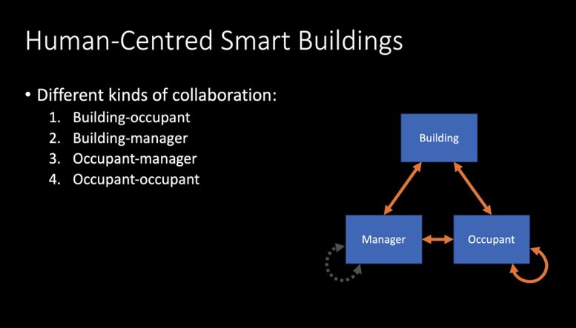
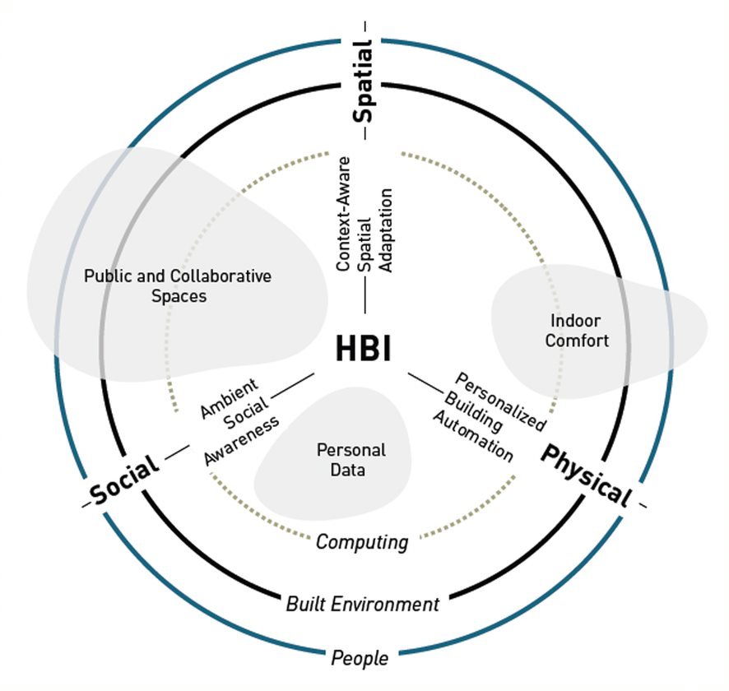
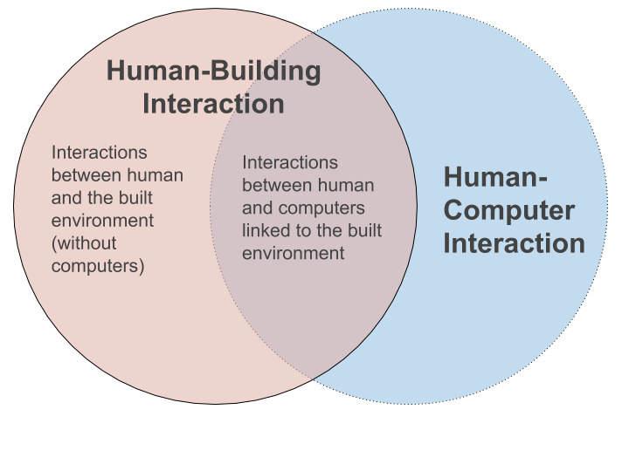
Intelligent workplaces for wellbeing
Addressing users in intelligent buildings.
Human Building Interaction (HBI) research agenda
Notes:
https://youtu.be/zwarPoJgpJ0
Within this problem space and address some of these limitations of smart environments, the interdisciplinary HBI field has been evolved.
Studying How users interact with smart environments and what are the potentials/implications in that space
There are three major forces driving the current evolution toward human-building interaction: 1) recent advancements in sensing and communication technologies that enable the integration of computerized elements into physical infrastructures (e.g., NarrowBand IoT), 2) developments within architectural practice that include reactive, interactive, and self-modifying architectural elements, and 3) ecological and sustainability concerns that call for lasting, human-centered environments.
https://interactions.acm.org/archive/view/july-august-2019/human-building-interaction
https://medium.com/@jayzhaonyc/what-is-human-building-interaction-hbi-a6839a88f121
The research agenda of human points to some directions for future development of human - centric smart environments, for instance
Buildings as interfaces / technologies for negotiation and collaboration between different occupant groups (Reference Human Building Collaboration);
As technologies to enhance social awareness and social interaction; advance personalized building control, and context-aware adaptation; but not limited to these.
data feedback loops in these environments and temporal aspects of interaction as some of the points of interests.
How users interact with smart environments and what are the potentials/implications in their behaviour in that space

Slide 7
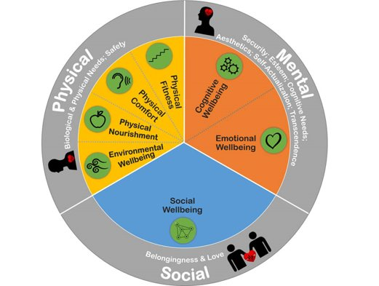
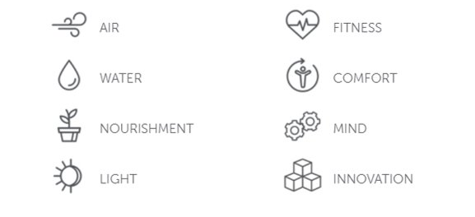
Intelligent workplaces for wellbeing
Assessing wellbeing in the
the workplace.
The places that we work have a great impact on our wellbeing.
Notes:
There are many dimensions to workplace wellbeing, and many approaches to assess it. One of the most comprehensive approaches for KPIs in workplace wellbeing comes from PROWELL -see
https://www.innovativeworkplaceinstitute.org/workplace-wellbeing-prowell.php
https://www.ucl.ac.uk/bartlett/environmental-design/workplace-health-wellbeing-linking-environment-employee-health-wellbeing-workplaces
Whereby workplace wellbeing is addressed as a set of physical, mental and social aspects.
This model refers to collocated workplaces and not to remote connected workplaces, and therefore has limitations.
For the purpose of our research and given that we re-frame aspects of this model to embrace challenges of the remote workplace wellbeing that are not addressed by the current model.
https://workinmind.org/
https://legacy.wellcertified.com/en
https://workinmind.org/2020/06/03/workplace-ergonomics-how-to-create-a-healthy-home-office/

Slide 8
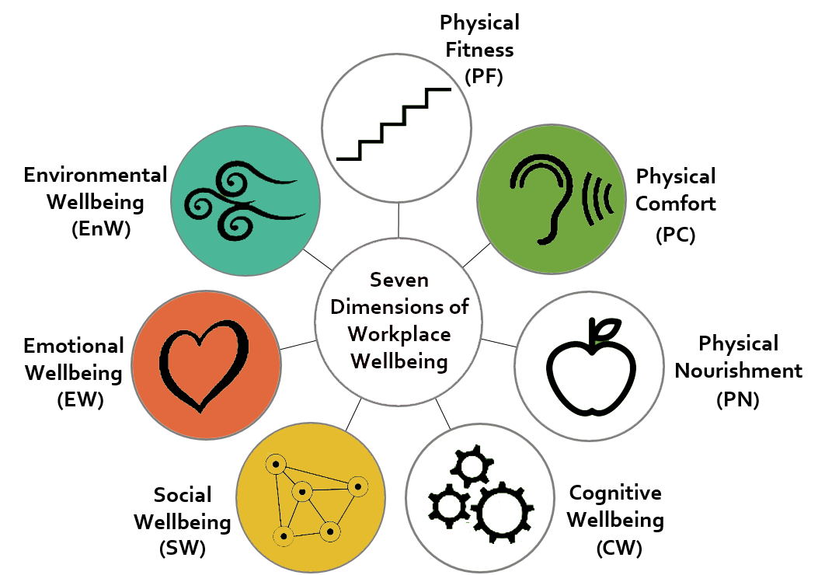
Wellbeing Aspects
Intelligent workplaces for wellbeing
Environmental Wellbeing
Air Quality Awareness
Contact with Nature
Emotional Wellbeing
Mood awareness
Work – life transitions
Social Wellbeing
Social Awareness
Collective synchrony
Physical Comfort
Posture alternation
Active Working
Notes:
To give 3 problem spaces / directions.
1 env. Aspects / - air quality ---> all aspects (indoor/outdoor, breathing)
2 postures / activity
3 emotional / social wellbeing - light and mood
Brinding the two worlds together for the future. The dimensions of physical and digital collide into one comprehensive framework for the connected (digital and physical) hybrid (remote and collocated) workplace.
https://www.innovativeworkplaceinstitute.org/workplace-wellbeing-prowell.php
https://www.rand.org/randeurope/research/work-and-wellbeing/digital-solutions.html
https://powell-software.com/en/digital-wellbeing-and-the-digital-workplace/
https://workinmind.org/2020/06/03/workplace-ergonomics-how-to-create-a-healthy-home-office/

Slide 9
Intelligent workplaces for wellbeing
Designing data-ecosystems for hybrid workplace wellbeing.
Connected workplaces
Anywhere office.
Enhancing social presence in remote through ambient interactions.
Any place can become a workplace and adapt to different needs and tasks.
Environmentally aware office.
On / Off workplace.
Environmental monitoring and calm eco-feedback to surface latent aspects.
Ambient interactions for transitioning between online and offline work, and domestic life.
Notes:
Co-designing connected data ecosystems for workplace wellbeing.

Slide 10
Workplace wellbeing design futures
Intelligent workplaces for wellbeing
Passive & Eco
Aware & Happy
Connected / Disconnected
Passive adaptation based on environmental monitoring;
biophilic environments;
Surfacing data for wellbeing & engaging the occupants.
Workplaces that enhance self-awareness, social awareness and collaboration.
Adaptive spaces to accommodate changing needs in hybrid and remote work;
Workplaces that enhance climate awareness (eco-feedback);
Enhance the physical and the tangible in the workplace.
Connected workplaces and people;
Privacy – friendly workplaces.
Shift from performance to wellbeing; work – life inclusion; happiness is productive.
Notes:
https://interactions.acm.org/archive/view/may-june-2020/technologies-for-healthy-work
There are these shifts in policy level, but these are conditions yet to be met.

Slide 11



Thank you
Lenia Margariti
PhD student - Open Lab, Newcastle University

