Slide 1
SQuAD Dataset Generation
Llam3B instruct GAI
Baseline Model
BETO for QA
Fine Tuning
Adapt Model to Real Documents

Slide 2

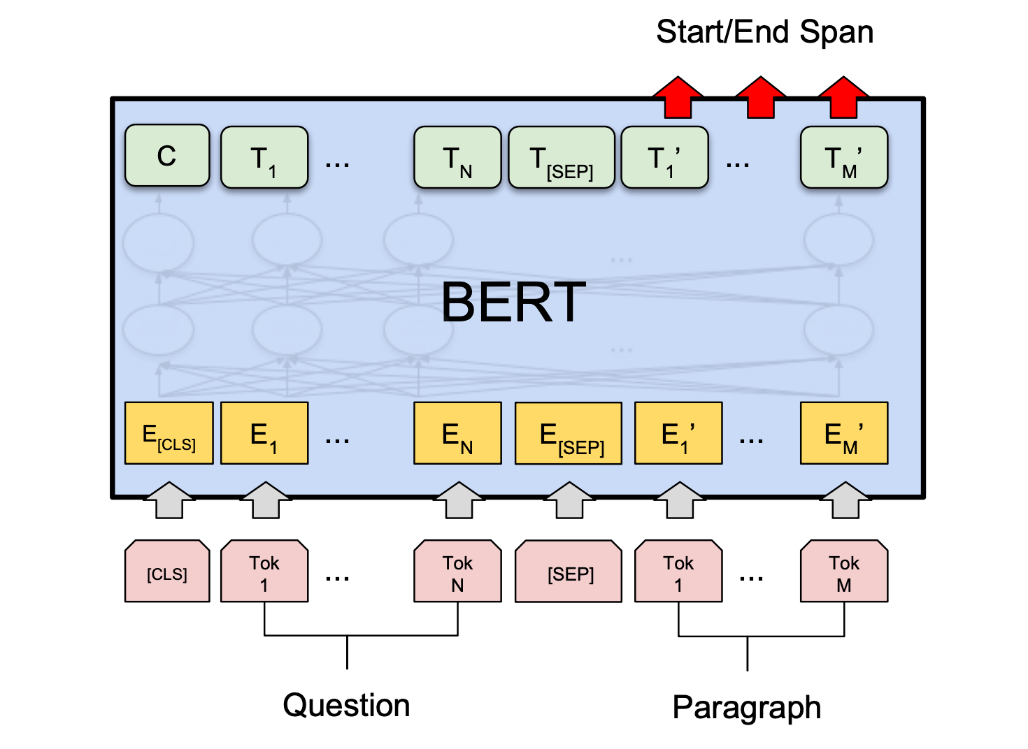
Robbery Documents
SQuAD Robbery Dataset
Base Line
F1-Score 81.70
Fine Tuning
F1-Score 82.88

