Slide 1

AED to CAD Exchange Rate Forecasting
Lenin Prakash Vasudevan

Slide 2
Introduction:-
In this project, I am leveraging two decades' worth of historical data on the AED to CAD exchange rate to forecast future currency trends. Employing advanced time series forecasting techniques, including Linear regression, ARIMA, SARIMA, and LSTM machine learning models, I aim to develop accurate predictions for the exchange rate dynamics.
This comprehensive analysis utilizes the rich historical context to enhance the forecasting capabilities, providing insights into potential trends and fluctuations in the AED to CAD exchange rate

Slide 3
Agenda:-
Introduction to the Case
Agenda
EDA
Data preprocessing
Machine Learning models
Conclusion

Slide 4
Data types in each Column:-
EDA
Missing values in the dataset:
Date 0
Price 0
Open 0
High 0
Low 0
Volume 317
Change 0
dtype: int64

Slide 5
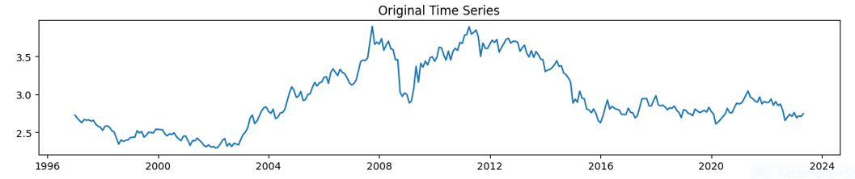
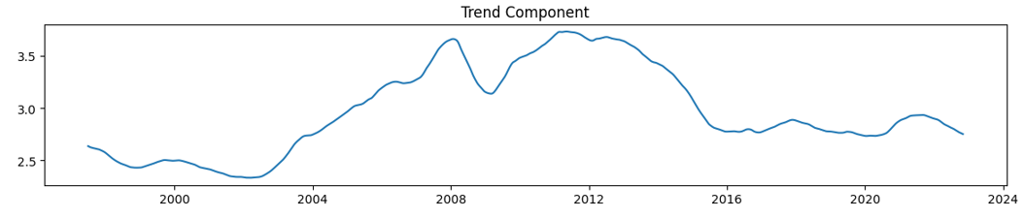
EDA
Raw Data Plot:-
Trend Plot:-

Slide 6
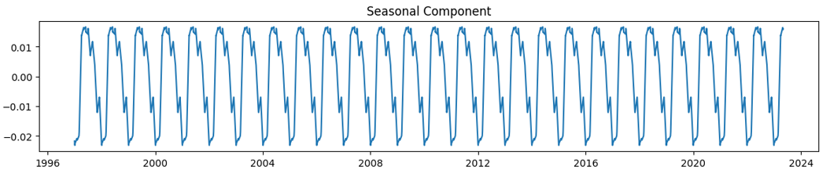
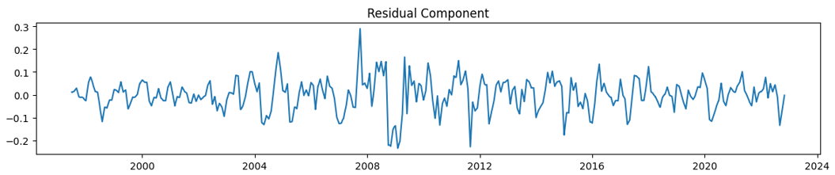
EDA
Seasonal Plot:-
Residual Plot:-

Slide 7
Assumption:-
In this dataset, we focus exclusively on the "Price" and "Date" columns, excluding all other variables under the assumption that they exhibit a seasonal pattern.

Slide 8
Setting Index and Date:
We are deleting all the columns expect Price and Date.
The Dataset has Date column so we are assigning it in date format.

Slide 9
ML model:
In this project, we employed a combination of time-tested machine learning models to forecast the AED to CAD exchange rate based on historical data spanning the past two decades.
we utilized Linear regression, ARIMA (AutoRegressive Integrated Moving Average) and SARIMA (Seasonal ARIMA) models, which are well-suited for capturing time-dependent patterns and seasonality inherent in financial time series data. Additionally, we incorporated LSTM (Long Short-Term Memory) neural network models, known for their effectiveness in capturing long-term dependencies and intricate patterns in sequential data.
Each model contributes distinct strengths to our analysis: ARIMA and SARIMA are adept at handling temporal patterns and seasonality, while LSTM excels in capturing intricate relationships in the data. By employing this diverse set of models, we aim to leverage their respective strengths to enhance the accuracy and robustness of our exchange rate predictions.

Slide 10
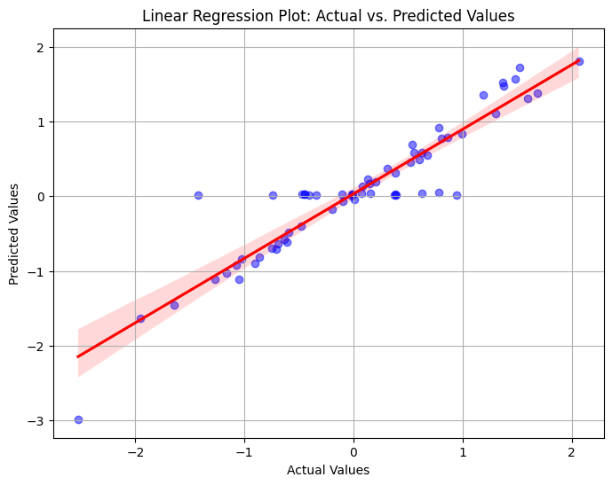
ML model:

Slide 11
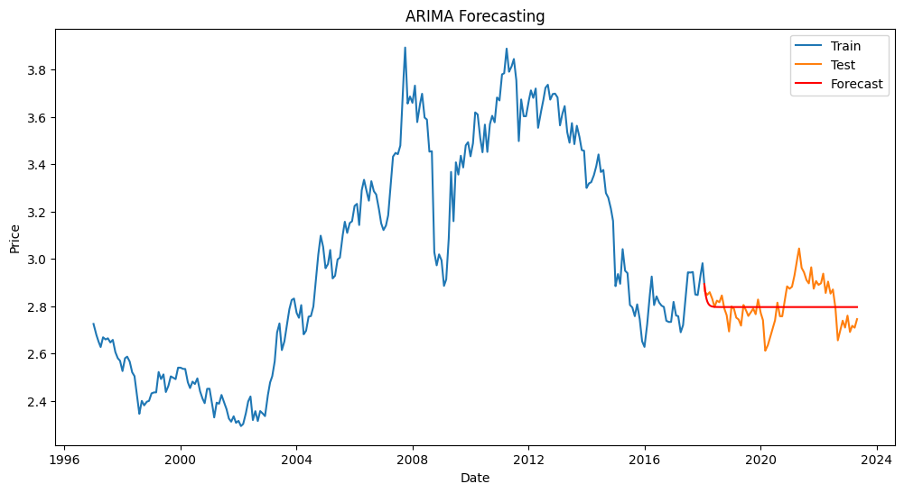
ML model:

Slide 12
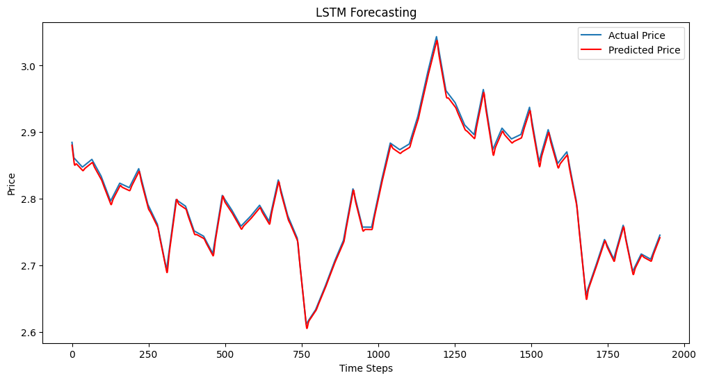
ML model:

Slide 13
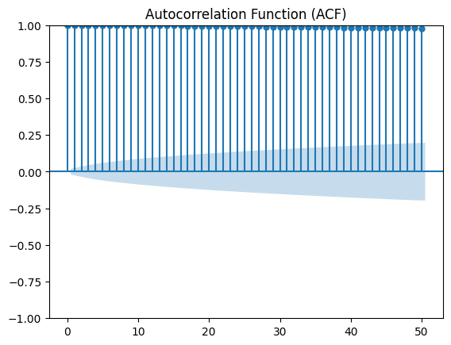
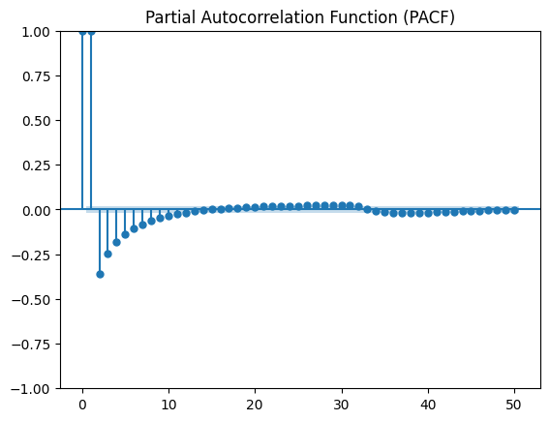
ML model:
Due to constraints on my computer's processing capabilities, I faced difficulties in executing the results as the computational demands were notably high, primarily due to elevated CPU usage.

Slide 14
Conclusion:-
In conclusion, while computational challenges were encountered with the SARIMA model due to high CPU usage, the LSTM predictions for the AED to CAD exchange rate were exceptionally accurate, closely mirroring the actual values. This underscores the effectiveness of LSTM in capturing intricate patterns, despite the limitations faced with SARIMA. The project highlights the need to balance model complexity with computational resources for successful forecasting implementations.

Slide 15
Data Collection
Dataset:-
Indexing.com. (Year). Title of the Data Set. Retrieved from https://www.indexing.com/

Slide 16
Thank you

