Slide 1

Air Quality analysis in New York city
Using ML to predict levels
by
Lenin Prakash Vasudevan

Slide 2

Introduction:-
Delving into the urban fabric of New York City, we confront a pressing environmental challenge — air pollution.
This ubiquitous threat affects every citizen, yet its nuances unfold uniquely across neighborhoods, characterized by variations in pollutant emissions, exposure levels, and community vulnerability.
The health toll of exposure to common air pollutants is profound, manifesting in respiratory and cardiovascular diseases, cancers, and premature mortality.
Our exploration employs key indicators, offering a temporal and spatial lens to comprehensively characterize air quality and its impact on public health throughout different corners of NYC.
Objective: Analyze air quality data to predict risk levels.
Techniques: Data preprocessing, exploratory data analysis, and machine learning.
Dataset: Air Quality Dataset from Data.gov.

Slide 3
Agenda:-
Introduction to the Case
Agenda
EDA
Data preprocessing
Machine Learning models
Conclusion

Slide 4
EDA
Data Preprocessing
Date Conversion: Converted Start_Date to numeric format.
Encoding: Encoded categorical variables using LabelEncoder.
Scaling: Applied MinMaxScaler to numerical features.
Splitting: Divided data into training and testing sets.

Slide 5
EDA
Resource Name | Count of Name
Annual vehicle miles traveled | 209
Annual vehicle miles travelled (cars) | 214
Annual vehicle miles travelled (trucks) | 209
Asthma emergency department visits due to PM2.5 | 384
Asthma emergency departments visits due to Ozone | 384
Asthma hospitalizations due to Ozone | 384
Boiler Emissions- Total NOx Emissions | 96
Boiler Emissions- Total PM2.5 Emissions | 96
Boiler Emissions- Total SO2 Emissions | 96
Cardiac and respiratory deaths due to Ozone | 192
Cardiovascular hospitalizations due to PM2.5 (age 40+) | 192
Deaths due to PM2.5 | 192
Fine particles (PM 2.5) | 5499
Nitrogen dioxide (NO2) | 5499
Outdoor Air Toxics - Benzene | 203
Outdoor Air Toxics - Formaldehyde | 203
Ozone (O3) | 1974
Respiratory hospitalizations due to PM2.5 (age 20+) | 192
Grand Total | 16218

Slide 6
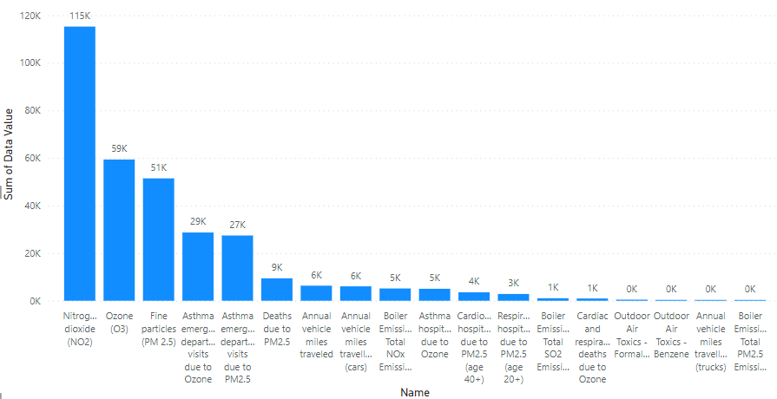
Name Vs data value
EDA

Slide 7
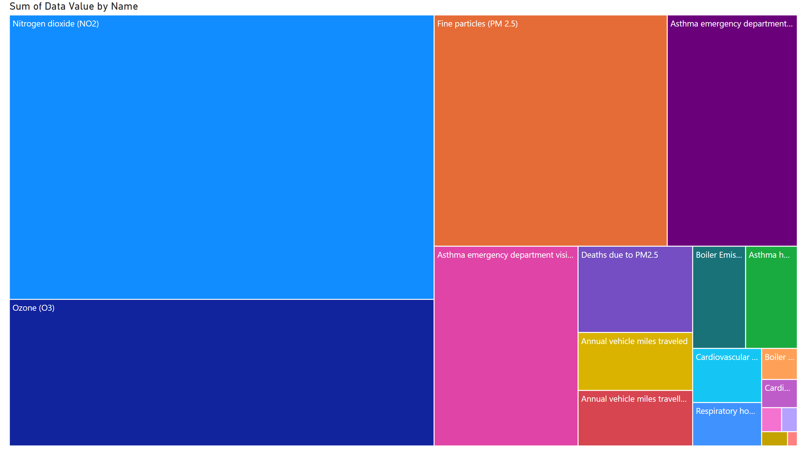
Page 1
Notes:
treemap
No alt text provided

Slide 8
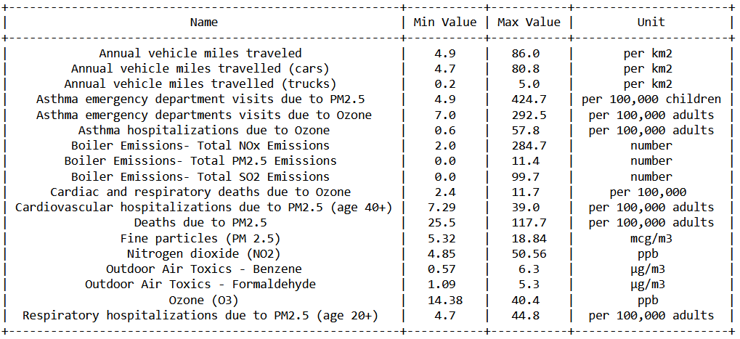
EDA
Finding the Minimum and Maximum values for each name

Slide 9
Assumption:-
In this project, we determined the maximum values(Data Values) for each category.
If a new value falls below 30%, it is classified as Low risk.
If the value is between 30% and 60%, it is categorized as Medium risk.
For values exceeding 60%, they are identified as High risk.

Slide 10
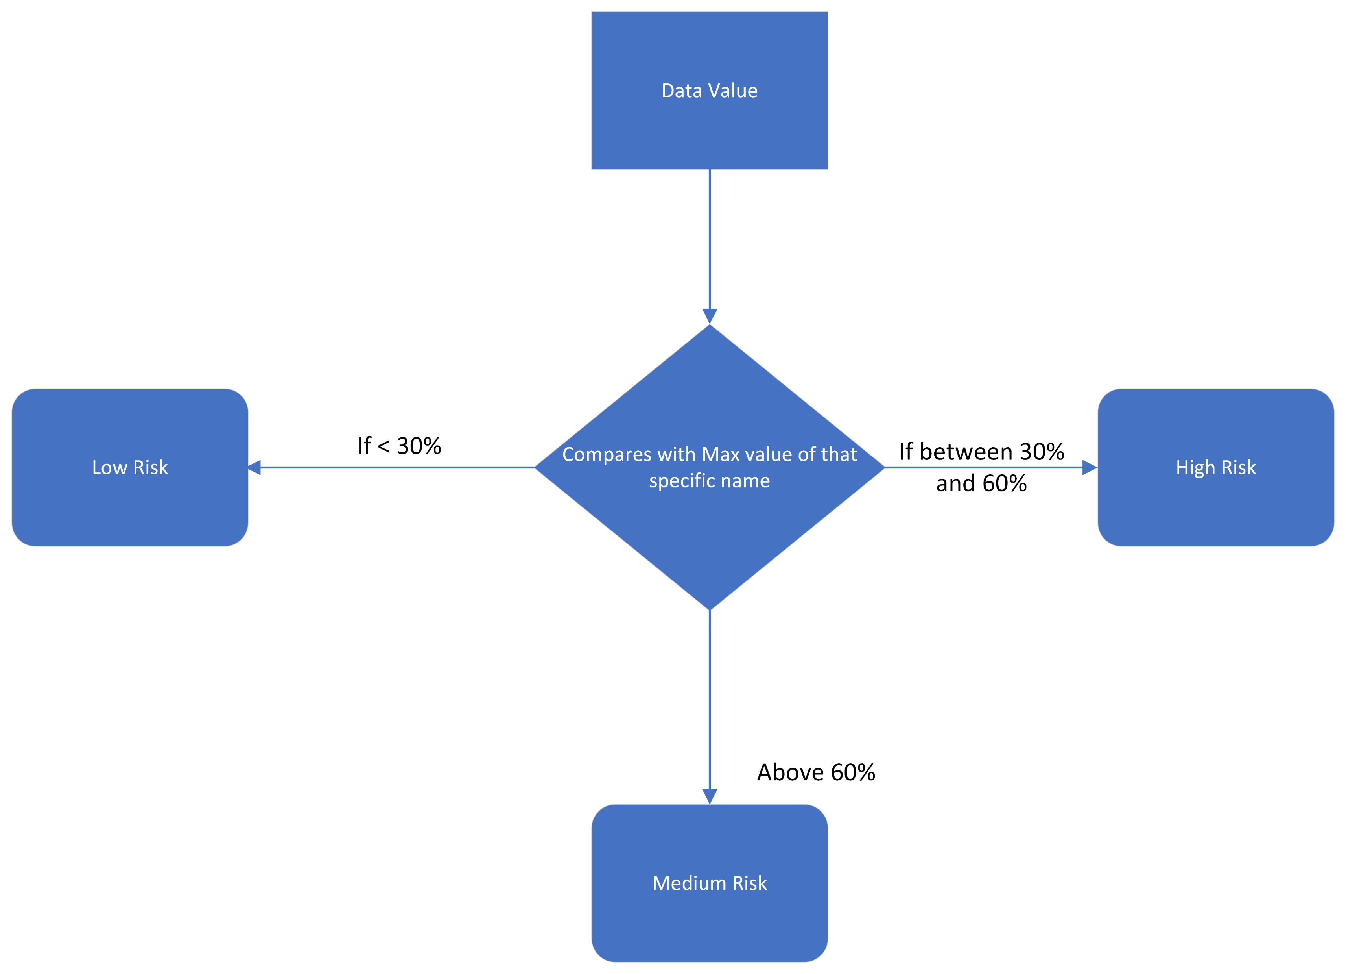
Flow Chart:-
Using this Logic we fill the
Message column.

Slide 11
Data Preprocessing:-
Finding Null values
Dropping unnecessary columns

Slide 12
Data Conversion:
Through label encoding, we have transformed categorical data into numerical representations. The columns that have been converted include “Name” and “Geo Type Name encoded.”
Setting Index and Date:
We have set the "Unique ID" as the index since it uniquely identifies each row. Additionally, we have defined the "Start_Date" column as a date to facilitate date-related operations.

Slide 13
ML model:
We are preparing to predict the risk levels (Message column) using selected features. The features (X) include 'Name', 'Measure Info Encoded', 'Geo Type Name encoded', and 'Normalized_Data_Value', while the target variable (Y) is the 'Message' column.

Slide 14
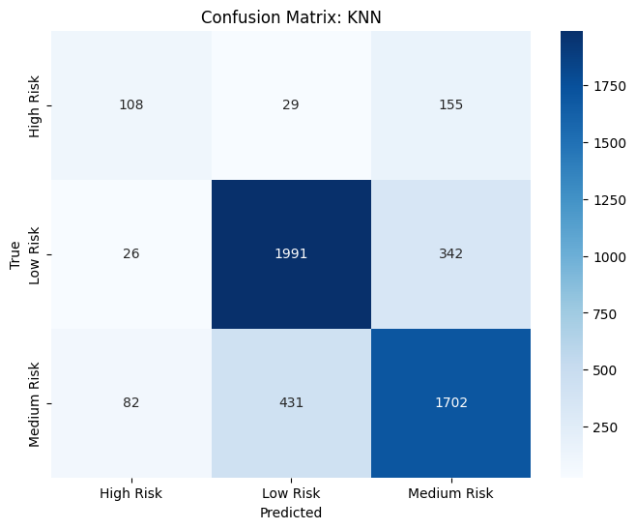
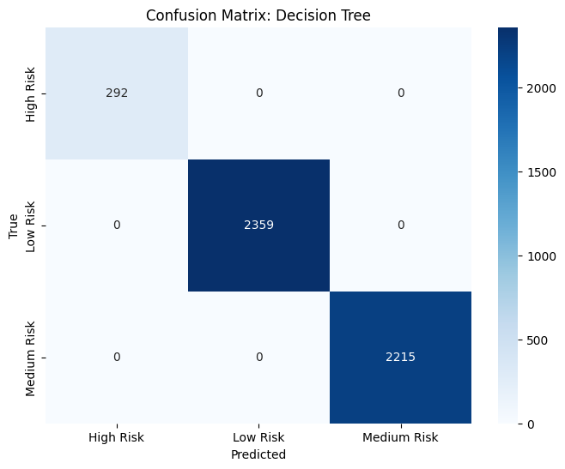

Slide 15
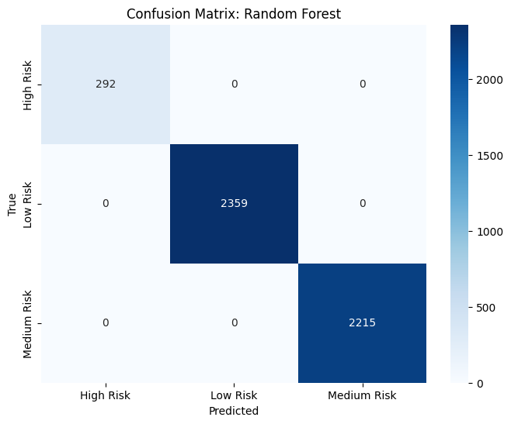

Slide 16
ML model:
We employed three classification models, namely K-Nearest Neighbors (KNN), Decision Tree, and Random Forest. Here are their respective accuracy scores:
ML Model | Accuracy
KNN | 0.78
Decision Tree | 1
Random Forest | 1

Slide 17
Model Evaluation - Classification Report
KNN:
- Precision, Recall, F1-Score for each class.
Decision Tree:
- Perfect scores, indicating overfitting.
Random Forest:
- Perfect scores, indicating overfitting.

Slide 18
Conclusion:-
In summary, our project delved into air quality data, analyzing pollutants' impact on health. We preprocessed data, categorized pollution levels, and employed KNN, Decision Tree, and Random Forest models. These models, after label encoding, provided accuracy insights for informed decision-making in public health and environmental management. The project establishes a foundational understanding for future air quality assessments and predictions.

Slide 19
Data Collection
Air Quality Dataset. Data.gov. https://catalog.data.gov/dataset/air-quality.

Slide 20
Thank you

