Slide 1
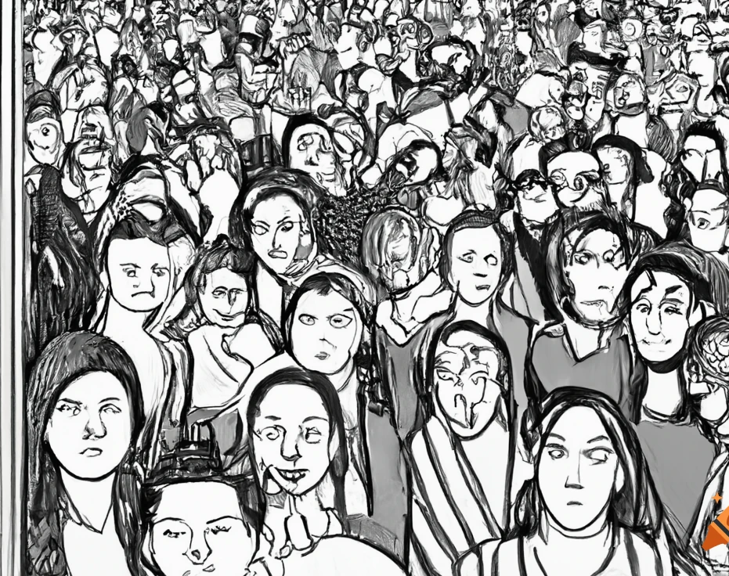
Exploring Labour Force Dynamics
Unveiling Insights from Canada's Workforce
Lenin Prakash Vasudevan

Slide 2
Introduction:-
In this presentation, we're taking a closer look at how people in Canada work, considering things like age, gender, and what kind of jobs they have.
We're using information from the 2021 Census, which gives us a snapshot of 25% of the population.
Our goal is to discover interesting details about work across different places in Canada, from the whole country down to smaller areas.
By doing this, we hope to better understand how people who are 15 years and older take on jobs and contribute to Canada's workforce, revealing the different ways employment happens across the country.

Slide 3
Overview of Dataset
Introduction to the dataset: "Labour force status by age and gender: Canada, provinces and territories, census divisions, and census subdivisions" (Table: 98-10-0485-01).
Release Date: November 15, 2023.
Geography Coverage: Canada, Province or territory, Census division, Census subdivision.
Universe: Population aged 15 years and over in private households, 2021 Census — 25% Sample data.

Slide 4
Agenda:-
Introduction to the Case
Overview of Dataset
Agenda
EDA
Data preprocessing
Machine Learning models
Conclusion

Slide 5
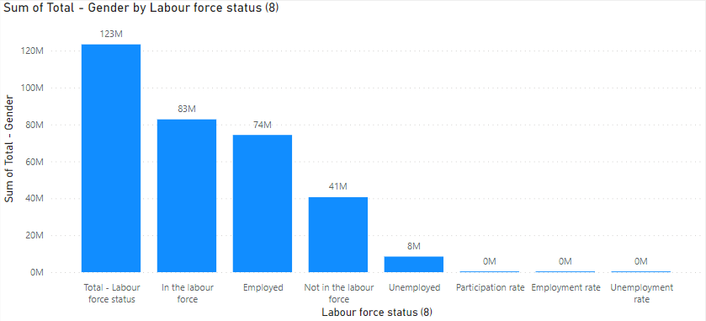
Total Labour vs Type of Labour foce status:-
EDA

Slide 6
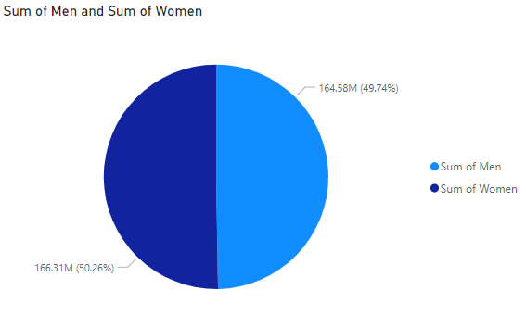
Total Men vs Type Women:-
EDA

Slide 7
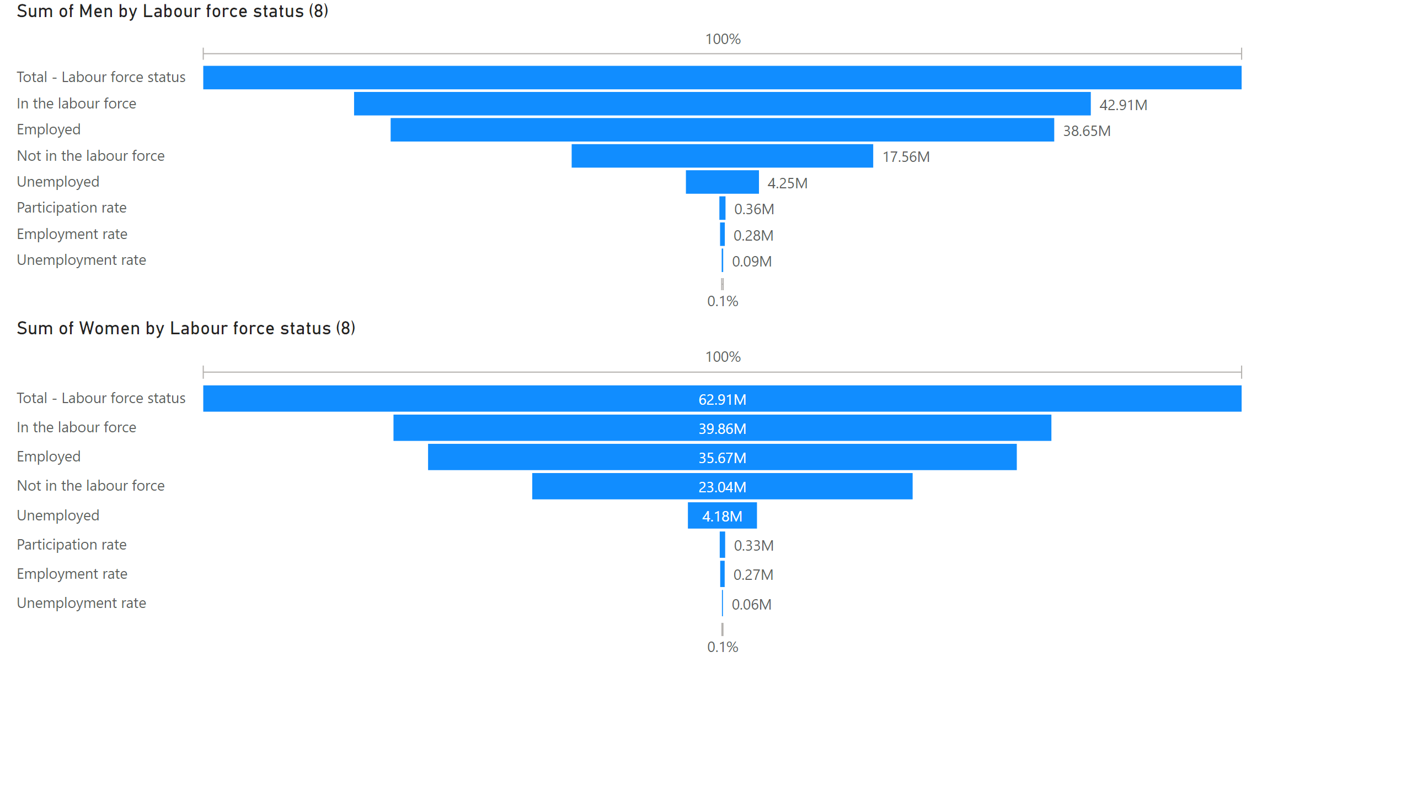
Page 1
Notes:
funnel
No alt text provided
funnel
No alt text provided

Slide 8
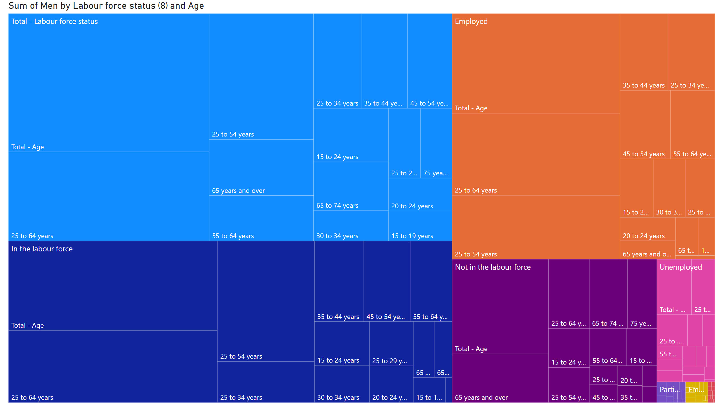
Page 2
Notes:
treemap
No alt text provided

Slide 9
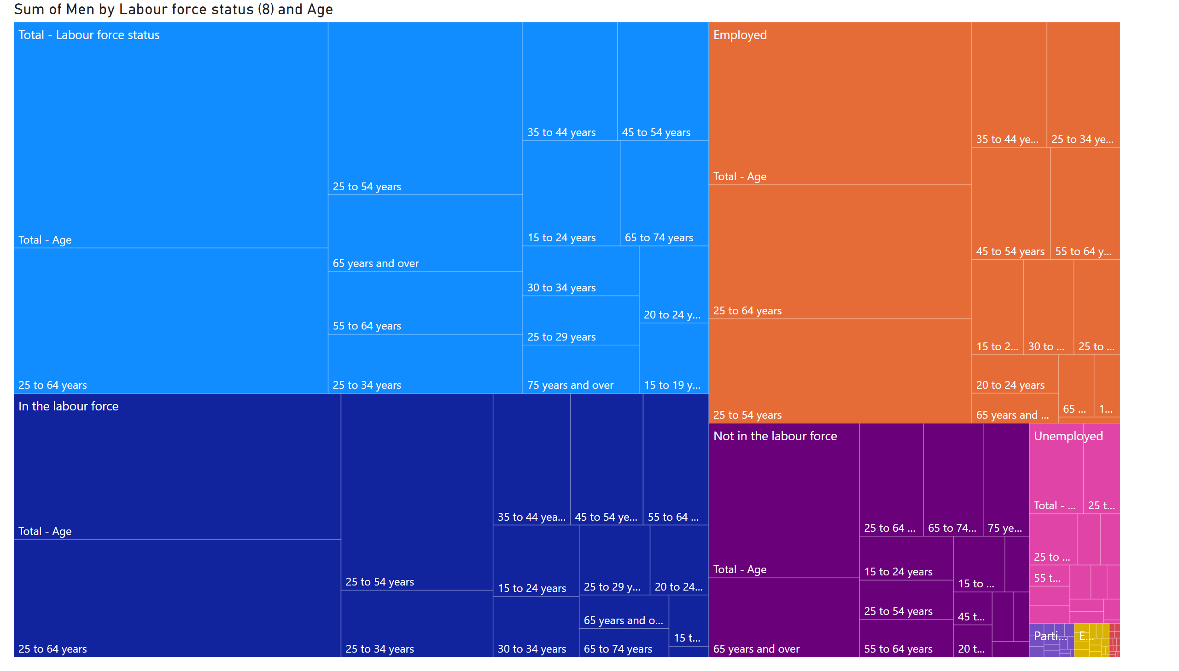
Page 3
Notes:
treemap
No alt text provided

Slide 10
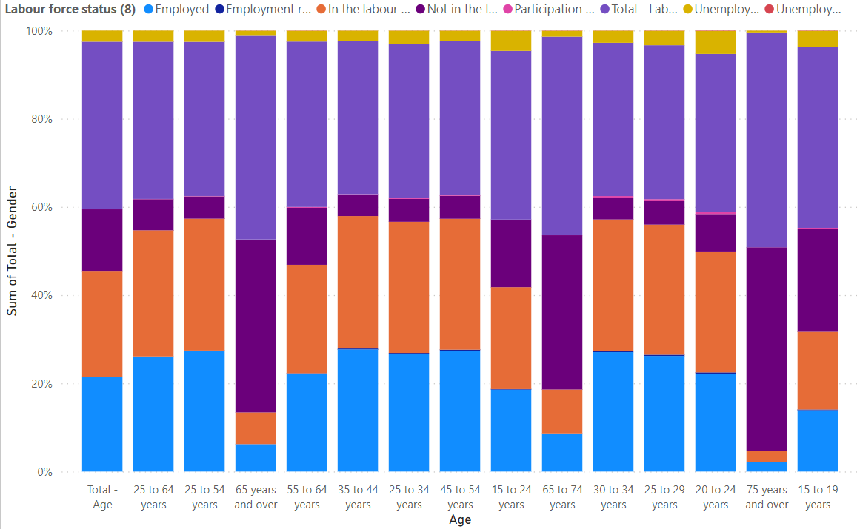
EDA
Total Labour vs Type of Labour foce status vs Age:-

Slide 11
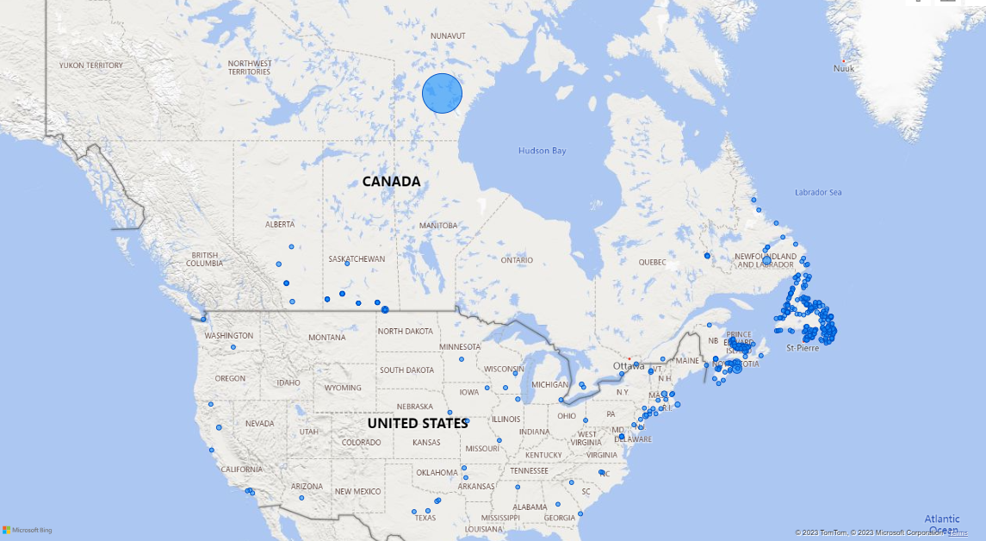
Total Labour vs GEO location:-
EDA

Slide 12
Assumption:-
For this project, our focus is solely on aggregating data for Canada as a whole, without delving into specific territories or cities. This approach is based on the understanding that Canada's overall data encapsulates the cumulative information across all categories under labor types, providing a comprehensive perspective on the national labor force dynamics.

Slide 13
Data Preprocessing:-
Finding Null values
Dropping unnecessary columns

Slide 14
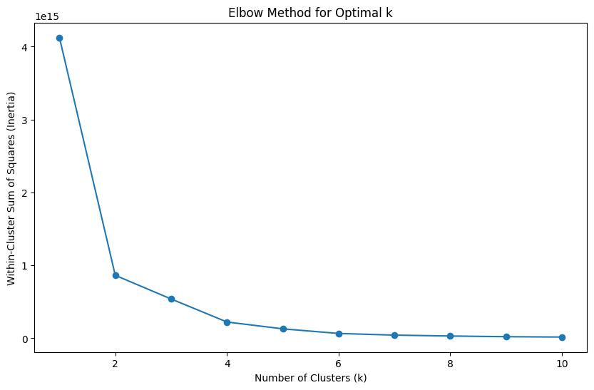
Data Seperation:
We are separating numerical data and categorical data.
Finding the number of clusters:
We are trying to find the optimal number of clusters for this dataset using elbow method.

Slide 15
ML model:
In this model, we employ the K-Prototypes clustering algorithm to categorize data into two distinct clusters based on both numerical and categorical features.
The approach involves one-hot encoding categorical variables, standardizing numerical features, and then applying the KPrototypes algorithm, initializing with the 'Cao' method. By combining information from various types of features, this model enhances the clustering process and provides valuable insights into patterns within the dataset.
The resulting clusters aim to capture the inherent structure in the data, shedding light on potential distinctions in labor force dynamics across different groups.

Slide 16
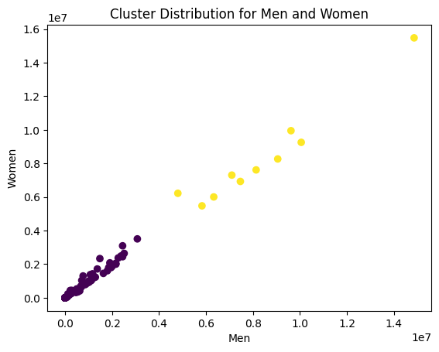
ML model:
Number of Cluster | Data
Cluster 0 | 110
Cluster 1 | 10

Slide 17
Conclusion:-
The K-Prototypes clustering of Canada's labor force data identifies two clusters based on age, gender, and labor force status.
Integrating numerical and categorical features, the analysis offers nuanced insights into employment patterns for individuals aged 15 and above across diverse regions.
This holistic approach informs targeted strategies and policies, contributing to a comprehensive understanding of Canada's employment landscape, crucial for stakeholders and policymakers.

Slide 18
Data Resource:-
citation: Statistics Canada. Table 98-10-0485-01 Labour force status by age and gender: Canada, provinces and territories, census divisions and census subdivisions
DOI: https://doi.org/10.25318/9810048501-eng

Slide 19
Thank you

