Slide 1

Electric vehicle population Data
Lenin Prakash Vasudevan

Slide 2
Introduction:
As the world transitions toward cleaner energy alternatives, understanding the growth of EVs is crucial. This dataset allows us to explore trends, identify patterns, and assess the impact of EV adoption on transportation and the environment.
Researchers, policymakers, and industry stakeholders can use this data to make informed decisions regarding infrastructure development, incentives, and sustainable mobility solutions.

Slide 3
Overview of the Dataset:
Title: Electric Vehicle Population Data
Source: Washington State Department of Licensing (DOL)
Purpose: To analyze and predict characteristics of electric vehicles (EVs) using a dataset of EV registrations.
Coverage: The dataset includes information on VINs, vehicle locations, types, electric ranges, and pricing.

Slide 4
Agenda:-
Introduction to the Case
Overview of Dataset
Agenda
EDA
Data preprocessing
Machine Learning models
Conclusion

Slide 5
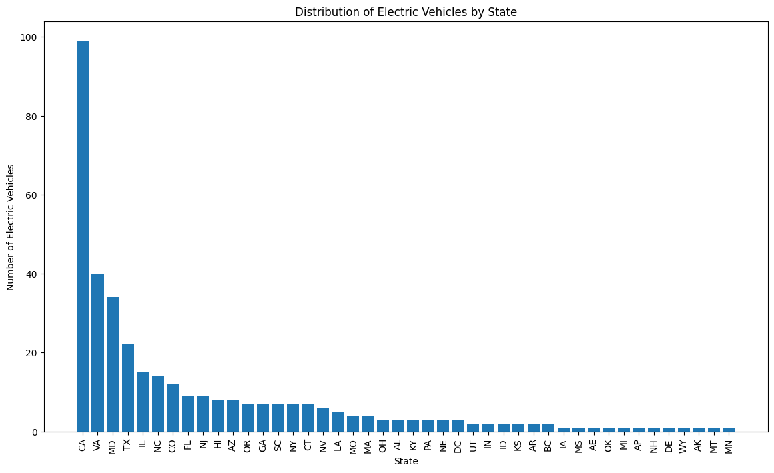
EDA

Slide 6
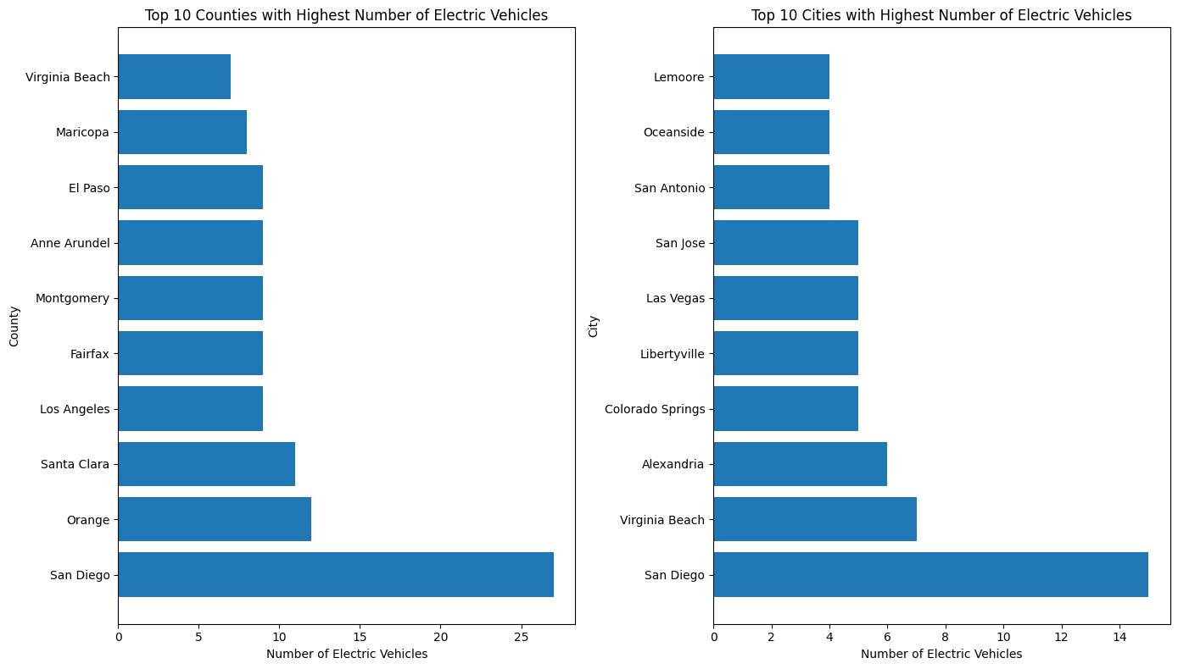
EDA

Slide 7
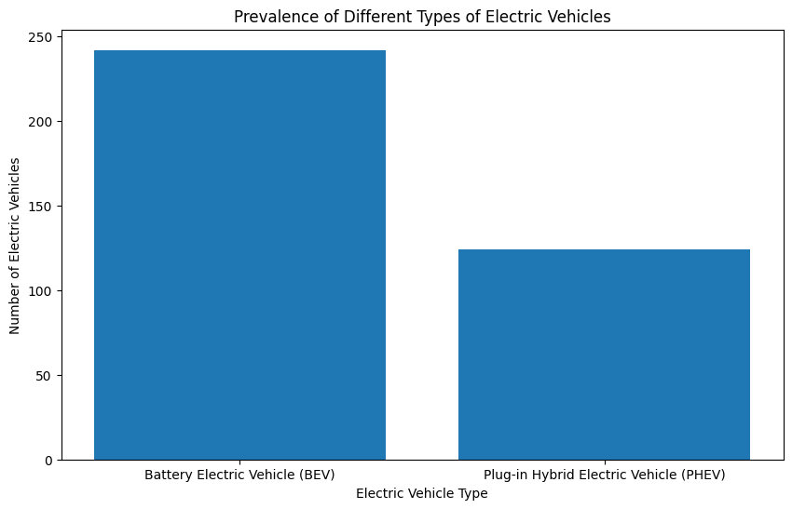
EDA

Slide 8
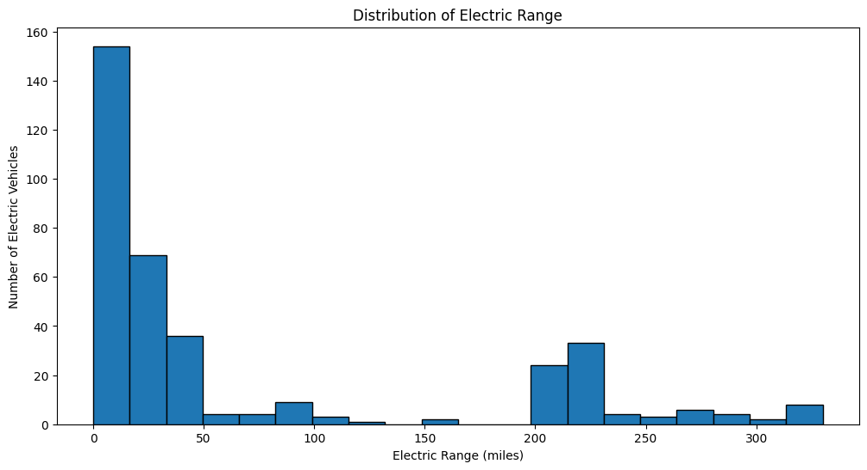
EDA

Slide 9
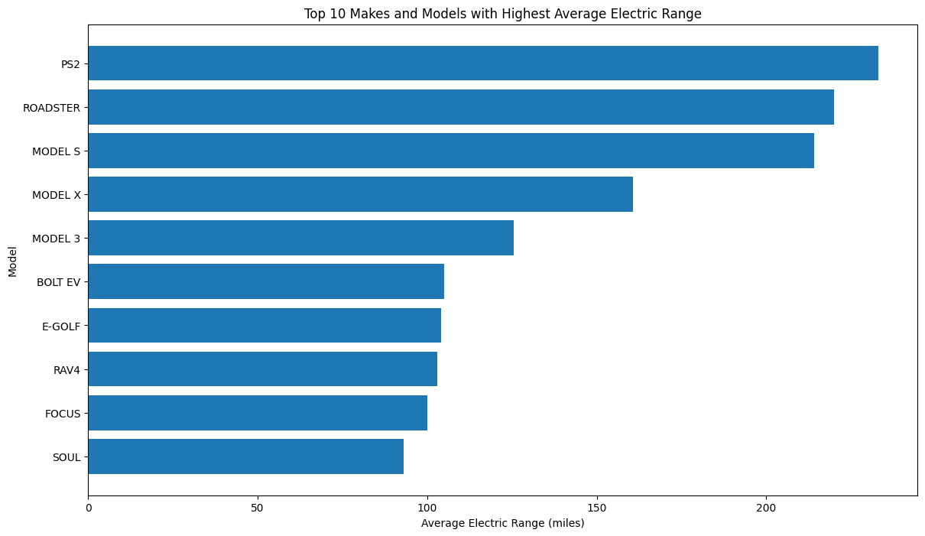
EDA

Slide 10
Data Preprocessing:
Handling Missing Values
Strategy: Imputation
Encoding Categorical Variables
Label Encoding for Make and Model
Encoding Target Variables
Feature Scaling
Standard Scaler for numerical features

Slide 11
Machine Learning Models:
Predicting EV Type:
Model: Random Forest Classifier
Results: 93.2% Accuracy
Visual: Classification report

Slide 12
Machine Learning Models:
Predicting Electric Range:
Models: Linear Regression and Random Forest Regressor
Results:
Linear Regression: 19.5% R²
Random Forest Regressor: 89.7% R²
Visual: Model performance metrics

Slide 13
Conclusion:
Summary of Findings:
California leads in EV registrations.
BEVs are more prevalent than PHEVs.
Random Forest models provide better predictions.
Insights:
Importance of data preprocessing.
Advanced models significantly improve prediction accuracy.

Slide 14
Future Work:
Expand analysis to include more features.
Use more advanced models and hyperparameter tuning.
Explore the impact of geographical factors on EV adoption.
Analyze the economic impact of EV adoption.

Slide 15
Dataset:
Washington State Department of Licensing. "Electric Vehicle Population Data." Data.WA.gov. Available at: https://data.wa.gov/d/f6w7-q2d2.

