Slide 1

Government Procurement Data Analysis Overview
Data Cleaning, Analysis, and Power BI Dashboard
By
Lenin Prakash Vasudevan

Slide 2
Project Overview
Objective:
Analyze government procurement data to uncover insights, trends, and patterns using Power BI for visualization.
Key Tasks:
Data Cleaning
Data Analysis
Dashboard Creation using Power BI

Slide 3
Dataset Overview
Source: Kaggle - Government Procurement Dataset
Content:
Government contracts, suppliers, and procurement outcomes.
Includes details like contract value, supplier information, contract duration, and performance metrics.
Size and Scope:
Number of records (e.g., 100,000+ rows).
Key features such as contract type, supplier details, payment terms, etc.

Slide 4
Data Cleaning Process
Challenges Faced:
Missing values
Inconsistent formats (dates, numeric values, etc.)
Outliers and duplicates
Steps Taken:
Removed/filled missing values
Standardized formats for dates, currency, and numerical values
Identified and handled outliers
Checked for duplicate records and eliminated them

Slide 5
Data Analysis and Key Insights
Procurement Trends:
Identify trends in procurement spending across years
Average contract size, contract duration, and payment terms
Supplier Analysis:
Most frequent suppliers
Performance metrics (e.g., on-time delivery)
Budget Utilization:
How government budgets are allocated and spent
Variations in procurement by region or department

Slide 6
Power BI Dashboard Overview
Features:
Dynamic filters for contract types, suppliers, time periods, etc.
Visualizations like bar charts, pie charts, trend lines, and KPIs
Interactive data exploration for stakeholders
Purpose:
Allow decision-makers to explore procurement data in real-time
Help identify areas for improvement, cost-saving opportunities, and supplier performance optimization

Slide 7
Key Metrics Visualized
Contract Value Distribution:
Visualize the spread of contract values and identify high-value contracts.
Procurement Trends Over Time:
A chart showing changes in procurement spending year-over-year.
Supplier Performance:
Pie chart visualizing the share of total contracts by each supplier.

Slide 8
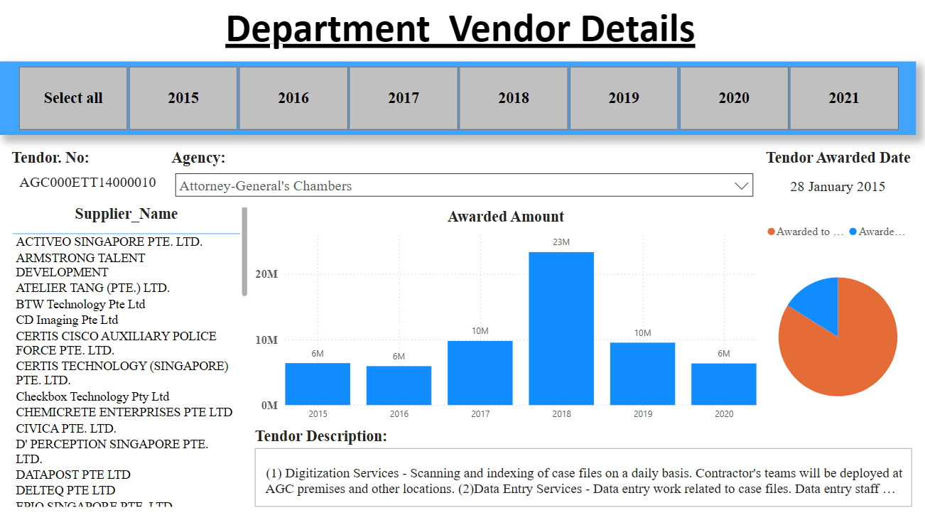
Key Metrics Visualized

Slide 9
Challenges and Learnings
Data Limitations:
Missing or incomplete data fields
Data biases in supplier selection or procurement allocation
Lessons Learned:
Importance of clean and standardized data for accurate analysis
Value of interactive dashboards in decision-making processes

Slide 10
Conclusion
Summary of Findings:
Identified key procurement trends and supplier performance insights.
The dashboard provides an efficient way for stakeholders to analyze and
optimize procurement strategies.
Next Steps:
Possible process improvements based on insights gained.
Further exploration of international procurement data or integration with
other datasets for enhanced analysis.

