Slide 1
Deep Learning: Advanced Models and Methods (DL26)
Track 3: Graph-based Metric Learning for Scene Understanding
Gruppo: G18
Membri: [Salvatore Mario Carota]
Repository:
https://github.com/LenionK/dl26-projects

Slide 2
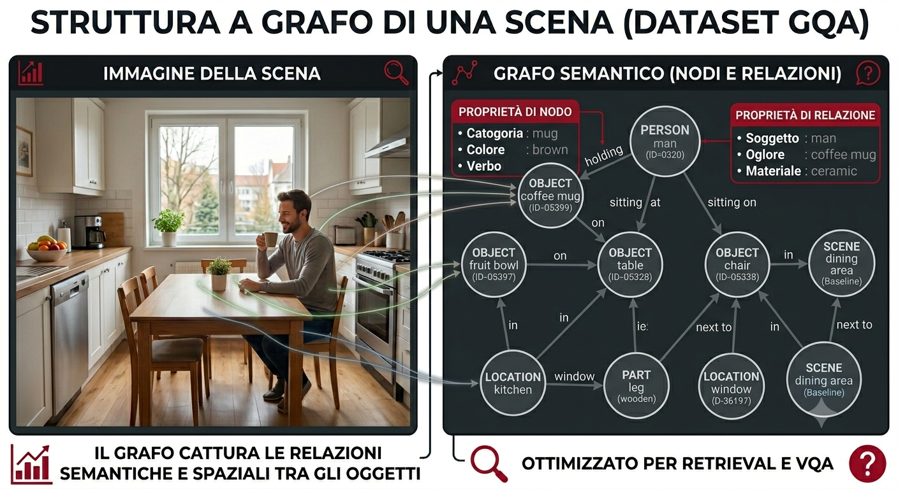
From Pixels to Graphs: Representing Scenes as Structured Data
G18 · Track 3 · Graph-based Metric Learning for Scene Understanding

Slide 3
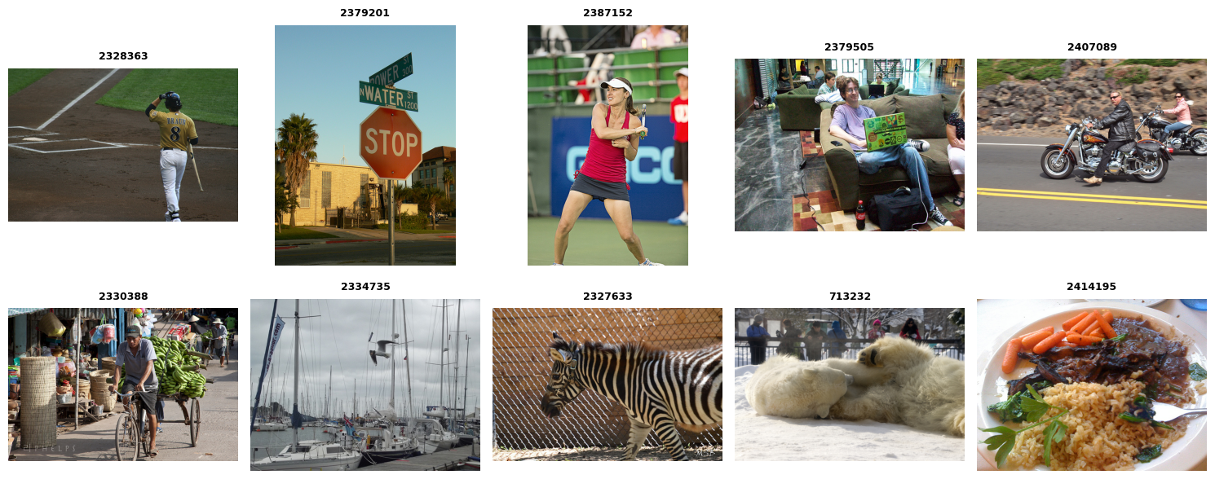
GQA: Visual Reasoning in the Real World
G18 · Track 3 · Graph-based Metric Learning for Scene Understanding

Slide 4
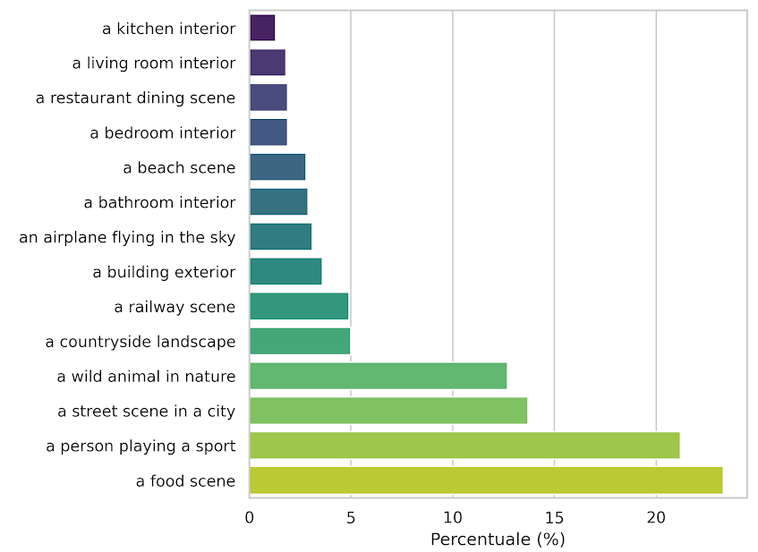
Bridging the Gap: Automatic Labeling via CLIP
Classi di Partenza
Interni
Urbano
Natura
Cibo
G18 · Track 3 · Graph-based Metric Learning for Scene Understanding

Slide 5
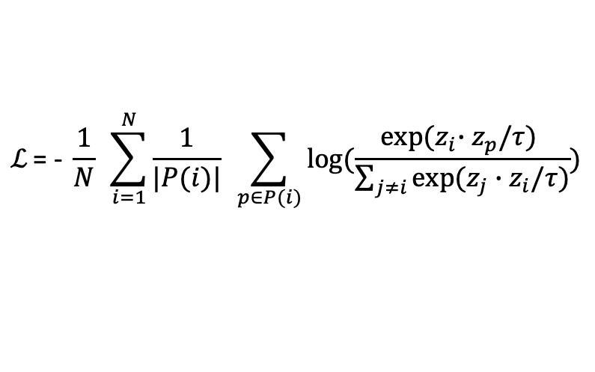
Tre encoder, stesso obiettivo metrico
Baseline - Graph - Contrastive Training
Modello | Input | Architettura | Embedding
Baseline | Immagine | ResNet-18 → FC | 128-d
GCN | Grafo | 3× GCNConv + pool mean/max | 128-d
GINE | Grafo + edge type | 4× GINEConv + pool mean/max | 128-d
Supervised Contrastive Loss
$$ℒ\text{ = − }\frac{1}{N} \sum_{i=1}^{N}{\frac{1}{|P(i)|}} \sum_{p∈P(i)}{log⁡(\frac{exp⁡{(z}_{i}∙z_{p}/τ) }{\sum_{j≠i}{exp⁡(z_{j}∙z_{i}/τ)}})}$$
G18 · Track 3 · Graph-based Metric Learning for Scene Understanding

Slide 6
Training e iperparametri
Parametro | Baseline | GCN/GINE
Optimizer | Adam (lr=1°-4) | Adam (lr=3e-4, weight_decay=1e-4)
Scheduler | - | CosineAnnealingLR
Grad clipping | - | Max_norm=1.0
Batch sampling | 6 classi x 4 campioni | 6 classi x 4 campioni
Epochs | 10 | 20
G18 · Track 3 · Graph-based Metric Learning for Scene Understanding

Slide 7
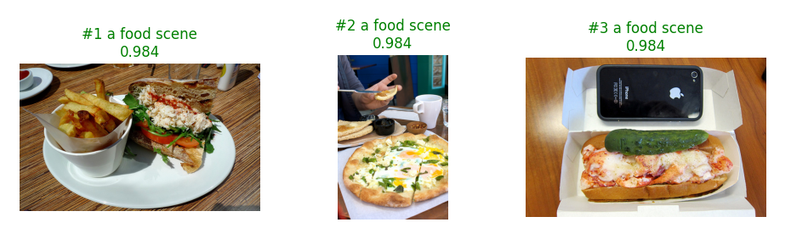
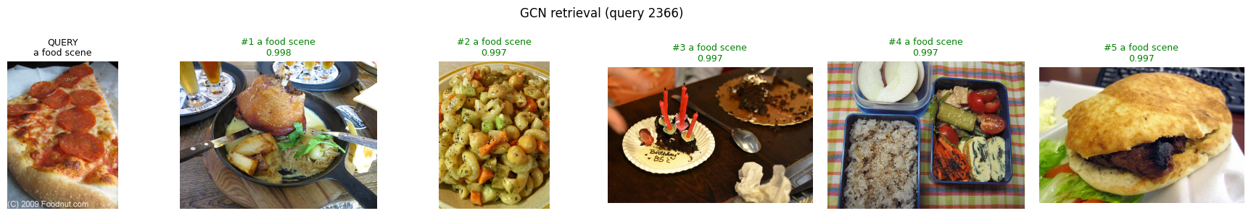
Scene-To-Scene retrieval con metric learning
Retrieval Evaluation: Given a query scene graph, perform retrieval on the dataset to fetch structurally similar graphs, evaluating via standard classification metrics (Accuracy, Precision, Recall).
CNN
QUERY
GCN
G18 · Track 3 · Graph-based Metric Learning for Scene Understanding

Slide 8
Metriche: Scene-To-Scene retrieval con metric learning
Metric | Baseline | GCN | GINE
acc@1 | 0.6231 | 0.5966 | 0.4991
precision_macro | 0.5855 | 0.5673 | 0.4877
recall_macro | 0.5668 | 0.5661 | 0.4892
recall@1 | 0.6231 | 0.5966 | 0.4991
recall@10 | 0.8881 | 0.8791 | 0.8572
precision@1 | 0.6231 | 0.5966 | 0.4991
precision@10 | 0.6152 | 0.6046 | 0.4978
mrr | 0.7163 | 0.6949 | 621
map | 0.68 | 0.6631 | 0.5778
G18 · Track 3 · Graph-based Metric Learning for Scene Understanding

Slide 9
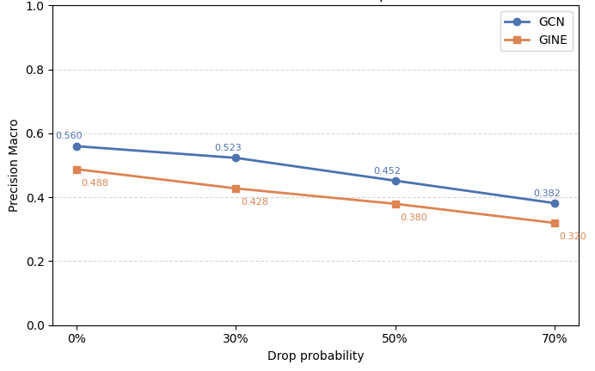
GNN degrada gradualmente anche con il 70% dei nodi rimossi
Extra Objective: robustezza alle perturbazioni strutturali
G18 · Track 3 · Graph-based Metric Learning for Scene Understanding

Slide 10
GNN degrada gradualmente anche con il 70% dei nodi rimossi
Extra Objective: robustezza alle perturbazioni strutturali
drop Prob. | GCN
 | Precision (macro) | Recall (macro) | Acc@1 | MAP
0% | 0.5598 | 0.5538 | 0.5966 | 0.6594
30% | 0.5232 | 0.5188 | 0.5592 | 0.6236
50% | 0.4519 | 0.4567 | 0.5103 | 0.5821
70% | 0.3817 | 0.3822 | 0.4514 | 0.5299
G18 · Track 3 · Graph-based Metric Learning for Scene Understanding

Slide 11
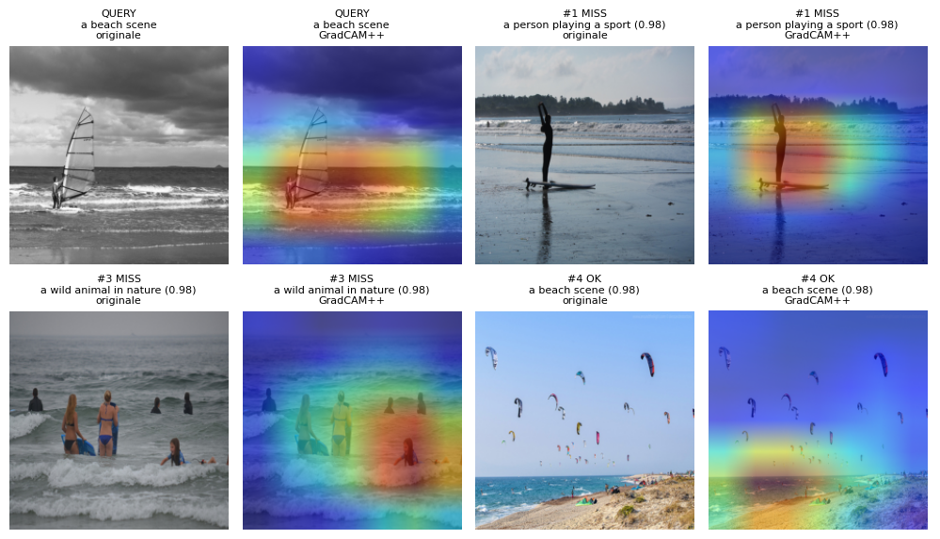
GRADCAM++
Extra Objective: Visualize and interpret which edges/relations
act as critical focal points for the model's similarity metric.

Slide 12
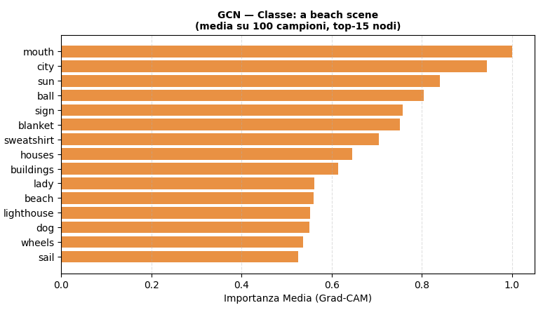
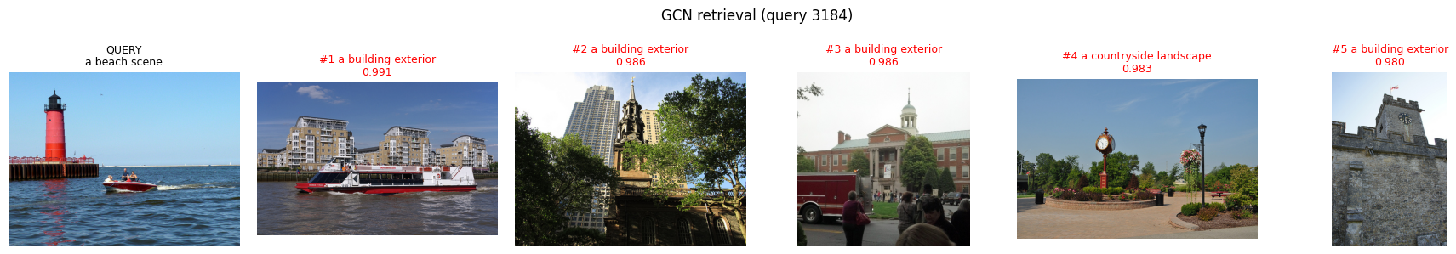
GRAPHGRADCAM
Extra Objective
QUERY
Retr #1
Retr#2
G18 · Track 3 · Graph-based Metric Learning for Scene Understanding

Slide 13
Focal Point Analysis — Ranking Disruption
Extra Objective: Visualize and interpret which edges/relations
act as critical focal points for the model's similarity metric.
GCN
GINE
Relazioni | Disruption
leaves → tree | 0.700000
sky → cloud | 0.560000
cloud → sky | 0.540000
tree → leaves | 0.540000
clouds → sky | 0.433333
sky → clouds | 0.400000
water → boat | 0.360000
Relazioni | Disruption
to the left of | 0.480000
to the right of | 0.448148
on | 0.218657
in | 0.120896
wearing | 0.094074
near | 0.061481
of | 0.059701
Disruption = 1 − overlap(top-k base, top-k perturbed)
overlap = |top-k(base) ∩ top-k(perturbato)| / k
G18 · Track 3 · Graph-based Metric Learning for Scene Understanding

Slide 14
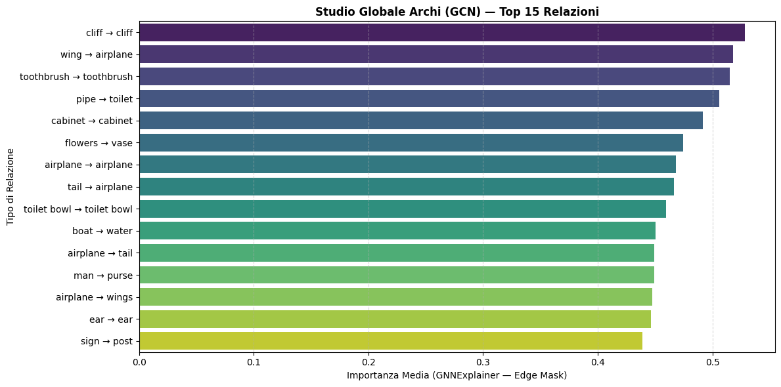
GCN: Studio Archi — GNNExplainer
Extra Objective: Visualize and interpret which edges/relations
act as critical focal points for the model's similarity metric.
G18 · Track 3 · Graph-based Metric Learning for Scene Understanding

Slide 15
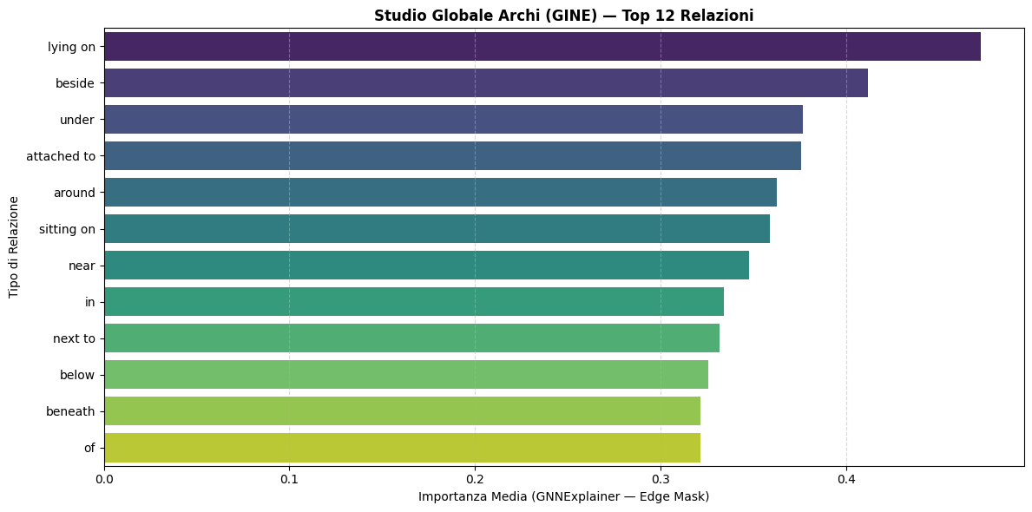
GINE: Studio Archi — GNNExplainer
Extra Objective: Visualize and interpret which edges/relations
act as critical focal points for the model's similarity metric.
G18 · Track 3 · Graph-based Metric Learning for Scene Understanding

