Slide 1
Linear Discriminant Analysis
Lenka Rozborilova
16/2 2021

Slide 2
Linear Discriminant Analysis (LDA)
supervised learning concept that categorizes a set of data into known classes
similar to Principal Component Analysis (PCA)
aim: assign labels to the data - make an accurate classification decision
linear technique - draw an optimal line (= decision threshold) that is discriminating between different classes in data set

Slide 3
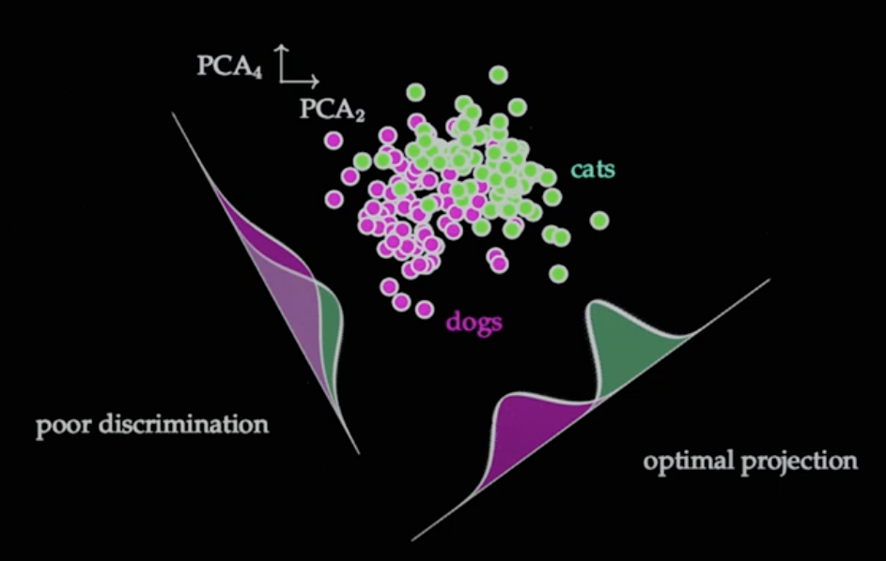
Source: YouTube: Nathan Kutz - Supervised Learning and Linear Discriminants

Slide 4
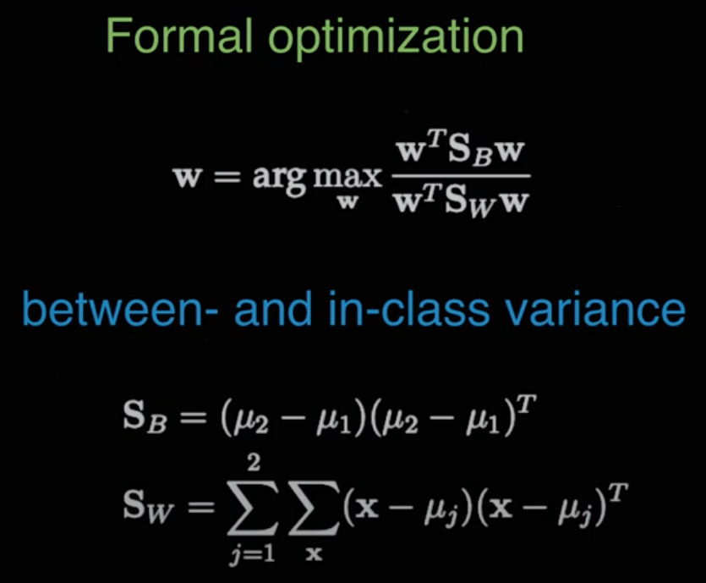
Linear Discriminant Analysis (LDA)
Mathematics behind (computing two quantities):
distance between means
variation of data around each mean (scatter)

Slide 5
Linear Discriminant Analysis (LDA)
Mathematics behind (computing two quantities):
distance between means
variation of data around each mean (scatter)
maximise
minimise

Slide 6
Source: YouTube: Nathan Kutz - Supervised Learning and Linear Discriminants

Slide 7
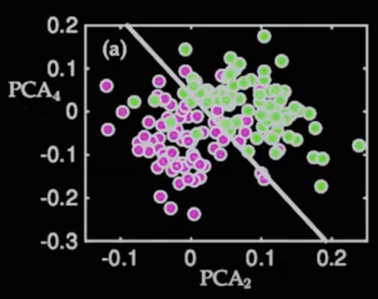
Linear Discriminant Line
Source: YouTube: Nathan Kutz - Supervised Learning and Linear Discriminants

Slide 8
Linear Discriminant Analysis (LDA)
LDA is like PCA, they both reduce the dimensions, however LDA focuses on maximising the separability among known categories

