Slide 1
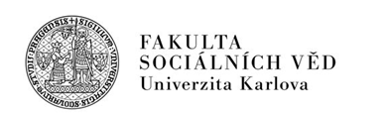



How is social network influencing waste separation?
PhDr. František Kalvas Ph.D.
Mgr. Michaela Kudrnáčová, MSSc.

Slide 2



Network influences behavior
Close links support predominant behavior - the more close links, the higher probability of predominant behavior (waste sorting in our case). On the other hand, homophily (bonding with similar others = similar environmental attitudes) hinder the pressure of close links and supports survival of minor behavior.
How do we know that
We use Consumat model (Jäger, Janssen 2001, 2002; Bravo et al. 2013)
We calibrated the model by ISSP 2010 data from Czech Republic
We made 500 simulations for every combination of network parameters

Slide 3
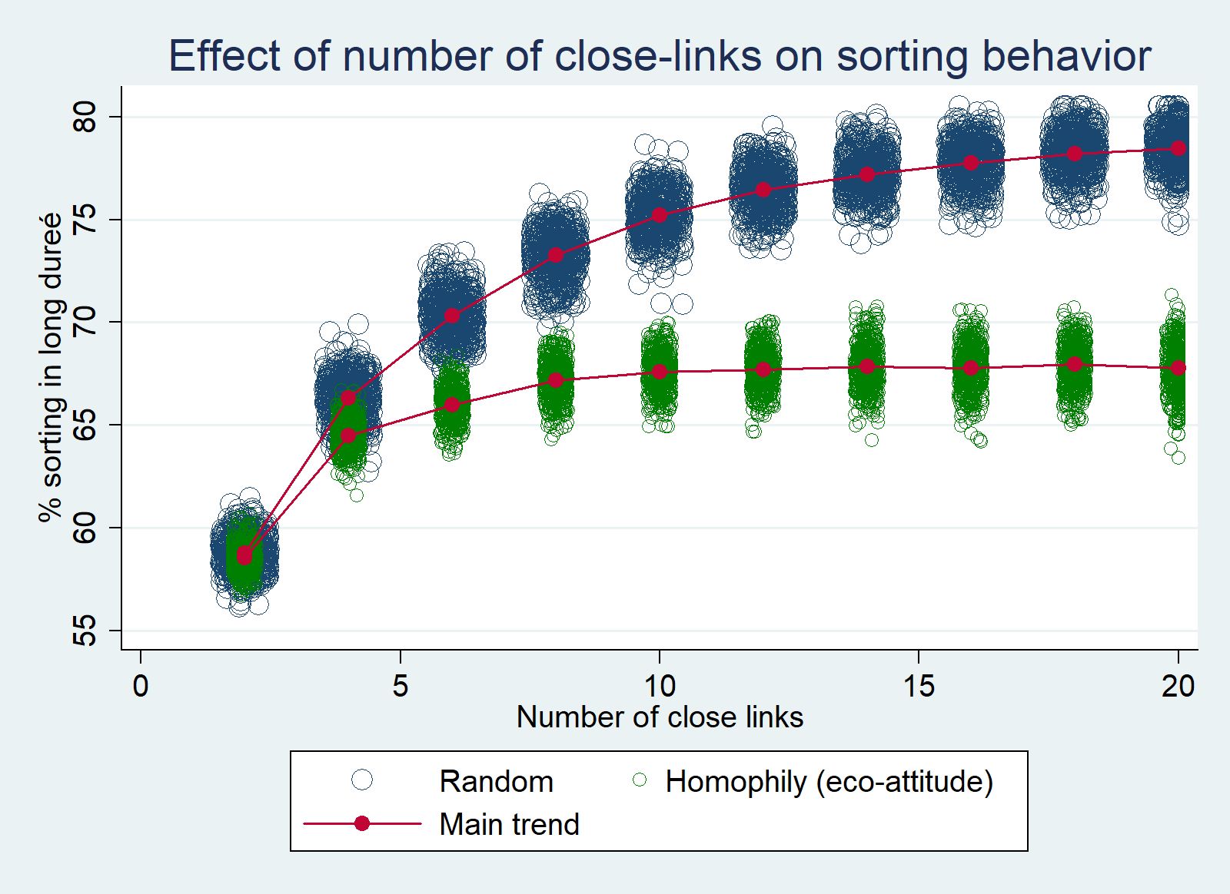
Notes:
Použil bych asi tenhle graf, ten je na úvod srozumitelnější

Slide 4
Consumat description I.
Consumat is an agent originally designed by Jäger and Janssen [2001] and seeks satisfaction by getting its behavior in line with its attitude and behavior of others.
Consumat weights its attitude to do some behavior and prevalence of this behavior in the neighborhood. The weight is not same for all consumats, some weight more their own attitude, some others‘ behavior.
The more consumat’s behavior is in line with its attitude and the more the same behavior is prevalent, the higher satisfaction of the consumat is.
Every consumat is sensitive to its satisfaction and the change of satisfaction which is called uncertainty. Consumat updates its behavior according to both.

Slide 5
Consumat description II.
If satisfaction exceeds threshold and uncertainty is bellow threshold, consumat replicates behavior from previous round.
If satisfaction exceeds threshold and uncertainty also exceeds threshold, consumat imitates the most prevalent behavior in the neighborhood.
If satisfaction is bellow threshold and uncertainty is also bellow threshold, consumat deliberates – computes satisfaction for all known behaviors and chooses the most satisfying one.
If satisfaction is bellow threshold and uncertainty exceeds threshold, consumat compares its most prevalent behavior in the neighborhood and chooses the most satisfying one.

Slide 6
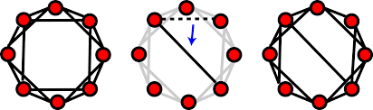
Network description
We use small-world Watts-Strogatz network.
Firstly, every in circle node connects to the 2, 4, 6, 8 … etc. closest neighbors. (We experiment with this parameter!)
Secondly, 10% of close links are re-wired to the random node. (Preliminary experiments show the percentage of random links do not affect consumats’ behavior.)
According Bravo et al. 2013 we take 6 close links and 10% of random links as benchmark case.

Slide 7
Description of ISSP data and calibration
Collected in 2010 in Czech Republic, N=1841. But 11 did not provide attitudinal data or had no possibility to separate waste. So we use 1830 cases.
Used for constructing the model:
Environmental behavior = self-reported frequency of waste sorting
NEP scale = measuring attitudes towards the environment; constructed summary index of 5 attitudes rescaled from 0 to 1
For every respondent from ISSP survey, an agent with same attitude/attitudinal index was created and information on final sorting behavior.

Slide 8
Description of empirical specification
It is not possible to calibrate several parameters of the model, because we have no information on them from the real world: Threshold for satisfaction [0.35] Threshold for uncertainty [0.5] Probability that the consumat changes just chosen behavior [10%] The price of sorting behavior [1.05 of not sorting] Cut-offs for transforming continuous percentage of sorting into ordinal variable [35.5%; 60.5%; 80.5%]
Via genetic algorithms in NetLogo BehaviorSearch we find the values in brackets – with them, the behavior of consumats best matches behavior from ISSP survey.

Slide 9
Description of simulation experiment
We studied two parameters of small-world network:
- number of close links [2, 4, … , 20] - homophily [random assignment vs. homophilic]
For every combination of these parameters we ran 500 simulations

Slide 10
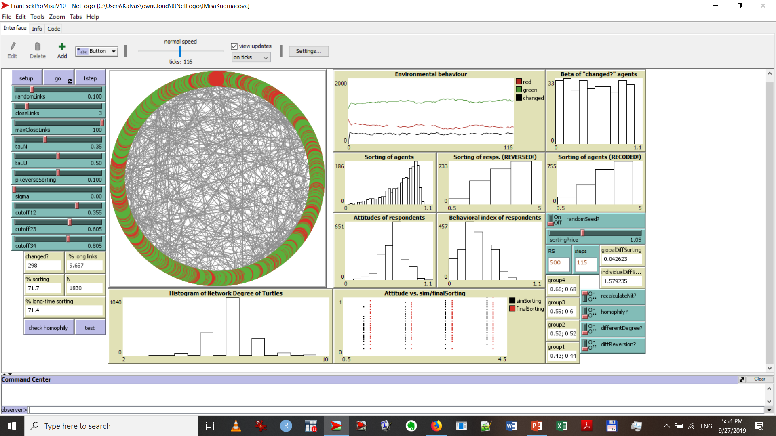
Model and main results

Slide 11
Notes:
Použil bych asi tenhle graf, ten je na úvod srozumitelnější

Slide 12
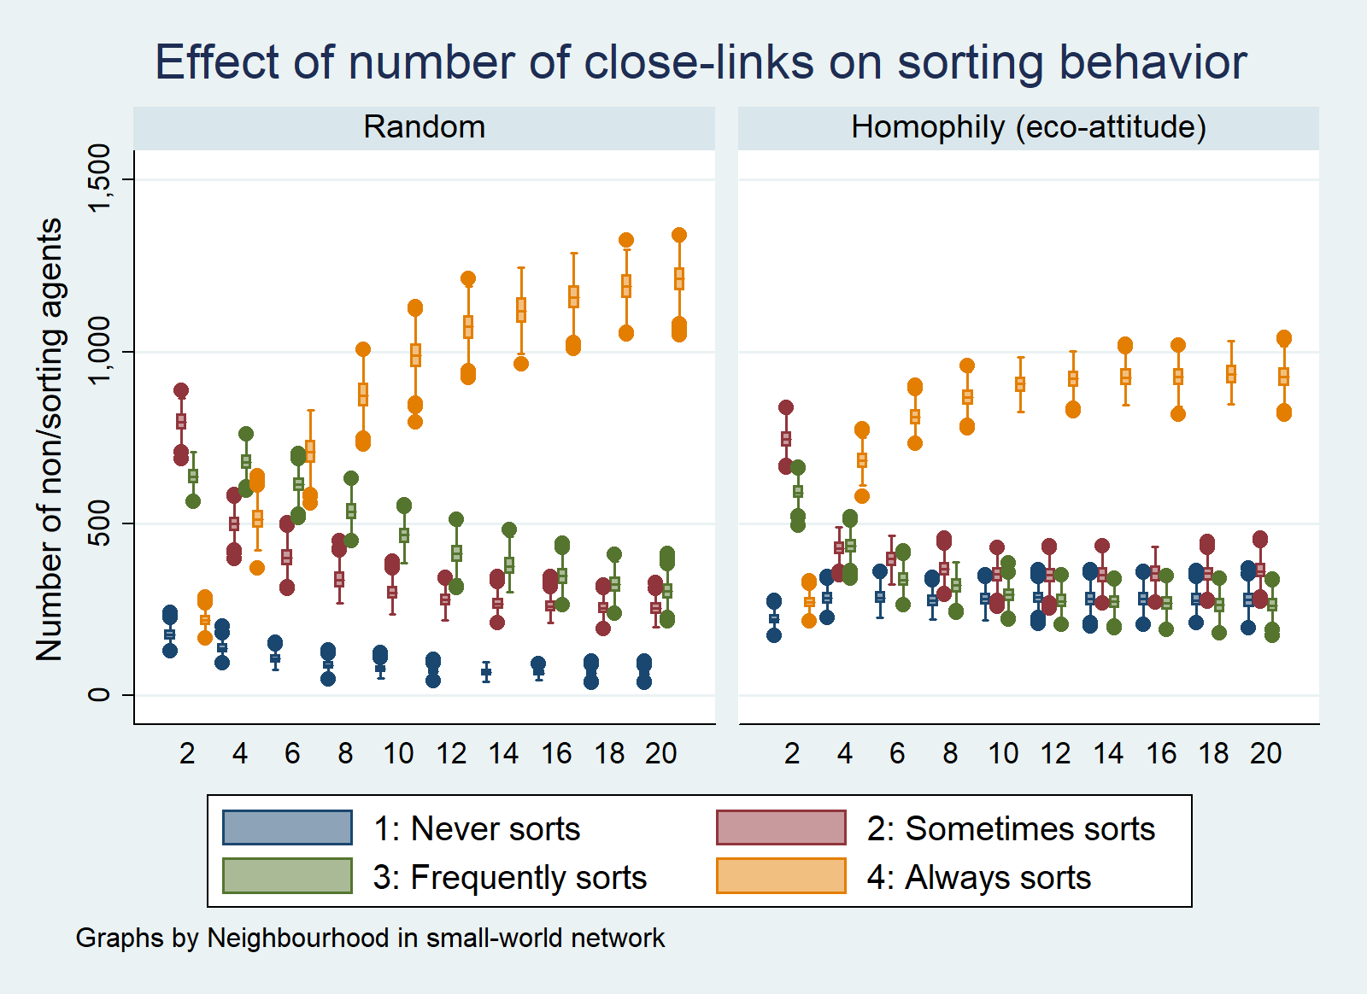

Slide 13
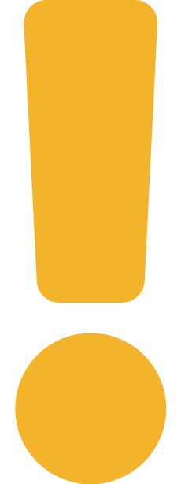
Conclusion: Network influences behavior
Close links support predominant behavior - the more close links, the higher probability of predominant behavior (waste sorting in our case). On the other hand, homophily (bonding with similar others = similar environmental attitudes) hinder the pressure of close links and supports survival of minor behavior.
How do we know that
Waste sorting grows with the number of close links
BUT homophily stops this growth when reaching 8+ close links

Slide 14
Thank you for your kind attention!
kalvas@kss.zcu.cz
kudrnacova.m@gmail.com
Our project on GitHub:
https://github.com/frantisek901/wasteSeparation

