Slide 1
Group 14, DEGO 2606
09.03.2026 | Carcavelos
NovaCred Credit Application Governance Analysis
Data Engineer: Lenn Schneidewind (67548) | Data Scientist: Fatima Zubair (70319) | Governance Officer: Eduarda Dionísio (56503) | Product Lead: Leon Schmidt (71644)

Slide 2
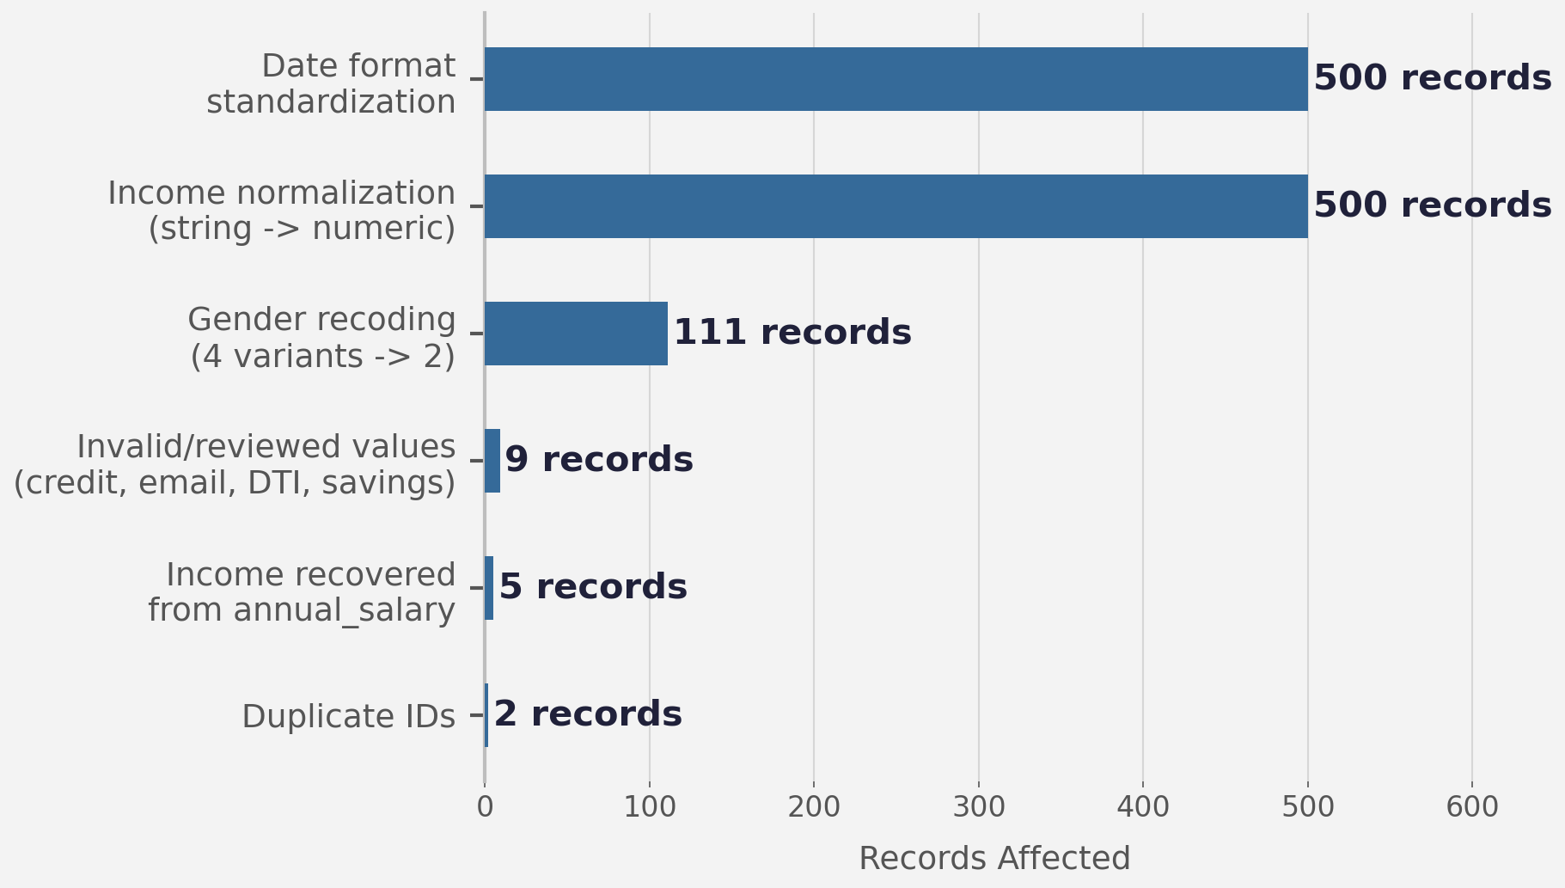
DATA QUALITY | 09.03.2026
Ensuring Data Integrity: 99.6% Retention Post-Cleaning
502
Raw Records Audited
6
Issue Categories Found
99.6%
Data Retained After Clean
Completeness:
5 records stored income under annual_salary (column mislabelling) -> merged and fully recovered.
13/21 columns had missing values, but all critical fields (income, decision, DTI) had 0% missingness.
Consistency:
Gender coded 4 ways (M/F/Male/Female) — 111 records remapped
Income stored as string — 500 converted.
Validity:
2 negative credit history records imputed; 4 invalid emails cleared; 1 invalid income corrected.
Accuracy:
2 duplicate application IDs removed. Final dataset: 500 unique records ready for analysis.

Slide 3
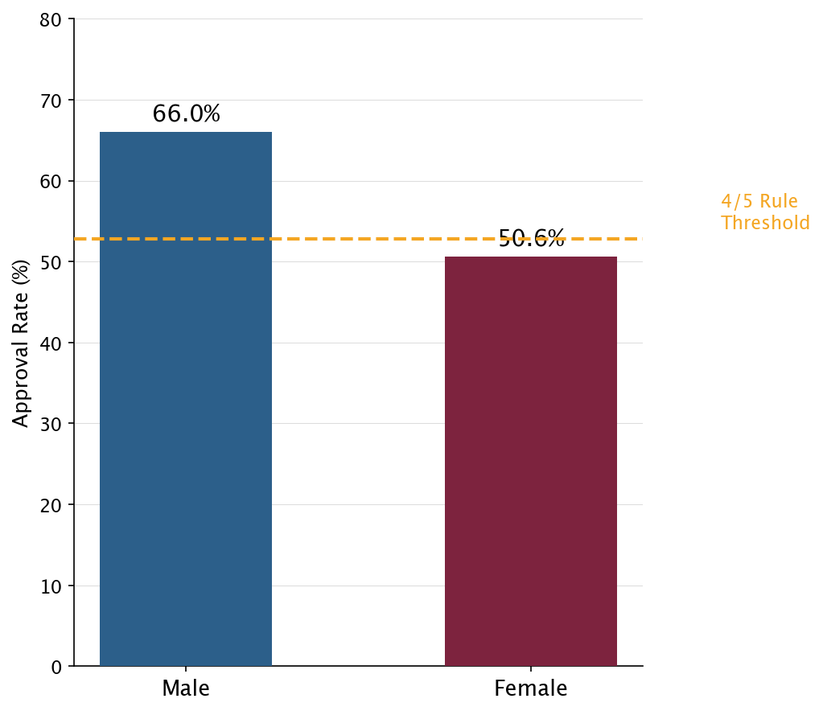
BIAS ANALYSIS | 09.03.2026
Statistical Analysis of Gender Bias: Breach of the 4/5 Rule Threshold
0.77
Disparate Impact Ratio
−15.4pp
Gender Approval Gap
P<0.05
Chi-Square Significance
Approval rate:
Male 65.9% | Female 50.6%
Approved loans:
Male €48,963 | Female €46,669
Significant Disparate Impact Identified:
DI ratio of 0.77 < 0.80 legal threshold -> bias against female applicants.
Gender as a Key Predictor:
Logistic regression confirms gender is a significant driver (coef = −0.352)
Gap Unexplained by Financials:
Approval disparity persists regardless of income, credit history, debt-to-income (DTI) ratios, or savings -> bias is not risked based

Slide 4
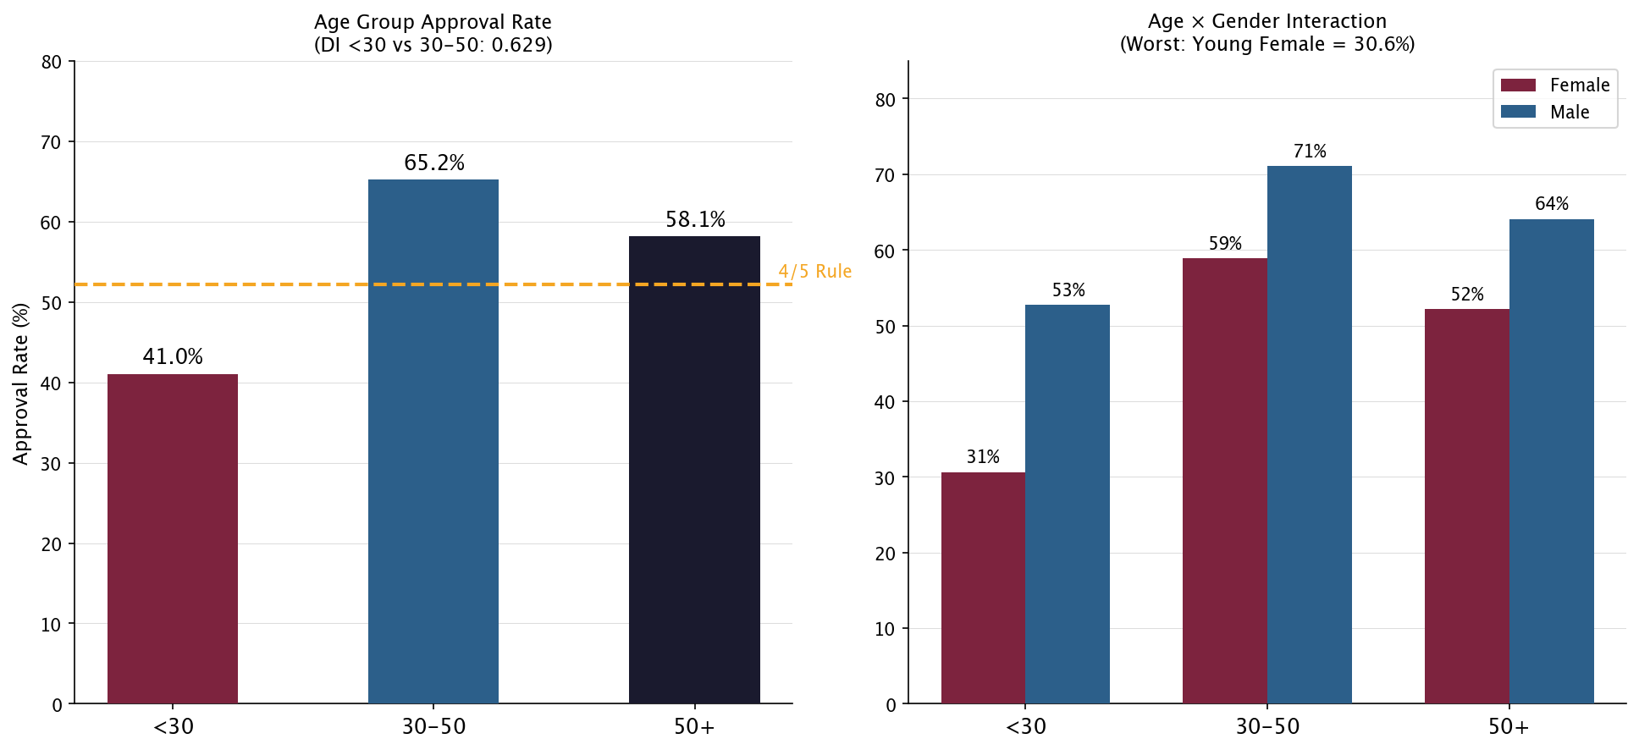
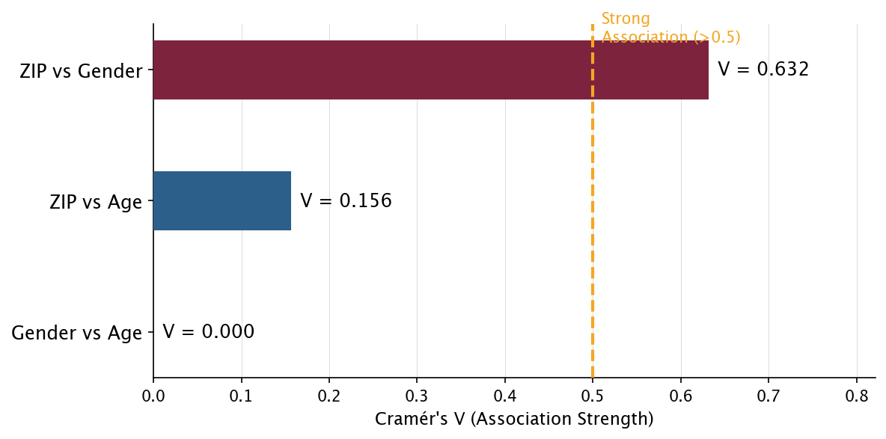
BIAS ANALYSIS | 09.03.2026
Age-Based Bias & Proxy Discrimination via ZIP Code
DI = 0.629
Under-30s vs 30-50 Group
30.6%
Young Women Approval Rate (Worst)
V = 0.63
ZIP-to-Gender Cramer’s V
Removing gender from the model does NOT fix bias if ZIP code remains -> acts as a direct proxy (Cramer’s V = 0.63)

Slide 5
PRIVACY & GOVERNANCE | 09.03.2026
Personal Data Exposure: 7 PII Fields Stored Without Protection
FIELD | PII TYPE | RISK
ssn | Sensitive Identifier | CRITICAL
full_name | Direct Identifier | HIGH
email | Direct Identifier | HIGH
spending_behavior | Sensitive Behavioral | MED-HIGH
ip_address | Quasi-Identifier | MEDIUM
date_of_birth | Quasi-Identifier | MEDIUM
zip_code | Quasi-Identifier | LOW / PROXY
GDPR Compliance Assessment
Art. 5 – Data Minimisation:
SSN should not be retained beyond ID verification.
Notes field (99.6% empty) means no justification for decisions.
Art. 6 – Lawful Basis:
Contractual necessity + legitimate interest. No consent field currently tracked.
Art. 17 – Right to Erasure:
No deletion mechanism exists in the current pipeline -> GAP
Art. 22 – Automated Decisions:
Credit scoring produces legal effects. Consent tracking field is MISSING from all 500 records.
EU AI Act Annex III, 5(b):
NovaCred’s system is classified HIGH-RISK. Conformity assessment required before deployment.

Slide 6
GOVERNANCE Recommendations | 09.03.2026
Four Mandatory Controls Before NovaCred Can Deploy
01
02
HIGH-RISK
EU AI Act – Annex III, 5(b)
Audit Trail
Human Oversight
Log every automated credit decision with timestamp, input features, and output. Enables explainability under GDPR Art. 22 and EU AI Act.
Flag borderline cases for manual review before final decision. Required under GDPR Art. 22 to prevent purely automated legal effects.
03
04
These controls are legally required — NOT optional!
Non-compliance with the EU AI Act carries fines up to €30M or 6% of global annual turnover!
Consent & Transparency
Data Retention Policy
Inform applicants an algorithm evaluates their application and obtain explicit consent. Currently ZERO consent records exist in the dataset.
Define max 5-year retention period. After expiry, delete or fully anonymise all PII. Addresses GDPR Art. 5 Storage Limitation.

Slide 7




conclusion| 09.03.2026
NovaCred Must Act Now — The Evidence Is Clear
QUALITY
BIAS
GOVERNANCE
production-ready after remediation (99.6% retained)
DI below 0.80 (gender 0.77, age 0.62); ZIP proxy risk
consent missing (0/500) + no audit/retention/erasure
deploy validation + cleaning pipeline
remove/coarsen ZIP + monitor DI (target ≥ 0.80)
Implement audit logging + human oversight + consent tracking
Go live only when DI > 0.80 and Governance Measures are implemented!

Slide 8
conclusion| 09.03.2026
NovaCred Must Act Now — The Evidence Is Clear
QUALITY
Production-ready after remediation
BIAS
Age DI / Gender DI — Below Legal Threshold
GOVERNANCE Records With Consent Field
Immediate Action 1
Implement pipeline into production
Immediate Action 2
Remove ZIP before next training
Run DI monitoring with threshold 0.80
Immediate Action 3
Implement audit logging + human oversight (GDPR Art. 22)
Add consent tracking + transparency
Go live only when DI > 0.80 and Governance Meassures are implemented!

Slide 9
CONCLUSION
NovaCred Must Act Now — The Evidence Is Clear
0.77
Gender DI — Below Legal Threshold
0.62
Age DI (Under-30s vs 30-50)
0 / 500
Records With Consent Field
Immediate Action 1
Remove or coarsen ZIP code from model features before next training run. ZIP = 0.63 Cramer’s V with gender — it reproduces discrimination.
Immediate Action 2
Implement quarterly DI monitoring (threshold: 0.80). Add consent tracking field to all new applications before processing.
Immediate Action 3
Deploy audit trail + human oversight mechanism. Required for EU AI Act conformity assessment before production deployment.

Slide 19


