Slide 1

Data Driven Modelling
Master Digital Sciences WS 24/25
by Ole Berg, Kristan Böttjer & Lennard Feuerbach

Slide 2
Table of Contents
Business and Research Questions
Selected Features
Methods Applied
Results & Interpretation
Reflection

Slide 3
1.1 Business Questions
August Rüggeberg produces tools for surface processing and metal cutting
August Rüggeberg wants to expand their presence in the US market
To do this as efficiently and effectively as possible, which regions should August Rüggeberg focus its (sales) activities on?

Slide 4
1.2 Research Questions
How can we identify these regions?
What data should we use for this task?
What methods do we need to apply to the data?

Slide 5
2. Selected Features
Rated tool consumption for NAICS and SOC codes from 0 to 3
Done individually by each person, aggregated the rating afterwards
Discussed and analyzed the rating results
Eliminated codes with average rating below 0.5
Ranked codes based on weighted criteria

Slide 6
2. Selected Features
SOC:
0.33: Number of counties
0.33: Tool consumption
0.33: Number of employees
NAICS:
0.10: Number of counties
0.50: Tool consumption
0.25: Number of employees
0.15: Number of establishments
GDP: Tool consumption based on subindustries

Slide 7



2. Selected Features
# Employees in top 5 SOC by mean rank
# Employees in top 5 NAICS by mean rank
# Employees in next best 10 NAICS aggregated
GDP from relevant industries: Average and average growth

Slide 8
2. Selected Features – SOC
49-3023: Automotive Service Technicians and Mechanics
49-9041: Industrial Machinery Mechanics
49-9071: Maintenance and Repair Workers, General
51-4041: Machinists
51-4121: Welders, Cutters, Solderers, and Brazers
Notes:
Occupations that we ranked really high were not used as features -> wrong weighting?

Slide 9
2. Selected Features – NAICS
8111: Automotive Repair and Maintenance
3320A2: Architectural and structural metals manufacturing
2362: Nonresidential Building Construction
3364: Aerospace Product and Parts Manufacturing
2373: Highway, Street, and Bridge Construction

Slide 10
2. Selected Features – GDP
Agriculture, forestry, fishing, and hunting
Construction
Manufacturing
Other services (except government and government enterprises)
Aggregated into two columns/features
Average GDP in those industries
Average GDP growth in those industries

Slide 11
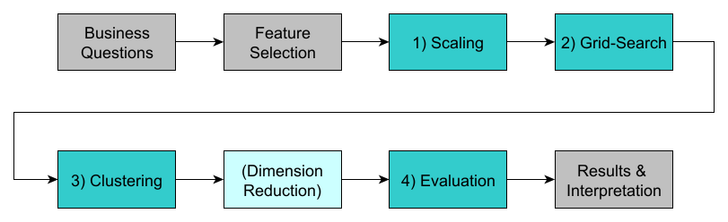
3. Methods Applied
Fig. 1: Visualization of the method application roadmap

Slide 12
3. Methods Applied - Scaling
Done precleaning of the data to avoid errors in the scaling
This includes dropping the FIPS column and setting NaN values to 0
log10 scaling on all columns except averageGdpGrowthPerYear
Left out due to negative values in the values of the column
Apply min-max scaling on the already log10 scaled columns
Also apply min-max on the averageGdpGrowthPerYear column
Notes:
Log10 scaling is used because it normalizes skewed data, compresses large ranges, and preserves relative structures, making it more interpretable Min-Max is then applied since it also perseveres the relative shape but still brings the data closer together.
Especially for clustering the same magnitude is really important and necessary so that all features are comparable

Slide 13
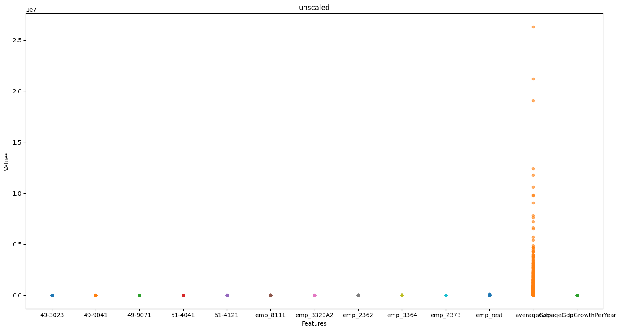
3. Methods Applied - Scaling
Fig. 2: Visualization of the unscaled data
Notes:
TODO: Entfernen?

Slide 14
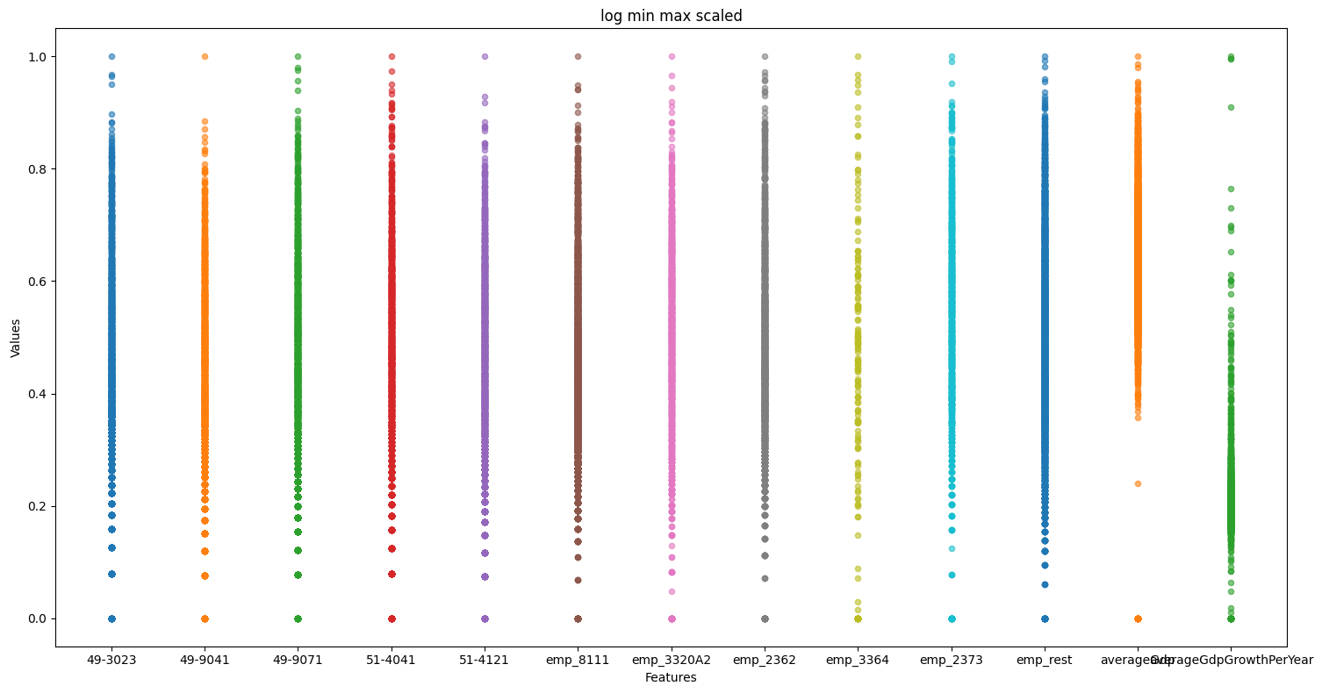
3. Methods Applied - Scaling
Fig. 3: Visualization of the log10 and min-max scaled data

Slide 15
3. Methods Applied – Grid Search
Parameter Ranges:
k-means
Number of clusters : 5 – 20
DBSCAN:
ε: 1 – 7
Min Samples: 3 – 25
Distance Metric: [mahalanobis, euclidean]
Hierarchical Clustering:
Number of clusters: 5 –20

Slide 16
3. Methods Applied – Grid Search
Following metrics were calculated to evaluate the combinations:
Global Silhouette score
Minimum Silhouette score (per point)
Silhouette score standard deviation
Davies-Bouldin score
Largest cluster ratio
Outlier count (DBSCAN)

Slide 17
3. Methods Applied – Grid Search
Each parameter combination was ranked for each metric
The mean rank and std. dev. of the ranks were calculated
These values were used to determine the final rank

Slide 18
3. Methods Applied – Grid Search
The following parameter combination came out on top:
k-means:
Number of Clusters: 12
DBSCAN:
ε: 1.6
Min Samples: 19
Distance Metric: Mahalanobis (good because features are highly correlated)
Hierarchical Clustering:
Number of Clusters: 14

Slide 19
3. Methods Applied – Clustering
Continue using the best parameters from the grid search results
k-means: Groups data in k clusters by minimizing variance within
DBSCAN: Groups points based on density, sparse labeled noise
Hierarchical: Hierarchy of cluster, either bottom-up or top-down
Fuzzy C-Means: Assigns each data point a partial membership
Notes:
Fuzzy C Means: dropped due to its not so easy to interpret data, e.g., what does 80% assignment to cluster x mean in a business context
Decided to stick with the three, since easier to manage pipeline and fuzzy-c-mean would have brought a big technical overhead

Slide 20
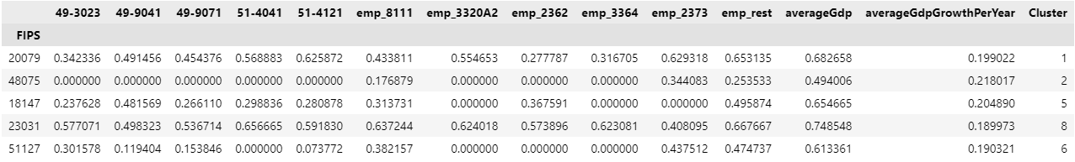
3. Methods Applied – Clustering
Fig. 4: Snippet of the data after clustering using the k-means algorithm
Notes:
IMPORTANT: This is only a snippet, so not all features are shown.

Slide 21
3. Methods Applied – Dim. Reduction
t-SNE as form of dimension reduction was used differently before
Approach was to apply t-SNE on features and then start clustering
After consultation, this approach was revamped and redone
Clustering is now performed on the un-reduced native data
t-SNE is now only used for visualization purpose in either 2D or 3D

Slide 22
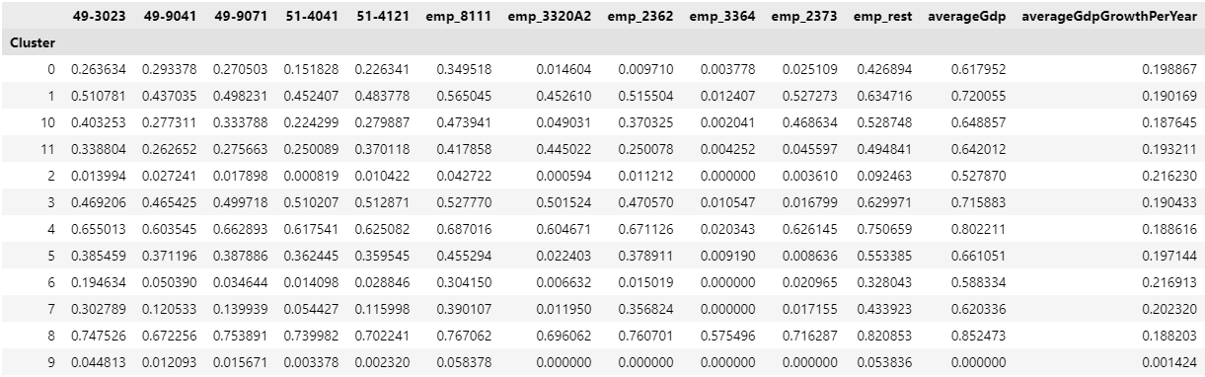
3. Methods Applied – Evaluation
Calculated the mean or median values per cluster per feature
Fig. 5: Snippet of the data after mean calculation of values per feature and cluster

Slide 23
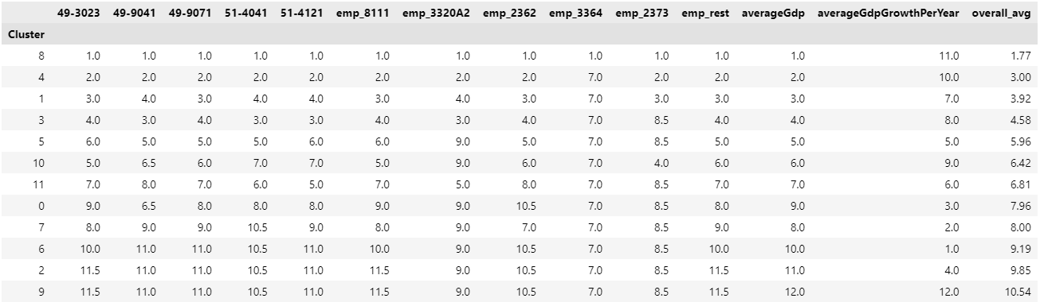
3. Methods Applied – Evaluation
Ranked and sorted the clusters based on their overall average
Fig. 6: Snippet of the data after ranking and sorting the clusters

Slide 24
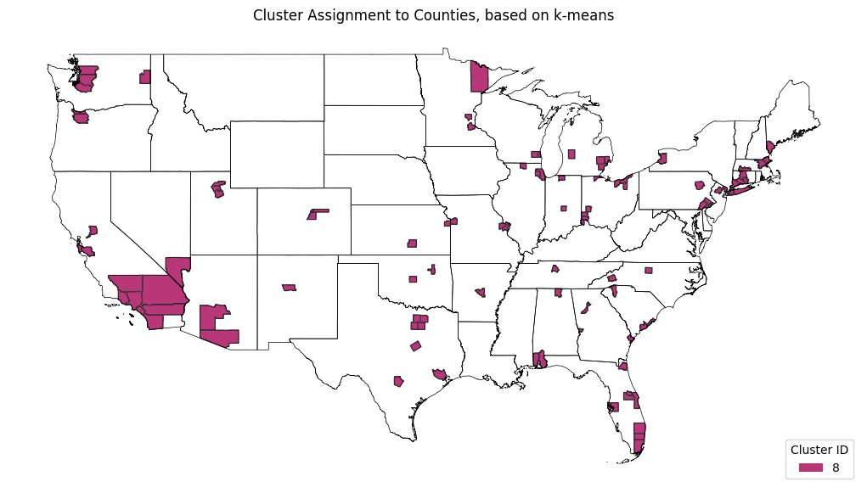
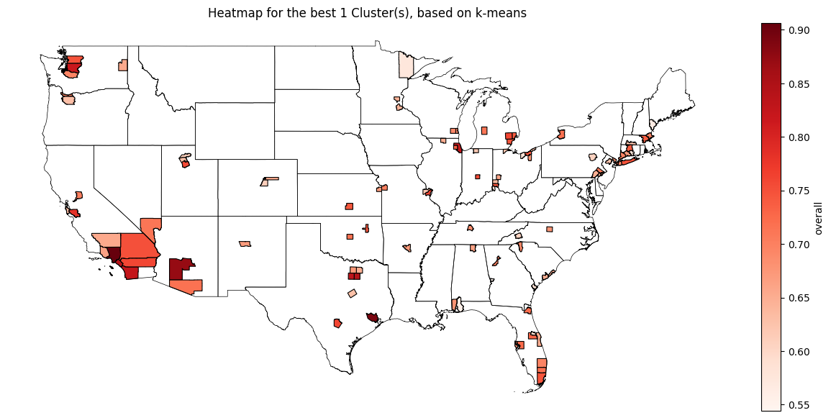
3. Methods Applied – Evaluation
Based on selection, the best x clusters will be visualized on map as:
Basic coloring
and heatmap
Basic approach for the evaluation, further steps are done if needed
Fig. 7: Visualization of the best single cluster on the U.S. map

Slide 25
4. Results & Interpretation
98.04% intersection between top clusters of k-means and Hierarchical Clustering (HC), also overlaps in the lower clusters
Decided to only focus on k-means, as the results and interpretation are nearly identical for both methods
→ Therefore, all k-means result presented are representative for HC
Results of DBSCAN-algorithm will be looked at independently

Slide 26

4. Results & Interpretation – k-means
[…]
Fig. 8: Larger snippet of the data after ranking and sorting the clusters
Notes:
All features correlate strongly with each other, ‘if one value is good, the other values are about equally good’
Significant differences and clear drop in overall_avg_rank between the clusters

Slide 27
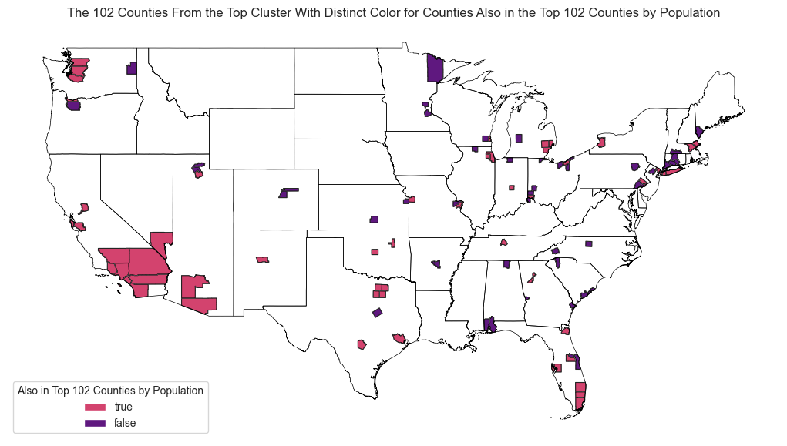
4. Results & Interpretation – k-means
Seattle
Chicago
New York metro area
SoCal with Greater Los Angeles
Miami – Fort Lauderdale
Houston
Fig. 9: Visualization of the top cluster counties, highlighting those within the top populations

Slide 28
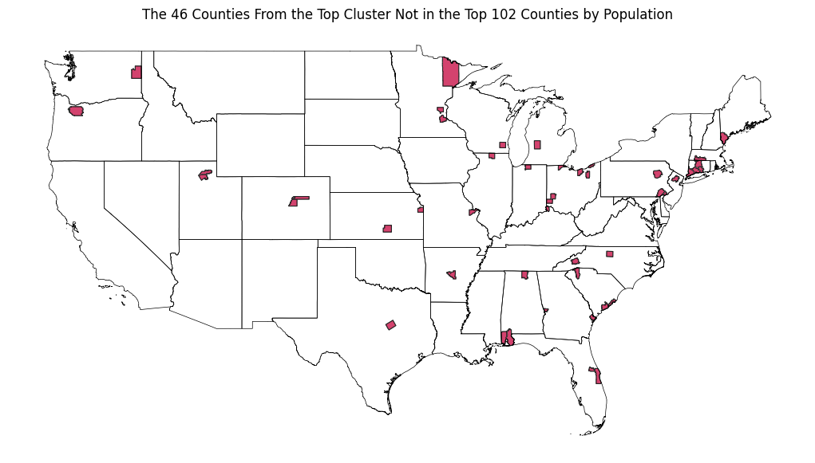
4. Results & Interpretation – k-means
Greenville County, SC
Sedgwick County, KS
Fig. 10: Visualization of the counties from the best cluster, which are not part of the most populated ones

Slide 29
4. Results & Interpretation – k-means
Sedgwick County, KS (138 by pop.):
Pretty high values in all given features
Aerospace manufacturing very high
Due to the companies Cessna & Learjet
Greenville County, SC (127 by pop.):
Ranks in SOC better than NAICS
Occupation and industry mismatch?
Above AVG aerospace manufacturing
Fig. 11: Feature ranks of Sedgwick County, KS (20173)
Fig. 12: Feature ranks of Greenville County, SC (45045)
Notes:
TODO: Maybe morgen noch schön machen

Slide 30
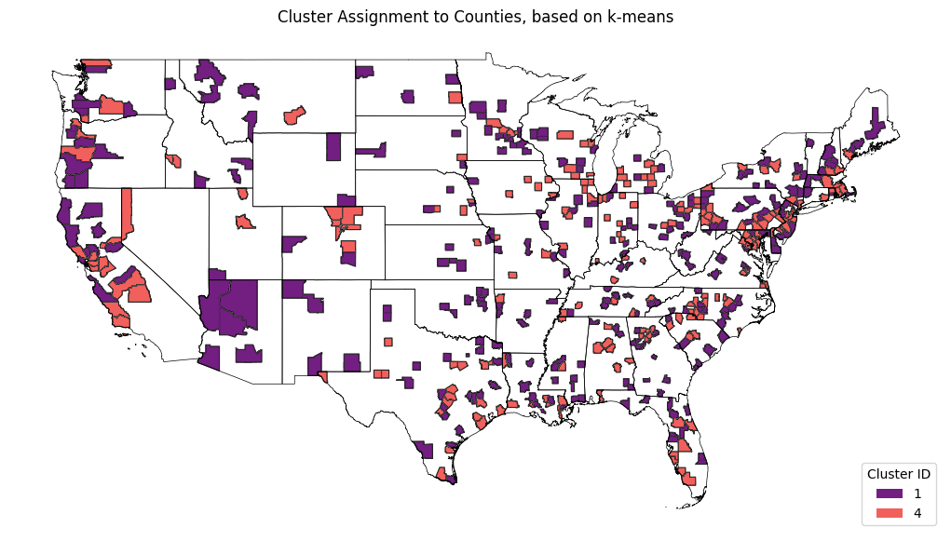
4. Results & Interpretation – k-means
Fig. 13: Visualization of the counties from the second and third best clusters

Slide 31
4. Results & Interpretation – k-means
Since almost all cluster features are correlated, lower-ranked clusters are less relevant for the analysis
Focus should be set on higher-ranked clusters, as they consistently offer better overall values
Consistent results from both algorithms confirm robustness

Slide 32
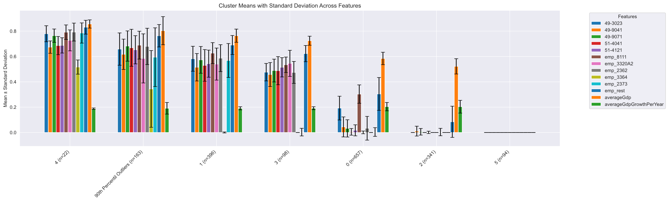
4. Results & Interpretation – DBSCAN
Fig. 14: Visualization of the best Outliers compared to the other DBSCAN Clusters

Slide 33
4. Results & Interpretation – DBSCAN
Cluster 5
The "No existent industry" cluster
Cluster 2
Counties where other industries are strong but not the ones of interest
Cluster 0
Relatively good Automotive Repair and Maintenance

Slide 34
4. Results & Interpretation – DBSCAN
Cluster 3
Solid overall but lacks Aerospace and Contruction completely
Cluster 1
2nd best Cluster, has everything apart from Aerospace Sector
Cluster 4
Best cluster, good overall counties with extra solid Aerospace sector

Slide 35
4. Results & Interpretation – Outliers
Outliers are typically the most heterogeneous data points
Top 10% Outliers however are particularly interesting
Similarly good as Cluster 4 (best) but with more deviations
Outliers act as an expert cluster, regarding aerospace, highway, and street construction, and fabricated product manufacturing
Or simply somewhere between cluster 4 and 1

Slide 36
4. Results & Interpretation – Overall
Which regions should August Rüggeberg focus its activities on?
Based on k-means (~= HC) the top cluster should be focused
Heatmaps can be used to further differentiate the results
Clear distinction between the clusters, features highly correlate
DBSCAN’s can be used if smaller top cluster is favored
Except the outliers, expert clusters are generally uncommon
General Sales strategy should work well for most counties
Notes:
k-means, HC: If you are good in one feature, you are good in everything

Slide 37
4. Results & Interpretation – Overall
Which regions should August Rüggeberg focus its activities on?
An exception to the sales strategy would be aerospace
Feature values show significant regional differences
Strategies should include analysis of counties with a strong aerospace manufacturing presence
Counties in top cluster with relatively low population can be considered hidden gems, as they keep up with larger counties
Notes:
Aerospace is an exception, with significant regional differences
Sales strategies should include analysis of counties with a strong aerospace manufacturing presence
Hidden Gems: Counties in top cluster with relatively low population

Slide 38
5. Reflection
Is our choice of clustering algorithms appropriate?
Should we revisit scaling for GDP growth?
Does including "Other Services" in GDP add value?
Was our weighting of the metrics in grid search appropriate?
Is our ranking approach for the clusters robust enough?
Are the insights genuinely valuable and actionable?
Notes:
Note that this reflection is out of the „acting“ part in the company, and is a reflection of our project from our student side.

Slide 39
References
[1] US Census Bureau, “County Population by Characteristics: 2020-2023,” Census.gov. Accessed: Jan. 22, 2025. [Online]. Available: https://www.census.gov/data/tables/time-series/demo/popest/2020s-counties-detail.html

