Slide 1



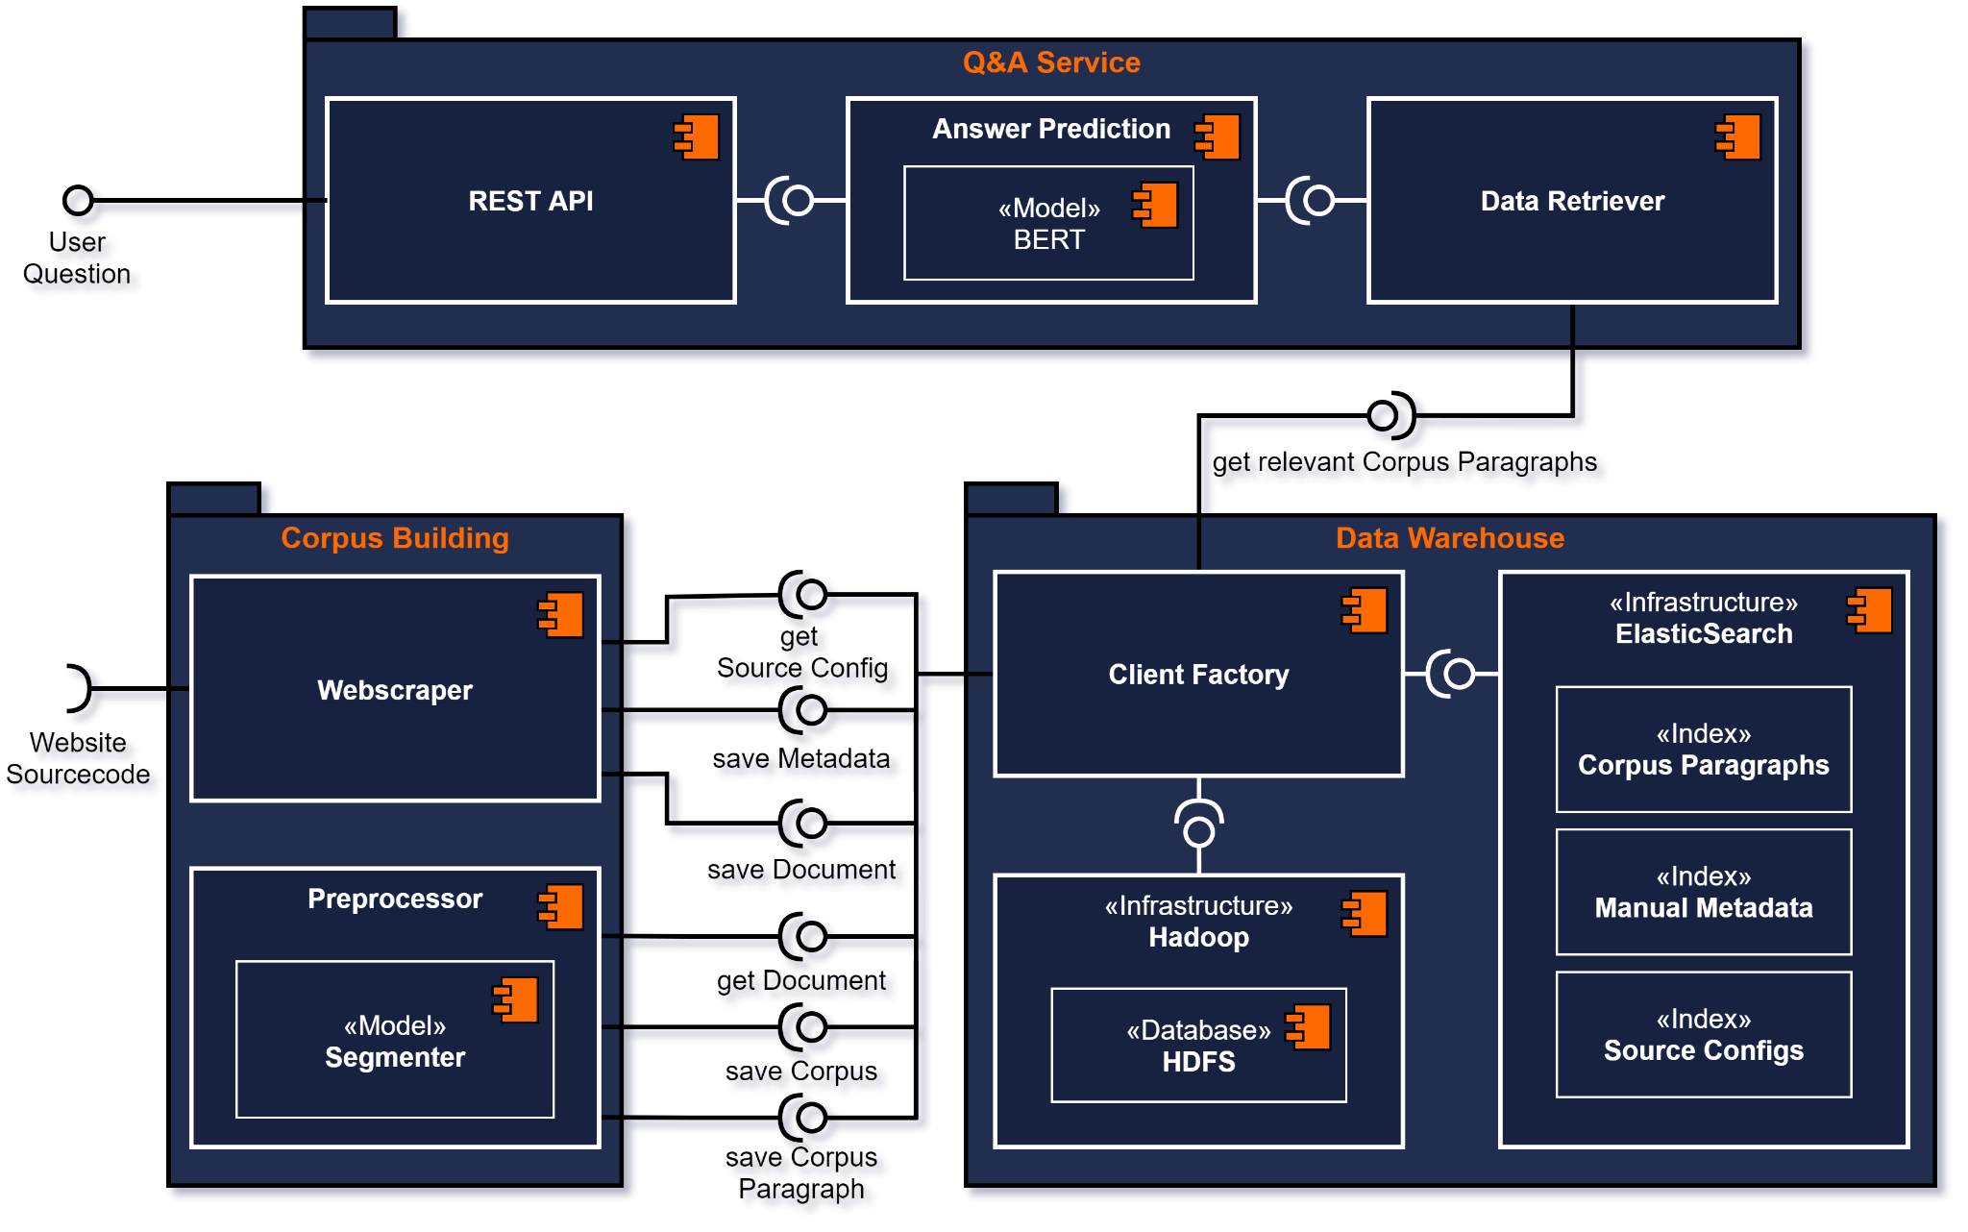


~~
Coffee Machine Q&A System
Esther Ademola, Marius Benkert, Lennard Rose, Jochen Schmidt
What coffee beans should I use?
Only roasted,
untreated coffee beans!
Motivation
Data Warehouse
Problem:
Searching for an answer in technical documents and manuals for coffee machines can be tiresome and time-consuming.
Solution:
A fully integrated system that is able to answer user provided, technical questions regarding coffee machines.
Hadoop serves as a data storage for the manuals
Hadoop ensures availability and scalability
Elasticsearch stores the metadata for each manual document
Elasticsearch serves as a search and management tool and helps finding relevant documents in the Hadoop Distributed File System
Preprocessor
Separates every manufacturer and each of their products
Segments individual manuals into header, subheader and paragraphs
Stores corpus segments in Elasticsearch for fast retrieval
Stores complete corpus in Hadoop
Q&A Service
Retrieves relevant paragraphs for questions by a Sentence Similarity Search
Uses fine tuned NLP-model trained with data from the corpus
NLP-model answers user provided questions based on the relevant paragraphs
Figure 1: Component Diagram of the system
Model | With Fine-Tuning |  | Without Fine-Tuning
 | F1 | Exact-Match | F1 | Exact-Match
bert-base-uncased | 61.7 | 54.6 | 10.4 | 0.3
distilbert-base- uncased-squad | 66.4 | 57.0 | 49.9 | 21.1
bert-base-cased- squad2 | 67.6 | 55.8 | 52.3 | 22.0
roberta-base | 66.7 | 57.2 | 14.6 | 0.15
roberta-base- squad2 | 68.3 | 59.8 | 58.3 | 27.5
Web Scraper
Uses templates with which new sources can be added easily
Automatically queries web pages for documents with BeautifulSoup and Selenium
Adds metadata for each document
Stores documents and metadata in the data warehouse
Table 1: Evaluation results of different models
References:
Wolf, T., Debut, L., Sanh, V., Chaumond, J., Delangue, C., Moi, A., Cistac, P., Rault, T., Louf, R., Funtowicz, M., and others 2019. Huggingface's transformers: State-of-the-art natural language processing.
Gormley, C., and Tong, Z. 2015. . Elasticsearch: the definitive guide: a distributed real-time search and analytics engine. O'Reilly Media, Inc..
Esther Ademola
Marius Benkert
Esther.Ademola@study.thws.de
Marius.Benkert@study.thws.de
Lennard Rose
Jochen Schmidt
Lennard.Rose@study.thws.de
Jochen.Schmidt.1@study.thws.de

