Slide 1
Mission 4
Mr. John

Slide 2
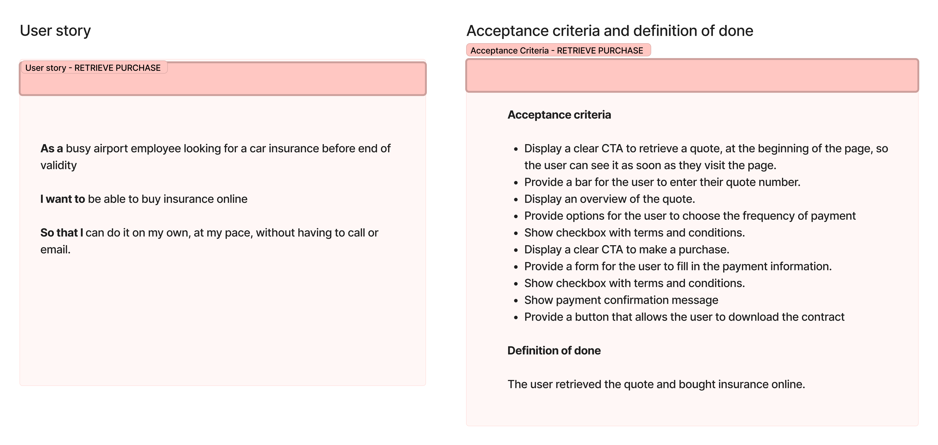


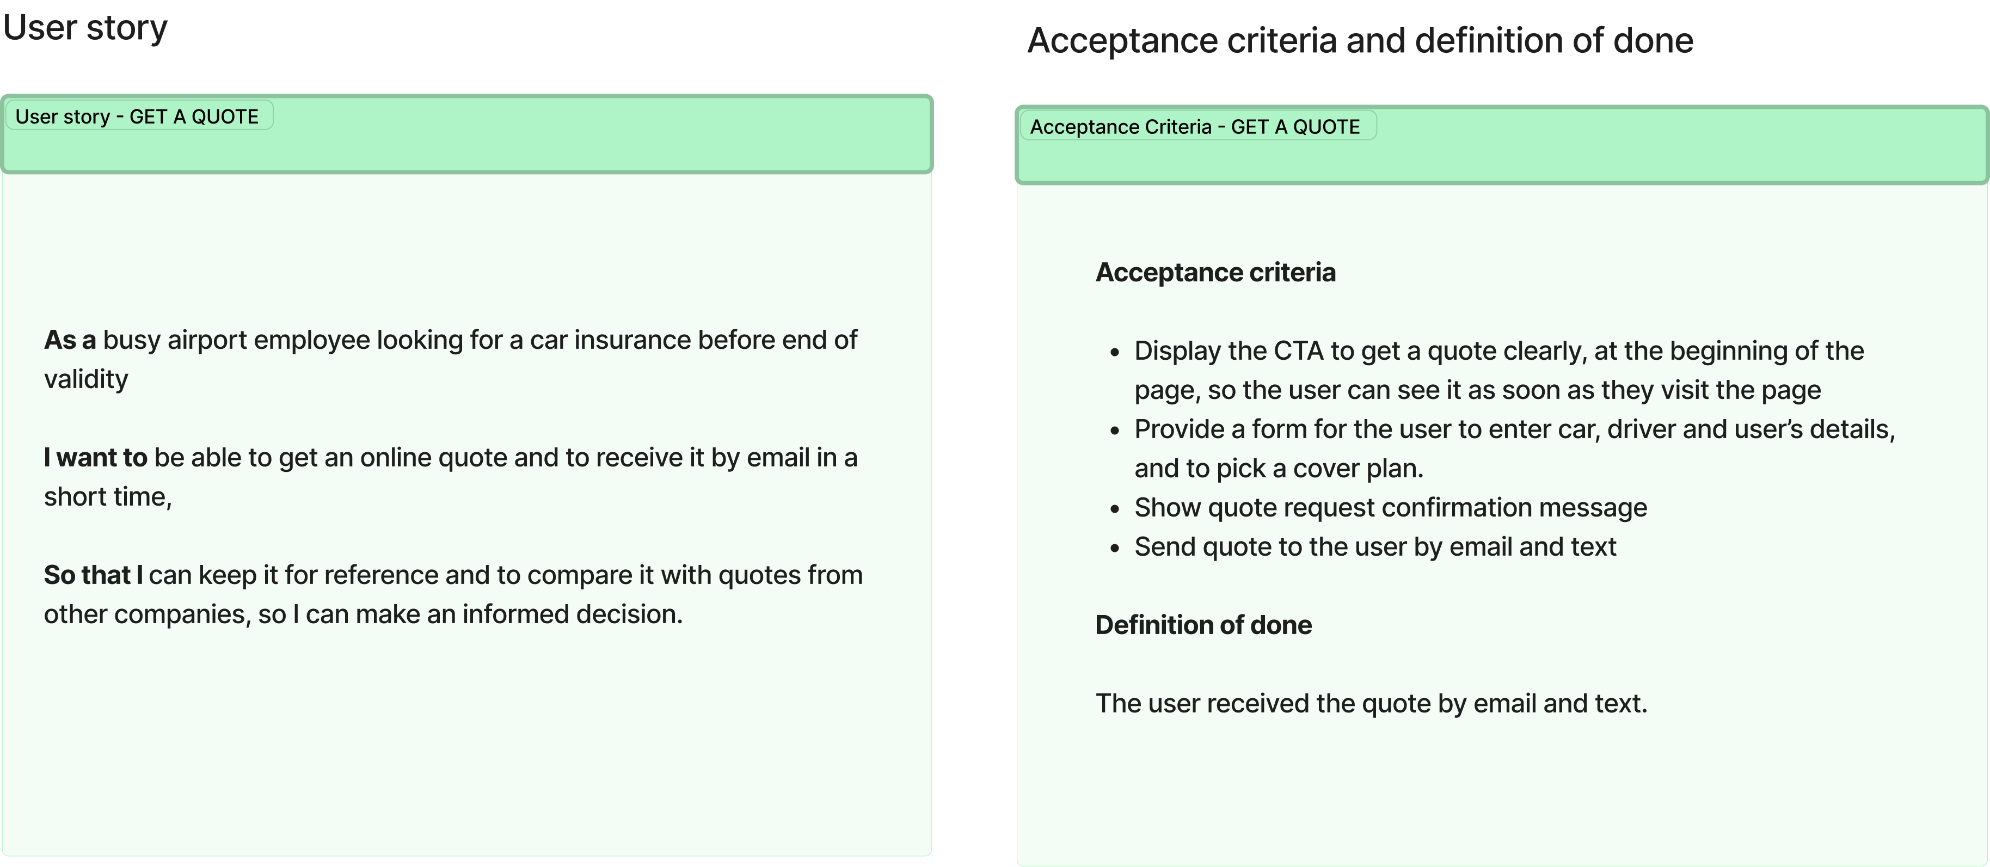
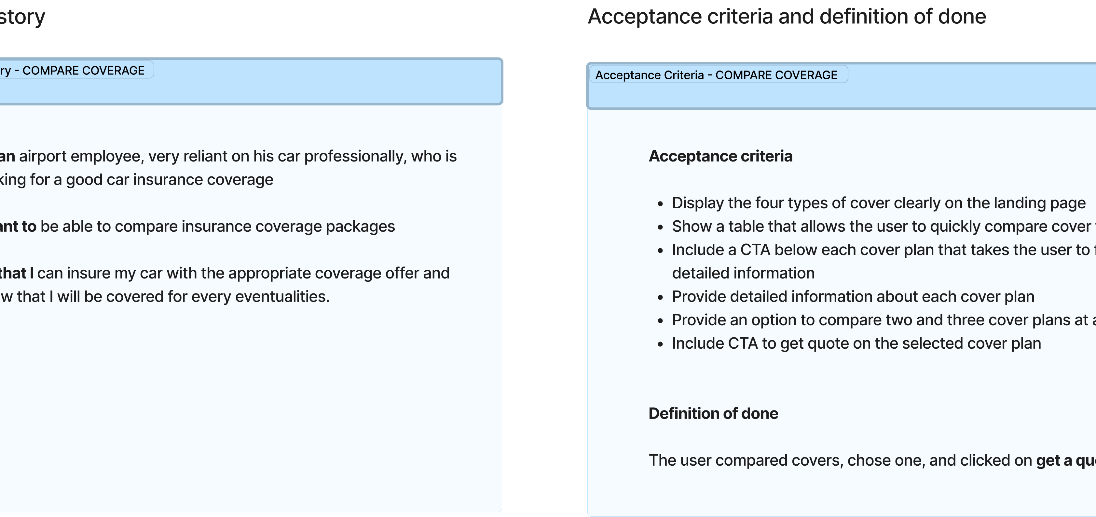
Provide feedback to UX Designer on "feasibility"

Slide 3

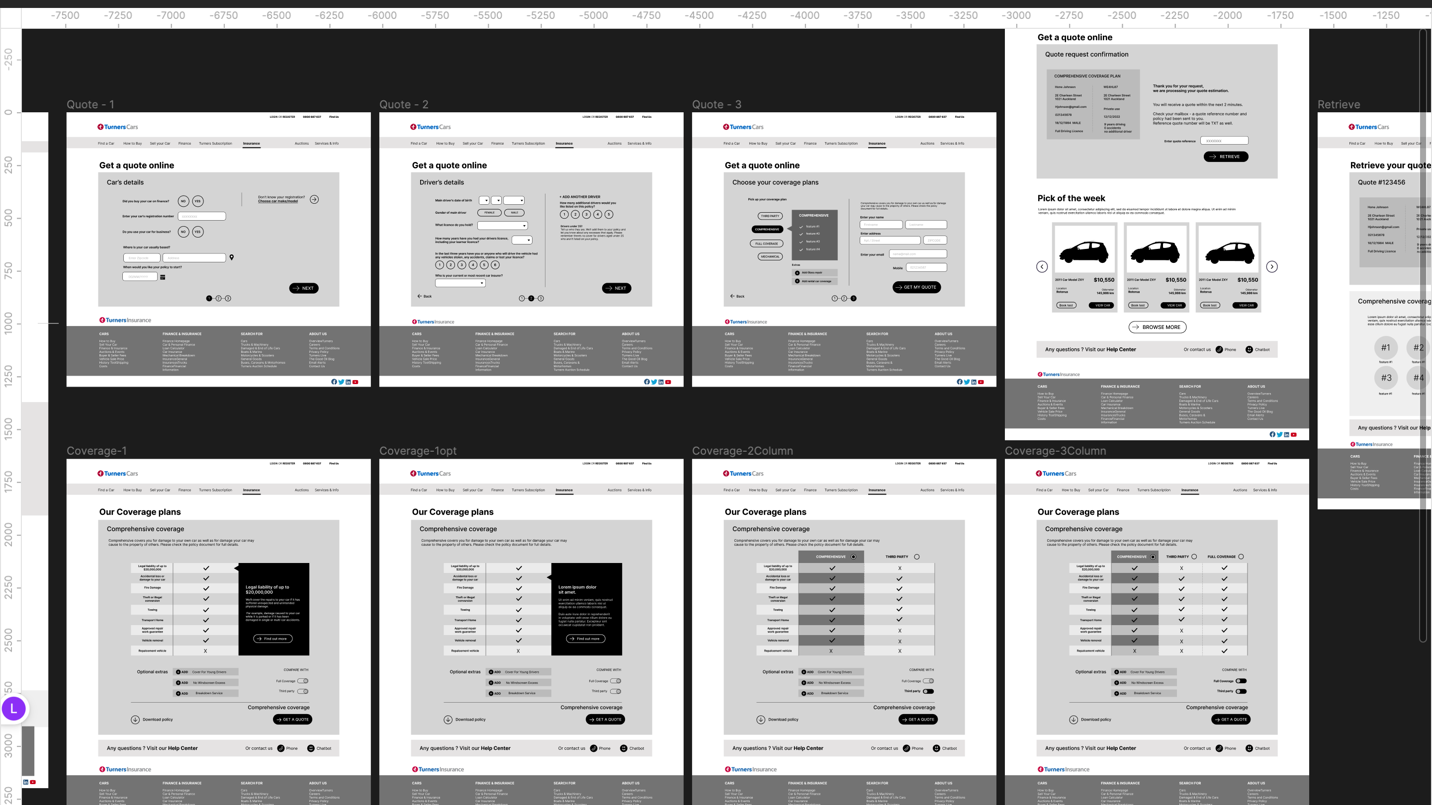

Slide 4
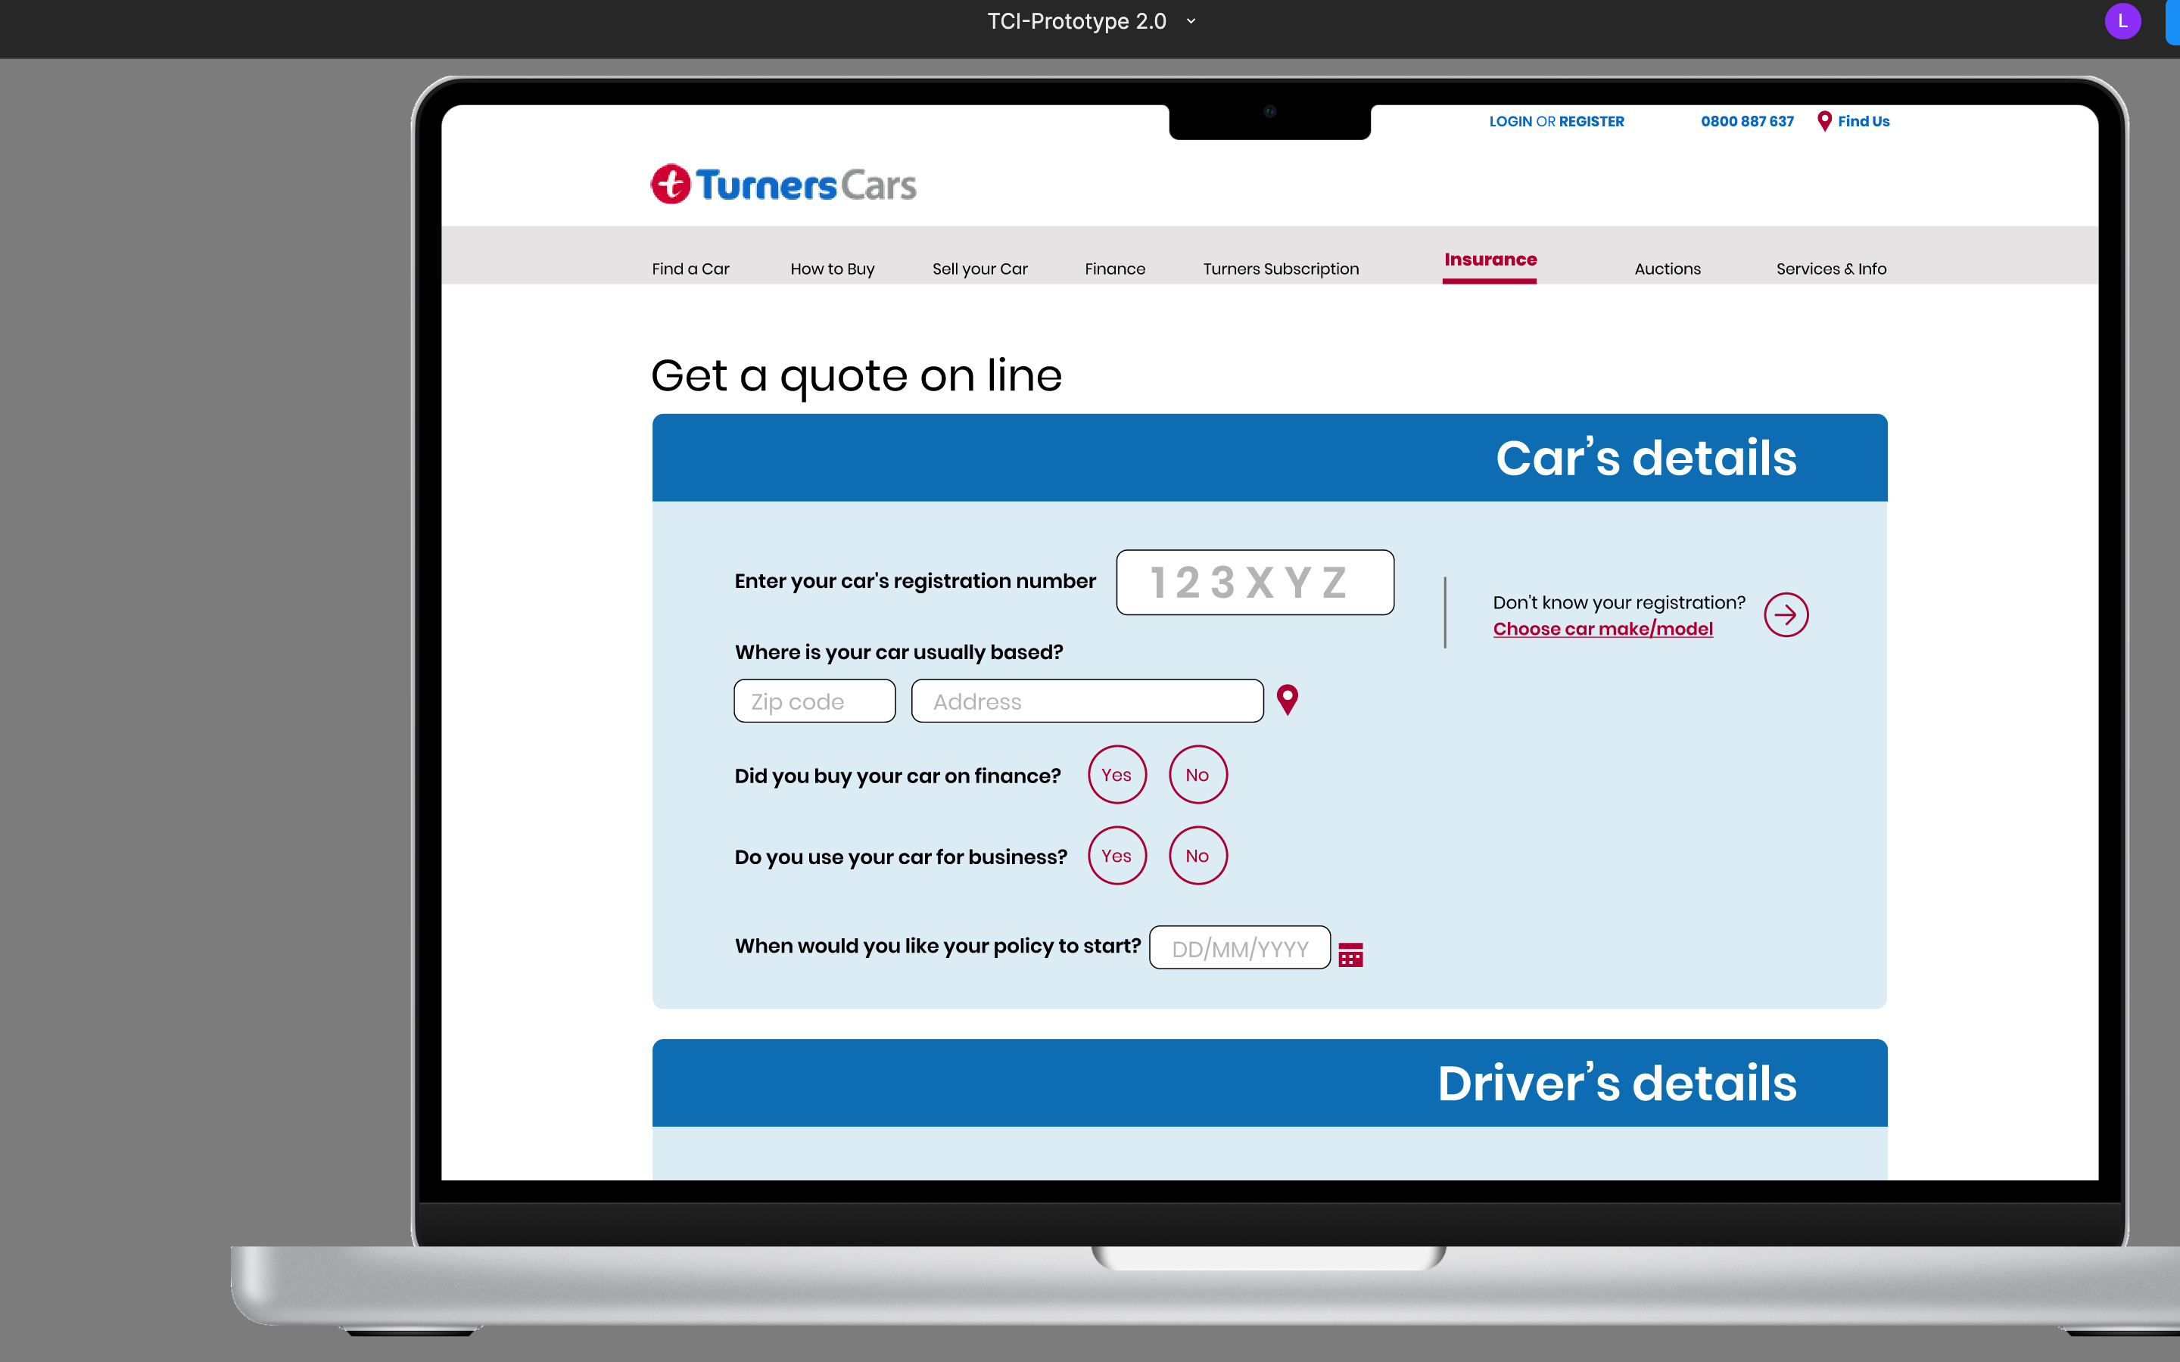

Slide 5
Build a DevOps pipeline for your API
App Services
Web App – used for hosting websites and web applications (previously Azure Websites)
API App – used for hosting the RESTful APIs
Logic App – used for business process automation, system integration and sharing data across clouds
Mobile App – used for hosting mobile app back ends (previously delivered by Azure Mobile services)

Slide 6
Static Code Analysis

