Slide 2
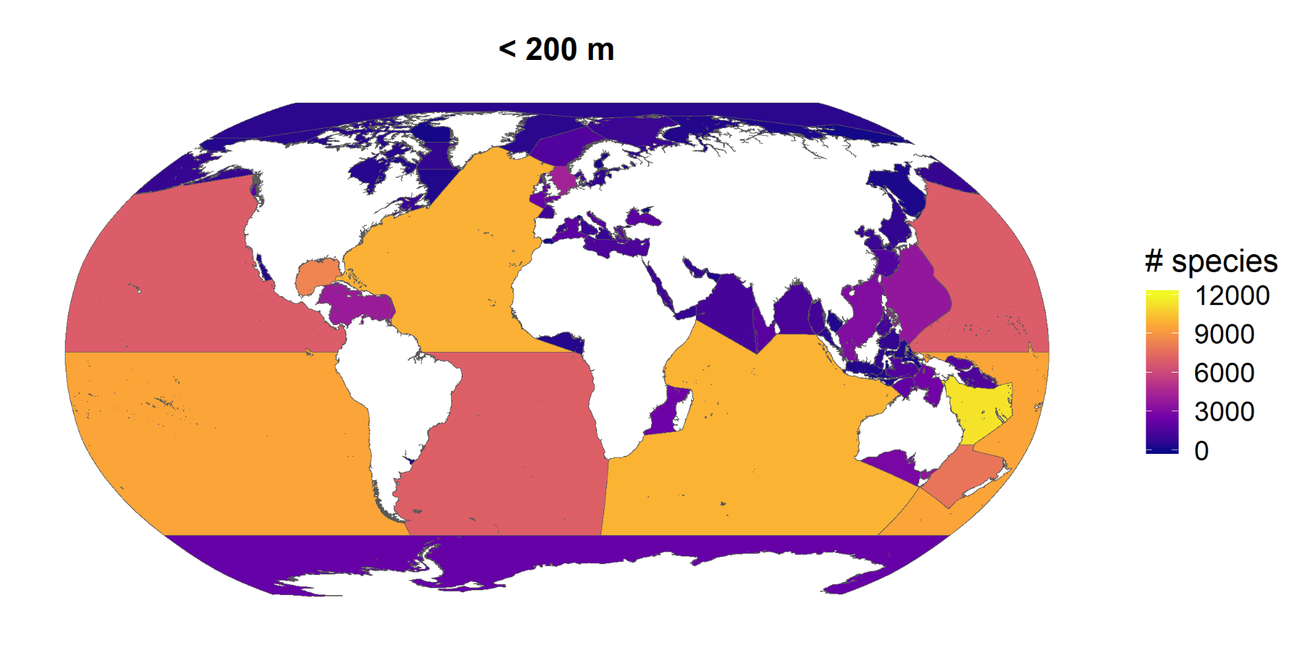
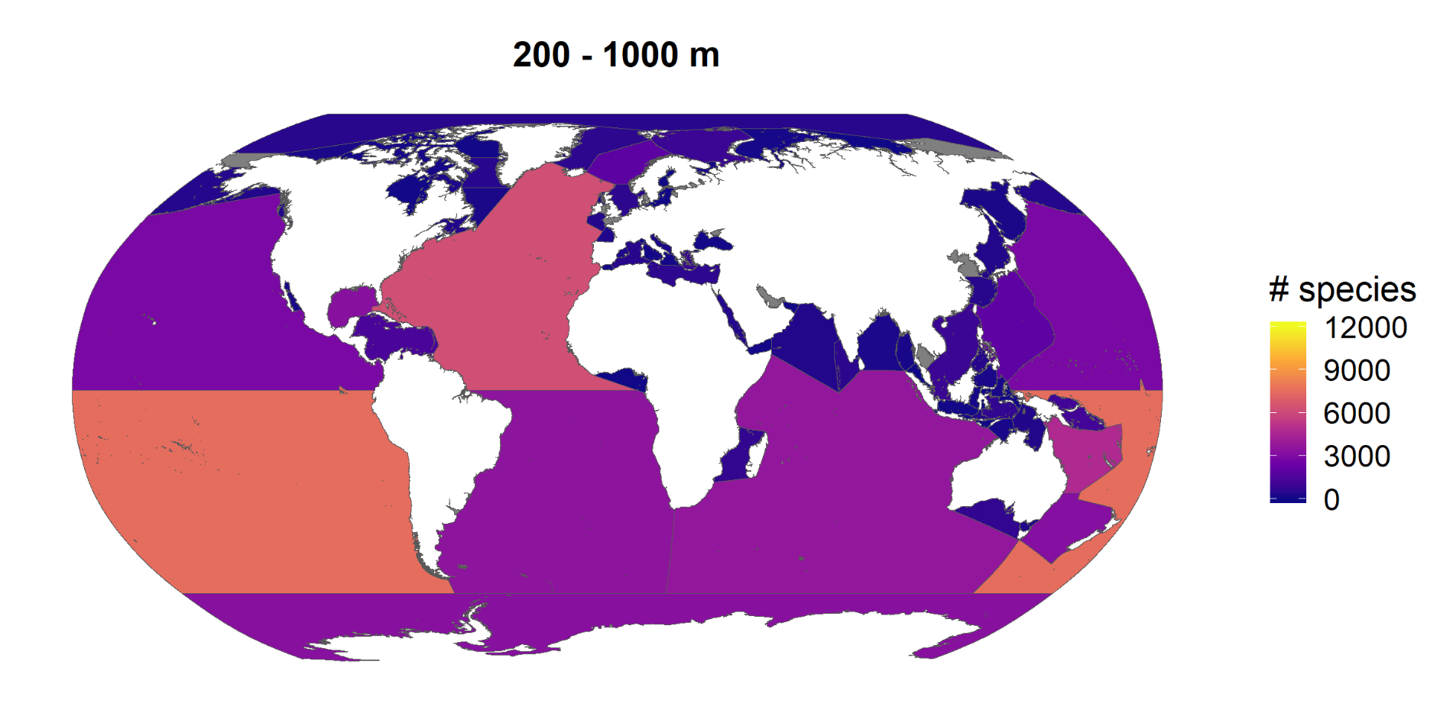
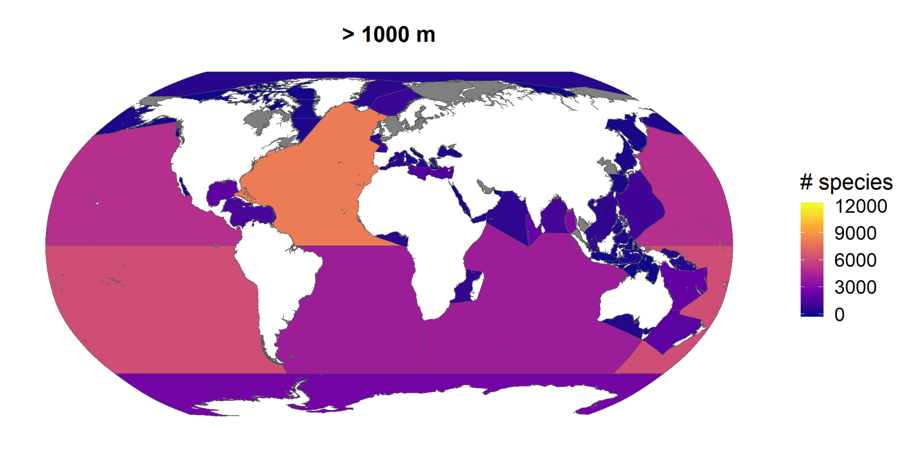
North Atlantic Ocean
South Pacific Ocean
Coral Sea
Indian Ocean
North Pacific Ocean
South Atlantic Ocean
Gulf of Mexico
Tasman Sea
Southern Ocean
Philippine Sea
Caribbean Sea
North Sea
Laccadive Sea
South China Sea
Norwegian Sea
Andaman or Burma Sea
Bass Strait
Mozambique Channel
Great Australian Bight
Mediterranean Sea - Eastern Basin
Celtic Sea
Bismarck Sea
Solomon Sea
Arafura Sea
Mediterranean Sea - Western Basin
Bay of Bengal
English Channel
Banda Sea
Aegean Sea
Timor Sea
Bay of Biscay
The Coastal Waters of Southeast Alaska and British Columbia
Arabian Sea
Black Sea
Eastern China Sea
Inner Seas off the West Coast of Scotland
Irish Sea and St. George's Channel
Adriatic Sea
Barentsz Sea
Sulu Sea
Greenland Sea
Bay of Fundy
Skagerrak
Red Sea
Arctic Ocean
Bering Sea
Balearic (Iberian Sea)
Bristol Channel
Davis Strait
IHO Sea Area
Gulf of Aden
Kattegat
Gulf of St. Lawrence
Tyrrhenian Sea
Japan Sea
Gulf of Alaska
Celebes Sea
Ionian Sea
Gulf of Guinea
Yellow Sea
Makassar Strait
Gulf of California
Flores Sea
Labrador Sea
Beaufort Sea
Persian Gulf
Baltic Sea
Molukka Sea
White Sea
Hudson Strait
The Northwestern Passages
Sea of Okhotsk
Gulf of Oman
Malacca Strait
Hudson Bay
Kara Sea
Singapore Strait
Ceram Sea
Java Sea
Gulf of Tomini
Chukchi Sea
Savu Sea
Laptev Sea
Bali Sea
Gulf of Thailand
Halmahera Sea
Depth Category
Baffin Bay
Alboran Sea
All
Gulf of Aqaba
Gulf of Bothnia
< 200 m
Seto Naikai or Inland Sea
200 - 1000 m
Rio de La Plata
Gulf of Finland
> 1000 m
Strait of Gibraltar
Gulf of Boni
Gulf of Suez
East Siberian Sea
Ligurian Sea
Gulf of Riga
IHO areas by MarineRegions.org; species information by WoRMS;
Sea of Azov
species distributions by OBIS; bathymetry by EMODnet Bathymetry and GEBCO
Sea of Marmara
0
5000
10000
15000
20000
25000
number of species

