Slide 1
How do i…? microscopy and cell counts
2015 Jan 16

Slide 2
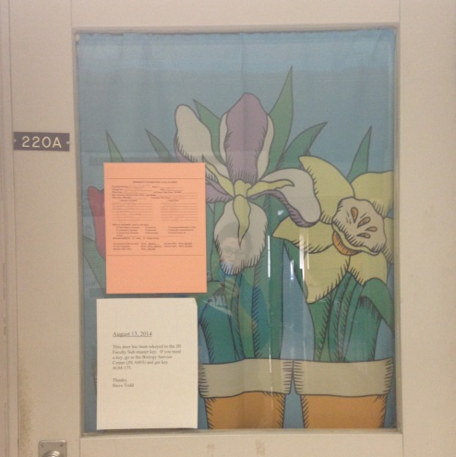
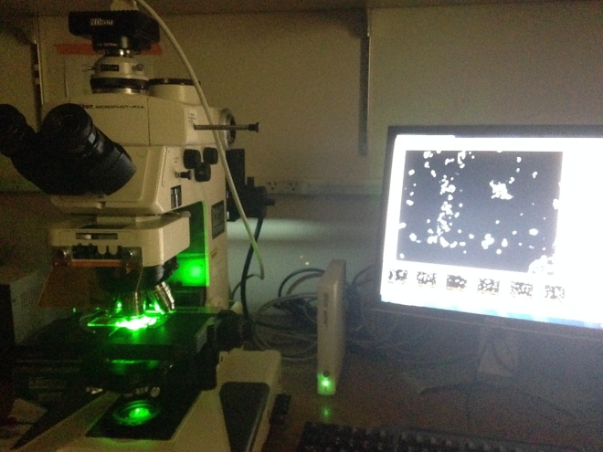
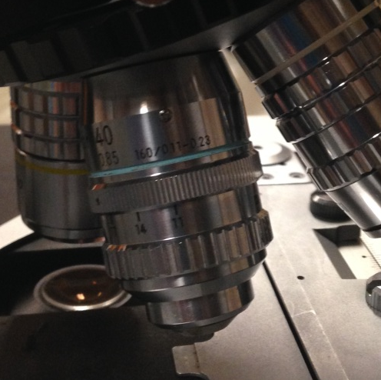
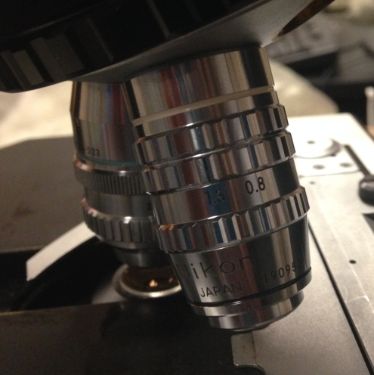
Your STEP by STEP guide to MICROSCOPY
Prep samples | most bacterial cells will require staining with SYBR or DAPI. Both stain nucleic acids
Prepare slides | filter stained samples on to black polycarbonate filters for best viewing and preserve slide with anti-fade solution
Onto the scope room!!
JH 220A – can be accessed by JH key GM 174 (office key)
Nikon with 10x, 40x, and 100x objectives

Slide 3
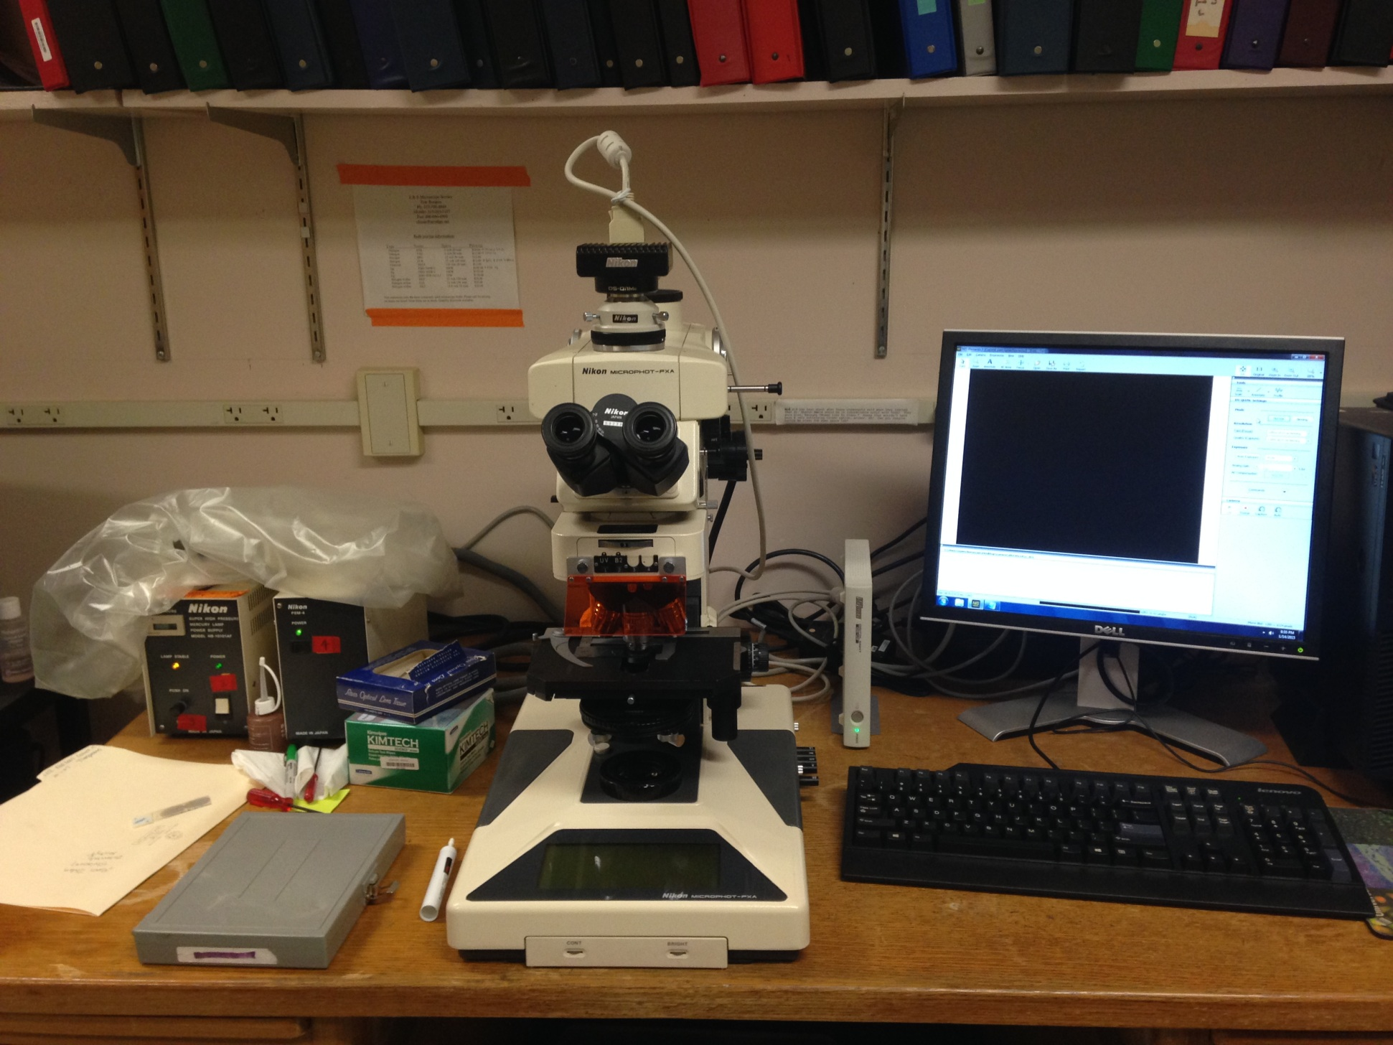
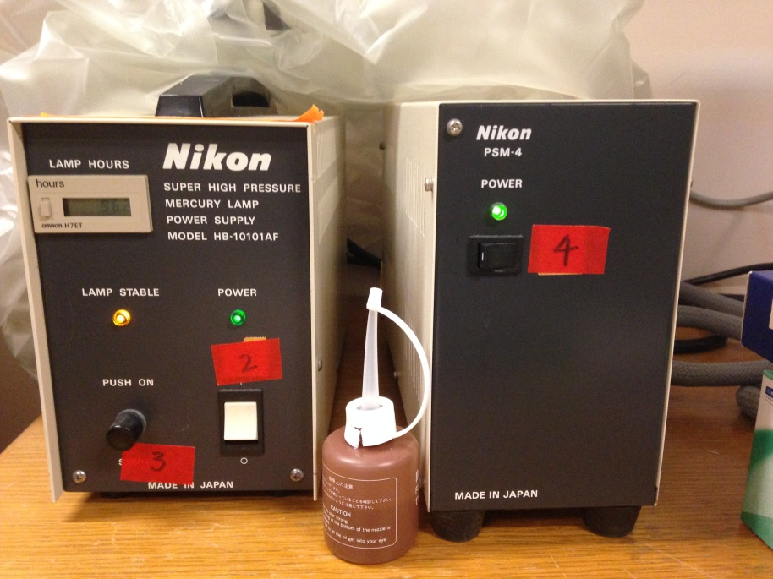

Slide 4
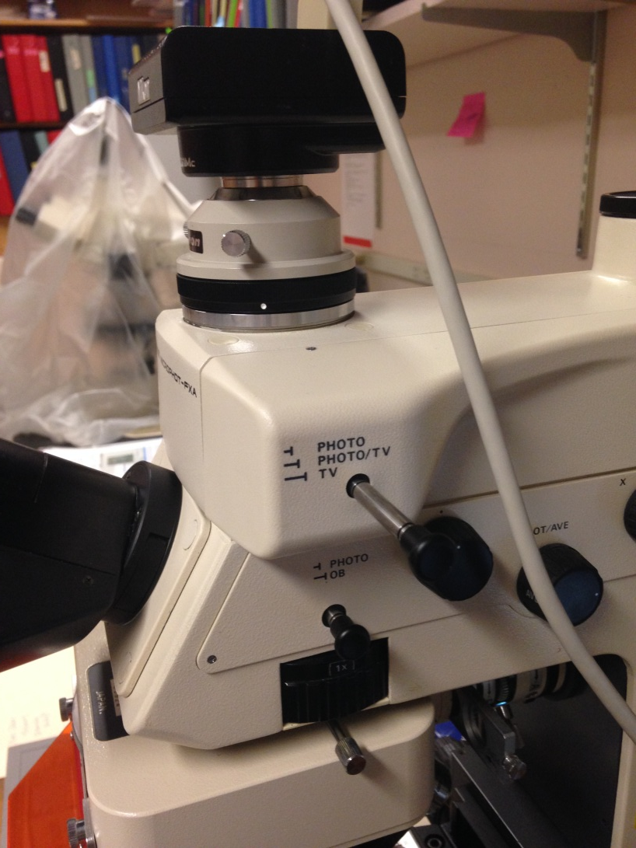
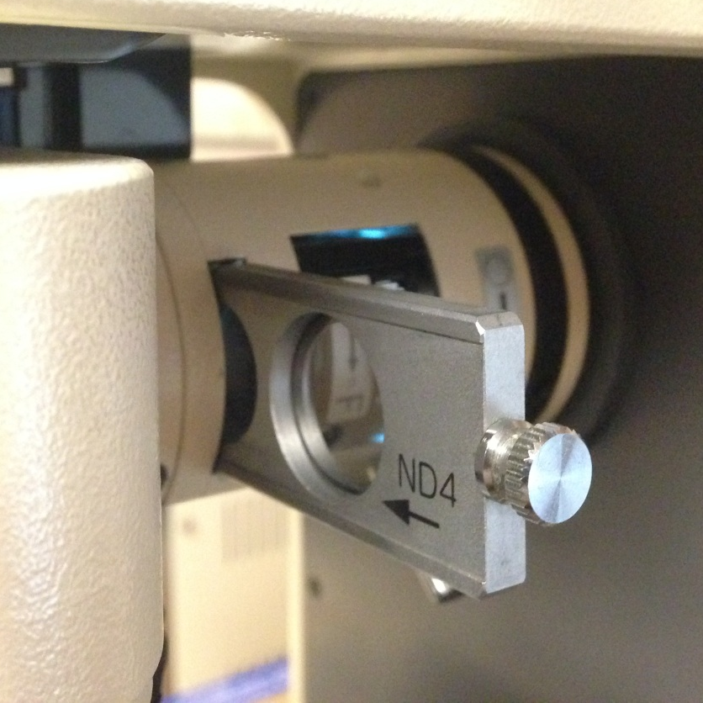

Slide 5
Your STEP by STEP guide to Image processing
Login to computer and open software
login: synechococcus password: ihatephage
Set working directory | create working directory:
Username > date (YRMODA) > same name
This is important for image processing later
Set working directory in image capture software
File > Options > directory name
select “apply”
Capture images | generally use transect across filter and capture 10-20 images using AUTO
Transfer images to jump drive | The computer is not networked nor does it have the image processing software installed currently
Analyze images using ImageJ |Free software available for download to process images

Slide 6
Your STEP by STEP guide to Cell enumeration
Save results as csv or enter into counting template
Use R code to calculate cellular density

