Slide 1
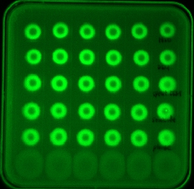
A
B
Dead cells
C
18
ANOVA p-value = 0.1
Spent media
Phage lysate
7500
Fresh media
Water
5000
17
GFP (a.u.)
Sporulation onset (h)
2500
16
Non-GFP
0
Background
Water
Fresh
Spent
Dead
Phage
10
15
20
25
media
media
cells
lysate
Time (h)
Treatment

