Slide 1
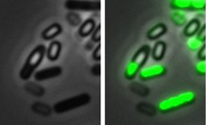
A
B
1.5e+09
C
18
ANOVA p-value = 0.7
Fresh media
1.0e+09
17
Buffer
Sporulation onset (h)
Phage lysate
Spores (#/mL)
Spent media
16
5.0e+08
15
Buffer
Fresh
Spent
Phage
0.0e+00
media
media
lysate
10
15
20
25
30
Treatment
Time (h)

