Slide 1
Pokémon Plots
These are some plots from a Pokémon csv file. The original was from Keith Galli on YouTube.

Slide 2
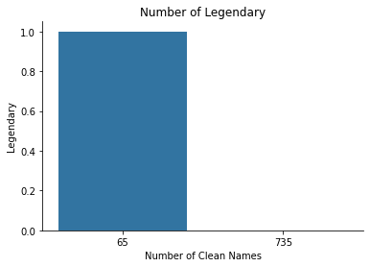
Just a simple plot of the Number of Legendary Pokémon. I cleaned up the names a bit, as there were some doubles.

Slide 3
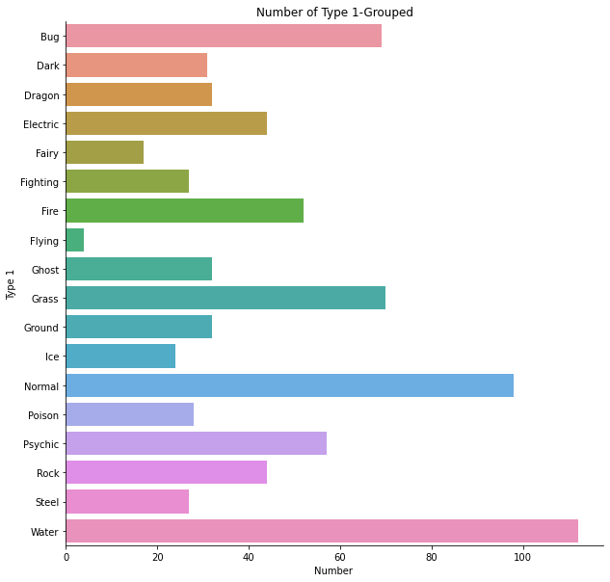
The number of Type 1 Pokémon grouped.

Slide 4
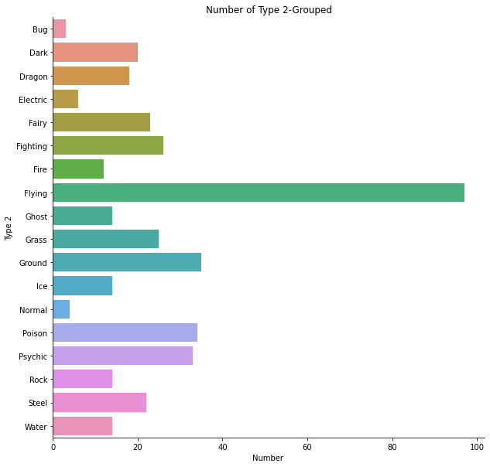
The number of Type 2 Pokémon grouped.

Slide 5
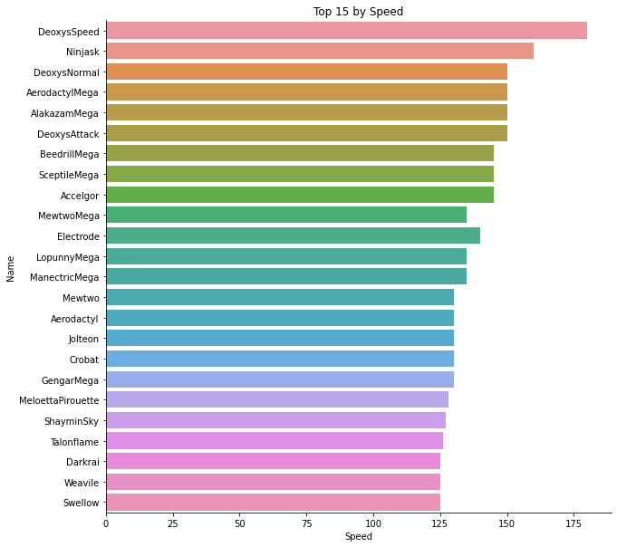
The fastest 15 Pokémon

Slide 6
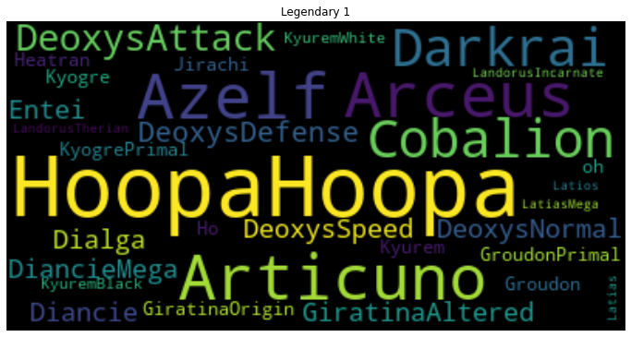
The first half of the legendary Pokémon

Slide 7
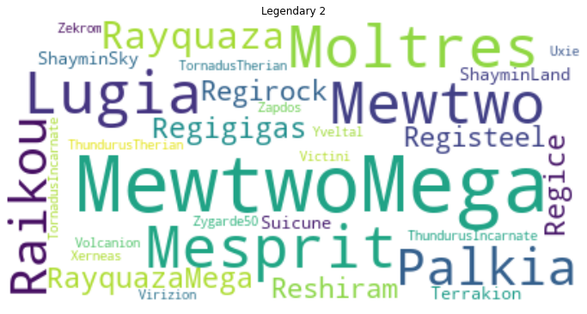
The second half of the legendary Pokémon

Slide 8
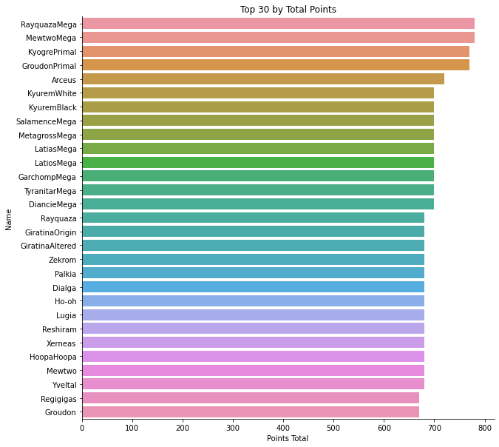
The top 30 Pokémon by total points

Slide 9
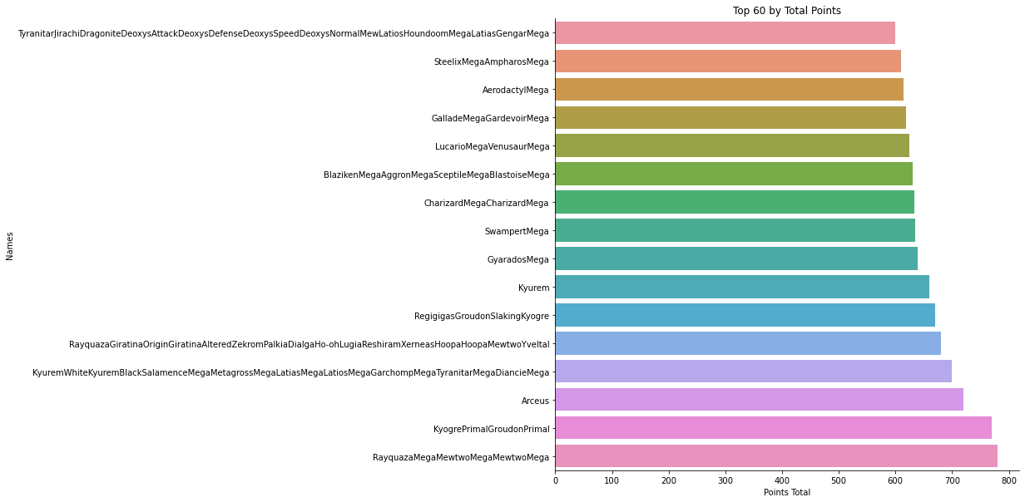
The top 60 Pokémon by total points

