Slide 1
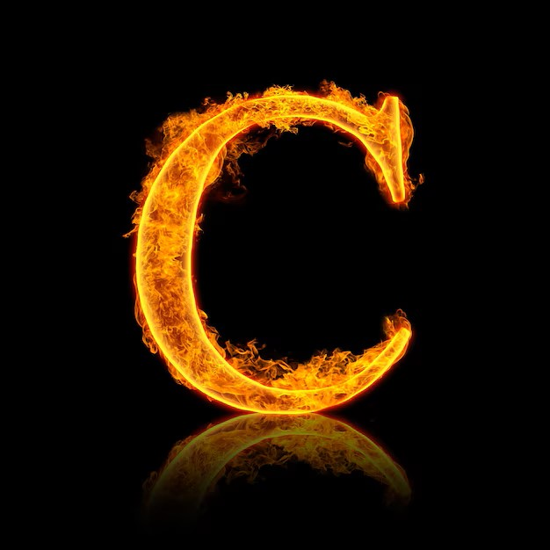
Cyber Resilience Unified System
CYRUS
Peter BIRO
Team AHUM
Notes:
C: https://www.freepik.com/premium-photo/fire-alphabet-letter-c-isolated-black-background_23682093.htm#fromView=search&page=1&position=0&uuid=16e0fe88-d12c-49fc-a1c2-36dbb1628ce2&query=%40andrei-armiagov+fire+alphabet+c

Slide 2
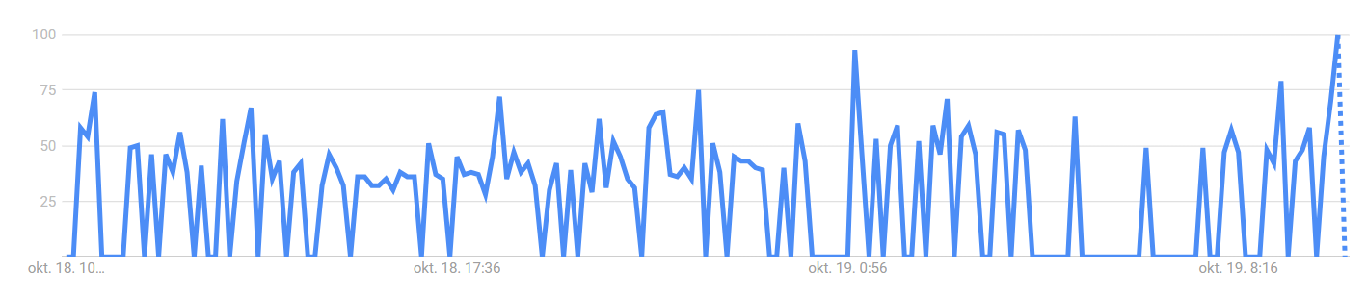
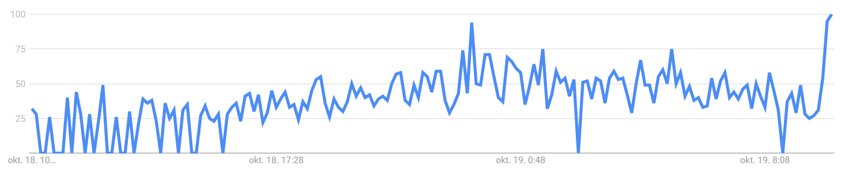
Search term: cyber attack
Search term: security breach
Notes:
C: https://www.freepik.com/premium-photo/fire-alphabet-letter-c-isolated-black-background_23682093.htm#fromView=search&page=1&position=0&uuid=16e0fe88-d12c-49fc-a1c2-36dbb1628ce2&query=%40andrei-armiagov+fire+alphabet+c
https://trends.google.com/trends/explore?date=now%201-d&q=cyber%20attack&hl=hu
https://trends.google.com/trends/explore?date=now%201-d&q=security%20breach&hl=hu

Slide 3



Notes:
C: https://www.freepik.com/premium-photo/fire-alphabet-letter-c-isolated-black-background_23682093.htm#fromView=search&page=1&position=0&uuid=16e0fe88-d12c-49fc-a1c2-36dbb1628ce2&query=%40andrei-armiagov+fire+alphabet+c
https://cloudfront-us-east-2.images.arcpublishing.com/reuters/I5TGJYHZZJLSJPH7QN6MR2YYGM.jpg
https://upload.wikimedia.org/wikipedia/commons/thumb/0/0a/Asahi_logo.svg/1200px-Asahi_logo.svg.png
https://www.f5.com/content/dam/f5-com/global-assets/f5-logos/f5-logo-rgb.png

Slide 4
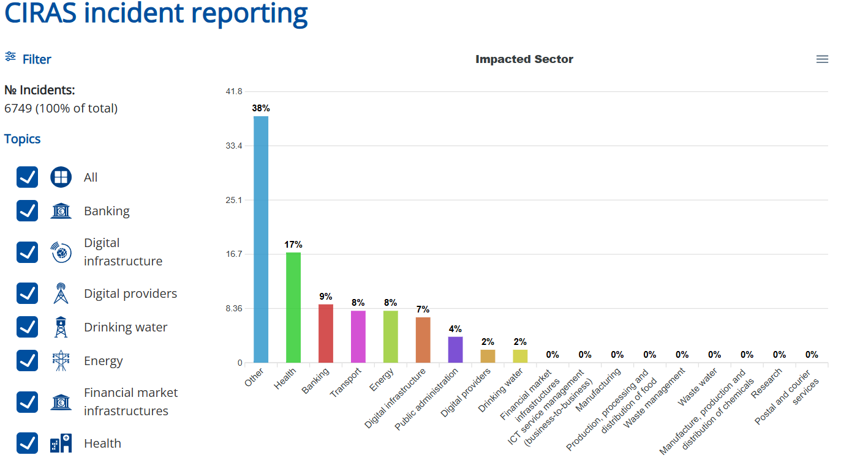


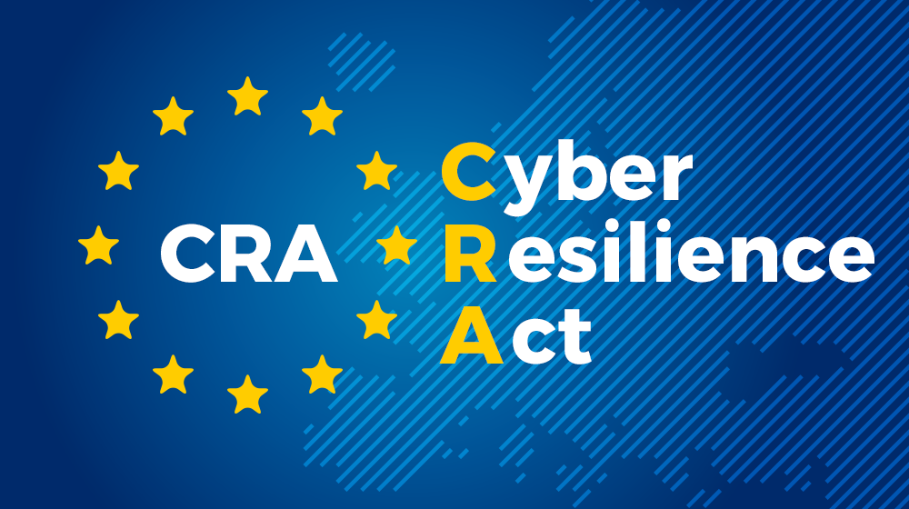
Notes:
C: https://www.freepik.com/premium-photo/fire-alphabet-letter-c-isolated-black-background_23682093.htm#fromView=search&page=1&position=0&uuid=16e0fe88-d12c-49fc-a1c2-36dbb1628ce2&query=%40andrei-armiagov+fire+alphabet+c
https://ciras.enisa.europa.eu/ciras-public
https://triovega.com/wp-content/uploads/Blog_-CRA_Titelbild.png
https://cdn-knowitallent.pressidium.com/wp-content/uploads/2021/12/traditional-media.png
https://upload.wikimedia.org/wikipedia/commons/thumb/7/74/Social_media_collection_2020s.png/500px-Social_media_collection_2020s.png

Slide 5
Notes:
C: https://www.freepik.com/premium-photo/fire-alphabet-letter-c-isolated-black-background_23682093.htm#fromView=search&page=1&position=0&uuid=16e0fe88-d12c-49fc-a1c2-36dbb1628ce2&query=%40andrei-armiagov+fire+alphabet+c

Slide 6

Thank you for your attention
Support AHUM!
Notes:
C: https://www.freepik.com/premium-photo/fire-alphabet-letter-c-isolated-black-background_23682093.htm#fromView=search&page=1&position=0&uuid=16e0fe88-d12c-49fc-a1c2-36dbb1628ce2&query=%40andrei-armiagov+fire+alphabet+c

