Slide 1

Millennials.ai

Slide 2
Millennials.ai
Millennials.ai is a research based Artificial Intelligence (A.I.) company with a focus on middle large companies already using their data to efficiently execute their business proposition. We integrate custom made algorithms and machine learning into existing business processes to optimize the value of your business data.

Slide 3
About me
MSc Artificial Intelligence student at the UvA
AI developer at Millennials.ai
Currently doing my thesis about Compositionality in Reinforcement Learning at the Institute for Logic Language and Computation (ILLC)

Slide 4
Training: Reinforcement Learning
17-05-2019

Slide 5
Content
Introduction
(Machine) Learning
Background info
Theory
MDP formalization
Policy evaluation
Policy iteration
Value iteration
Hands on
Your turn!
Practical applications & Takeaways
Showcasing the cool stuff

Slide 6
Introduction

Slide 7
Artificial Intelligence
Definition of artificial intelligence?
“The study of agents that receive percepts from the environment and perform actions” - Russel & Norvig
Art of learning mappings
Function from input to labels -> y = f(x)
What do we consider learning? Semantic debate!

Slide 8
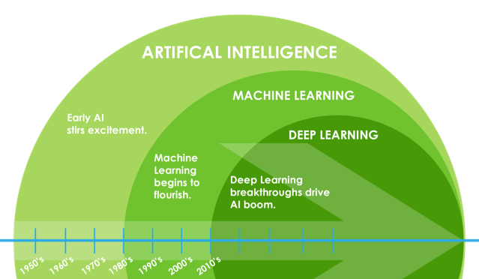
Terminology
First things first, lots of people seem to get this wrong!

Slide 9
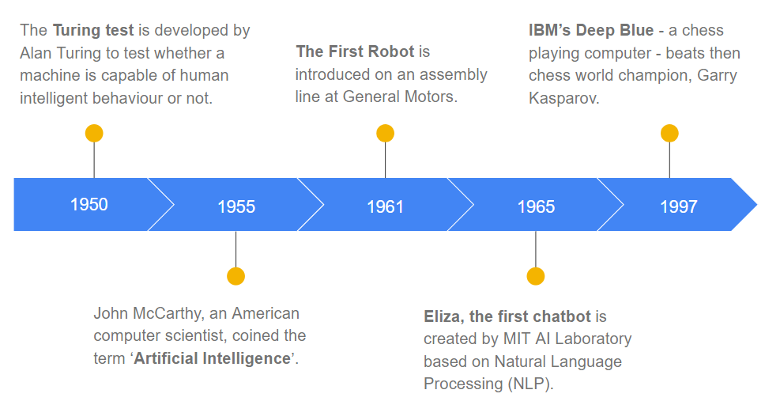
Brief history of AI

Slide 10
More recent history
1998: Gradient-based learning with backpropagation, Yann LeCunn
2009: Launch of ImageNet Dataset & Challenge
Millions of annotated images of cats, dogs, cars, etc.
2011: AlexNet wins ImageNet Challenge by a large margin
Eight layer deep network
Trained using GPUs
Use of relu activations
2014: Facebook publishes DeepFace, a 97% accuracy face detector
2015: Deep Q-Learning achieves human-level control on 49 Atari games

Slide 11
Types of learning
Supervised: Learning to predict
Unsupervised: Learning to structure
Semi-supervised (self training): Learning to induce
Reinforcement: Learning to do!
We’ll see the difference between RL and supervised learning later

Slide 12
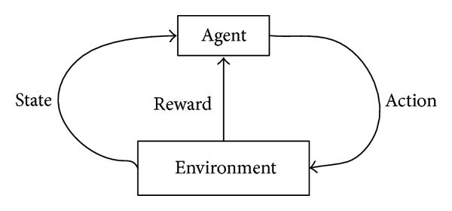
Reinforcement Learning in a nutshell
Agent should learn to “maximize future reward”
Talk about states, actions, reward
Learning from negative or positive feedback
In the end: no direct human dataset -> better than human performance?

Slide 13
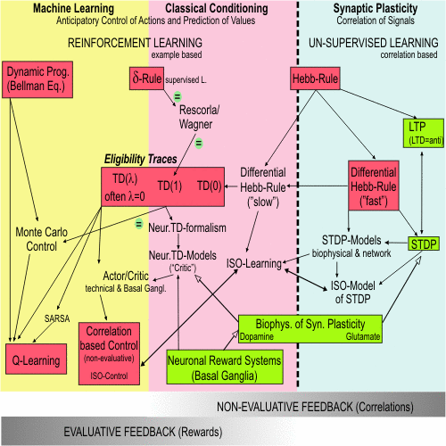
RL is difficult to position as a single research area

Slide 14
Reinforcement Learning vs other types
Sequential decision making
Actions influence your future observations
In supervised learning, actions (predictions) only influence your future actions
This is learning!
No i.i.d. assumptions
Individual states are hard (impossible?) to label

Slide 15
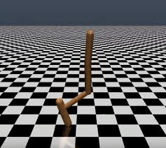
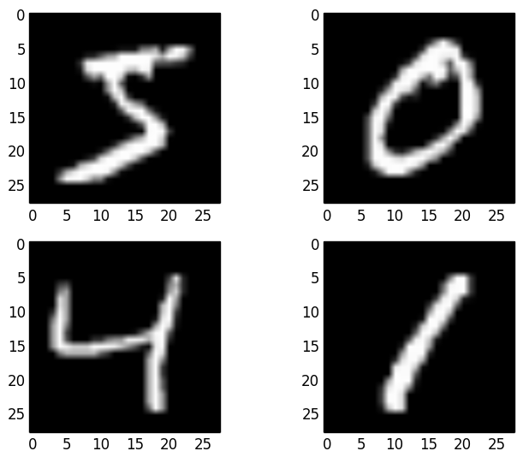
Reinforcement Learning vs Supervised Learning
Learning to do
Become better than humans
Data depends on current strategy
Data is sequential
Learning to predict
Dataset annotated by humans
Data doesn’t depend on learned behavior*
Data is assumed to be i.i.d.

Slide 16
Why is RL hard?
Credit assignment
If reward is good -> What action in the sequence was good? The last? The first?
If reward is bad -> there might exist even worse actions than the ones we picked
Data is non-iid and depends on the actions chosen
Get stuck in “bad” states
Now, we learn to deal well with bad states but cannot reach good ones

Slide 17
Some more definitions
Markov Decision Processes (MDPs): a model for sequential decision processes
(discounted) return: cumulative reward, discounted when we have a continuous task.
Trajectories & Episode: sequence of states, actions and rewards. If we have natural termination states, we split trajectories into episodes
Policy
Value function

Slide 18
Learning methods in RL
Tabular
Model-based
Model free
Q-learning
DQN (we’ll see some examples later)
Policy gradient (enabled Neural networks)
More sophisticated methods

Slide 19
Learning with gradient updates
Basis for neural networks, generally applies to all NN architectures
However, hard to find right set of hyperparameters
Even more so in RL!
We will not go into detail today about these methods, but we’ll see some applications
Today: tabular methods, this means we’re keeping track of all values in a big table, and allows us to use dynamic programming

Slide 20
RL Theory

Slide 21
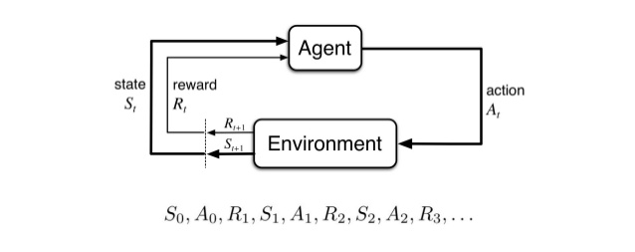
MDP formalization
Since RL is based on sequences of actions, observations and rewards, we call this a Process
Markov Decision Processes are a formulation of sequential decision making
Actions impact not only immediate reward, but next states, and future rewards as well
Group sequences in episodes
At the end, observe reward

Slide 22
MDP formalization
Since RL is based on sequences of actions, observations and rewards, we call this a Process
Markov Decision Processes are a formulation of sequential decision making
Actions impact not only immediate reward, but next states, and future rewards as well
Group sequences in episodes
At the end, observe reward

Slide 23
MDP formalization
MDP = (S, A, T, R, γ)
S: set of states
A: set of actions
T: Transition probabilities
From state s, we take action a, what is the probability we end up in state s’
R: rewards
Numerical value to reward the agent upon completion of an objective
γ: discount factor
Reduce reward the longer it takes to achieve
Solves the problem of cyclic action set

Slide 24
MDP formalization
Assumptions:
Next state only depends on current state (markov assumption)
Reward is only dependent on state, action and next state
Discrete time steps
Environment is fully observable
No hidden information
Environment is stationary
Same action from same state will always have same effect

Slide 25
MDP?
Are the following processes (vanilla) MDPs?
Chess
Autonomous driving
Robot in a maze (camera on robot)
Robot in a maze (camera above robot)
Examples that are not, can often be cast into MDPs, or some additional definition can be made to accomodate (POMDP, Continuous MDPs)

Slide 26
Big picture: how to learn policies
Learn value functions V(s) or action-value functions Q(s,a)
How good is the current state s?
How good is the action a in state s?
Use these functions to improve on our policy π(s)
Dictates what action we pick in state s
Employ dynamic programming:
simplifying a complicated problem by breaking it down into simpler sub-problems in a recursive manner
Introduced by Bellman in the 1950s

Slide 27
Big picture: how to learn policies
A good policy π(s) should get high expected returns
When do we prefer one policy π over another policy π’?
When V_{π}(s) > V_{π’}(s)
Similarly, we can do the same for state-action pairs
When Q_{π}(s,a) > Q_{π’}(s,a)
We can use these Q values for finding the best action in state s:
a* = max_{a}Q_{π}(s,a)

Slide 28
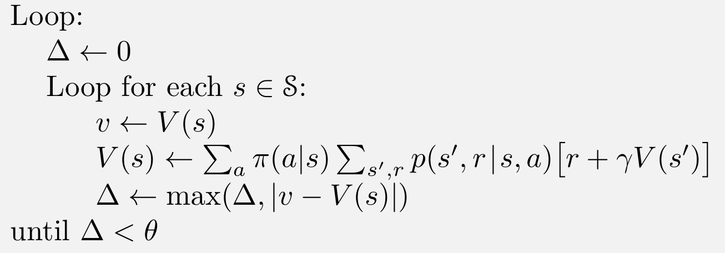
Policy evaluation
How do we come up with V_{π}(s)? Iterative solution, with MDP dynamics as given:

Slide 29
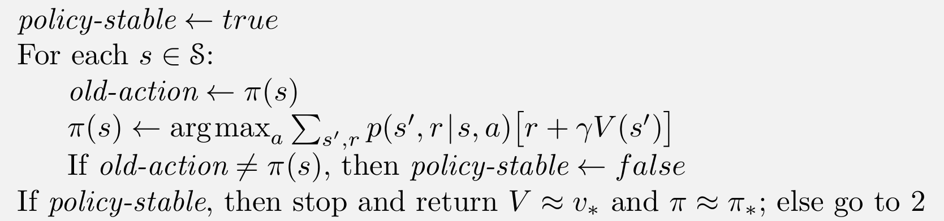
Policy improvement
Exploit V_{π}(s) to come up with the best actions in all states.
Pick the action that looks best in the short term, according to V_{π}(s)
Greedy action selection!

Slide 30
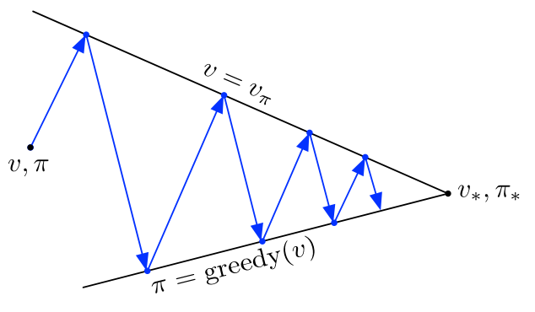
Policy iteration
Consists of two iteration processes
Policy evaluation:
Make the value function consistent with the current policy
Policy improvement
Making the policy greedy with respect to the current value function

Slide 31
Value iteration
Drawback of policy iteration: evaluate policy at every iteration is computationally expensive
Value iteration effectively combines, in each of its sweeps, one sweep of policy evaluation and one sweep of policy improvement
Algorithm on next slide

Slide 32
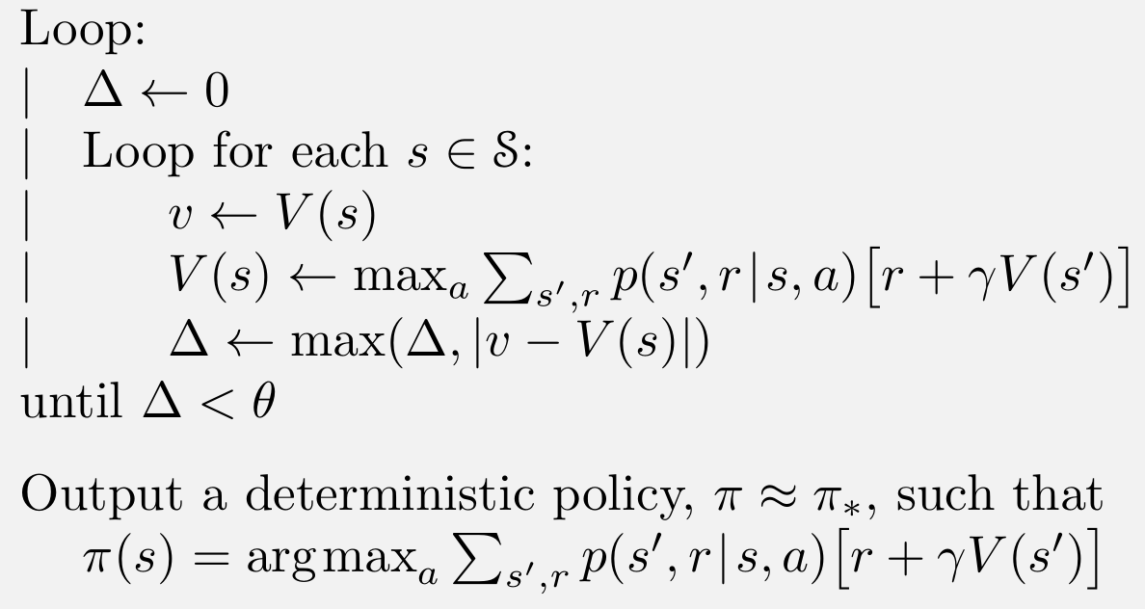
Value iteration

Slide 33
Hands on

Slide 34
Hands on: your turn
Implement policy iteration & value iteration yourself on a toy problem
Don’t hesitate to ask questions or consult the documentation
Good luck!
https://git.io/fjlph

Slide 35
Practical Applications

Slide 36
Examples we’ll go over
AlphaGo
The DeepBlue of our age, outperforming the human world champion
AlphaGo Zero
Purely RL based Go-playing AI, outperforming the original in merely days of training
RTS games (Starcraft 2 / Dota 2)
Moving into massively scalable RL
Robotics
The cool stuff
Traffic Light Control
https://pure.uva.nl/ws/files/10793554/vanderpol_oliehoek_nipsmalic2016.pdf
Display Advertising
https://arxiv.org/pdf/1802.09756.pdf

Slide 37
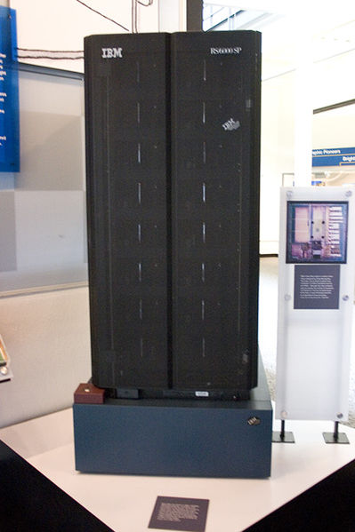
Chess?
Chess is a combinatory explosive game
Hard to search and plan ahead on “good” actions, since there are many states
1996: IBM develops Deep Blue to beat the World Champion
However, it was not RL
Combination of heuristics and brute force using massively parallel computational power
“Think ahead” 6-8 steps.

Slide 38
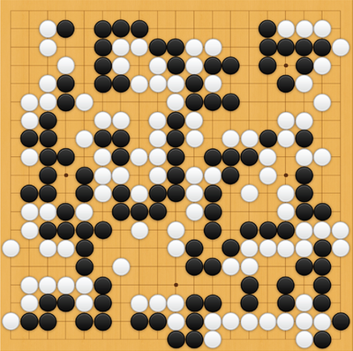
AlphaGo
Chinese game “Go”, even computationally more difficult to enumerate all states due to large branching factor
Board is 19x19, turn based between two players placing white and black stones
Goal is to capture an area larger than the opponent.
Monte Carlo Tree Search had already shown good performance

Slide 39
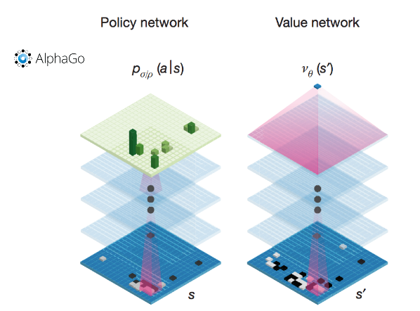
AlphaGo
Difficult to evaluate “good” board positions
MCTS executes a simple idea in finding good actions: just try (rollout) games from the current position according to some policy (next slide)
When the games end, we know whether we win or lose
Combine MCTS with Neural Networks and win everything!

Slide 40
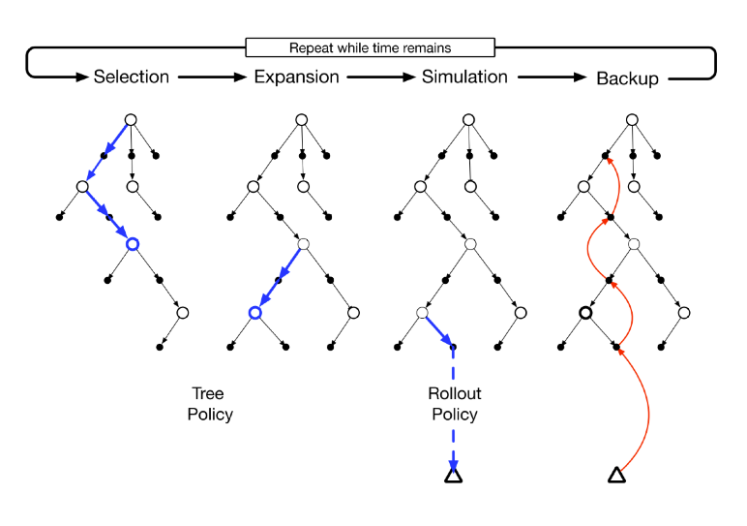
AlphaGo

Slide 41
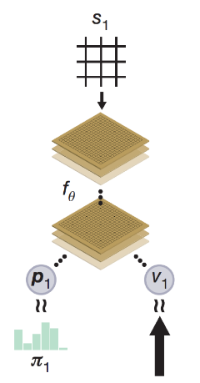
AlphaGo Zero
AlphaGo took months to train
Initialized the neural networks by supervised learning
Data gathered by humans, bad!
How to outperform humans? Stop relying on them
AlphaGo Zero -> purely trained through self-play
Squash two networks from AlphaGo into one: Policy and value network now share the same network
Intuition: Guided tree search by network.
Result? Trainable agent in 3(!) days,

Slide 42

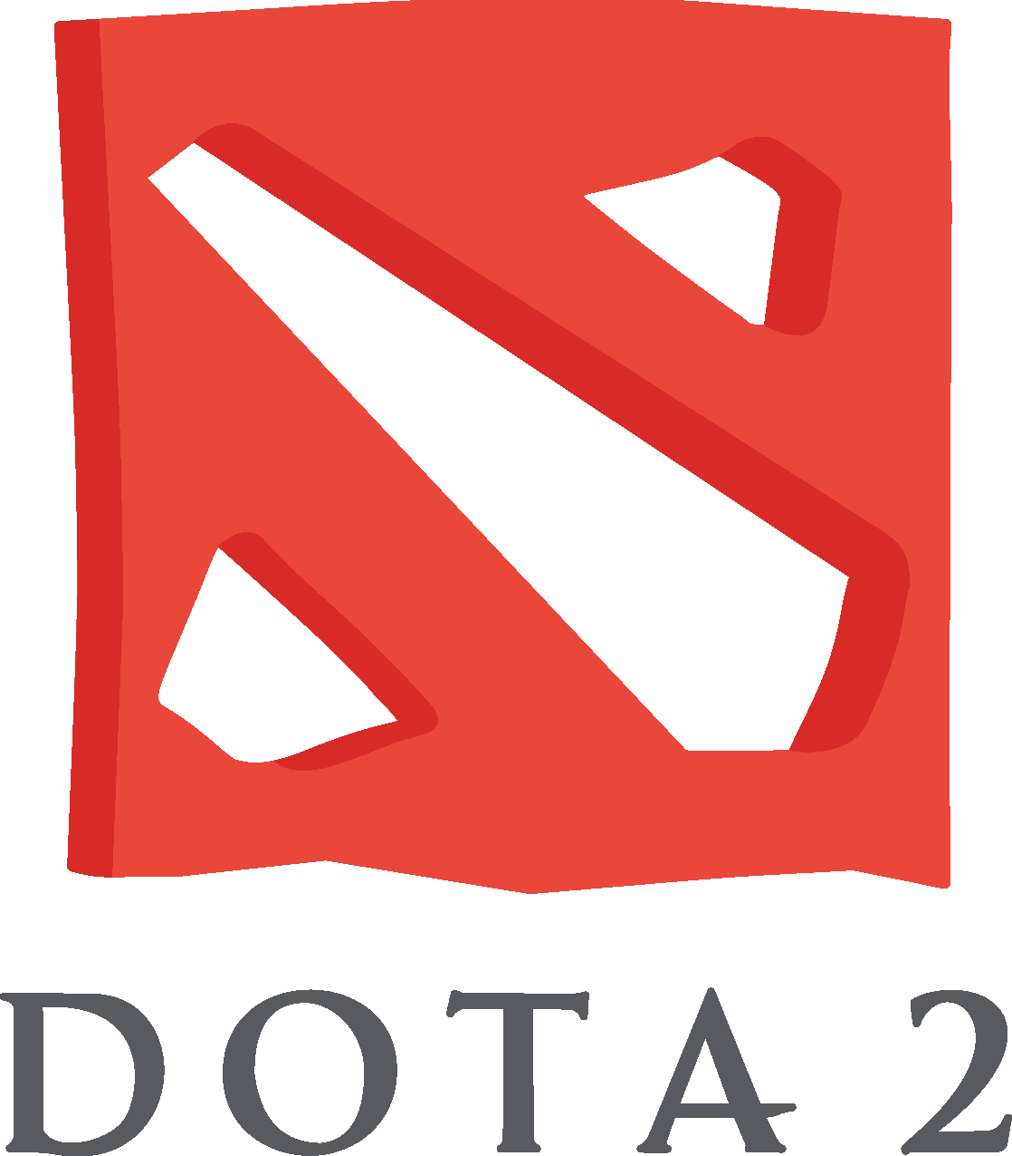
AlphaStar & OpenAI Five
Once classical games are beaten, where do you go?
Video games!
More difficult setting because of multiple factors:
Partial observation
Multi-agent setting
Changing environment
Lack of human experts
Continuous states
Long term horizons
..

Slide 43
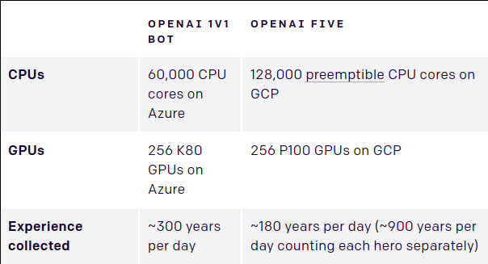
AlphaStar & OpenAI Five
Main approach?
Parallelize training & train a lot!
Use general learning strategies:
Proximal Policy Optimization
(PPO)
Did I say a lot? I mean a lot!

Slide 44
AlphaStar & OpenAI Five
These big players take the theoretical properties of the algorithms for granted, and use them on huge models.
Moves the problem to an engineering point-of-view: How do I get as many training iterations as possible
Shows how general these methods are
How to see what these agents learn? Can we learn from the computer again?
Strive for explainable and generalizable models (XAI)

Slide 45
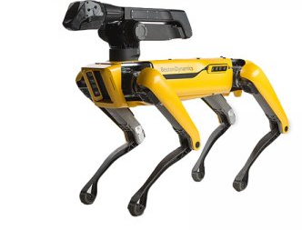
Robotics (Boston Dynamics)
What happens if we put some of these powerful algorithms to work in the real world?
https://youtu.be/LikxFZZO2sk
Basically, a combination of fancy sensors, powerful hardware and sophisticated learning methods.
Very secretive about their methods, so hard to properly analyze

Slide 46
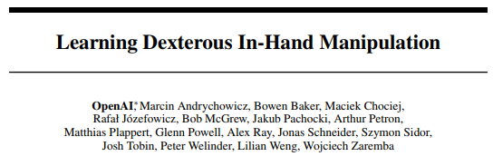
Robotics (Object manipulation)
Application of OpenAI Five approach to some other task
Train in simulation a lot, only finetune in the real world
Again, gathering of enough data is the real problem
Found policies correspond to human-like movements
https://youtu.be/jwSbzNHGflM

Slide 47
Traffic Light Control
Very practical problem, but hard to properly optimize using traditional methods
Number of states in a traffic control grid are huge (like the games before), but there is no easy way to “reset.” In the worst care we end up having a grid-locked traffic jam
Again, like more real-world AI relies on simulation for training
Scale to multi-agent setting to allow for communication between traffic lights

Slide 48
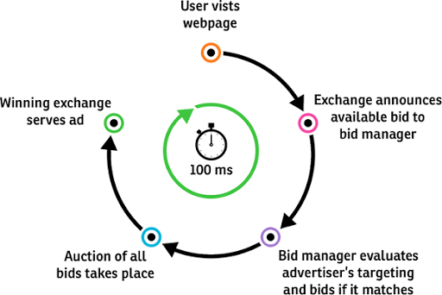
Display advertising
Use policies to find the best ad for a user/context pair
Move away from A/B testing, and instead make incremental improvements using RL methods
Use user clicks as feedback and reward signal.

Slide 49
Takeaway & more resources

Slide 50
Conclusion
You’ve seen:
A positioning of RL in the AI research area
Implementation of tabular RL methods
MDP formalization
Policy evaluation
Policy improvement
Value iteration
Real world examples of RL

Slide 51
Conclusion
Hard to apply RL in the real world
Thriving research area, but little examples in business
Implications are huge: looking for general learning algorithms
Need to explain these models and their decisions
Extensive testing
What caused certain actions
Accountability
How to deal with rapid automatization of tasks done by humans?
Ethics!
Large gaps to fill -> good place for more experiments

Slide 52

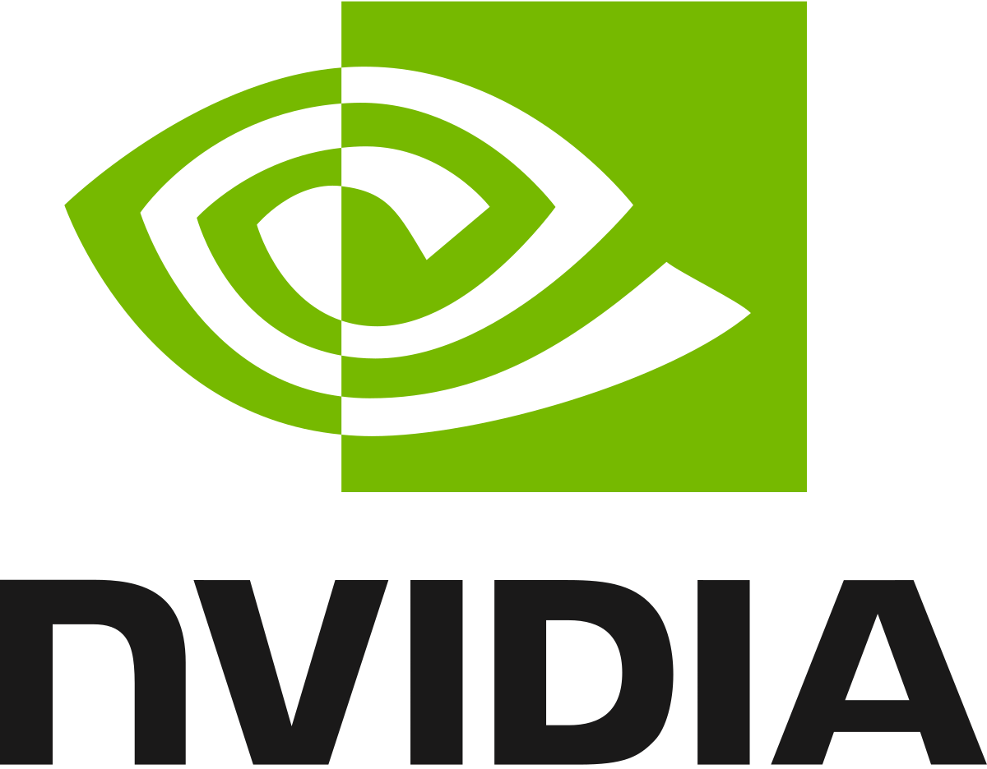

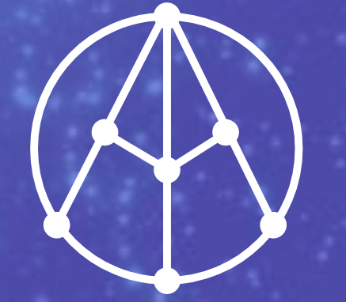

Biggest players
OpenAI
NVIDIA
(Google) DeepMind
Facebook AI Research
MILA
Stanford
.. many more

Slide 53
Where to find interesting RL content
Reinforcement Learning: an Introduction by Sutton & Barto (2018)
arxiv.org
Most research is put on here, also by bigger companies
Blog posts by the big three: DeepMind, OpenAI & FAIR
Browse GitHub repos!
More recommended literature: Artificial Intelligence: A Modern Approach by Russel & Norvig (2009)

